Slide 1
Distributed Ray Tracer
Remy Oukaour
CSE 328

Slide 2
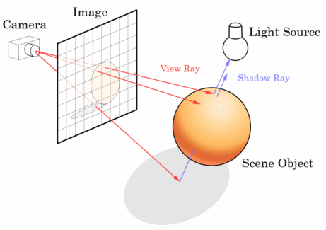
What is ray tracing?
Physically, light emerges from a source, bounces around a scene, and some rays hit a camera or eye
Ray tracing works backwards, projecting rays from the camera into the scene until they hit a light

Slide 3
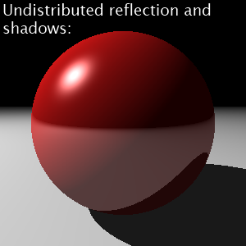
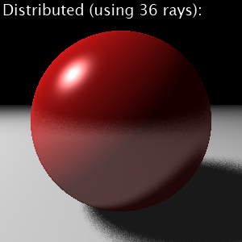
What is distributed ray tracing?
Whenever one ray is fired, multiple rays can be distributed in different directions and averaged
This allows rendering of “fuzzy” phenomena

Slide 4
How does trace.exe work?
Parse a given scene file into an array of objects, an array of lights, and a camera
For each pixel, trace a ray from the camera and find the closest object it intersects with
Calculate the Phong lighting components at the point of intersection (if the point is not in shadow)
Trace any reflected or refracted rays the same way as above
Combine the Phong, reflected, and refracted colors to get the pixel’s color

Slide 5
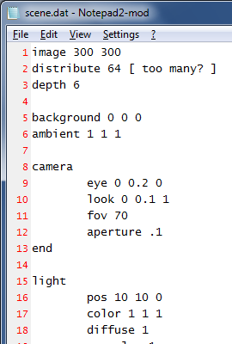
1. Parsing a scene file
Scene definition files are parsed as sequences of space-separated tokens
Keywords, followed by numeric parameters, define the scene and its contents
image 320 240 sets the image’s resolution to 320×240
Everything between sphere and end defines a new sphere
radius 4 sets the radius to 4 units
reflect 1 0 0 makes it reflect 100% of red light, but no green or blue
…et cetera

Slide 6
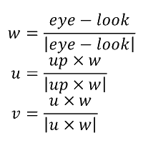
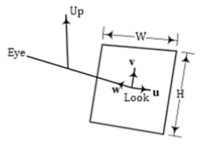
2. Tracing rays
The camera has its location (the “eye”), a point to look at, and an upward direction
The image plane has a width and height
These values are used to calculate unit vectors u, v, and w
Each pixel fires a ray proportional to u and v in the direction of w

Slide 7

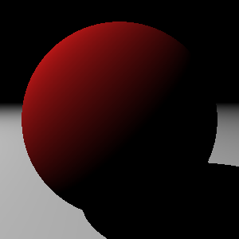

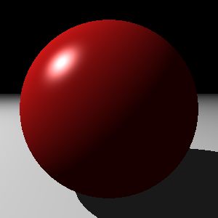
Phong lighting
The lighting model has ambient, diffuse, and specular components
Ambient light is the same throughout the scene
Diffuse light is reflected off microfacets; direct rays are well-lit, grazing rays aren’t
Specular light is reflected directly towards the viewer, resulting in focused highlights
+
+
=

Slide 8
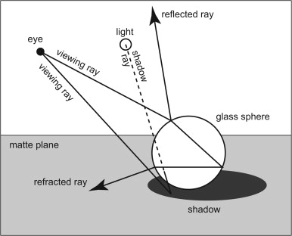
4. Recursive effects
Reflected rays obey the law of reflection: θ_{i} = θ_{r} (rays are reflected at an equal but opposite angle)
Refracted rays obey Snell’s law: η₁ sin θ_{i} = η₂ sin θt (the change in angle is proportional to the change in the index of refraction)
Shadow rays are fired directly towards light sources, and if they intersect with any objects then the point is in shadow

Slide 9
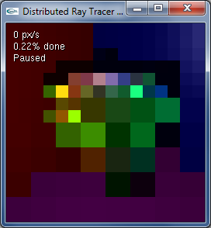
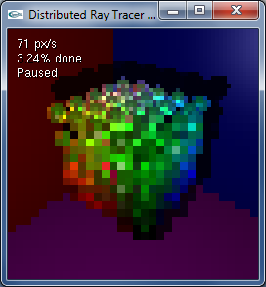
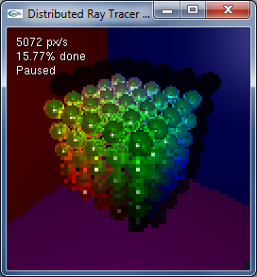
5. Drawing the pixels
Drawing pixels row by row would take too long to show all parts of an image
Progressively drawing it at higher resolutions gives an approximation of the final product

Slide 10
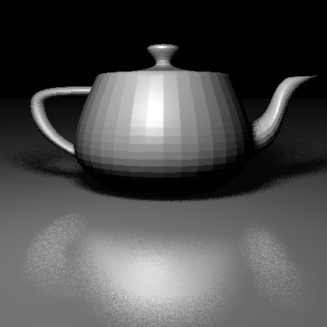
Example: Utah teapot

Slide 11
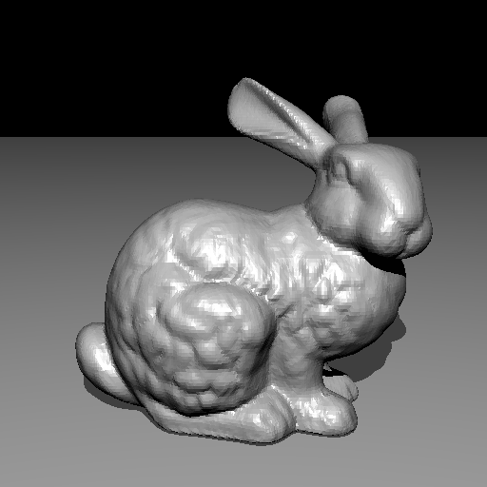
Example: Stanford rabbit

Slide 12
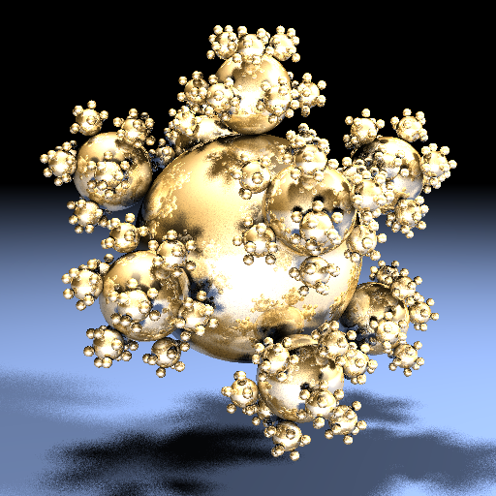
Example: Sphereflake

Slide 13
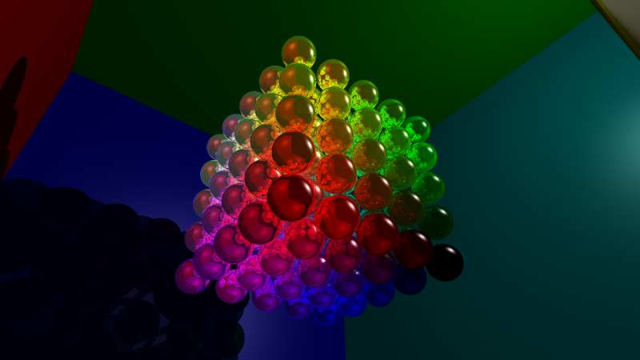
Example: RGB cube

