Slide 1



Cyber-Physical Security Analysis using Bayesian Attack Trees
Rounak MEYUR
December 7, 2018

Slide 2
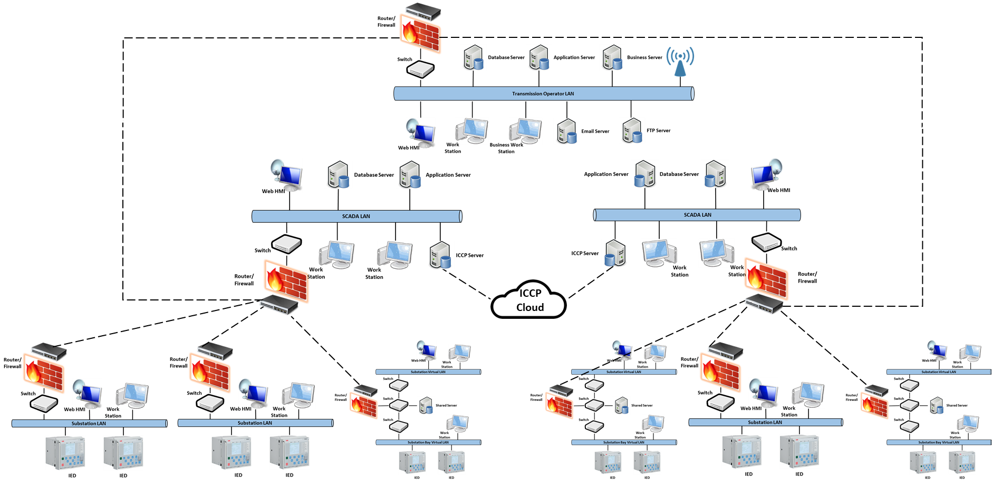
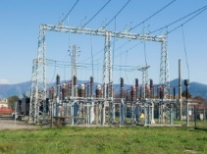
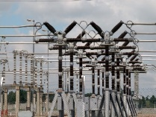
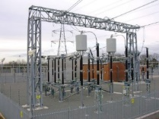

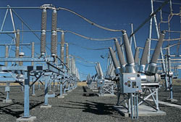
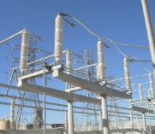
Introduction
MOTIVATION
Power system is identified as a critical infrastructure.
The interconnected SCADA system has made the power system susceptible to cyber vulnerabilities.
RISK ASSESSMENT
Model of the physical power system.
Model of the underlying SCADA system.
Model of the cyber attack.
Proposed risk assessment model
Models intruder attacks aimed to gain access to control elements in the SCADA system.
Models the vulnerabilities in the SCADA system based on the latest vulnerability database.
Models the ability of attacker to exploit vulnerabilities.

Slide 3
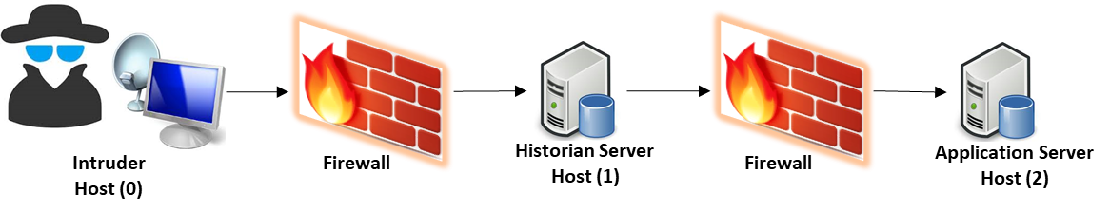
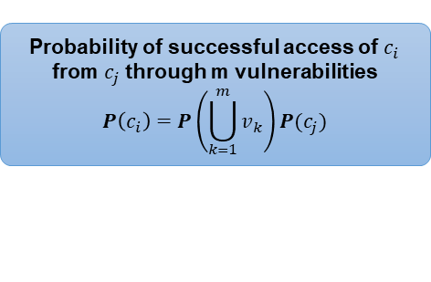
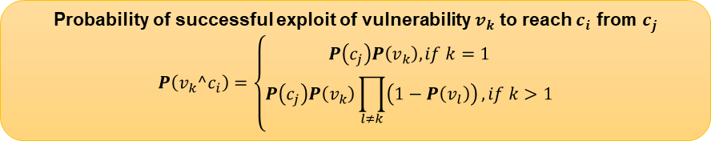
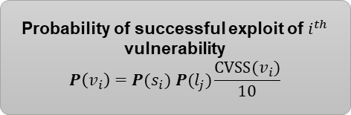
Cyber Attack Model: Bayesian Attack Trees
Cyber Attack Model
Intruder attacks the application server of the control center to get unauthorized administrative access to control assets.
Privilege: user(0)
Connection: <0,1>
Service: Ser1(1)
Service: Ser2(1)
<Ser1, 0, 1>
<Ser2, 0, 1>
Attack Tree Formulation
Each access condition can be reached by exploiting vulnerabilities with prior access condition.
The goal is reached through a set of access conditions.
Privilege: user(1)
Connection: <1,2>
Service: Ser3(2)
<Ser3, 1, 2>
Probability of successful exploit of $i^{th}$ vulnerability
$$P\left(v_{i}\right)=P(s_{i}) P(l_{j})\frac{CVSS(v_{i})}{10}$$
Probability of successful access of $c_{i}$ from $c_{j}$ through m vulnerabilities
$$P\left(c_{i}\right)=P\left(\bigcup_{k=1}^{m}{v_{k}}\right)P(c_{j})$$
Privilege: user(2)
Connection: <2,2>
Service: Ser4(2)
Probability of successful exploit of vulnerability $v_{k}$ to reach $c_{i}$ from $c_{j}$
$$P\left(v_{k}^c_{i}\right)=\left\{\begin{aligned}P\left(c_{j}\right)P\left(v_{k}\right), if k=1 \\ P\left(c_{j}\right)P\left(v_{k}\right)\prod_{l≠k}{\left(1−P\left(v_{l}\right)\right)}, if k>1\end{aligned}\right.$$
<Ser4, 2, 2>
Goal: root(2)

Slide 4










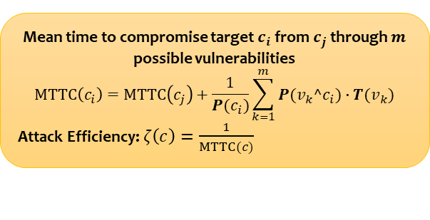
Cyber Attack Model: Mean Time to Compromise
Exploit
Vulnerability
Successful intrusion
user(0)
$$T\left(v_{1}\right)$$
<Ser1, 0, 1>
<Ser2, 0, 1>
$$T\left(v_{2}\right)$$
$$p(v_{1}^c_{1})$$
$$p(v_{2}^c_{1})$$
user(1)
Mean time to compromise a vulnerability
Time to exploit
Exploit code available: 1 day
Exploit code not available: 5.8 days
Can be scaled using CVSS scores.
Probability of exploit code being available or unavailable depends on skill level of intruder.
Additional time to identify vulnerability
Known existence: 32 days
Unknown existence: 65 days
Probability of the existence vulnerability to be known or unknown depends on skill level of intruder.
<Ser3, 1, 2>
$$T\left(v_{3}\right)$$
$$p(v_{3}^c_{2})$$
user(2)
Calculate $T(v_{k})$ for each vulnerability $v_{k}$.
<Ser4, 2, 2>
$$T\left(v_{4}\right)$$
Mean time to compromise target $c_{i}$ from $c_{j}$ through $m$ possible vulnerabilities
$$MTTC\left(c_{i}\right)=MTTC\left(c_{j}\right)+\frac{1}{P(c_{i})}\sum_{k=1}^{m}{P(v_{k}^c_{i})∙T(v_{k})}$$
Attack Efficiency: $ζ\left(c\right)=\frac{1}{MTTC(c)}$
$$p(v_{4}^c_{3})$$
root(2)

Slide 5

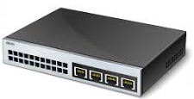


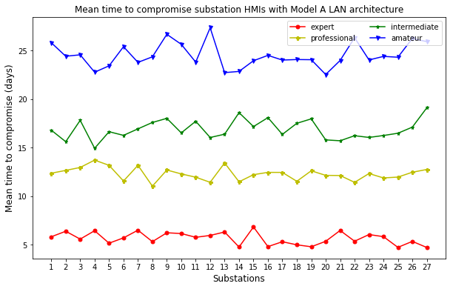

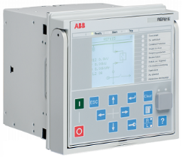
Cyber Attack Model: Substation LAN Model A
Substation LAN
Router/
Firewall
Intruder
Switch
Work
Station
Web HMI
IED
IED
ftp
Access user_intruder
Access user_HMI
bof
Access root_HMI
ssh

Slide 6
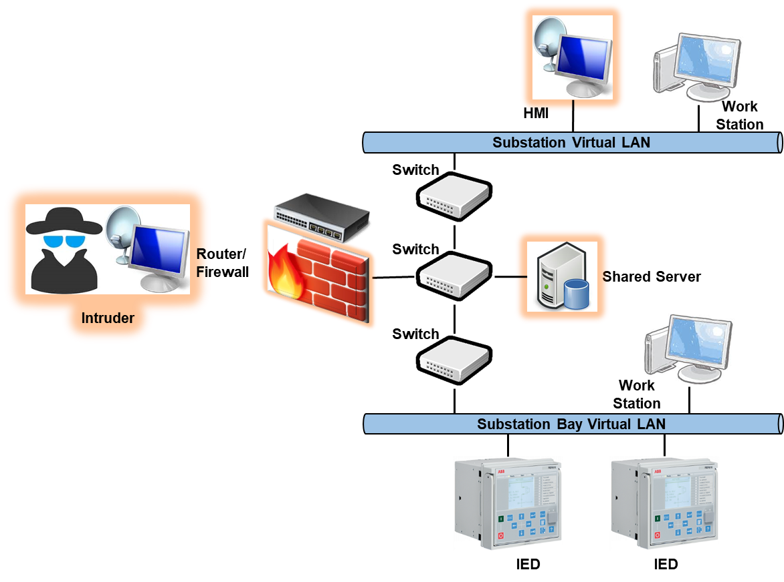
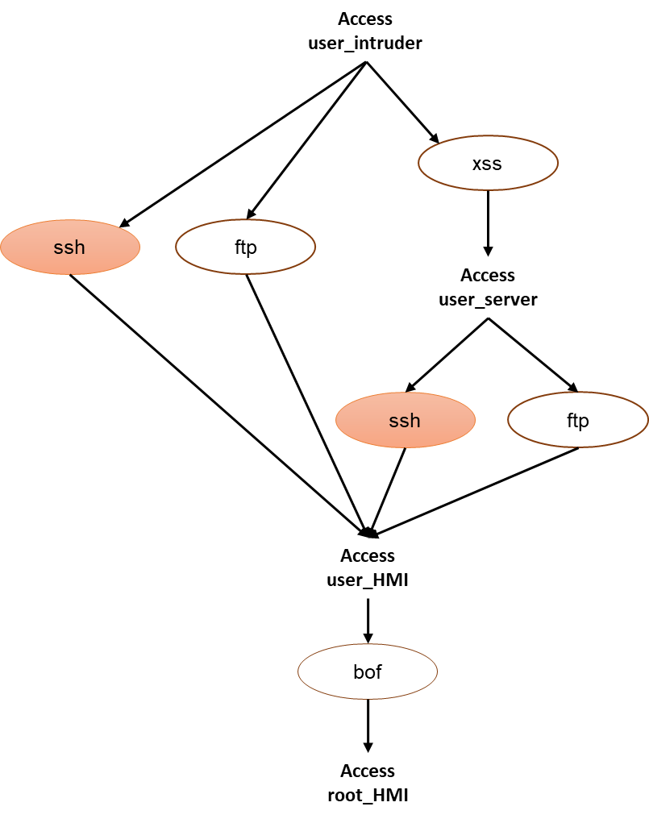
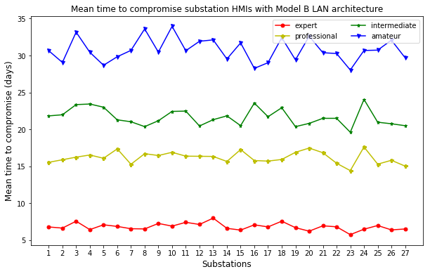
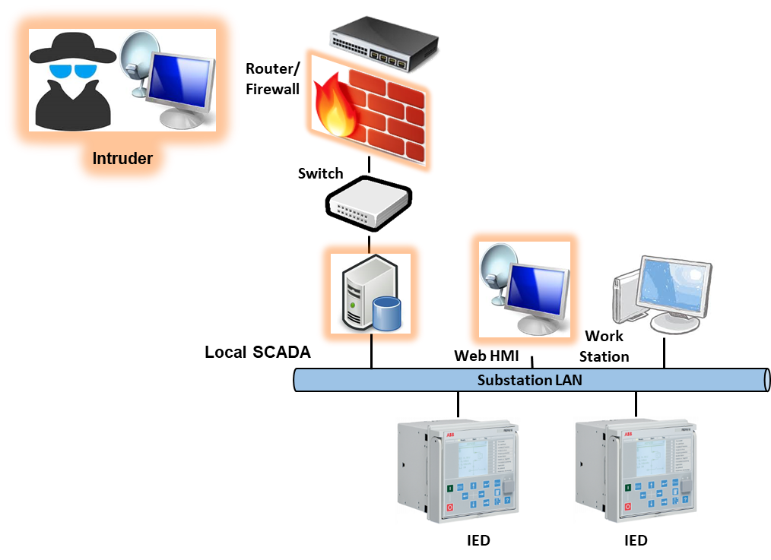
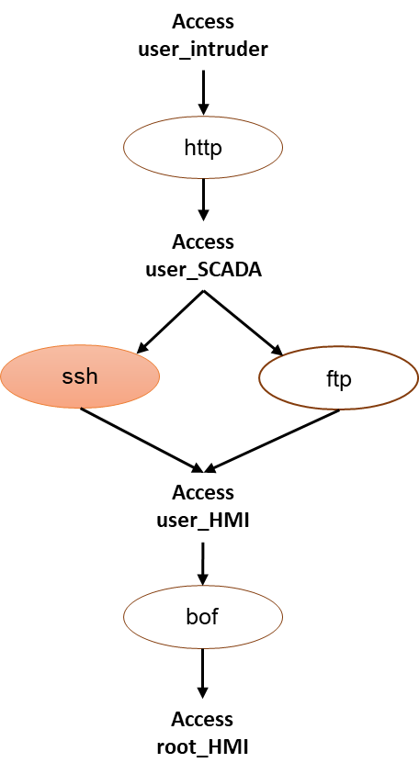
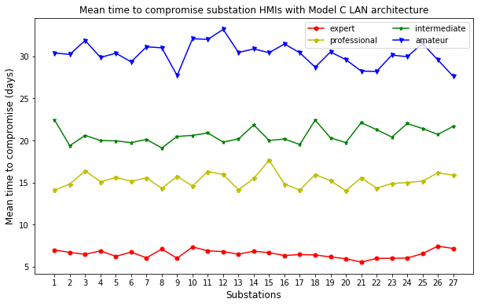
Cyber Attack Model: Substation LAN Models B and C

Slide 7
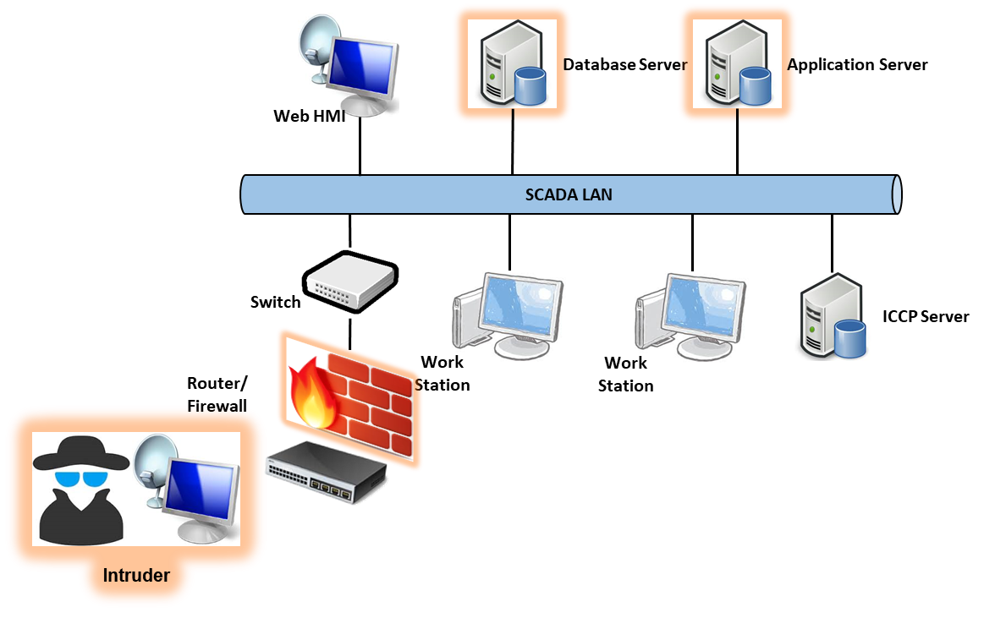
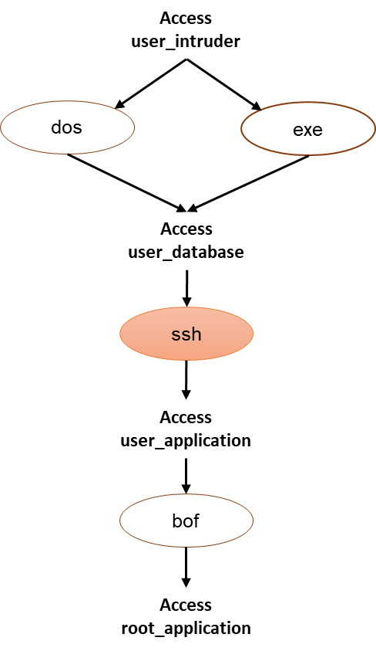
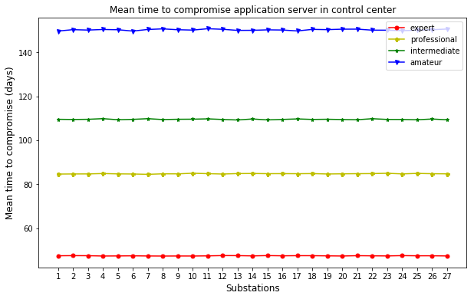
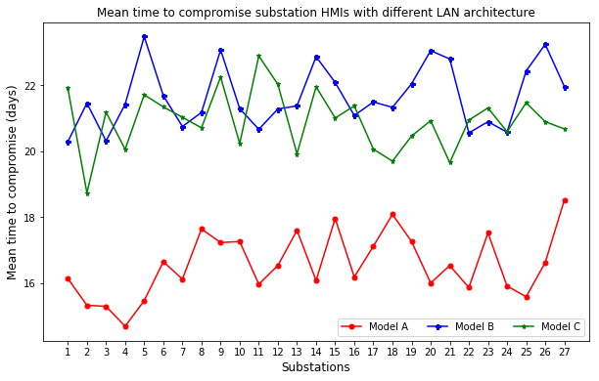
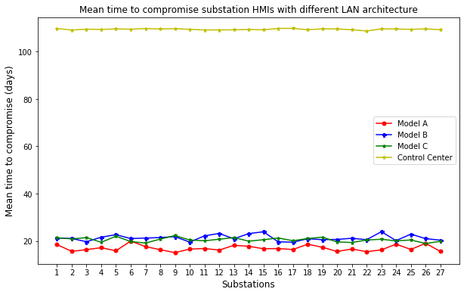
Cyber Attack Model: Control Center SCADA Model
Security comparison of different substation and control center SCADA architectures

Slide 8
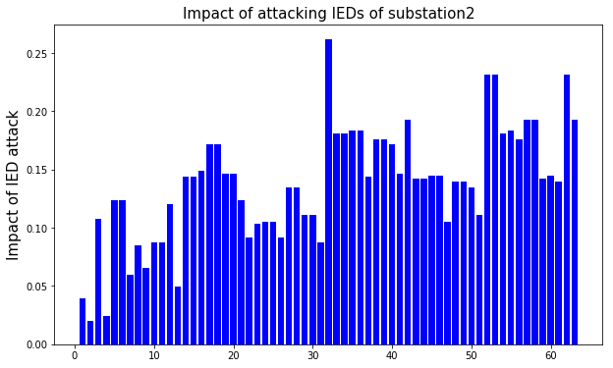
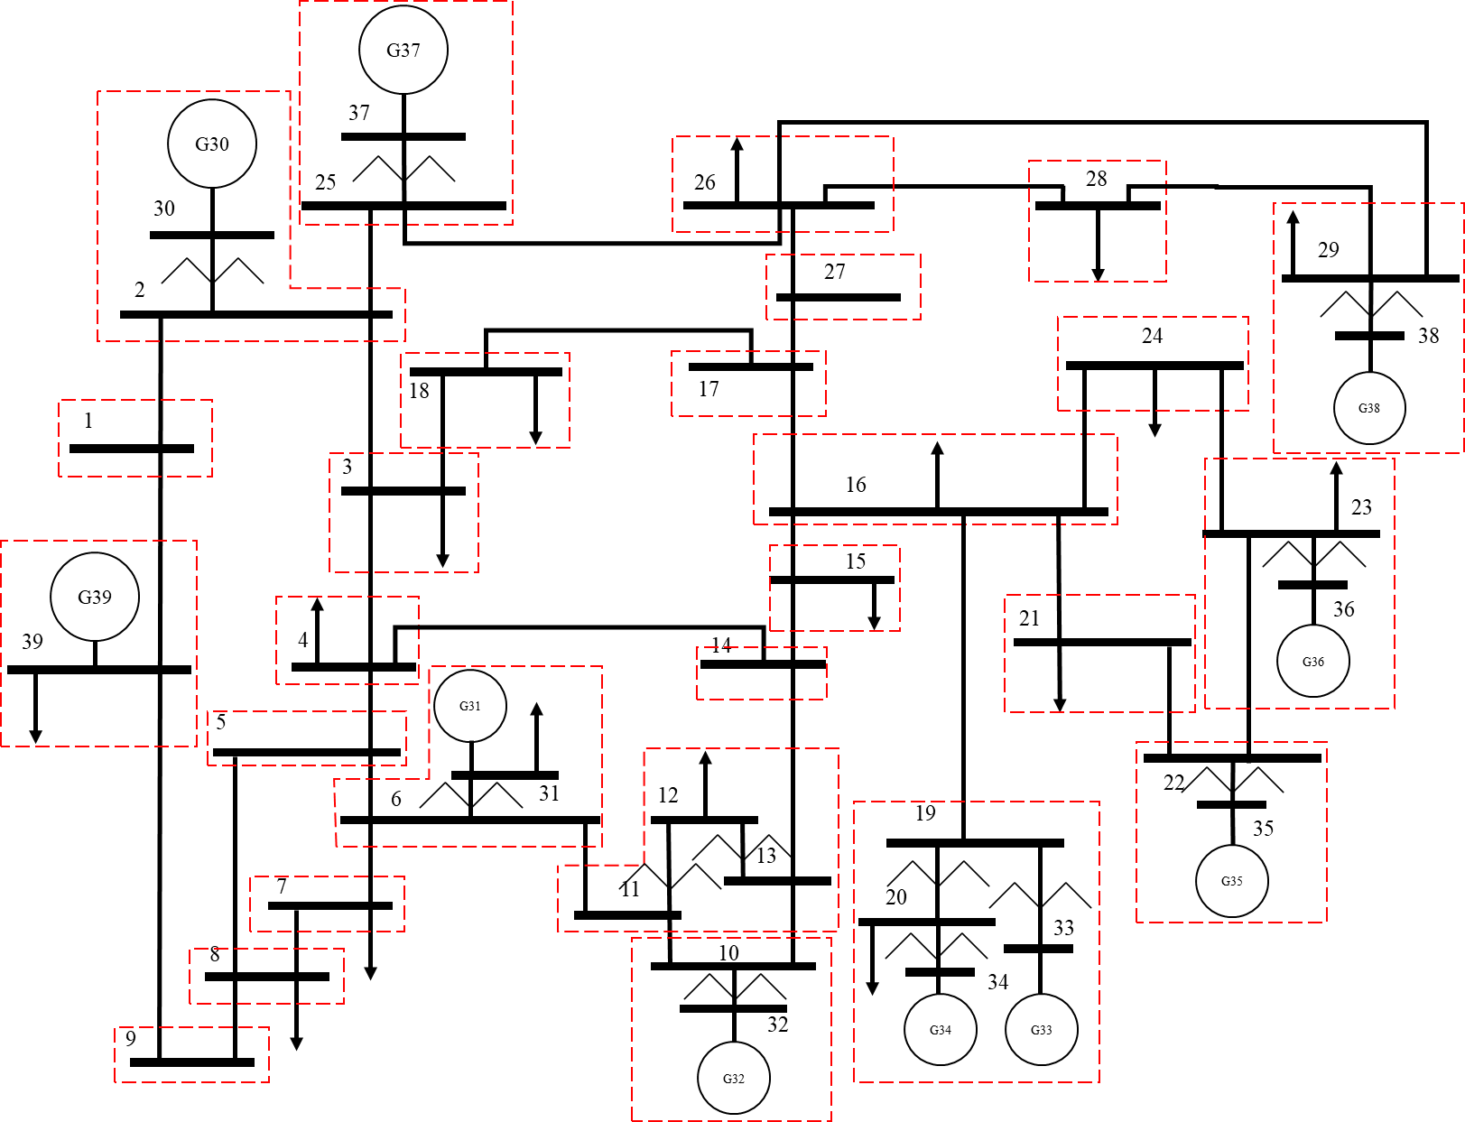


Physical Model: Impact on Power System
Identify substation IEDs
Find target combination of IEDs
Create contingency: open breakers using target IEDs
Run dynamic simulation using PSS/E
Evaluate resulting impact
IED list for Substation 2 (Buses: 2, 30)
Generator G30 circuit breaker.
Transformer 2-30 LV side circuit breaker.
Transformer 2-30 HV side circuit breaker.
Line 2-1 circuit breaker.
Line 2-3 circuit breaker.
Line 2-25 circuit breaker.
Impact analysis for contingency set $S_{i}$
$$I(S_{i})=0.1×\frac{∆f}{0.01}+0.1×\frac{∆V}{0.05}$$
Net impact of a cyber attack on a substation $S$
$$I\left(S\right)=\frac{1}{M}\sum_{i=1}^{M}{I(S_{i})}$$
Risk of a cyber attack on goal c in substation S
$$Risk\left(S,c\right)=ζ(c)∙I(S)$$

Slide 9
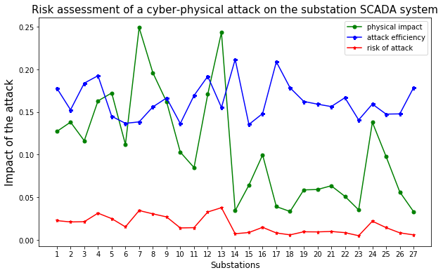
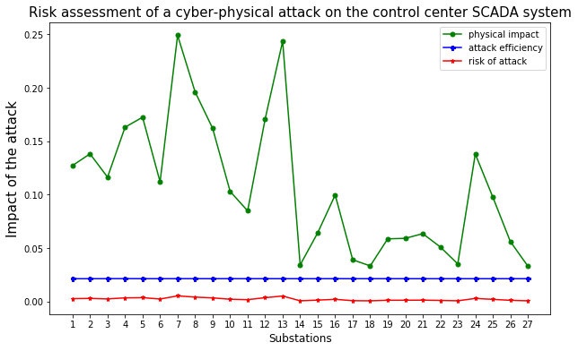
Impact of a Cyber-Physical Attack on IEEE 39-bus Power System

Slide 10
Conclusions
Modeled Bayesian attack trees for substation LAN architectures and control center SCADA system.
Models include possible vulnerabilities in the SCADA system.
Successful exploit of a vulnerability is evaluated from the CVE database of vulnerabilities.
Attack efficiency includes the time to compromise a vulnerability.
Models include the skill level of intruder to estimate the attack efficiency.
Risk analysis of a cyber attack on a power system.
Incorporates the impact on the physical power system when an HMI is compromised.
Incorporates the attack efficiency of the intruder.

Slide 11
References
W. Nzoukou, L. Wang, S. Jajodia and A. Singhal, "A Unified Framework for Measuring a Network's Mean Time-to-Compromise," 2013 IEEE 32nd International Symposium on Reliable Distributed Systems, Braga, 2013, pp. 215-224.
Y. Zhang, L. Wang, Y. Xiang and C. Ten, "Power System Reliability Evaluation With SCADA Cybersecurity Considerations," in IEEE Transactions on Smart Grid, vol. 6, no. 4, pp. 1707-1721, July 2015.
McQueen, M.A., Boyer, W.F., Flynn, M.A., & Beitel, G.A., “Time-to-Compromise Model for Cyber Risk Reduction Estimation”, Quality of Protection, 2006.
Stefanov, A., Liu, C., Govindarasu, M. and Wu, S. (2015), SCADA modeling for performance and vulnerability assessment of integrated cyber–physical systems. Int. Trans. Electr. Energ. Syst., 25: 498–519.
CVE Database of FTP Vulnerability. [Online]. Available: https://www.cvedetails.com/vendor/2/FTP.html
CVE Database of HTTP Vulnerability. [Online]. Available: https://www.cvedetails.com/vendor/45/Apache.html
CVE Database of SSH Vulnerability. [Online]. Available: https://www.cvedetails.com/vendor/120/SSH.html

