Slide 1




A Bayesian Attack Tree Based Approach to Assess Cyber-Physical Security of Power System
Rounak MEYUR
Paper Block 2
February 6, 2020
11:00 am – 12:00 pm
Cyber and physical security session a

Slide 2
Agenda
Motivation
Bayesian attack tree formulation
Mean time to compromise (MTTC)
Security of different cyber architectures
Substation LAN models
Control center SCADA model
Physical impact evaluation
Net cyber-physical impact evaluation
Conclusion
References

Slide 3
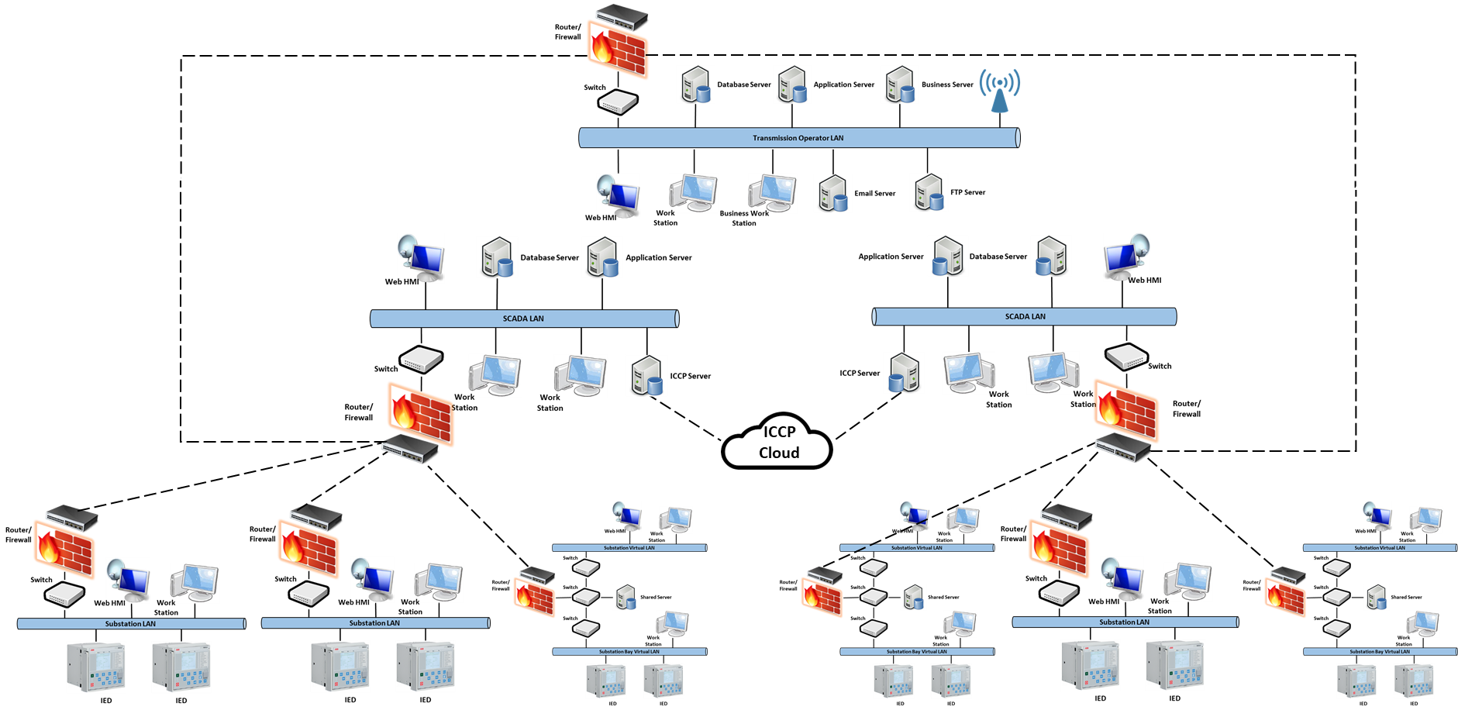

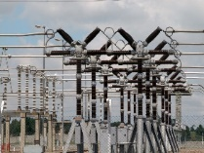
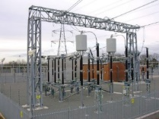

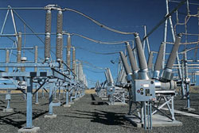
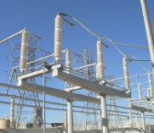
Introduction
MOTIVATION
Power system is identified as a critical infrastructure.
The interconnected SCADA system has made the power system susceptible to cyber vulnerabilities.
RISK ASSESSMENT
Model of the physical power system.
Model of the underlying SCADA system.
Model of the cyber attack.
Proposed risk assessment model
Models intruder attacks aimed to gain access to control elements in the SCADA system.
Models the vulnerabilities in the SCADA system based on the latest vulnerability database.
Models the ability of attacker to exploit vulnerabilities.

Slide 4
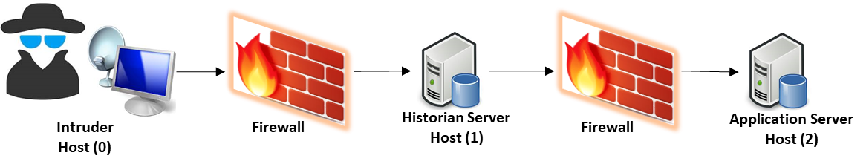

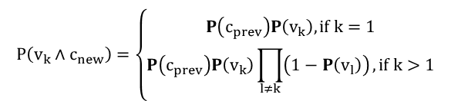
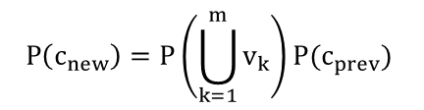
Cyber Attack Model: Bayesian Attack Trees
Cyber Attack Model
Intruder attacks the application server of the control center to get unauthorized administrative access to control assets.
Service: Ser1(1)
Service: Ser3(2)
Service: Ser4(2)
Vulnerability 1
Privilege: user(0)
Privilege: user(1)
Vulnerability 3
Privilege: user(2)
Vulnerability 4
Goal: root(2)
Connection: <0,1>
Vulnerability 2
Service: Ser2(1)
Connection: <1,2>
Connection: <2,2>
Exploiting a vulnerability
Probability of reaching access condition from a given vulnerability
CVSS database scores each vulnerability out of 10
Probability of successful exploit $P\left(v|s,l\right)=\frac{CVSS}{10}$
Access condition from a successful exploit
Vulnerabilities available
$$P\left(c_{new}\right)=P\left(\bigcup_{k=1}^{m}{v_{k}}\right)P(c_{prev})$$
$$P\left(v_{k}∧c_{new}\right)=\left\{\begin{aligned}P\left(c_{prev}\right)P\left(v_{k}\right), if k=1 \\ P\left(c_{prev}\right)P\left(v_{k}\right)\prod_{l≠k}{\left(1−P\left(v_{l}\right)\right)}, if k>1\end{aligned}\right.$$
Zero-day vulnerability
Known vulnerability

Slide 5

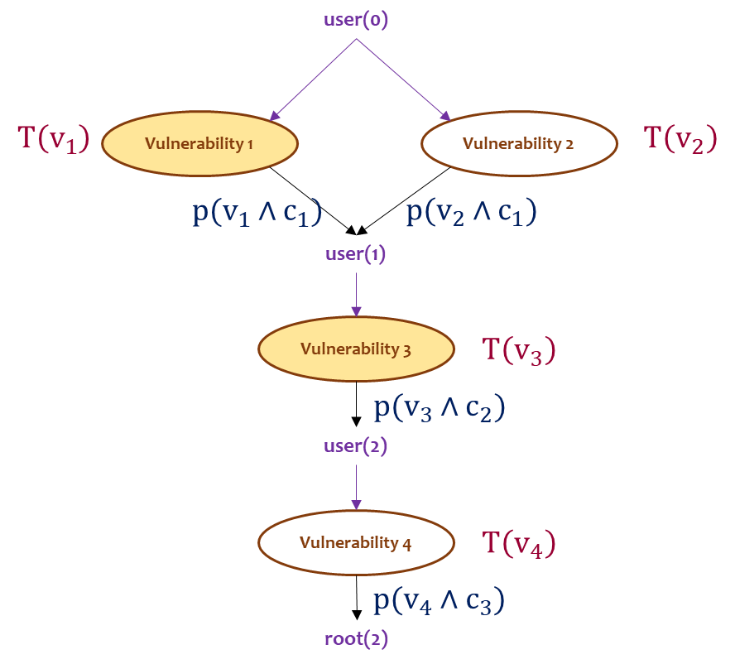
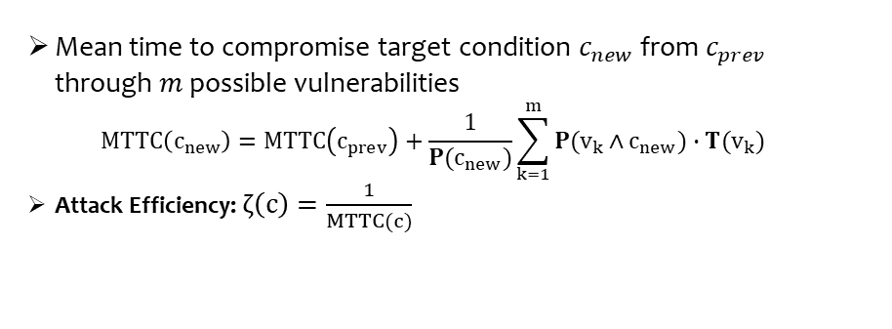
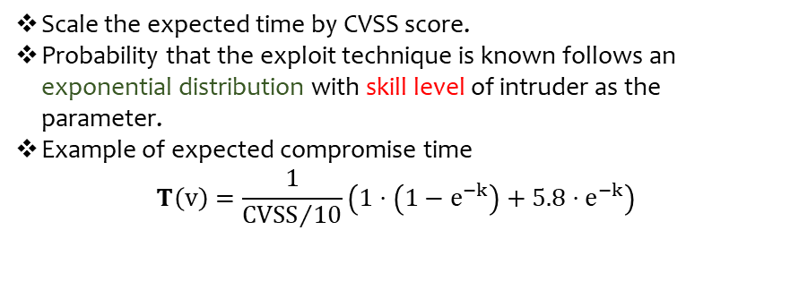
Cyber Attack Model: Mean Time to Compromise
Mean time to compromise a vulnerability[Ref]
 | Known vulnerability | Zero-day vulnerability
Exploit technique known | 1 day | 32 days
Exploit technique unknown to intruder | 5.8 days | 65 days
Scale the expected time by CVSS score.
Probability that the exploit technique is known follows an exponential distribution with skill level of intruder as the parameter.
Example of expected compromise time
$$T\left(v\right)=\frac{1}{{CVSS}/{10}}\left(1⋅\left(1−e^{−k}\right)+5.8⋅e^{−k}\right)$$
Mean time to compromise target condition $c_{new}$ from $c_{prev}$ through $m$ possible vulnerabilities $MTTC\left(c_{new}\right)=MTTC\left(c_{prev}\right)+\frac{1}{P(c_{new})}\sum_{k=1}^{m}{P(v_{k}∧c_{new})∙T(v_{k})}$
Attack Efficiency: $ζ\left(c\right)=\frac{1}{MTTC(c)}$
[Ref] M. A. McQueen, W. F. Boyer, M. A. Flynn, and A. G. Beitel, “Time-to-Compromise Model for Cyber Risk Reduction Estimation,” in Quality of Protection: Advances in Information Security, 1st ed., D. Gollmann, F. Massacci, and A. Yautsiukhin, Eds. Boston, MA: Springer US, 2006, pp. 49–64.

Slide 6
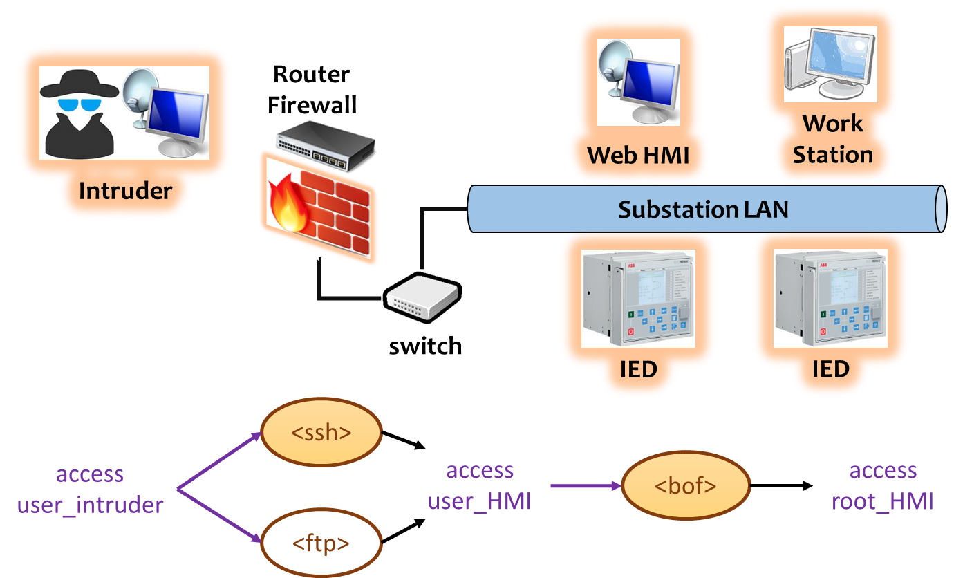
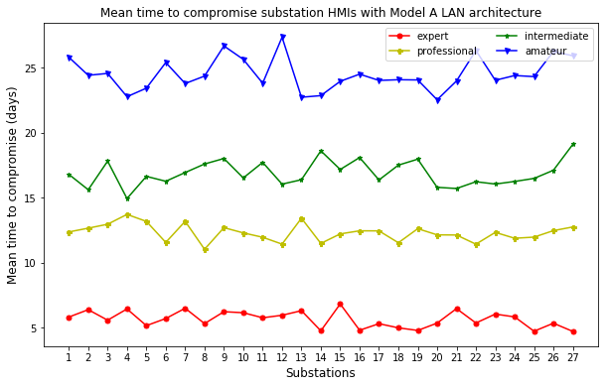
Cyber Attack Model: Substation LAN Model A
An expert intruder takes considerably less time to compromise substation HMIs connected to Model A LAN architecture than less experienced adversaries.

Slide 7
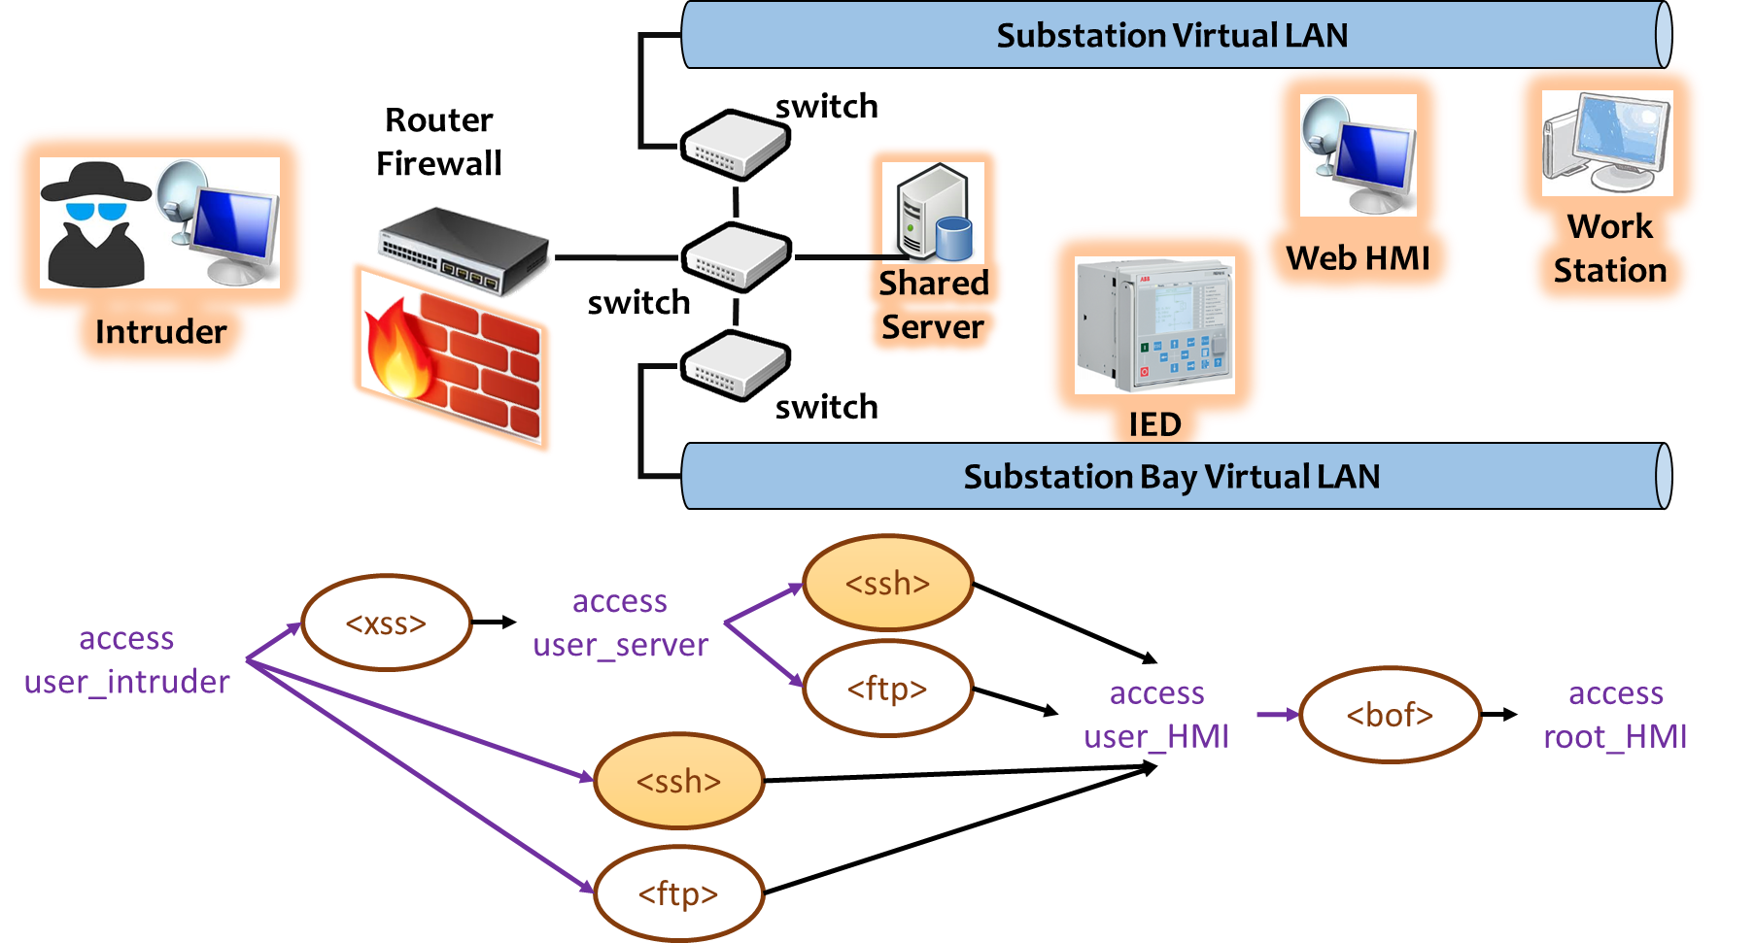
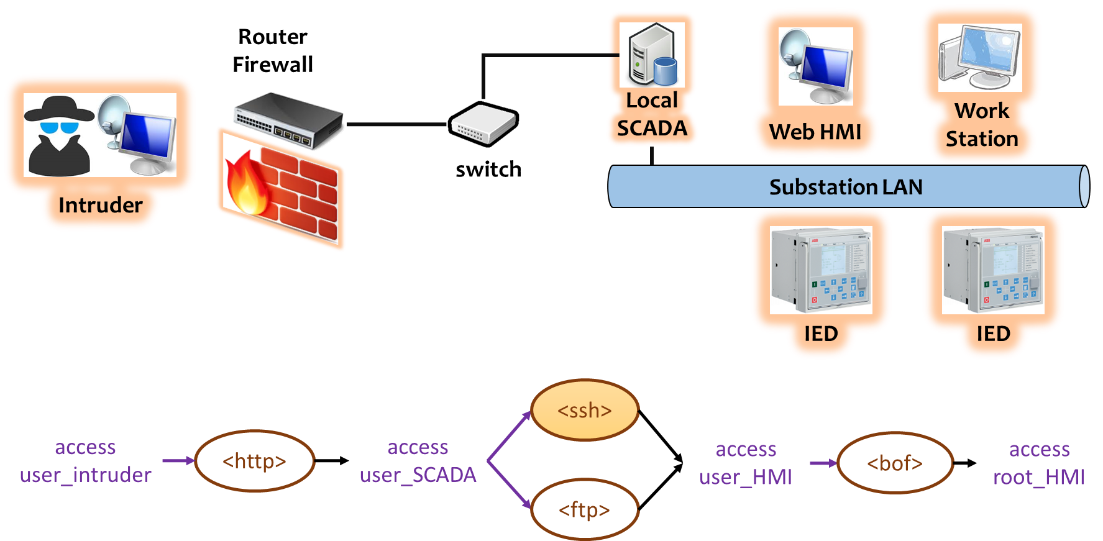
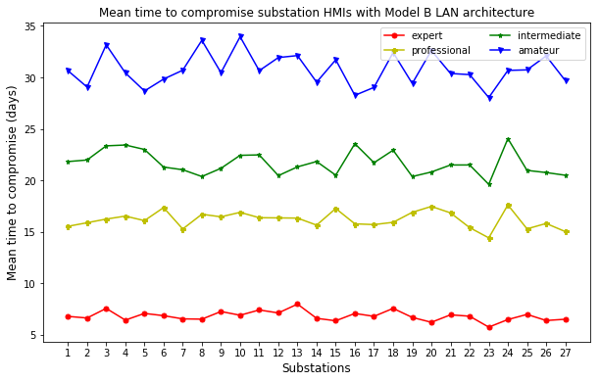
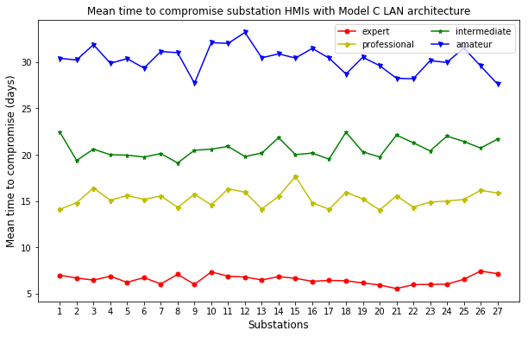
Cyber Attack Model: Substation LAN Models B and C
Model B LAN architecture
Model C LAN architecture

Slide 8
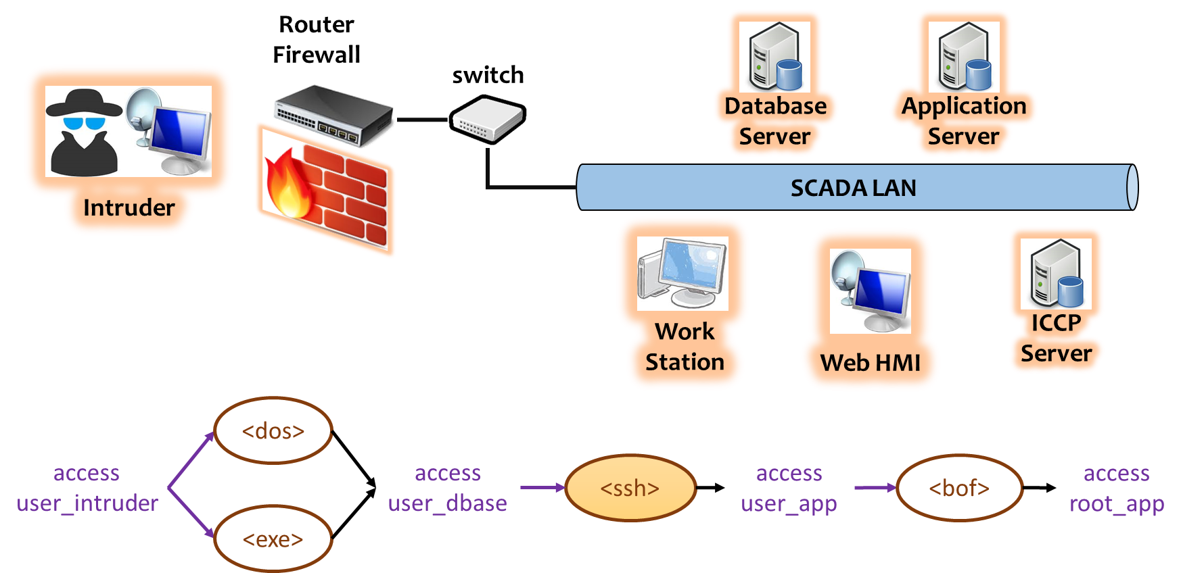
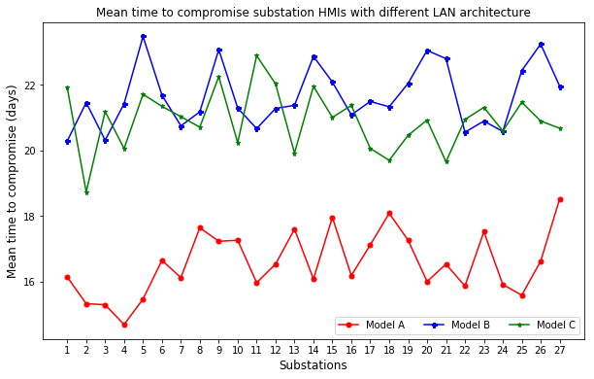
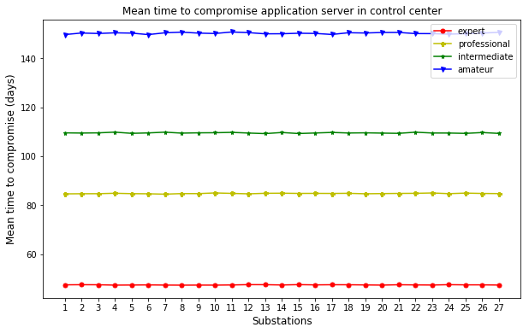
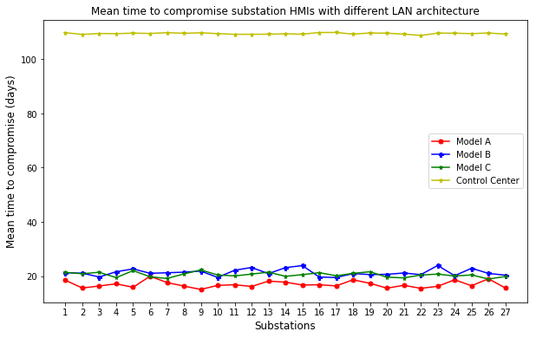
Cyber Attack Model: Control Center SCADA Model
Control center SCADA architecture
Comparison of security level of different cyber architectures

Slide 9
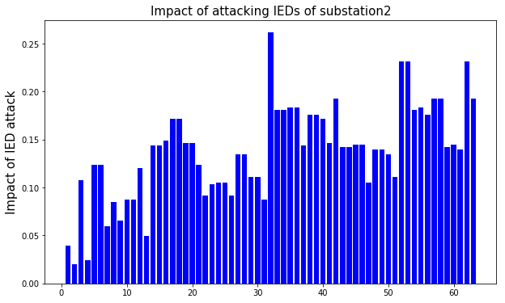
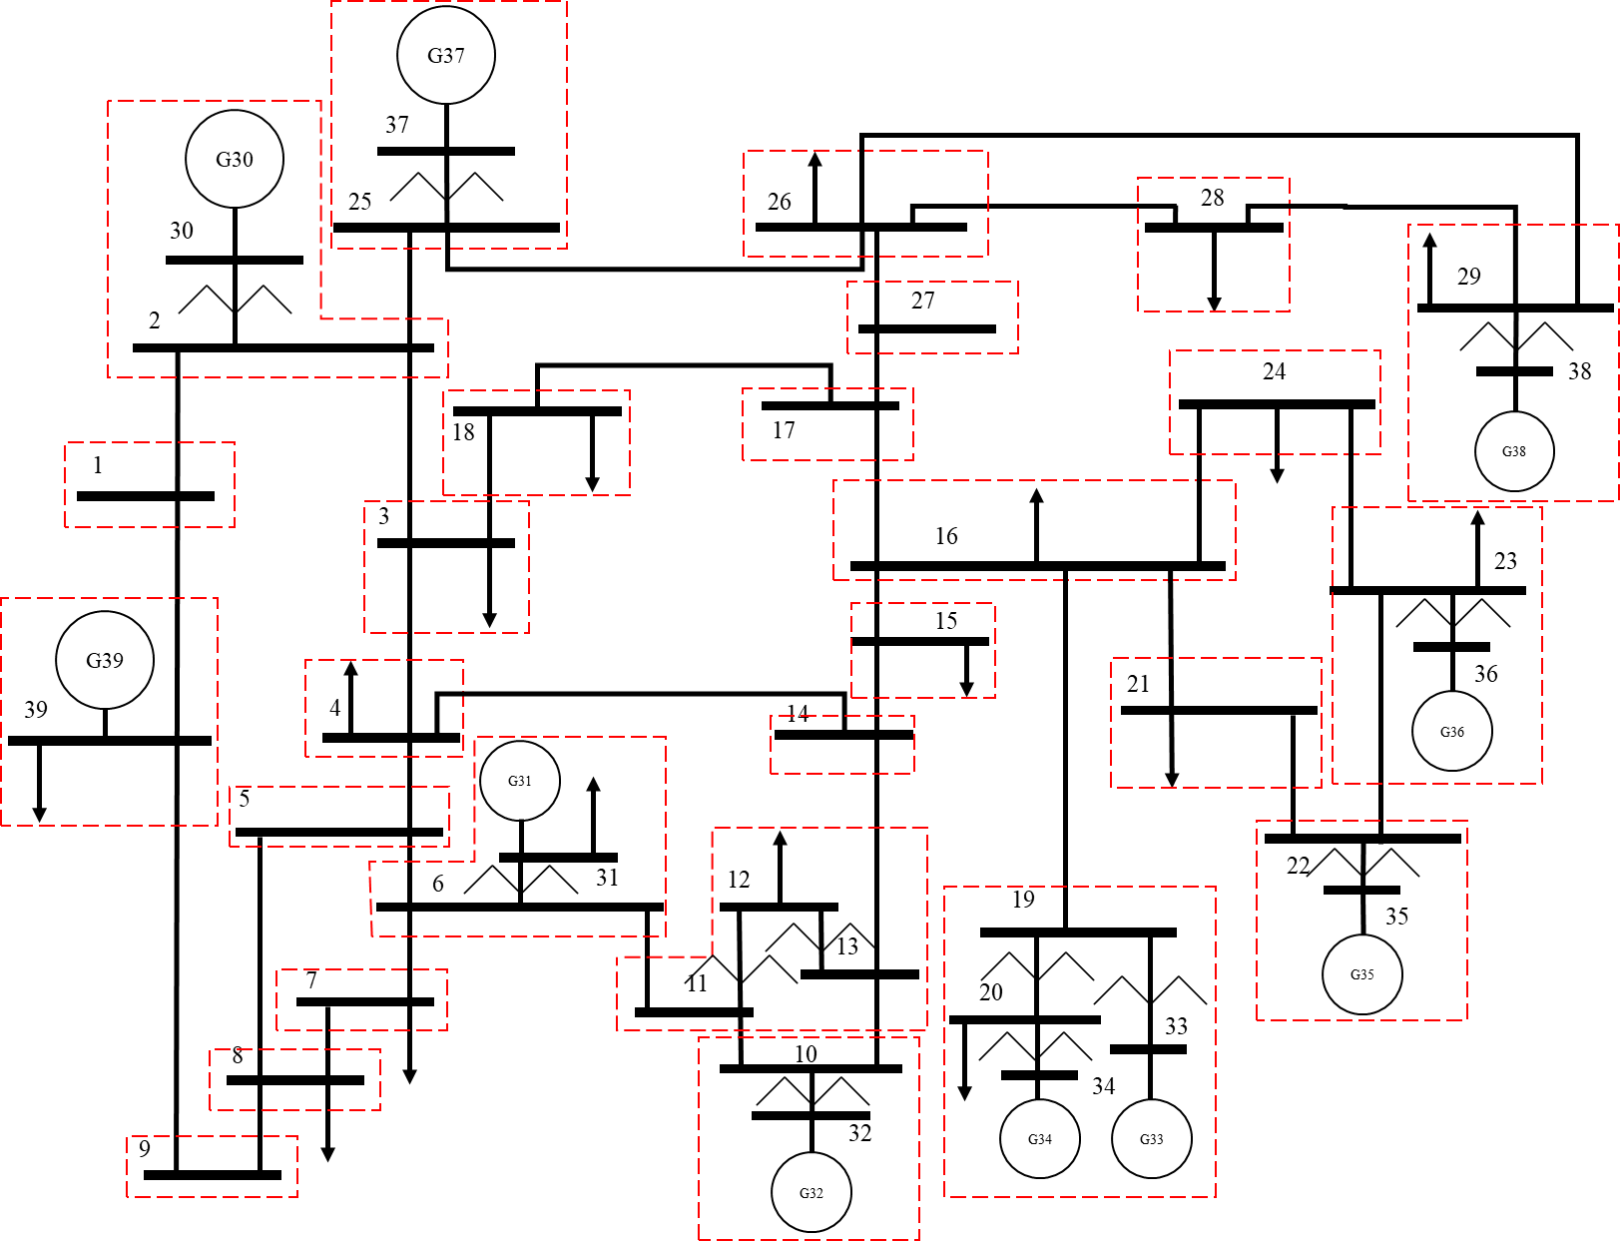


Physical Model: Impact on Power System
Identify substation IEDs
Find target combination of IEDs
Create contingency: open breakers using target IEDs
Run dynamic simulation using PSS/E
Evaluate resulting impact
IED list for Substation 2 (Buses: 2, 30)
Generator G30 circuit breaker.
Transformer 2-30 LV side circuit breaker.
Transformer 2-30 HV side circuit breaker.
Line 2-1 circuit breaker.
Line 2-3 circuit breaker.
Line 2-25 circuit breaker.
Impact analysis for contingency set $S_{i}$
$$I(S_{i})=0.1×\frac{∆f}{0.01}+0.1×\frac{∆V}{0.05}$$
Net impact of a cyber attack on a substation $S$
$$I\left(S\right)=\frac{1}{M}\sum_{i=1}^{M}{I(S_{i})}$$
Risk of a cyber attack on goal c in substation S
$$Risk\left(S,c\right)=ζ(c)∙I(S)$$

Slide 10
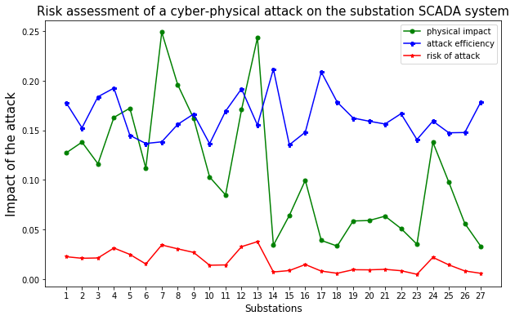
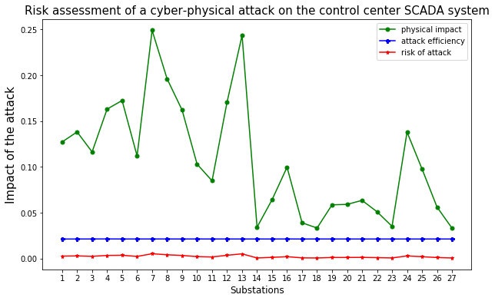
Impact of a Cyber-Physical Attack on IEEE 39-bus Power System
Substation IEDs are usually vulnerable for a cyber attack on substation LANs rather than an attack on control center SCADA system.

Slide 11
Conclusions
Modeled Bayesian attack trees for substation LAN architectures and control center SCADA system.
Models include possible vulnerabilities in the SCADA system.
Successful exploit of a vulnerability is evaluated from the CVE database of vulnerabilities.
Attack efficiency includes the time to compromise a vulnerability.
Models include the skill level of intruder to estimate the attack efficiency.
Risk analysis of a cyber attack on a power system.
Incorporates the impact on the physical power system when an HMI is compromised.
Incorporates the attack efficiency of the intruder.

Slide 12
References
W. Nzoukou, L. Wang, S. Jajodia and A. Singhal, "A Unified Framework for Measuring a Network's Mean Time-to-Compromise," 2013 IEEE 32nd International Symposium on Reliable Distributed Systems, Braga, 2013, pp. 215-224.
Y. Zhang, L. Wang, Y. Xiang and C. Ten, "Power System Reliability Evaluation With SCADA Cybersecurity Considerations," in IEEE Transactions on Smart Grid, vol. 6, no. 4, pp. 1707-1721, July 2015.
McQueen, M.A., Boyer, W.F., Flynn, M.A., & Beitel, G.A., “Time-to-Compromise Model for Cyber Risk Reduction Estimation”, Quality of Protection, 2006.
Stefanov, A., Liu, C., Govindarasu, M. and Wu, S. (2015), SCADA modeling for performance and vulnerability assessment of integrated cyber–physical systems. Int. Trans. Electr. Energ. Syst., 25: 498–519.
CVE Database of FTP Vulnerability. [Online]. Available: https://www.cvedetails.com/vendor/2/FTP.html
CVE Database of HTTP Vulnerability. [Online]. Available: https://www.cvedetails.com/vendor/45/Apache.html
CVE Database of SSH Vulnerability. [Online]. Available: https://www.cvedetails.com/vendor/120/SSH.html

Slide 13








Appendix
CVSS scores for common vulnerabilities
Vulnerability | What is it? | CVSS score
ssh | Secure shell protocol vulnerability | 0.8
ftp | File transfer protocol vulnerability | 6.4
http | http vulnerability | 9.3
xss | Cross scripting vulnerability. Inject web script to access remote data servers. | 4.5
bof | Buffer overflow | 6.8
exe | Execution code overflow | 10.0
dos | Denial of service | 5.0
$$T(v_{1})$$
Vulnerability 1
$$ℙ(v_{1}∧c_{0})$$
user(0)
user (1)
Vulnerability 3
user(2)
Vulnerability 4
root(2)
Vulnerability 2
$$ℙ(v_{3}∧c_{1})$$
$$ℙ(v_{4}∧c_{2})$$
$$ℙ(v_{2}∧c_{0})$$
$$T(v_{3})$$
$$T(v_{4})$$
$$T(v_{2})$$

