Slide 1

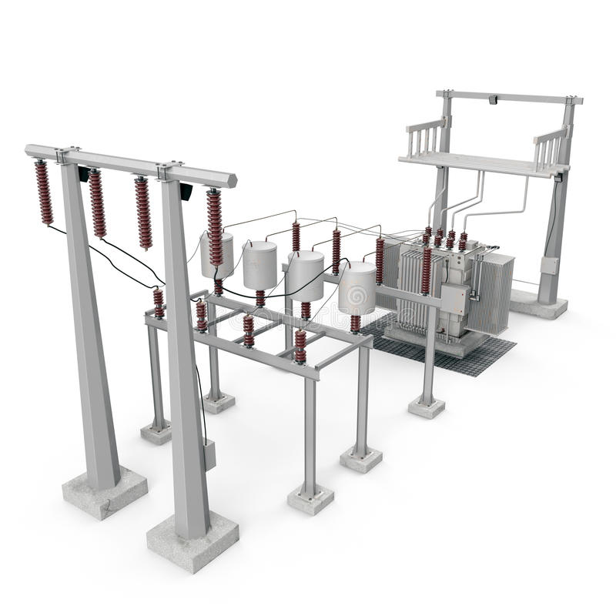
Substation
Residence
Local transformer
Substation
High voltage feeder
Distribution pole
Local transformer
Primary network
Road network
Residence
Secondary network

Slide 2
