Slide 1

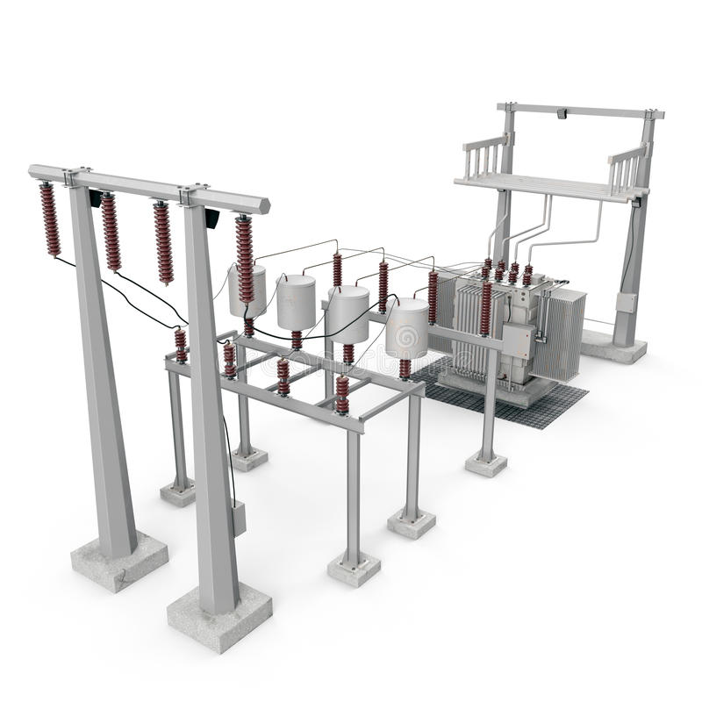
Substation
Residence
Local transformer
Substation
High voltage feeder
Distribution pole
Local transformer
Primary network
Road network
Residence
Secondary network

Slide 2
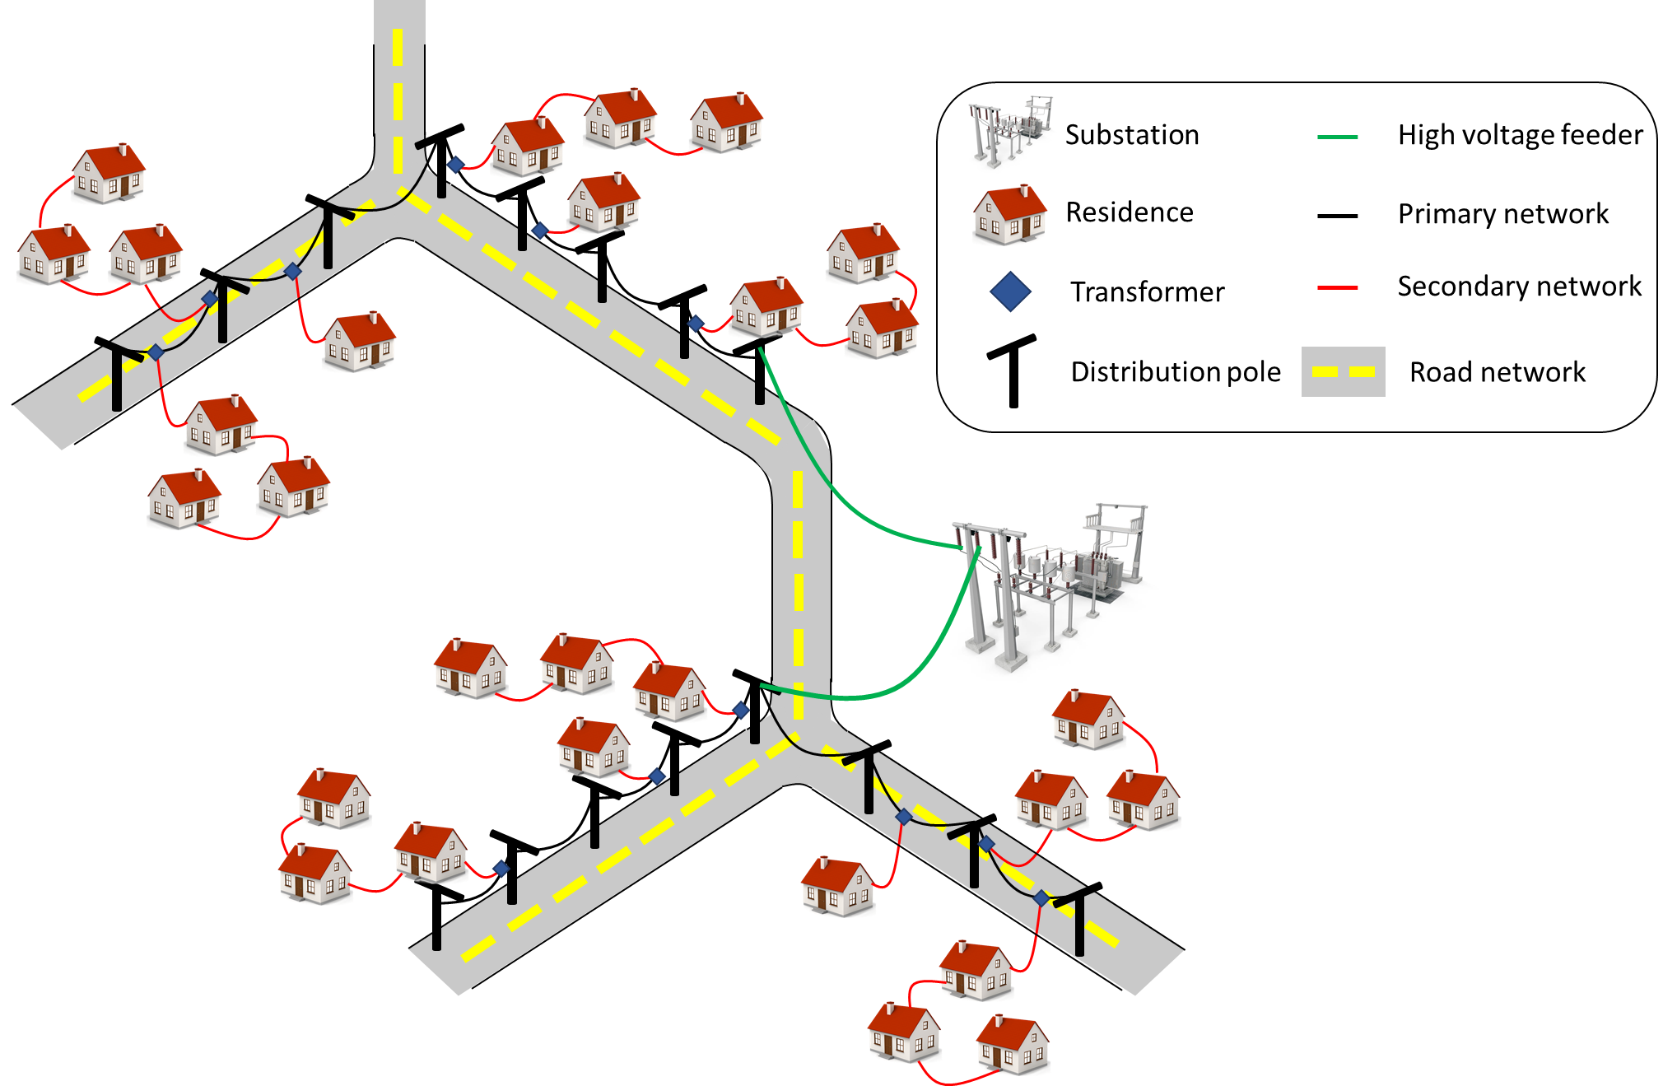

Slide 3
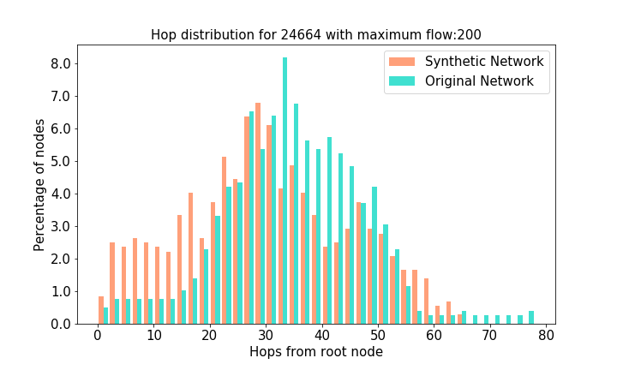
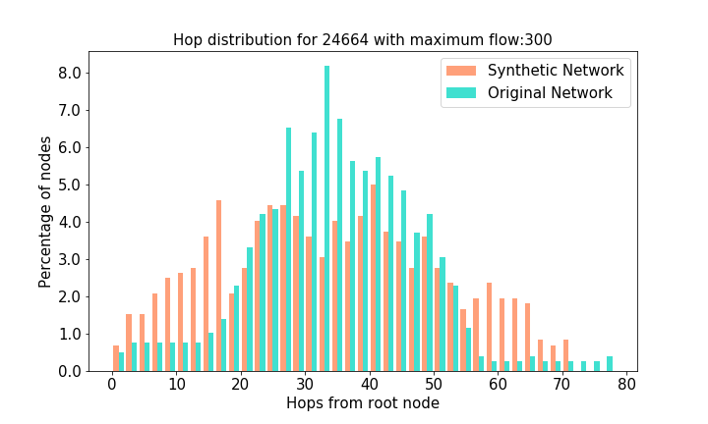
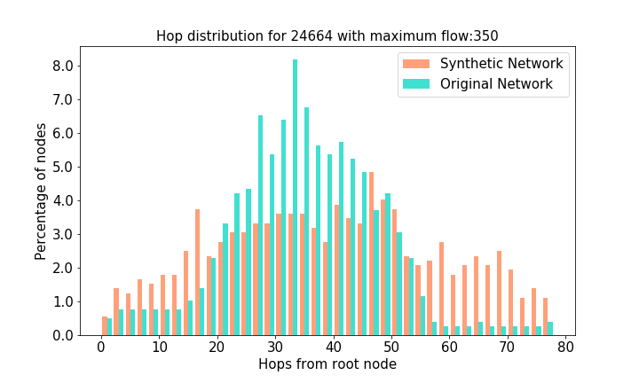
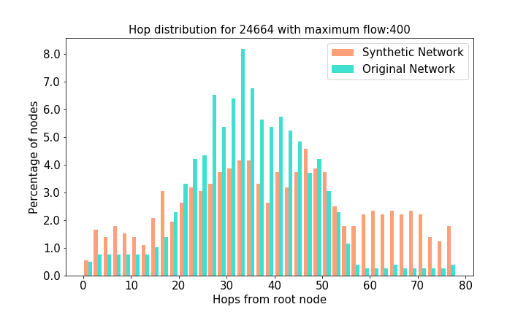
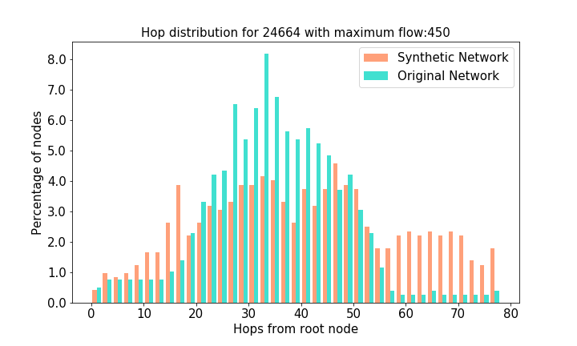
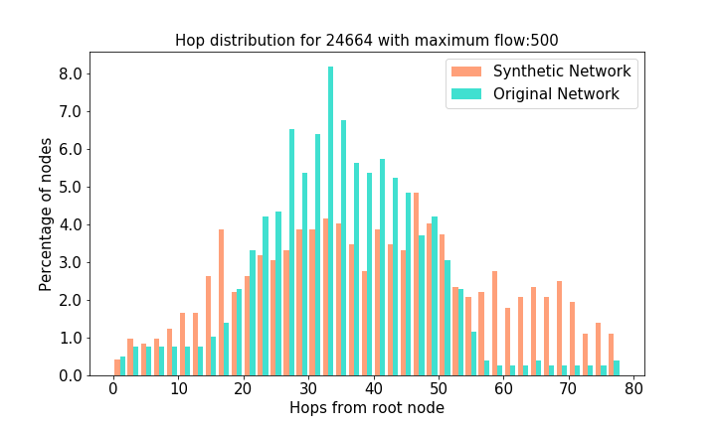




Slide 4
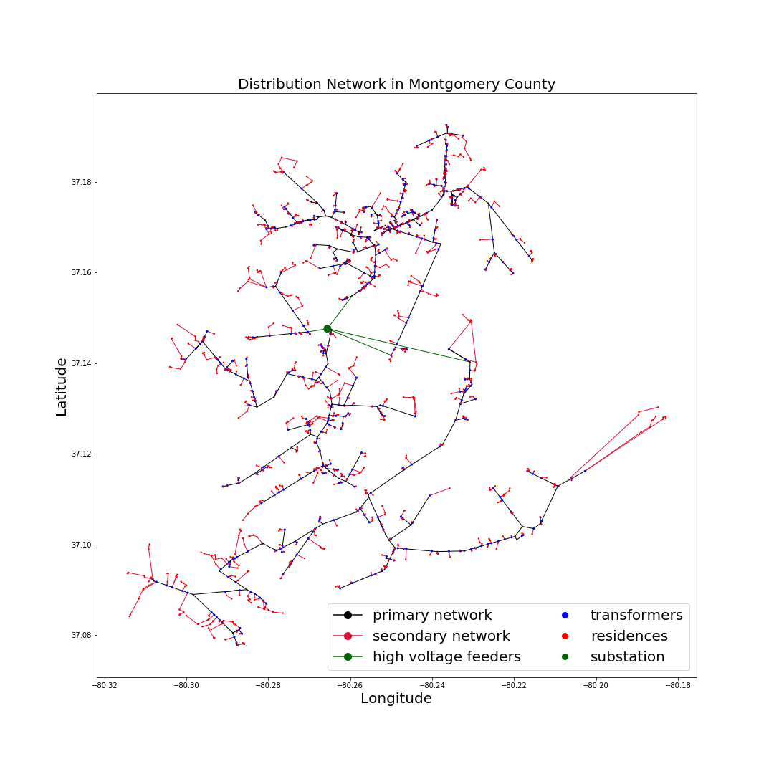
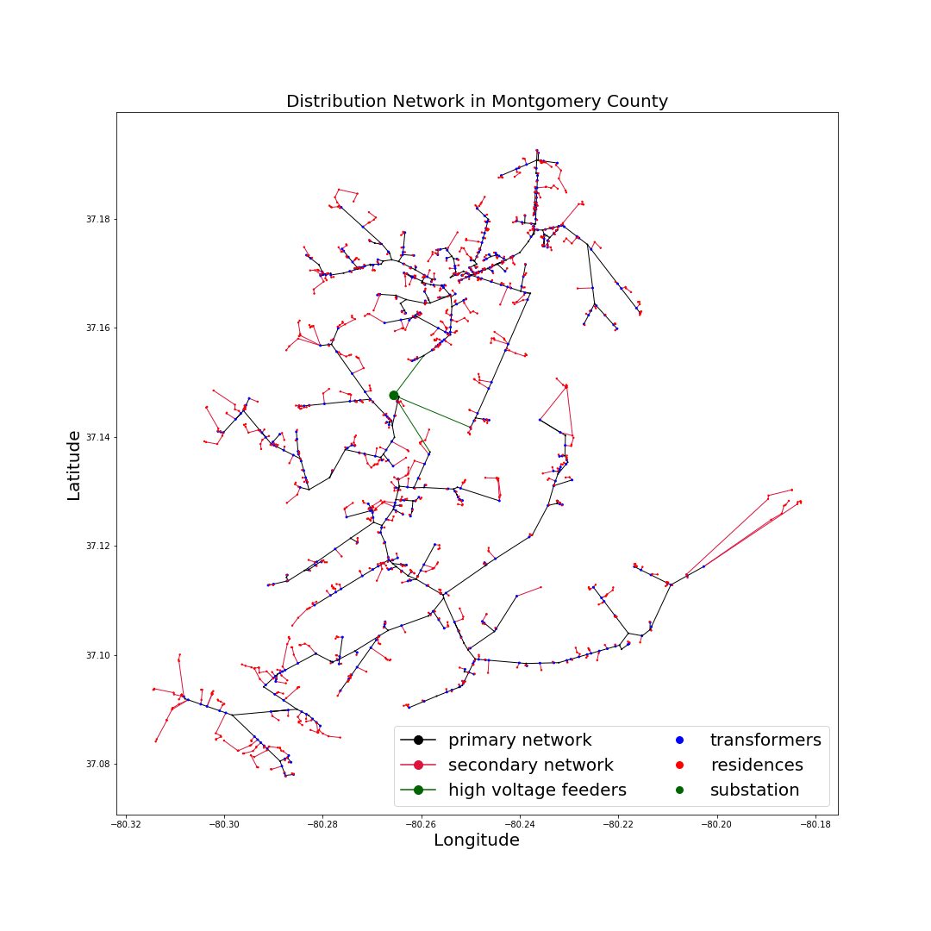
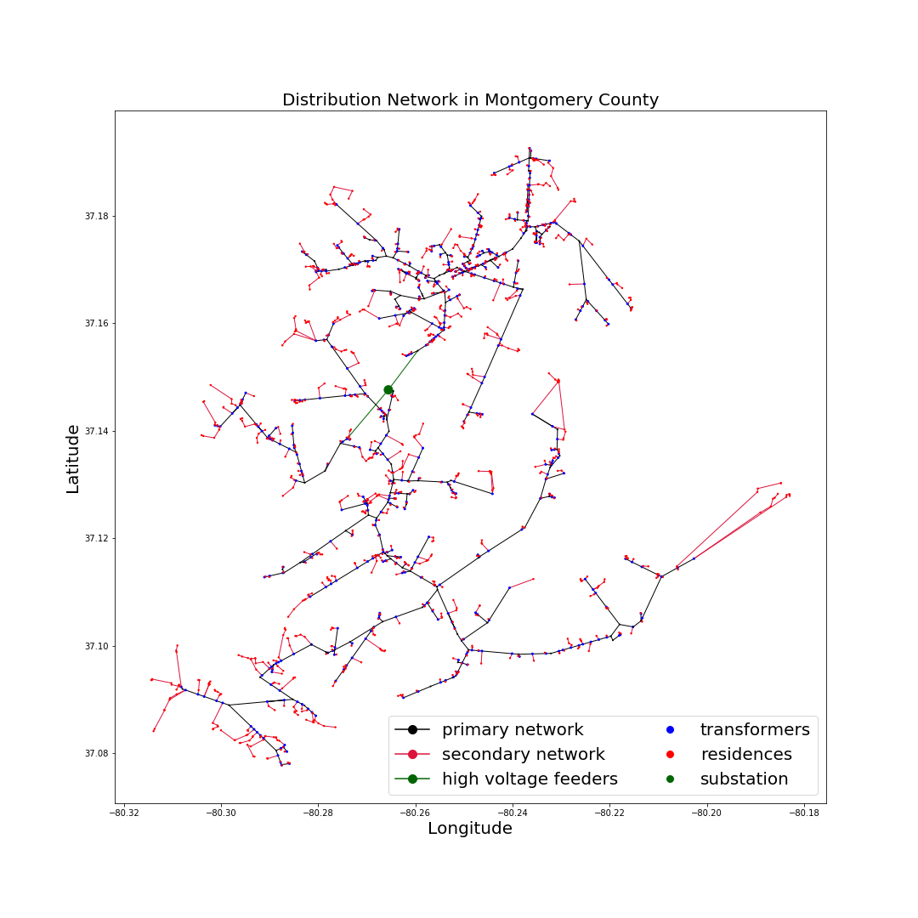

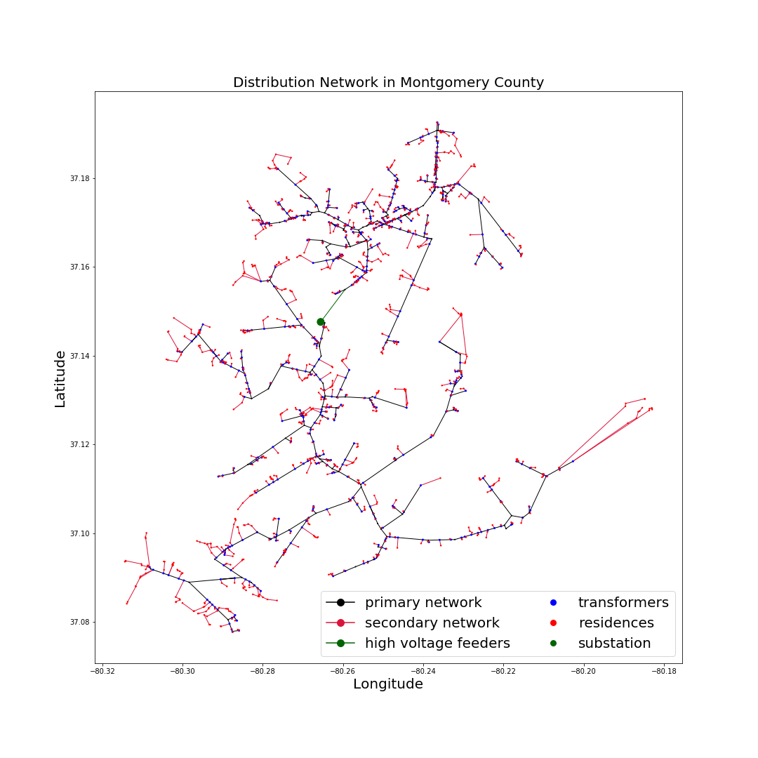




Slide 5
Map residential buildings to nearest road network link
Evaluate the secondary distribution network connecting mapped residences to local transformers placed along nearest road link.
Evaluate the primary distribution network connecting the local transformers to substations.

Slide 6
Substation
Residence
Local transformer
Distribution pole
Road network

Slide 8
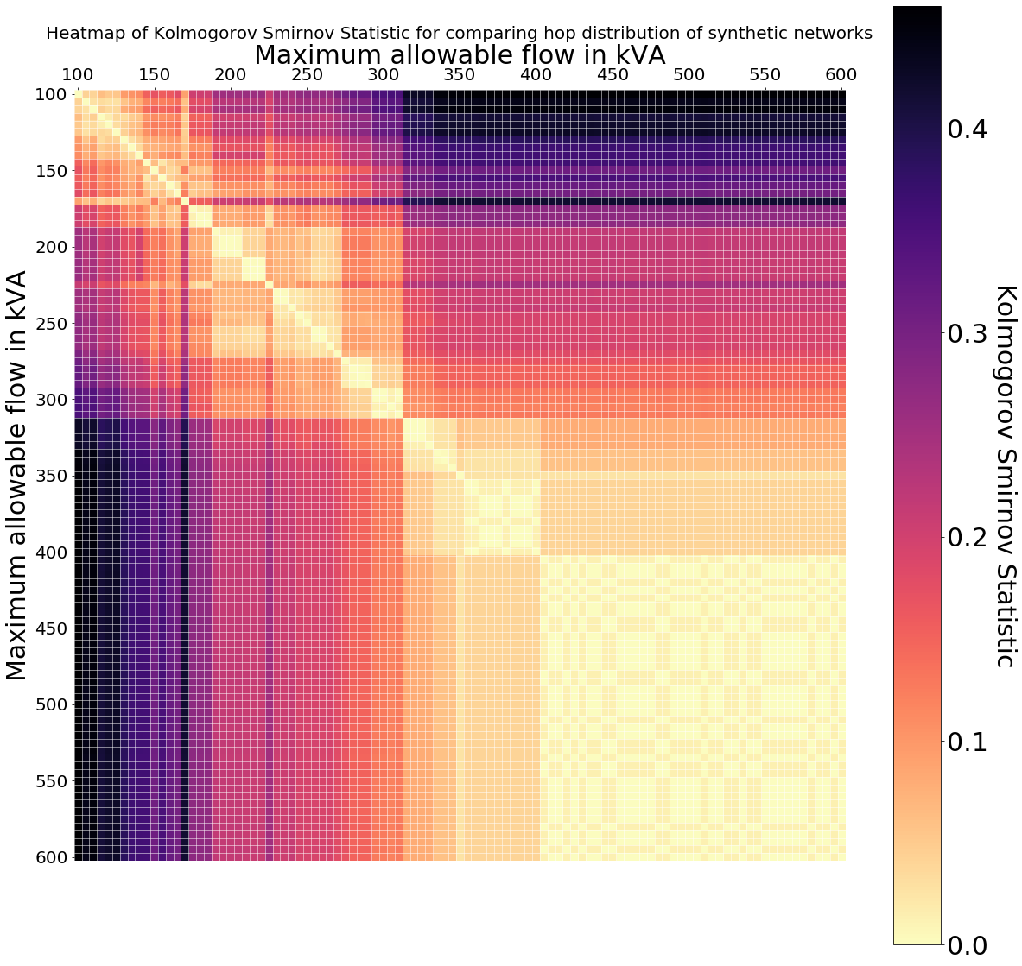
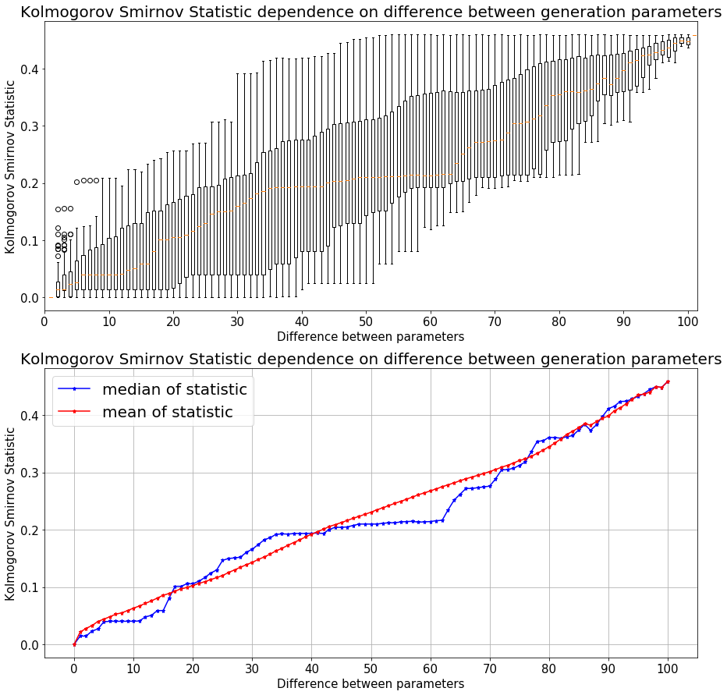




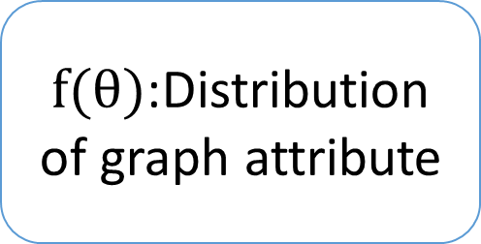
Parameter $θ$
Unique network $𝒢$
$f(θ)$:Distribution of graph attribute
Given a distribution of graph attribute $f(ϕ)$, we may want to find the parameter $ϕ$ generating the network.
Evaluate the distance statistic for distribution of a generated network with parameter $θ$.
Find $ϕ$.

