Slide 1

BITSHIFT 2026
TITLE PAGE
Problem Statement ID – 06
Problem Statement Title - Farmer Carbon Credit Readiness Assessment Platform
Theme - Agriculture
PS Category- Software
Team ID-
Team Name - Omnira

Slide 2
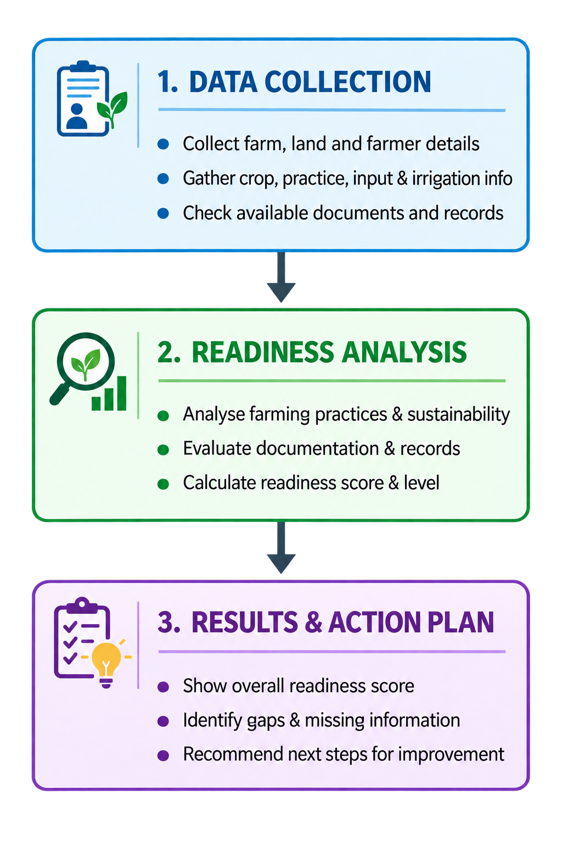
FarmerChoice
Omnira
Proposed Solution:-
It is an AI-powered readiness assessment platform that helps farmers understand their preparedness for carbon-credit programs by analysing their farming practices, land information, crop history, input usage, irrigation, soil management and available documentation.
What FarmerChoice Does:-
Assesses farmer readiness for carbon-credit programs based on farm information, practices and records.
Evaluates sustainable farming practices such as irrigation, soil management, crop rotation and residue management.
Identifies documentation gaps by checking the availability of land, crop, input and soil-related records.
Highlights areas for improvement where farming practices or required information may be insufficient.
Converts the assessment into an actionable recommendation:
Innovation / Uniqueness
Unlike platforms that only provide information about carbon-credit programs, FarmerChoice converts complex participation requirements into a simple, farmer-friendly readiness assessment — showing farmers where they currently stand and what they need to improve or document.
Data → Analysis → Readiness → Recommendation

Slide 3
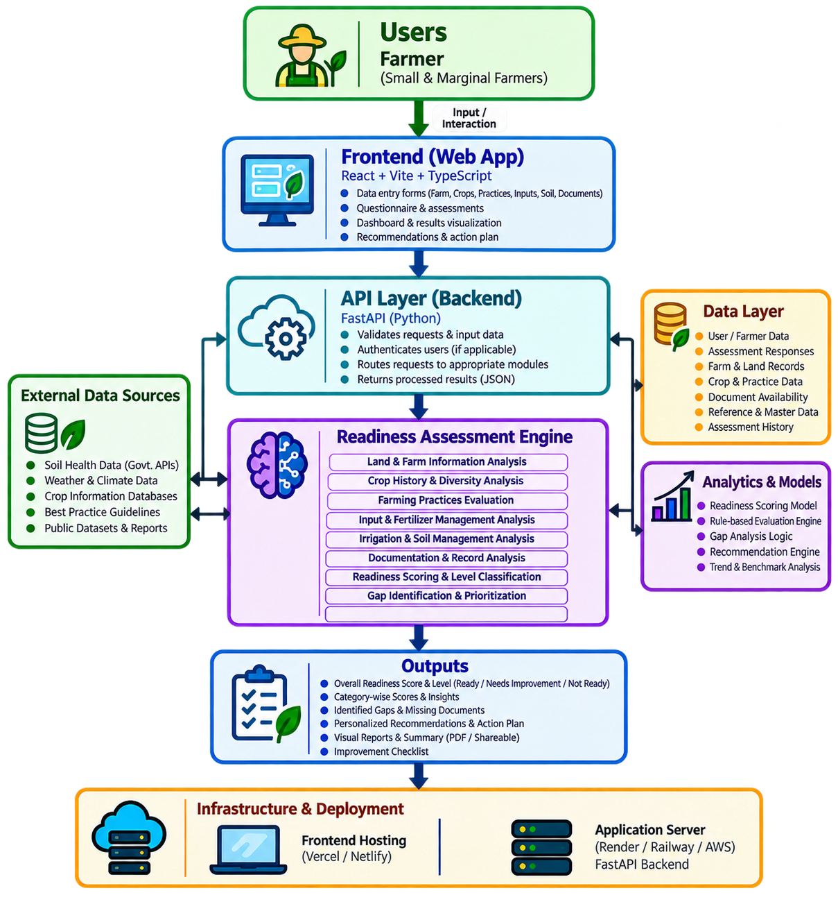
TECHNICAL APPROACH
Omnira
Technology | Why we use it
HTML5 + CSS3 | Builds the lightweight, responsive FarmerChoice interface.
JavaScript (ES Modules) | Handles frontend interactions and API communication.
Vite | Provides fast frontend development and production builds.
Node.js | Runs our backend server efficiently.
Express.js | Provides the REST API layer between frontend and backend.
TypeScript | Adds type safety and makes the backend easier to maintain reliably.
PostgreSQL | Stores real farmer, farm, crop, document and assessment data persistently.
Prisma ORM | Safely connects the TypeScript backend with PostgreSQL and manages database schema/migrations.
JWT | Handles secure user authentication and sessions.
bcrypt | Securely hashes farmer passwords instead of storing them directly.
Zod | Validates incoming API data before processing it.
Helmet + Rate Limiting + CORS | Adds basic API security and protects against unwanted requests/origins.
Cloudinary | Provides persistent cloud storage for uploaded farm documents in production.
Vitest | Tests the scoring engine, APIs, validation, security and complete workflows.
Render | Hosts the frontend and backend for public access.
Supabase | Provides the managed PostgreSQL database.

Slide 4
FEASIBILITY AND VIABILITY
Omnira
1. Feasibility of the Idea
• Existing farm data can support the assessment:
Land details, crop history, farming practices, input usage, irrigation, soil management and available records can be collected through simple forms.
• Readiness scoring is practical:
A rule-based scoring system can evaluate farmer inputs across key readiness categories without requiring complex infrastructure.
• Documentation assessment is achievable:
Available land, crop, input and soil records can be checked to identify documentation gaps.
• Recommendations are actionable:
The system can convert assessment results into clear improvement steps for farmers.
• Modular & scalable:
The platform can initially cover core readiness indicators and later expand to more carbon-credit programs, regions and data sources.
2. Potential Challenges & Risks
• Data availability & quality: Farmer-provided information may be incomplete, inconsistent or difficult to verify.
• Carbon program variability: Eligibility requirements and documentation standards can differ across carbon-credit programs.
• Limited awareness: Farmers may not understand technical terms or the purpose of different questions.
• Verification dependency: Readiness assessment cannot replace the formal measurement, reporting and verification required by actual carbon-credit programs.
3. Strategies to Overcome Challenges
• Data availability & quality → Use simple guided forms, validation and clear examples; allow incomplete information to be flagged.
• Carbon program variability → Keep assessment criteria modular and configurable for different program requirements.
• Limited awareness → Use simple, farmer-friendly explanations, tooltips and easy-to-understand questions.
• Verification dependency → Clearly position the platform as a pre-assessment/readiness tool and guide farmers toward required evidence and records.
“The platform is designed as a readiness-support system — helping farmers understand where they stand today and what they need to improve before approaching a carbon-credit program.”
This entire project is focused on solving 3 aspects of the problem faced by farmers:
Readiness → Gaps → Action

Slide 5
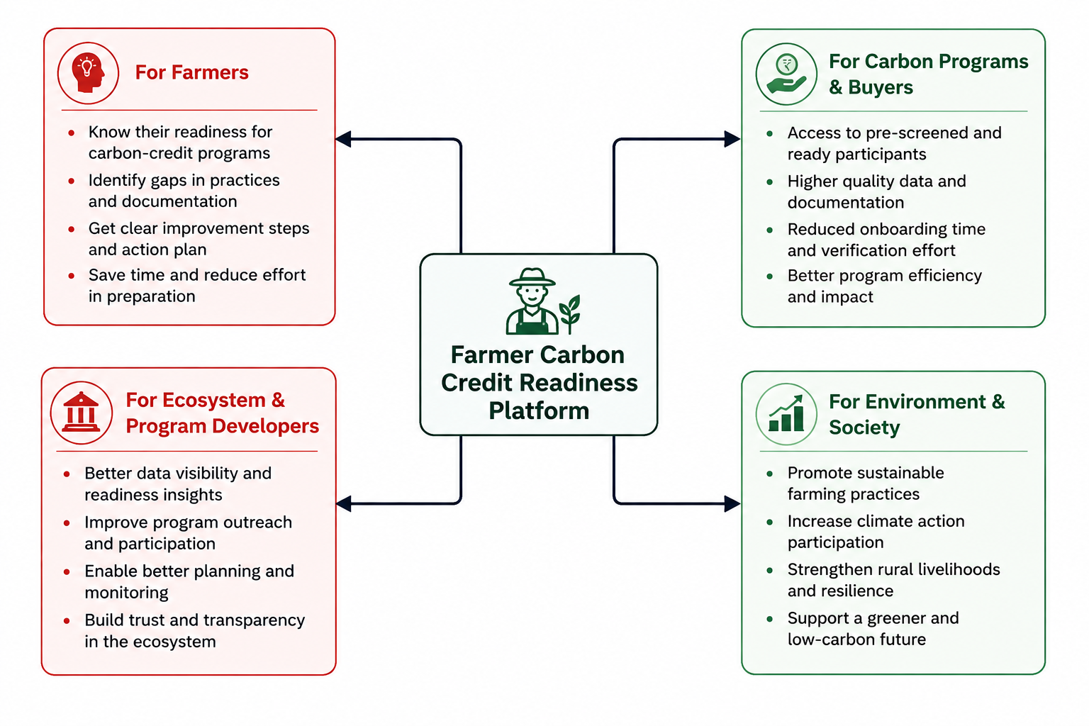
IMPACT AND BENEFITS
Omnira
☐ Better Carbon-Credit Readiness Awareness:
➢ Impact: Shows farmers how prepared they are based on their farming practices, records and available information.
➢ Benefit: Helps farmers understand their current position before approaching a carbon-credit program.
☐ Improved Documentation & Record Keeping:
➢ Impact: Identifies missing land, crop, input and soil-related records required for assessment.
➢ Benefit: Helps farmers maintain better evidence and become more prepared for program participation.
☐ Actionable Sustainable Practices:
➢ Impact: Highlights areas such as soil management, irrigation, crop rotation and input usage that may need improvement.
➢ Benefit: Guides farmers toward better farming practices while improving their readiness.
☐ Scalable Readiness Framework:
➢ Impact: Uses a modular assessment framework that can support different carbon-credit programs, crops and regions.
➢ Benefit: Makes the platform adaptable for wider farmer adoption and future real-world deployment.

Slide 6
RESEARCH AND REFERENCES
Omnira
📚 RESEARCH & REFERENCES
• Verra — VM0042: Improved Agricultural Land Management (verra.org)
Agricultural practices, soil carbon & GHG reduction/removal
• World Bank — Carbon Market MRV Framework (worldbank.org)
Measurement, Reporting & Verification of carbon reductions
• FAO — Climate-Smart Agriculture Sourcebook (fao.org)
Soil organic carbon, sustainable agriculture & resilience
• Verra — VM0042 FAQs & Methodology Resources
Fertilizer, irrigation, tillage, residue & crop-management practices

