Slide 1
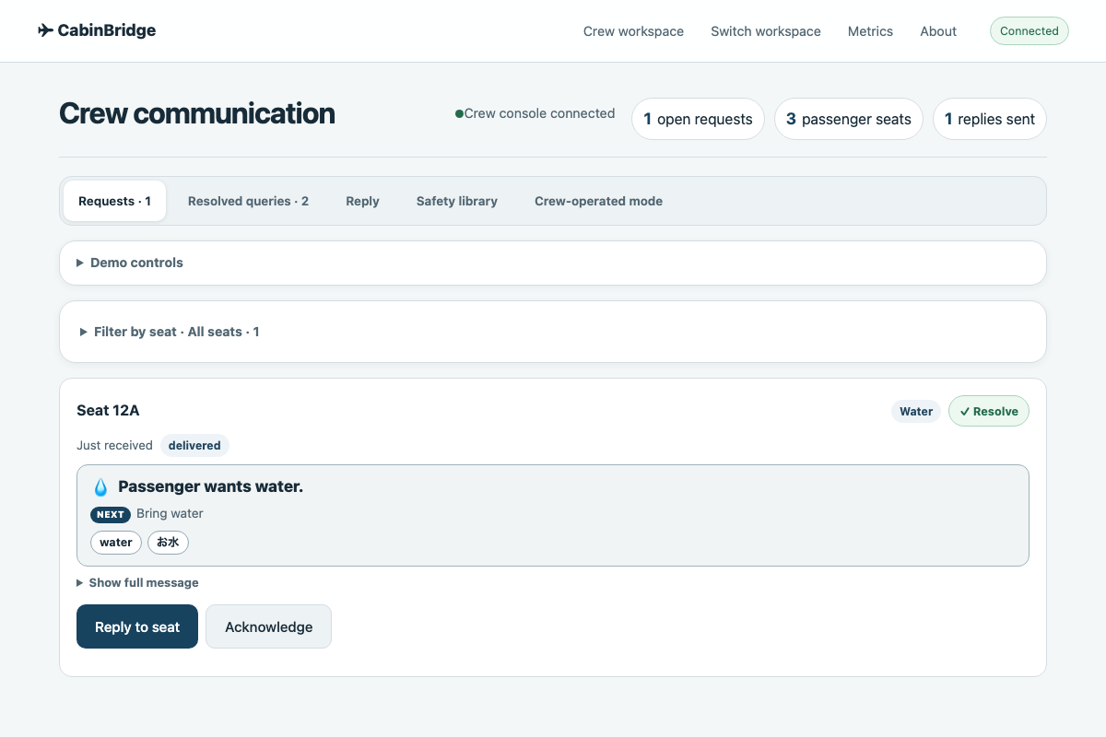
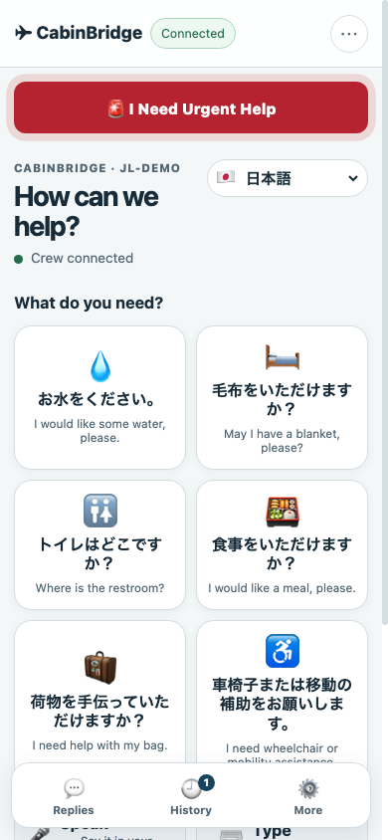
CABINBRIDGE · JAL DEMO DAY 2026
The cabin,
translated.
CREW
PASSENGER
A local-first communication layer for passengers and crew —
on two devices, in under two seconds.
0.7 s JP → EN
1.2 s VOICE
100% ON-DEVICE
0.7 s
Live demo · two devices · one judge
One session. Two devices. Local.
すべての乗客に、伝わる。
Notes:
Open: thank you, and frame this as a demo not a deck. One of us will be the passenger, one the crew. The judge will hold the passenger phone. Ask them to pick a need, and watch the crew tablet. We are going to show that a cabin request can be understood and acted on in under two seconds, without the internet.

Slide 2
01 · THE PROBLEM
Language is a safety system,
not a convenience.
PASSENGER · 12A · JAPANESE
CREW · ENGLISH
お水をください。
?
Which seat?
Water now?
Allergy?
!
“I would like some water, please.”
meaning lost
01
02
03
Mixed nationalities
Crew repetition
High-stakes nuance
The crew’s first language is rarely the passenger’s.
The same simple request is rephrased, repeated, guessed.
“No”, “not”, “allergy”, “2 tablets” can flip meaning.
CABINBRIDGE × JAPAN AIRLINES
02
Notes:
This is not a translation problem in the abstract. It is a passenger who feels unwell at 35,000 feet, and a crew member who needs the right information in seconds. The words matter, but so do seat, urgency, history, and confirmation. Today those are held in the crew's head, not in the tool.

Slide 3
02 · THE GAP
Google Translate translates words.
It doesn’t run a cabin.
1
Hear
2
Translate
3
Triage
4
Respond
5
Confirm
Voice or text
One sentence
Who? How urgent?
Seat + reply
Did it land?
A translator covers this
The cabin workflow lives here
A translator gives you…
A cabin needs…
a sentence, in isolation.
a closed loop.
No seat. No urgency. No queue. No confirmation.
Who asked · how urgent · what we promised · did it land?
CABINBRIDGE × JAPAN AIRLINES
03
Notes:
We are not saying Google Translate is bad. It is excellent at the word. But the cabin needs a workflow: who asked, how urgent, what did we promise, and did it land? That is the gap we close. The next slide is the loop.

Slide 4
03 · THE SOLUTION
One tap to speak.
One queue to act.
01
02
03
CAPTURE
UNDERSTAND
ACT
Voice, type, or one tap.
No language menu, no keyboard.
Phrasebook first.
Local AI only when needed.
Seat, urgency, summary.
Reply in one tap.
MediaRecorder
6 needs
7 languages
Whisper
Argos
Qwen 7B
Jev / local
WebSocket
Queue
ONE SESSION passenger ↔ crew · local · auditable
CABINBRIDGE × JAPAN AIRLINES
04
Notes:
Three moves. Capture: the passenger does not choose an engine; they choose a need. Understand: the phrasebook is the fast, deterministic path; local models handle free text. Act: the crew does not read a paragraph; they see a short decision and a reply button. That is the entire product.

Slide 5
04 · THE PRODUCT
Two devices. One conversation.
The actual demo build — passenger phone on the left, crew tablet on the right.
PASSENGER · PHONE
CREW · TABLET
One tap. No keyboard.
Six needs, voice, and type — in the passenger’s language.
Short summary, not a paragraph.
“Passenger wants water.” Next action, keywords, urgency.
Reply, resolve, keep the queue clean.
One action row; the request moves to Resolved.
The judge can hold the phone. The crew tablet is the other half of the same session.
CABINBRIDGE × JAPAN AIRLINES
05
Notes:
This is the actual product, not a mockup. On the left, the passenger sees six one-tap needs, voice, and type. On the right, the crew sees the request as a short decision: seat, water, keywords, next action. The full message is still there behind Show full message, but the crew does not have to read it to act. During the demo, hand the phone to a judge and let them tap.

Slide 6
05 · THE ENGINE
The right model for the job —
not one model for everything.
01
02
03
04
05
VOICE / TYPE
ASR
MEANING
TRIAGE
CREW
16 kHz · opus
browser capture
Whisper small
JP: turbo fallback
Phrasebook · Argos
Qwen 7B (JP)
Intent · urgency
keywords
Summary + reply
WebSocket
browser
1.2 s
0 / 60 / 700 ms
1–200 ms
<100 ms
PHRASEBOOK FIRST
LOCAL MODELS
CONFIDENCE, NOT GUESSWORK
0 ms, deterministic. 40 cabin phrases × 7 languages.
No cloud in the loop. Hindi: Argos. Japanese: Qwen 7B.
Empty is blocked. Low/medium is reviewed and editable.
Browser voice out · free, offline-capable · no server TTS
CABINBRIDGE × JAPAN AIRLINES
06
Notes:
We do not use one giant model for everything. Common phrases hit a deterministic catalog at zero milliseconds. English↔Hindi uses a 60ms Argos model. Japanese free text uses local Qwen 7B at about 0.7 seconds. Hard Japanese audio escalates to Whisper turbo. That ordering is how we keep both speed and accuracy. Browser speech handles the voice out; no server TTS.

Slide 7
06 · WHY RELIABLE
Designed to fail safely.
In a cabin, a confident wrong answer is worse than no answer.
12
0
100%
1
APPROVED SAFETY PHRASES
EMPTY SENDS
LOCAL PATH
AUDIT TRAIL
Exact match only. Safety wording never passes through machine translation.
Empty or unclear speech is blocked. Low confidence is reviewed, not guessed.
Phrasebook and models on the device. No internet required; cached fallback.
Per-request status and latency. Audio is processed in memory, never stored.
HUMAN IN THE LOOP the crew sends the final reply · we never claim delivery without confirmation
CABINBRIDGE × JAPAN AIRLINES
07
Notes:
Reliability here is not a model accuracy claim. It is system design. Safety phrases are exact-match. Empty speech is blocked. Low confidence is surfaced for editing. The local path works without internet. And we keep an audit trail without storing audio. The crew remains the human in the loop.

Slide 8
07 · PROOF
Fast enough to use.
Measured, not estimated.
Phrasebook match
0 ms
40 curated phrases
Argos en ↔ hi
60 ms
local CTranslate2
Qwen 7B ja ↔ en
0.7 s
local Ollama
Whisper small
1.2 s
2 s Japanese clip
Whisper turbo
5.5 s
only when confidence is low
COLD START: 24 h warm model + persistent phrase cache.
END-TO-END: ~1.5–2.5 s per voice turn, warm.
Bar length is illustrative; labels are measured. No formal WER/COMET yet — the pilot will measure in cabin noise.
CABINBRIDGE × JAPAN AIRLINES
08
Notes:
These are the numbers we can defend. A catalog phrase is instant. Argos is sixty milliseconds. Japanese free text is about seven hundred milliseconds. A two-second Japanese clip is about one point two seconds on the small model; the turbo fallback is only for hard audio. Cold start is gone because we keep the model warm. What we have not done yet is a formal WER/COMET study in cabin noise; that is a pilot deliverable, not a claim.

Slide 9
08 · WHY US
Keep Google Translate for the word.
Use CabinBridge for the cabin.
GOOGLE TRANSLATE
CABINBRIDGE
A great general translator.
A cabin communication system.
✓
Translate a sentence
✓
–
Crew queue + seat context
✓
–
Urgency + short summary
✓
–
Approved safety wording
✓
–
Works with no internet
✓
–
Local audio, no persistence
✓
–
Metrics + airline integration
✓
THE POINT Google Translate is an interpreter. CabinBridge is the cabin workflow around it.
CABINBRIDGE × JAPAN AIRLINES
09
Notes:
We are not trying to beat Google on generic translation. They are excellent. We win on the cabin workflow: seat context, a queue, urgency, a short summary, an approved safety catalog, offline operation, privacy, and metrics. If a passenger just wants a word, Google is fine. If a crew needs to act, they need the loop.

Slide 10
09 · BUSINESS VALUE
Minutes back to the crew.
Confidence back to the passenger.
1
Faster response
ILLUSTRATIVE · PER AIRCRAFT · YEAR
Less waiting, fewer repeats
250–1,000
2
Crew capacity
crew-hours returned per aircraft, per year
Time returned to service
250 passengers × 20% need help = 50 interactions / flight
3
Higher NPS
30–120 s saved per interaction
A calmer, clearer cabin
2 flights / day × 300 days
≈ 250–1,000 crew-hours / aircraft / year
4
Safer outcomes
At ¥4,000 / crew-hour ≈ ¥1M–¥4M
Nuance preserved
Pilot will measure actual minutes, repeat rate, and NPS.
CABINBRIDGE × JAPAN AIRLINES
10
Notes:
This is an illustrative model, not a claim. If a widebody carries 250 passengers and twenty percent need some crew assistance, that is fifty interactions. Saving thirty to one hundred twenty seconds each, across two flights a day, is two hundred fifty to one thousand crew-hours per aircraft per year. The pilot will measure the real number. The point is that the value is operational, not just a nicer app.

Slide 11
10 · DEPLOYMENT
Fits the aircraft you already fly.
No aircraft modification. Start with existing crew devices and a local edge.
LOCAL-FIRST no passenger audio leaves the aircraft · optional cloud only for consented summaries
RECOMMENDED
FAST START
LOUNGE / GATE
ONBOARD EDGE
CREW TABLET
GROUND-HOSTED
Small local device on the aircraft. Crew tablets connect over the cabin network. No internet.
Runs on existing crew tablets with local models. Syncs when the aircraft is on the ground.
For ground staff and gates. Optional Jev summary API, with consent and data controls.
Pilot · one route
Pilot · two aircraft
Phase 2
Per aircraft / month
Integration fee
8-week pilot
No passenger data stored
CABINBRIDGE × JAPAN AIRLINES
11
Notes:
The simplest deployment is a crew tablet plus a small local edge device. It does not require aircraft modification. We can also run on existing crew tablets for a fast pilot, and move to ground-hosted for lounge and gate use later. Commercial model is per aircraft per month plus integration; the pilot is the first step.

Slide 12
11 · STACK
Boring where it matters.
Local where it counts.
100% LOCAL PATH
EXPERIENCE
React 18
Vite
MediaRecorder
Web Speech
REALTIME
FastAPI
WebSocket
Session snapshots
Reconnect
INTELLIGENCE
Whisper small / turbo
Argos
Qwen 2.5 7B
Jev / local classifier
TRUST
Local-first
No audio stored
Confidence gates
Metrics + audit
Optional cloud only for Jev crew summaries, with consent and data controls.
CABINBRIDGE × JAPAN AIRLINES
12
Notes:
The stack is deliberately small. React and Vite for the two screens. FastAPI and WebSocket for the session. Whisper, Argos, Qwen, and Jev for the intelligence. The trust layer is the important one: local-first, no stored audio, confidence gates, and metrics. We are not hiding a cloud dependency in the critical path.

Slide 13
12 · PILOT
One route. Eight weeks.
Five numbers.
1 route
2 aircraft
20 crew
500 passengers
W0
W2
W4
W6
W8
SET UP
W0–2
LIVE
W3–6
EVALUATE
W7–8
Devices, seats, safety review, baseline.
Supervised flights, two crew per flight.
Compare to baseline, decide next route.
< 2 s
−30%
> 90%
≥ 4/5
baseline +
MEDIAN RESPONSE
REPEAT RATE
TASK COMPLETION
CREW CSAT
WER / COMET
Targets are illustrative until JAL signs off the baseline; the pilot defines the final thresholds.
CABINBRIDGE × JAPAN AIRLINES
13
Notes:
We are asking for a small pilot: one route, two aircraft, twenty crew, about five hundred passengers over eight weeks. We define the baseline and the thresholds with JAL before we start. The scorecard is response time, repeat rate, task completion, crew satisfaction, and WER/COMET on the real audio.

Slide 14
13 · LIVE DEMO
Three minutes. Two devices.
One judge.
1
Hand the phone to a judge.
Passenger workspace, seat 12A, Japanese.
BEFORE WE START
✓
Vite running with --host
2
Ask them to tap Water — or say “毛布をください”.
One tap is enough; no language menu.
✓
Phone + tablet on the same hotspot
3
Show the crew tablet.
✓
Open http://<mac-ip>:5173
Seat, summary, next action, keywords — in under a second.
✓
Seats: 12A / CREW-1
4
Crew replies.
The judge sees and hears the reply in Japanese.
If the venue network fails, use the local hotspot. The app does not need the internet.
5
Disconnect the Wi-Fi. Do it again.
The local path still works. That is the point.
FALLBACK if anything fails, the phrase cards still work — local, deterministic, no network.
CABINBRIDGE × JAPAN AIRLINES
14
Notes:
Keep the demo to three minutes. Hand the phone to a judge, let them choose. Show the crew tablet. Reply. Then disconnect the Wi-Fi and do one more — that is the memorable moment. If anything fails, the phrase cards still work locally. The runbook is on the slide: Vite with --host, same hotspot, Mac IP, seats 12A and CREW-1.

Slide 15
THE ASK
Start with
one route.
An eight-week pilot on one route, with a joint scorecard.
If the numbers hold, we scale with you.
01
02
03
PILOT ONE ROUTE
SECURITY REVIEW
DEFINE THE KPIs
2 aircraft · 8 weeks
local-first · no audio stored
speed · repeats · safety
Thank you.
CabinBridge · JAL Demo Day 2026
ありがとうございました。
Notes:
Close on the ask, not the technology: one route, eight weeks, a joint scorecard. Thank the judges. If they remember one thing, it should be that the loop is local, fast, and safe — and that they just used it themselves.

