Slide 1

Vth Semester End Semester Project Presentation
on
Dual Axis Solar Tracker
Under the Guidance of
Mrs Nirupam
Assistant Professor, ECE, University Polytechnic,
Birla Institute of Technology, Mesra
Presented By
Rounak Anand ;DL/025/22
Satyam kr Sinha ;D/059/21

Slide 2
Contents :-
• Introduction
• Concept of Solar Tracker
• List of components
• Circuit Diagram
• Circuit Explanation
• Working
• Future Scopes
• Applications
• Merits
• Drawbacks
• Visual Representation
• References

Slide 3
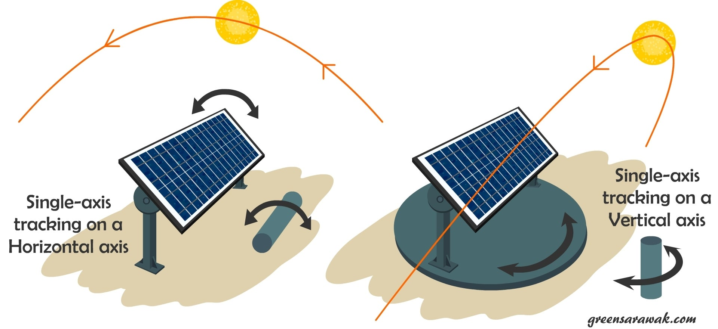
INTRODUCTION :-
A solar tracker is a device that orients a payload towards the sun.
Payloads can be photovoltaic panels, reflector, lenses or other optical devices.
In solar tracker concentrated photovoltaic (CPV) and concentrated solar power (CSP) applications are used.
These trackers are used to enable the optical components in the CPV and CSP system.
The optics is concentrated solar application accept the direct component of sunlight and therefore must be oriented appropriately to collect energy.

Slide 4
Concept of solar tracker:-
Sunlight has two components,
Direct beam
Diffuse sunlight
The direct beam that carries about 90% of the solar energy.
The diffuse sunlight that carries the remainder the diffuse portion is the blue sky on a clear day increases proportionately .
As the majority of the energy is in the direct beam, maximizing collection requires the sun to be visible to the panels as long as possible.

Slide 5
List Of components:-
1.100 k ohm Resistance
2.LDR sensor
3.Breadboard
4.Servomotor
5.Jumper wires
6. Arduino uno
7.Solar panel
8. Soldering kit
9.Rubber glue gun
10.Printed Circuit Board

Slide 6
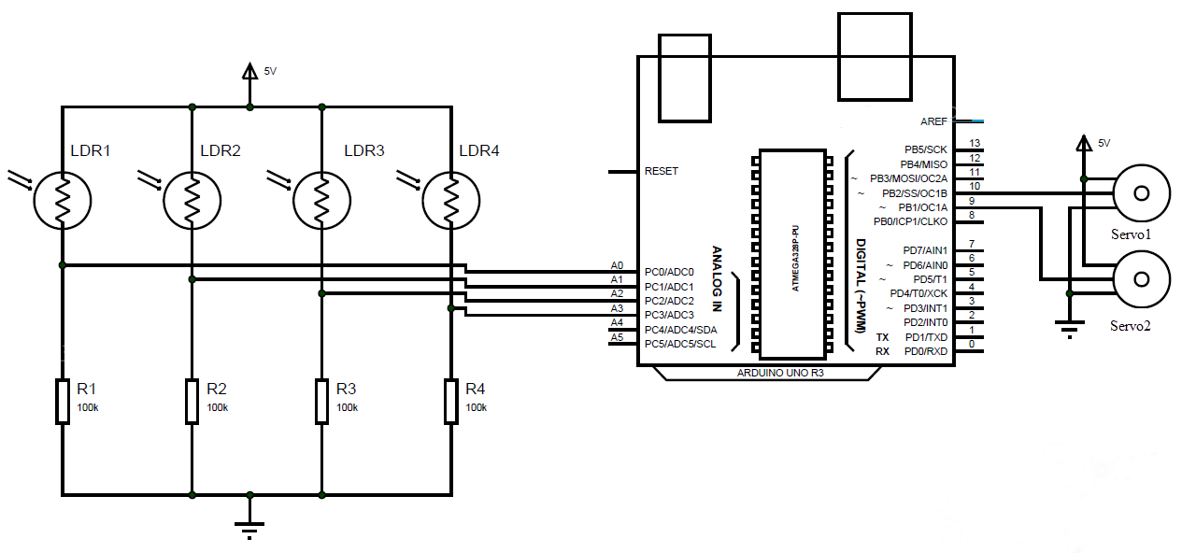
Circuit diagram :-

Slide 7
Circuit Explanation:-
The series connection of resistance and LDR is connected to the pin A0, A1 , A2 , A3 respectively, This pin is termed as analog input . The value of Each resistance is of 100 kilo ohm . 5v of power supply is applied to both the servo motors , and one pin connected to GND(ground). The servo motor is connected to the pin 10 and 9 of the Arduino Uno, Which used to give them a digital PWM signal i.e (pulse width modulating signal). Ground servo motor is connected to the pin 10 .Tilt servo motor is connected to the pin 9.
Ground servo motor help the solar panel to move in horizontal direction i.e (x-axis).
Tilt servo motor help the solar panel to move in vertical direction i.e (y-axis).

Slide 8
Working of Dual Axis Solar Tracker
Dual axis tracking is typically used to orient a mirror and redirect sunlight along a fixed axis towards a stationary receiver . But the system can also gain additional yield on our PV cells .The sensor used to sense the solar light rays and used to redirect the signal to the servo motor and servo motor used to move the Solar panel on the Direction of solar light and used to gain energy which is further used to converted into electricity.
LINAK can provide the good quality of actuators that moves these panels on dual axis .Solar tracking is an obvious way to improve the efficiency of solar power plants .As the sun moves across the sky an electric actuator system makes sure that solar panels automatically follow and maintain.

Slide 9
Applications of Solar Tracker :-
1. It helps to generate nearly 40% more power than a fixed solar panel.
2.Increase energy by tracking sun rays from switching solar panel in various directions.
3. According to the measured readings the efficiency of the dual axis tracker is found to be 81.68% higher than that of fixed panel.
4. Power output can be increased by about 30 to 40 percent.
5. It can be used for large and medium scale power generations.
6. It can also be used for power generation at remote places.
7. It may be used as domestic backup power systems.

Slide 10
Future Scopes Of Solar Tracker :-
The goals of this project were a purposely kept within what was believed to be attainable within the allotted timeline. As such, many advanced improvements can be made up of initial design of solar tracker. It is felt that this design represents a functioning scale model which could be replicated for a much larger scale.
following recommendations are provided as ideas for future expansion for this project.
1. We can use wood and other locally available materials instead of Mild steel and thus reduce the cost further.
2.A spring of appropriate stiffness could be designed to avoid sudden jerks.
3. Provisions for safety of solar panels from rain.
4. More accuracy can be achieved by providing measures against wind vibrations.

Slide 11
Merits of solar tracker :-
Trackers generate more electricity than their stationary counterparts due to increased direct exposure to solar rays. This increase can be as much as 10 to 25% depending on the geographic location of the tracking system. There are many different kinds of solar trackers, such as single-axis and dual-axis trackers, all of which can be the perfect fit for a unique jobsite. Installation size, local weather, degree of latitude and electrical requirements are all important considerations that can influence the type of solar tracker best suited for a specific solar installation. Solar trackers generate more electricity in roughly the same amount of space needed for fixed-tilt systems, making them ideal for optimizing land usage.

Slide 12
Drawbacks Of Solar Tracker :-
Even with the advancements in reliability, there is generally more maintenance required than a traditional fixed rack, though the quality of the solar tracker can play a role in how much and how often this maintenance is needed.
Trackers are a more complex system than fixed racking. This means that typically more site preparation is needed, including additional trenching for wiring and some additional grading.
Solar trackers are slightly more expensive than their stationary counterparts, due to the more complex technology and moving parts necessary for their operation. This is usually depending on the size and location of the project.

Slide 13
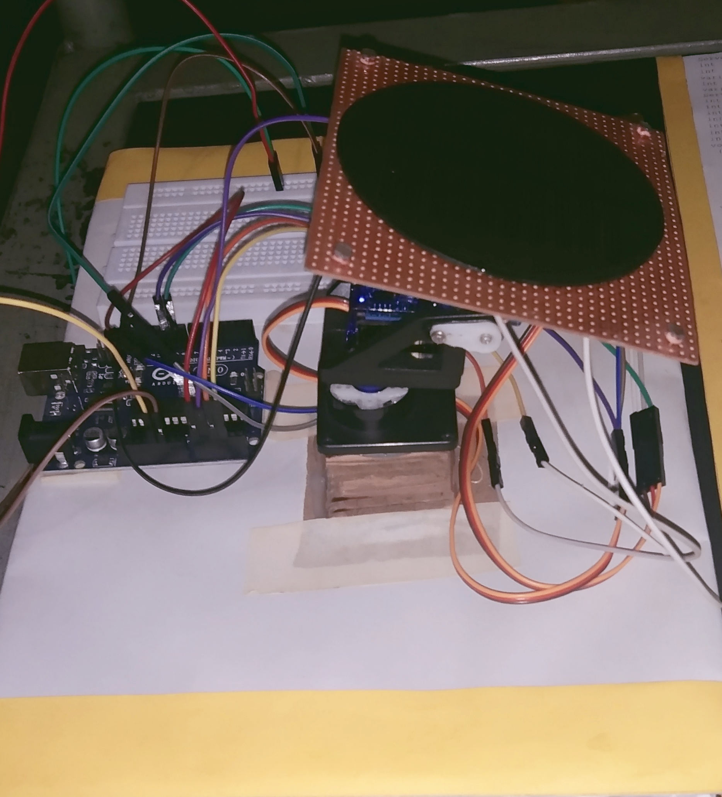
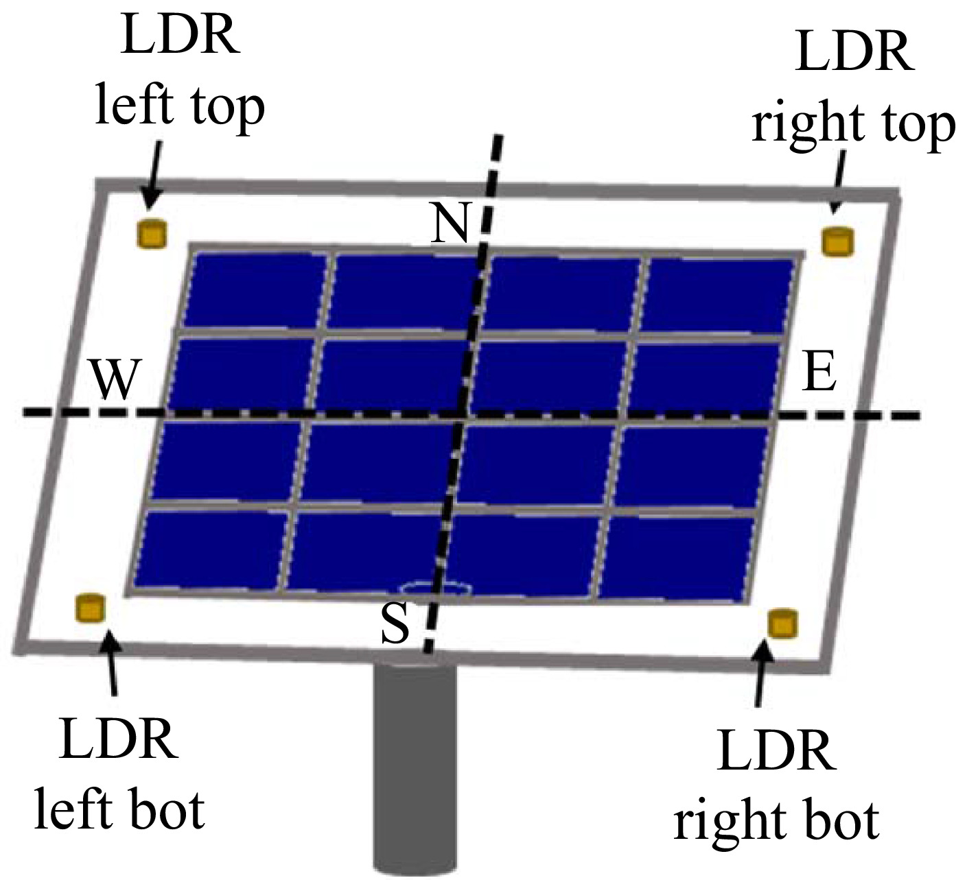
Visual Representation:-

Slide 14
References:-
1. Tracking Systems Vital to Solar Success Accessed 4-3-2012
2. Dam, J. Issue #17, June/July 1990. An active solar tracking system, Homebrew Magazine.
3. http://www.suntrix.cn/home-en/newsevents/company-news/suntrix-greece-solartracker-completion.aspx
4. Customers Recognize the Power of Solar Tracking Accessed 4-3-2012.
5. Machine Design, R.S.Khurmi, J.K. Gupta,27th Edition Design of Machine Elements, V.B. Bhandari, 3rd Edition.

Slide 15
Thank you !

