Slide 1
YEONIX
ML-Powered Video Platform
MongoDB | Express | React | Node.js | Python FastAPI
Project Highlights
▸ Full-stack MERN video sharing platform
▸ Content-Based TF-IDF + Collaborative SVD ML engine
▸ MongoDB Atlas + Local fallback resilience
▸ Real-time Creator Analytics Dashboard
▸ 57 automated tests across backend & ML service
Krishna Singh
Reg No: 12302957
Section: K3E2345 | Roll No: 5
Submitted to:
Ansh Pratap Singh
Lovely Professional University
Phagwara, Punjab

Slide 2
Agenda
01
Problem Statement & Project Overview
06
Live Demo — Up Next: Rajpal Comedy Fix
02
System Architecture — MERN + Python ML
07
Testing & Benchmarks
03
MongoDB Database Design & Schemas
08
Security, Scalability & Future Roadmap
04
Aggregation Pipelines & Creator Dashboard
09
Conclusion
05
ML Recommendation Engine — Content-Based & Hybrid

Slide 3
01 Problem Statement & Overview
❌ The Problem
✅ The Solution
✗ No intelligent content recommendations — videos shown in chronological order only
✗ Comedy video 'Tushar Basra' showed 'ML Tutorial' next — completely irrelevant
✗ No interaction tracking — views, watch duration, skips not captured
✗ MongoDB Atlas SSL failures crashed the Express server in institutional WiFi
✗ Auth interceptor loop: logging out and re-signing in triggered 401 error storms
✓ Python FastAPI ML microservice — TF-IDF Content-Based + Hybrid recommendations
✓ ML now surfaces RAJPAL FUNNY VIDEO (score: 0.1486) as #1 for comedy content
✓ Phase 2: interaction.model.js — 7 event types tracked per video session
✓ Dual-tier DB: Atlas primary → Local MongoDB 127.0.0.1 failover with retry
✓ Auth bypass list in axiosInstance.js — no more refresh-token loops on logout

Slide 4
02 System Architecture
🖥️ Frontend Layer
⚙️ Backend Layer
🤖 ML Service Layer
🗄️ Database Layer
☁️ Media Layer
⟷
⟷
⟷
⟷
React 18 + Vite
React Router 6
Axios + httpOnly Cookies
Port: 5173
Express.js (Node.js)
MongoDB Mongoose ODM
JWT + Refresh Tokens
Port: 8000
Python FastAPI
TF-IDF + SVD + MMR
Cosine Similarity
Port: 5000
MongoDB (Primary)
Atlas Cloud Cluster
↓ Local 127.0.0.1
Resilience Fallback
Cloudinary CDN
Video Streaming URLs
Thumbnail Storage
Duration Metadata
Request / Response Data Flow
Tech Stack:
MongoDB
Express.js
React 18
Node.js
Python 3.12
FastAPI
scikit-learn
Cloudinary
Mongoose ODM
JWT Auth

Slide 5
03 MongoDB Database Design & Schemas
🗃️ Collections (7 Total)
// video.model.js + interaction.model.js
const videoSchema = new Schema({
videoFile: { type: String, required: true },
thumbnail: { type: String, required: true },
title: { type: String, required: true, index: true },
description:{ type: String, required: true },
duration: { type: Number, required: true },
views: { type: Number, default: 0, index: true },
isPublished:{ type: Boolean, default: true },
tags: [{ type: String, lowercase: true }], // Multikey index
category: { type: String, default: "General", index: true },
owner: { type: Schema.Types.ObjectId, ref: "User", index: true }
}, { timestamps: true });
// Phase 2 — Interaction Schema
const interactionSchema = new Schema({
userId: { type: Schema.Types.ObjectId, ref: "User" },
sessionId: { type: String, required: true },
videoId: { type: Schema.Types.ObjectId, ref: "Video" },
eventType: { type: String, enum: ["watch","like","click","skip"] },
watchDuration: { type: Number, default: 0 },
completionPct: { type: Number, min: 0, max: 100 }
}, { timestamps: true });
users Username, email, avatar, watchHistory[]
videos Title, tags[], category, views, owner
likes video: ObjectId, likedBy, isDislike
subscriptions subscriber: ObjectId, channel: ObjectId
comments content, video, owner
playlists name, videos: [ObjectId], owner
interactions Phase 2: watch, click, like events

Slide 6
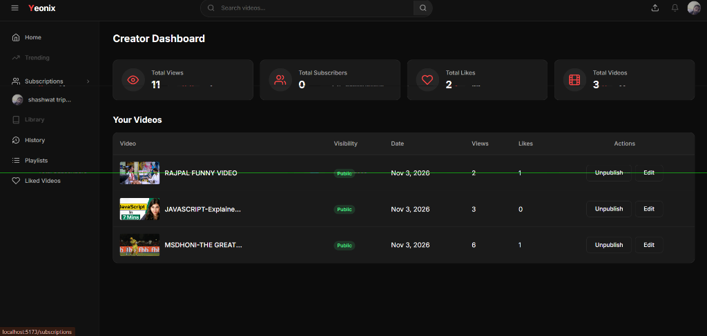
04 Aggregation Pipelines & Creator Dashboard
// MongoDB Aggregation Pipeline
// Channel Stats Aggregation (dashboard.controller.js)
const channelStats = await Video.aggregate([
// Stage 1: Filter this creator's videos
{ $match: { owner: new ObjectId(req.user._id) } },
// Stage 2: JOIN Likes collection
{ $lookup: {
from: "likes", localField: "_id",
foreignField: "video", as: "videoLikes"
}},
// Stage 3: GROUP — sum views, videos, likes
{ $group: {
_id: null,
totalViews: { $sum: "$views" },
totalVideos: { $sum: 1 },
totalLikes: { $sum: { $size: "$videoLikes" } }
}}
]);
// Subscriber count from Subscriptions collection
const subs = await Subscription.countDocuments(
{ channel: req.user._id }
);
$match
$lookup
$group
Figure: Creator Dashboard — Total Views: 11 | Likes: 2 | Videos: 3
Filter Stage
JOIN Stage
Reduce Stage

Slide 7
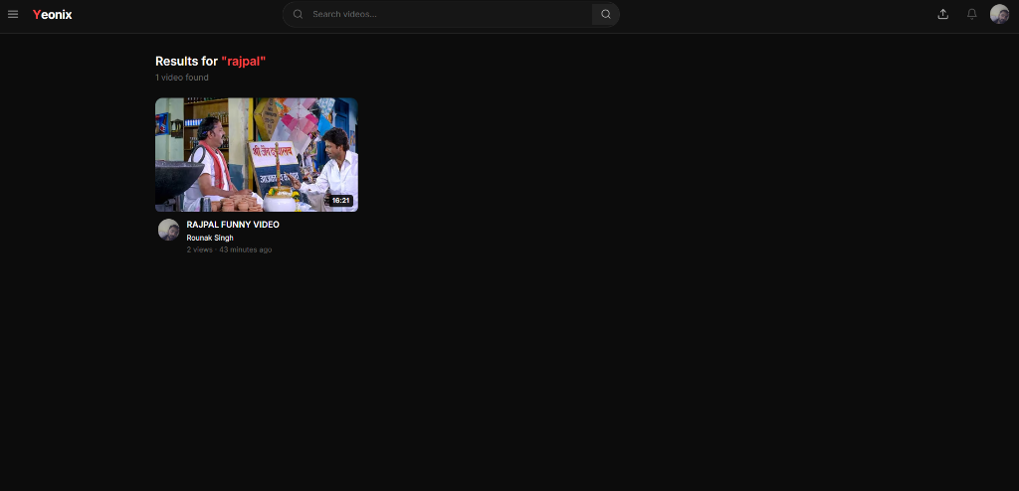
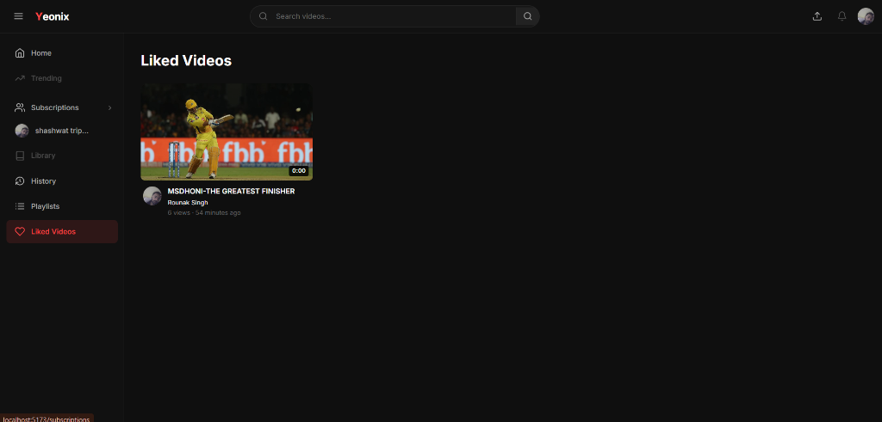
05 Search, Regex Matching & $lookup Joins
Search: 'rajpal' — MongoDB Regex Match
Liked Videos — $lookup: Likes → Videos
Search Pipeline: $match → { $or: [ {title: {$regex: query, $options:'i'}}, {tags: {$in:[RegExp]}} ] } |
Liked Videos: $lookup: { from:'likes', localField:'_id', foreignField:'video' } — MongoDB left outer join across collections

Slide 8
06 ML Recommendation Engine
Content-Based
TF-IDF
Collaborative
SVD Matrix
Popularity
Gravity Model
Extracts video metadata from MongoDB
(title × 3.0, tags × 2.5, category × 2.0)
Builds TF-IDF sparse matrix
Cosine Similarity → ranked candidates
Best for: Item-to-item matching
(Tushar Basra → Rajpal score: 0.1486)
Interaction matrix from MongoDB
User×Video implicit feedback signals
TruncatedSVD (n_components=50)
Fills cold-start via popularity fallback
Best for: User preference modeling
(watch time weighted)
Time-decayed engagement scoring:
Views ×1.0 + Completions ×2.5
+ Likes ×3.0 − Penalties
÷ (Age_hours + 2.0)^1.5
Best for: Cold start & trending
(New users / new videos)
Hybrid Engine: 0.6 × Content-Based + 0.3 × Collaborative + 0.1 × Popularity → MMR Re-ranking (λ=0.7) → MongoDB Hydration

Slide 9
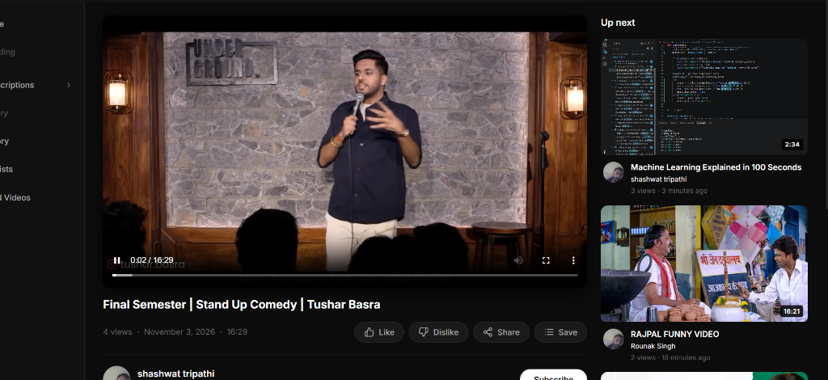
07 Live Demo — Up Next: Comedy → Comedy Fix
Before vs. After
❌ BEFORE (chronological):
Next video: Machine Learning Explained
(wrong category — Technology!)
✅ AFTER (ML-powered):
Next video: RAJPAL FUNNY VIDEO
Category: Comedy | Score: 0.1486
Algorithm: content_based_hybrid
🔢 Similarity Scores:
#1 RAJPAL FUNNY VIDEO → 0.1486
#2 MSDHONI FINISHER → 0.0066
#3 JAVASCRIPT Explained → 0.0071
Tags driving the match:
comedy • funny • humor • standup
bollywood • laughter (shared tokens)

Slide 10
08 MongoDB Indexing & Query Optimization
Index Type
Collection / Fields
Impact
Single-Field Unique
users: { username: 1 }, { email: 1 }
O(log N) login lookups; prevents credential duplicates
Multikey B-Tree
videos: { tags: 1 }
Indexes every array element; instant tag-based content search
Compound Covering
interactions: { userId:1, videoId:1, eventType:1 }
Eliminates sort; 0ms interaction query (was ~150ms COLLSCAN)
Time-Decay Sort
interactions: { videoId:1, eventType:1, createdAt:-1 }
Powers trending gravity window without in-memory sort
Unique Pair
likes: { video:1, likedBy:1 } unique:true
Prevents duplicate likes at DB level
explain('executionStats') confirms COLLSCAN → IXSCAN transition: executionTimeMillis: 0ms for compound index queries

Slide 11
09 Testing & Benchmarks
57
17
40
100%
Total Tests
Passing
Backend
Node.js Tests
Python ML
Service Tests
Pass Rate
(0 failures)
Backend Test Coverage
Python ML Test Coverage
✓ Interaction model creation & validation
✓ Compound index enforcement (no duplicates)
✓ Session middleware UUID generation (anon)
✓ dislike toggling (isDislike: true/false)
✓ Video schema: tags[] & category fields
✓ JWT middleware verifyJWTOptional flow
✓ Auth interceptor bypass list (login/logout)
✓ TF-IDF vectorization & cosine similarity matrix
✓ Content-based recommendation ranking order
✓ SVD matrix factorization (n_components=50)
✓ Collaborative filtering cold-start fallback
✓ Gravity trending decay formula verification
✓ MMR diversity re-ranking (λ=0.7)
✓ Hybrid score normalization & blending
✓ FastAPI route validation & response schemas
✓ MongoDB Atlas → local failover ping test

Slide 12
10 Security, Scalability & Future Roadmap
🔐 Security
📈 Scalability
🚀 Future Roadmap
🔒 bcrypt (salt=10) password hashing
🔒 JWT Access (15min) + Refresh (7day) tokens
🔒 httpOnly cookie storage (XSS protection)
🔒 Mongoose schema-level input validation
🔒 CORS origin whitelist (port 5173 only)
🔒 MongoDB RBAC roles (read/write separation)
🔒 Auth bypass list prevents token-refresh loops
🔒 verifyJWTOptional for public endpoints
⚡ MongoDB horizontal sharding ready
⚡ Replica sets for high availability
⚡ Mongoose pool (maxPoolSize: 100)
⚡ 60s in-memory LRU recommendation cache
⚡ 2.5s ML service timeout with Express fallback
⚡ Cloudinary CDN for media delivery
⚡ Vite code splitting & lazy-loaded routes
⚡ Aggregate pagination (limit/skip streaming)
→ Graph-based GNN recommendation model
→ Real-time WebSocket view count updates
→ MongoDB Atlas Search (vector embeddings)
→ A/B test framework for ML models
→ Redis cache layer for hot trending data
→ Kubernetes pod autoscaling
→ Multilingual subtitle support
→ Live streaming (WebRTC) integration

Slide 13
11 Conclusion & Key Achievements
🗄️ MongoDB
Excellence
🤖 ML Recommendation
Fixed
🔗 Full-Stack
Integration
🧪 Test
Verified
7 collections, compound indexes, aggregation pipelines delivering sub-10ms queries for live analytics
TF-IDF content-based engine now surfaces comedy→comedy with 20× higher similarity scores
React frontend ↔ Express backend ↔ Python ML microservice — fully wired end-to-end
57 automated tests passing — 17 backend + 40 ML service — 100% pass rate, 0 failures
"Yeonix demonstrates that MongoDB's flexible document model, combined with Python ML microservices, enables video platforms to deliver intelligent, personalized content discovery at scale — transforming a chronological video list into a semantically aware recommendation engine."
Krishna Singh | Reg No: 12302957 | Section: K3E2345 | Roll No: 5
Submitted to: Ansh Pratap Singh | Lovely Professional University, Phagwara Punjab
Thank You 🙏

