Slide 1
Matching Drivers and Passengers using Graphs

Slide 2

HELLO!
Arima Vu Ram Thayumanavar
thayumanavar.a@husky.neu.edu
Soumya Mohanty
mohanty.s@husky.neu.edu

Slide 3
Introduction
DESCRIPTION
The idea is to create a graph capable of storing data such that: People and Cars are entities with certain attributes connected to one another by certain relationships, these relationships can be of different types and have different attributes.
Using such a structure we can store and retrieve information in an innovative way to gain interesting insights.
GOALS
- Finding best routes, making multiple pick-ups and drop-offs.
- Finding driver better suited to passengers profile. (Graph-DB helps a lot)
- Matching co-passenger profiles
- Finding best ways to use the resources at hand.

Slide 4
Architecture
Neo4J graph DB
Cypher query language
Python API (Py2Neo driver)
Python application

Slide 5
1.
Graph Databases:
Neo4J
How can storing data differently impact functionality?

Slide 6
Driver
User
Drove
Owns
Car

Slide 7
Attributes
Person
{
"phone_no": "9803197860",
"address": "235 Park Drive",
"user_name": "Driver1",
"joined": "2018-07-20 13:56:56.209593000",
"rating": 4.9,
"is_driver": "True",
"current_loaction": "45"
}
Drove
{
"pickup_loc": "45",
"drop_loc": "39",
"ride_rating": 4,
"start_time": "2018-12-01 9:23:12.104591067",
"end_time": "2018-12-01 9:55:12.104591067"
“ride_duration”: 32
}
Car
{
"color": "Black",
"plate_no": "Ron07",
"max_capacity": 2,
"active": true,
"make": "Lamborghini",
"model_no": "Aventador"
}

Slide 8
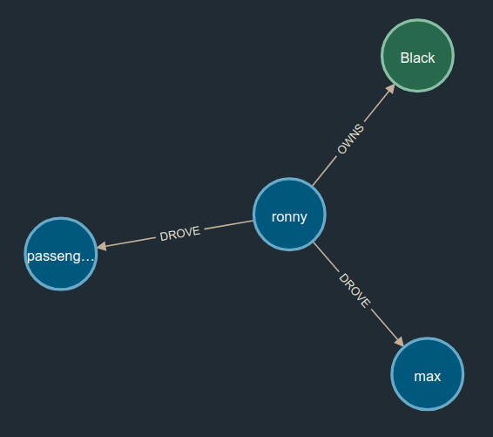

Slide 9
Example Queries
match (driver:Person)-[d:DROVE]->(user:Person) match (driver)-[o:OWNS]->(car:Car) where car.plate_no = 'Ron07' and user.user_name = ‘max’ return driver,user,car
match (car:Car)<-[o:OWNS]-(driver:Person)-[d:DROVE]->(user:Person) where car.plate_no = 'Ron07' and user.user_name = ‘max’ return driver,user,car

Slide 10
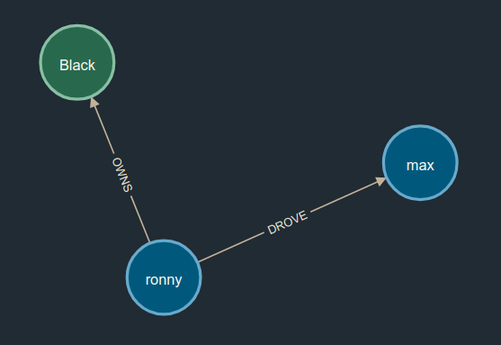

Slide 11
2.
Loading the data
Databases need to be populated!

Slide 12
How we did it?
Loading datasets stored as TSV files using Cypher and Python.
Using the application API to take user input and store it in the database.

Slide 13
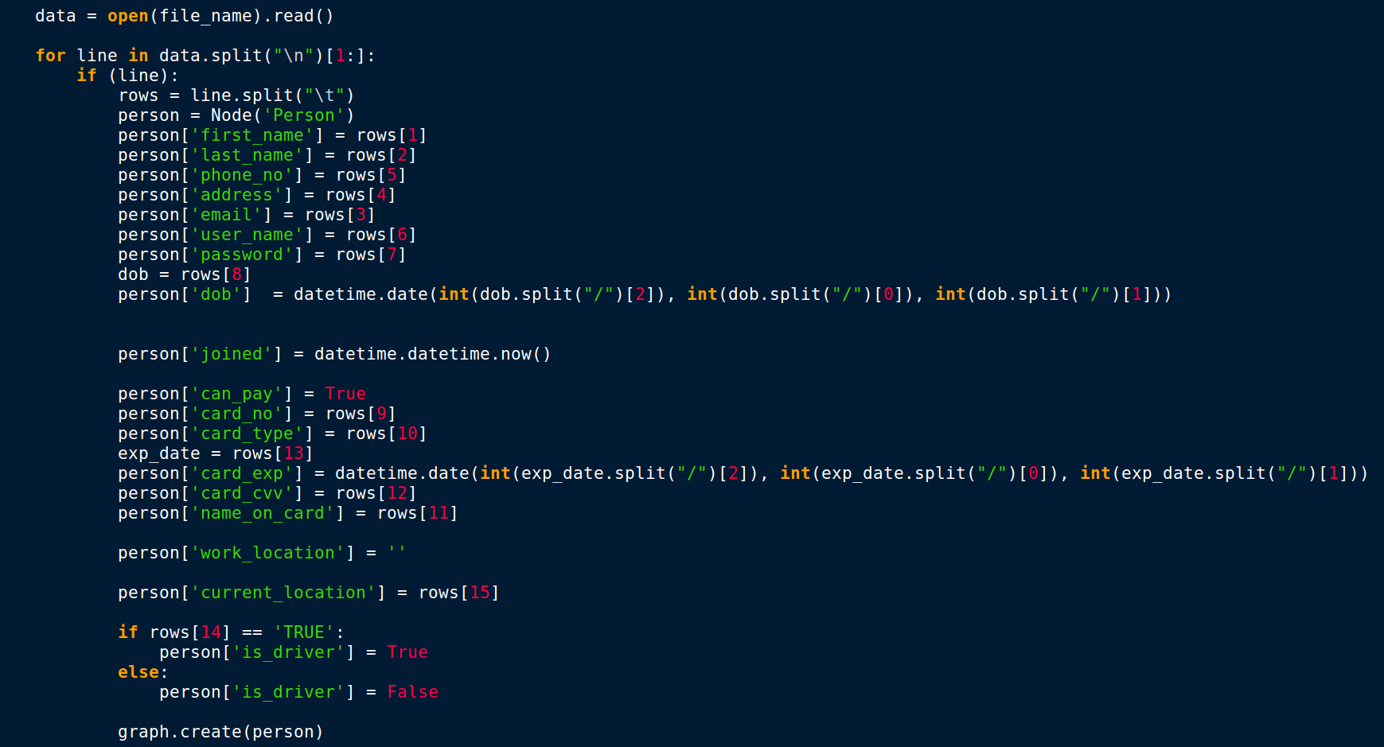

Slide 14
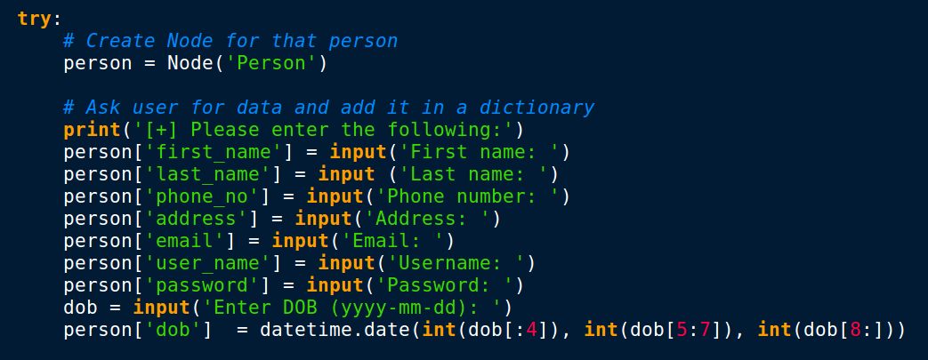

Slide 15
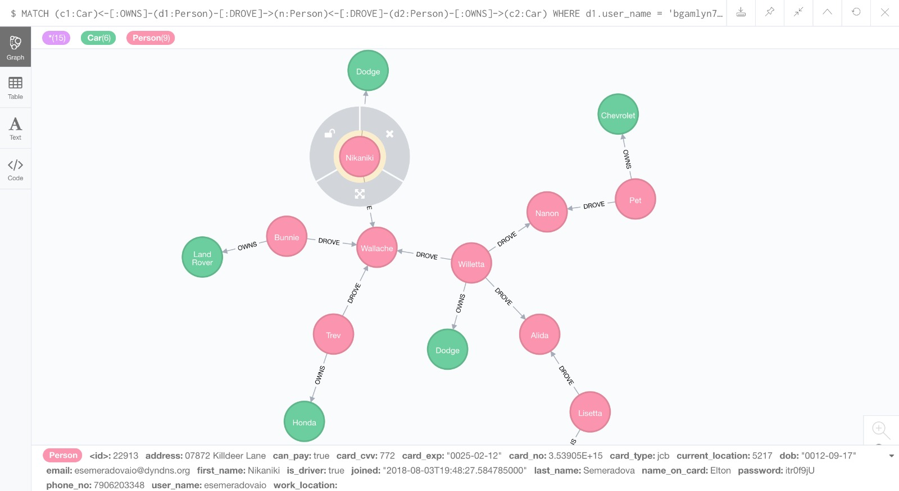

Slide 16
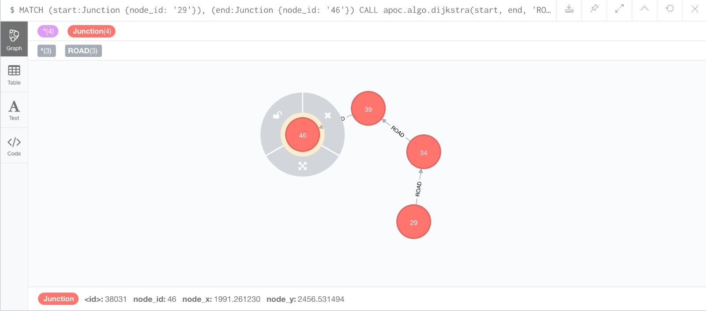
Also loaded a Map with roads and junctions and plotted it to see how it looks.

Slide 17
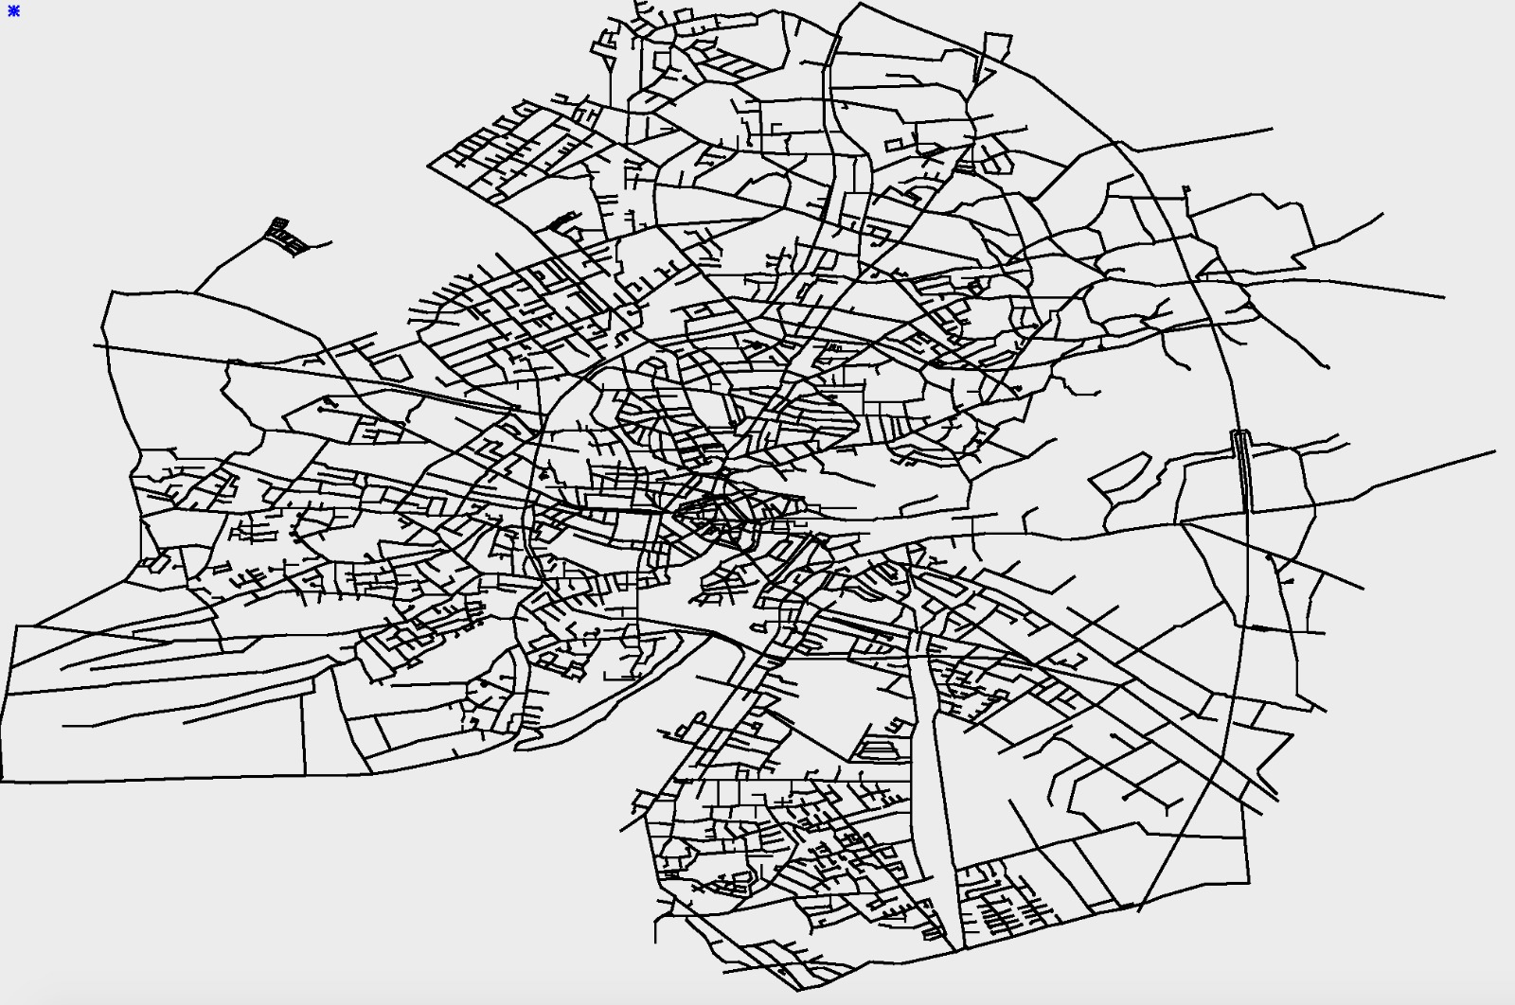

Slide 18
3.
Application Program Interface
Good API is the foundation of a good application.

Slide 19
API
Goal for the API was to build wrapper functions for all kinds of operations that talk to the database, in an attempt to make the application database independent.
Some functionalities among others:
- Adding users, cars
- Loading users, cars, drivers, maps
- User login
- Inserting and updating ride information (who-drove-who)
- Rating riders, users and co-passengers
- Calculating, inserting or updating the ride fare
- Find drivers
- Matching users to drivers
- Generating drive/ride history

Slide 20
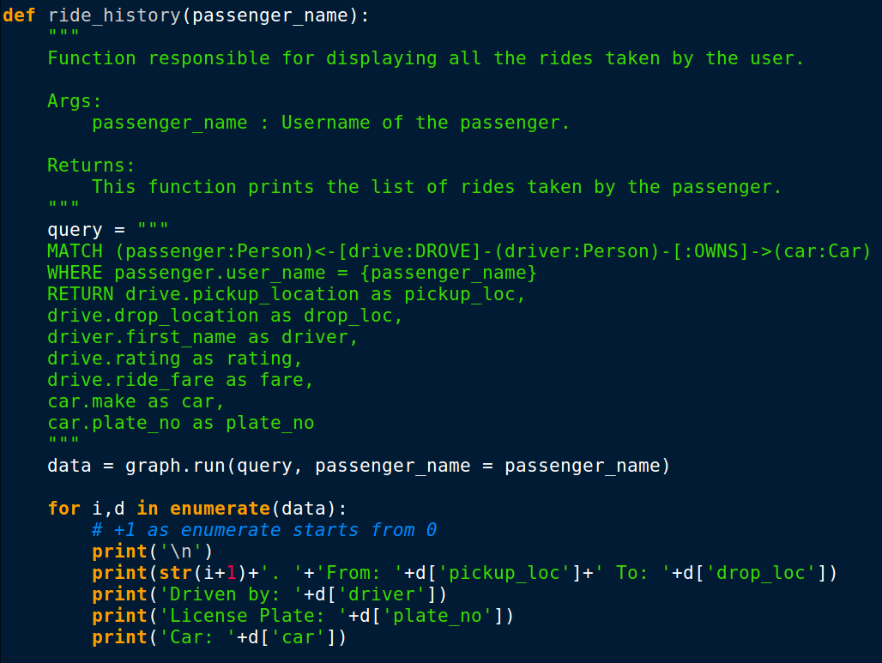

Slide 21
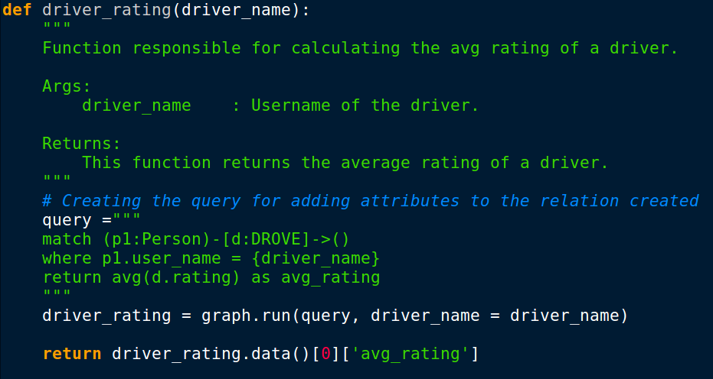

Slide 22
4.
Matching rides
The heart of it all...

Slide 23
Lets find some rides
The process is broken into two parts, finding drivers nearby, then getting the best match for our user.
Our current Recommendations are based on both distance and user preference.

Slide 24
Some relevant Criteria
User location
Detour distance
Rider-Driver ratings
Rider-rider relationships

Slide 25
Lets find some rides
The process is broken into two parts, finding drivers nearby, then getting the best match for our user.
Our current Recommendations are based on both distance and user preference.

Slide 26
5.
How does graph database help?
Does it help, or is RDBMS a better choice.

Slide 27
In this scenario,it sure does.
Avoiding Joins
The use of graph Db and Cypher query language makes it very easy for us to identify patterns.
We can find results to complicated queries without having to join tables.
Finding optimal paths
As the data is stored in a graph we can easily find best paths based on edge attributes. Cypher allows us to get multi-level paths easily.
Recommendations
Helps in building advanced recommendation systems as we can store many attributes both on nodes and relationships. This property allows us to take into account different kinds of features for better predictions.

Slide 28
Some other advantages
Storing Data
Using graphs makes storing, manipulating, and updating the data as and when needed. We can easily add more data and different kinds of information.
Dynamic
Allows us to change the structure of data and add attributes on the fly. If some attribute doesn’t exist in a node or relation, then it is simply returns NULL
Connected
Connections between nodes let us to fetch multi length paths with ease. Also lets us fetch data with ease.
Lookups
The implementation of Neo4J makes complicated lookups lightning fast. We can query the DB multiple times and don’t need to resort to complicated methods or data redundancy
Clusters
We can partition data based on the business requirement and creates separate databases that can interact with each other. These clusters also help us scale up fast.
ACID
Neo4J is ACID compliant
Atomicity
Consistency
Isolation
Durability

Slide 29
THANKS!
Any questions?
You can find us at
thayumanavar.a@husky.neu.edu
mohanty.s@husky.neu.edu

