Slide 1
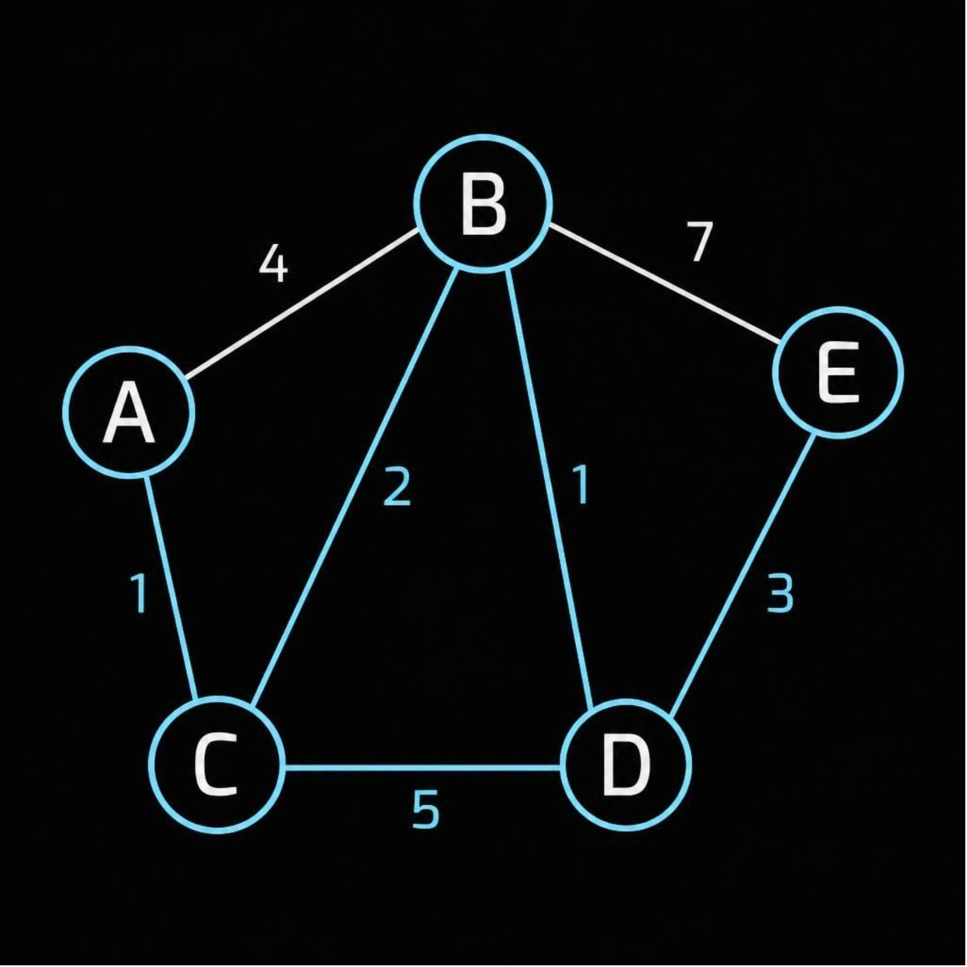
Generated using Gamma Ai
DESIGN AND ANALYSIS OF ALGORITHMS (DAA)
Dijkstra's
Algorithm
Finding the Shortest Path in a Weighted Graph
Rounit Makheja
PRN: 26070521503
Section: 3 D

Slide 2
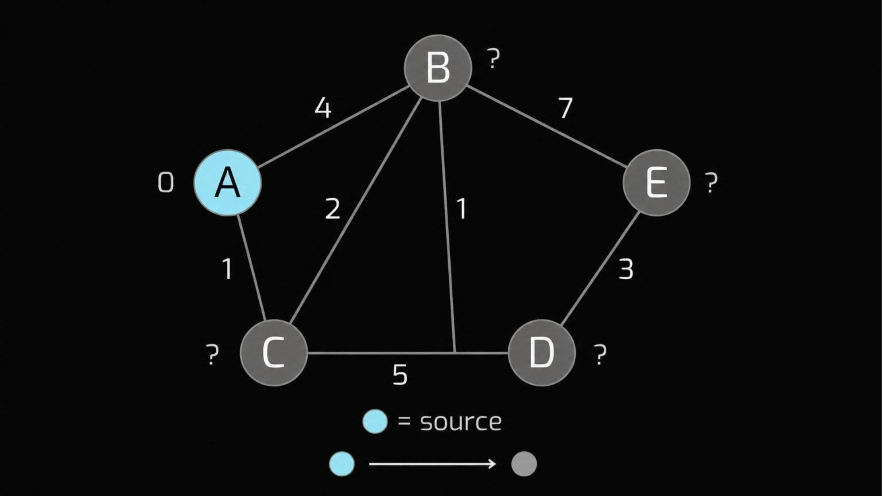
Generated using Gamma Ai
THE PROBLEM
One source, the cheapest route to everywhere
Given a weighted graph and a source vertex, find the minimum-cost path to every reachable vertex.
Example: shortest route between locations, with edge weights as distance or travel time.
Requires non-negative edge weights
02

Slide 3
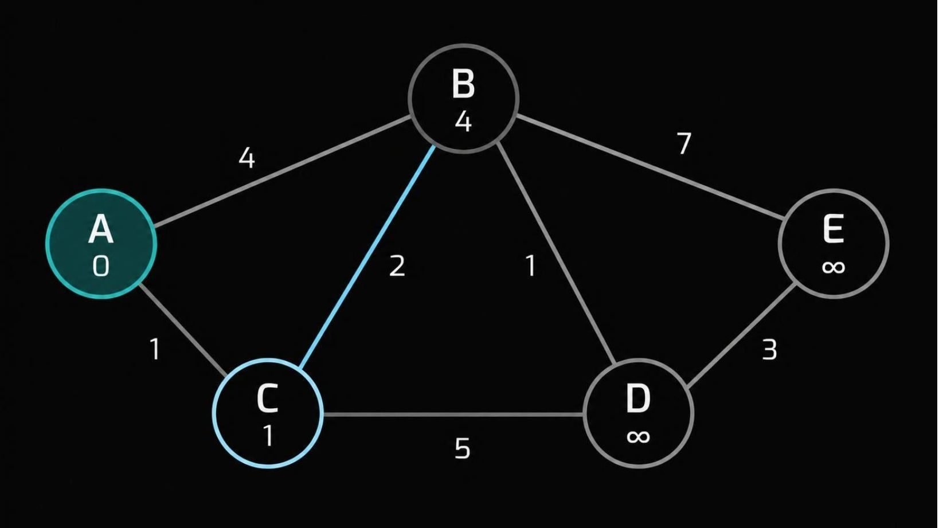
Generated using Gamma Ai
THE GREEDY RULE
Greedy core: always finalize the closest vertex
Set the source distance to 0.
1
Set all other distances to infinity.
2
Select the unvisited vertex with the smallest tentative distance.
3
Relax its outgoing edges.
4
Repeat until the required destinations are finalized.
5
Relaxation: check whether going through the current vertex gives a shorter path.
03
Notes:
With non-negative weights, no route through a farther unvisited vertex can improve the closest tentative vertex. That is why its distance can be finalized.

Slide 4
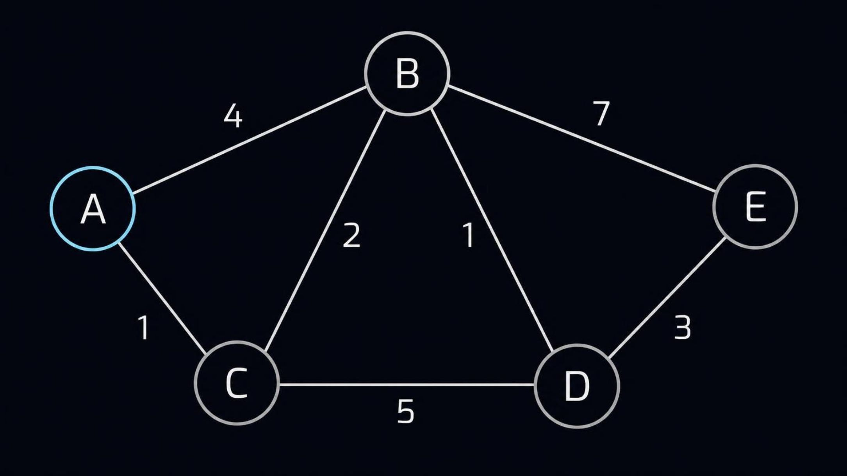
Generated using Gamma Ai
WORKED EXAMPLE · SOURCE A
Our example graph
Undirected weighted graph. Each edge can be traversed in either direction; its label is the travel cost.
04

Slide 5
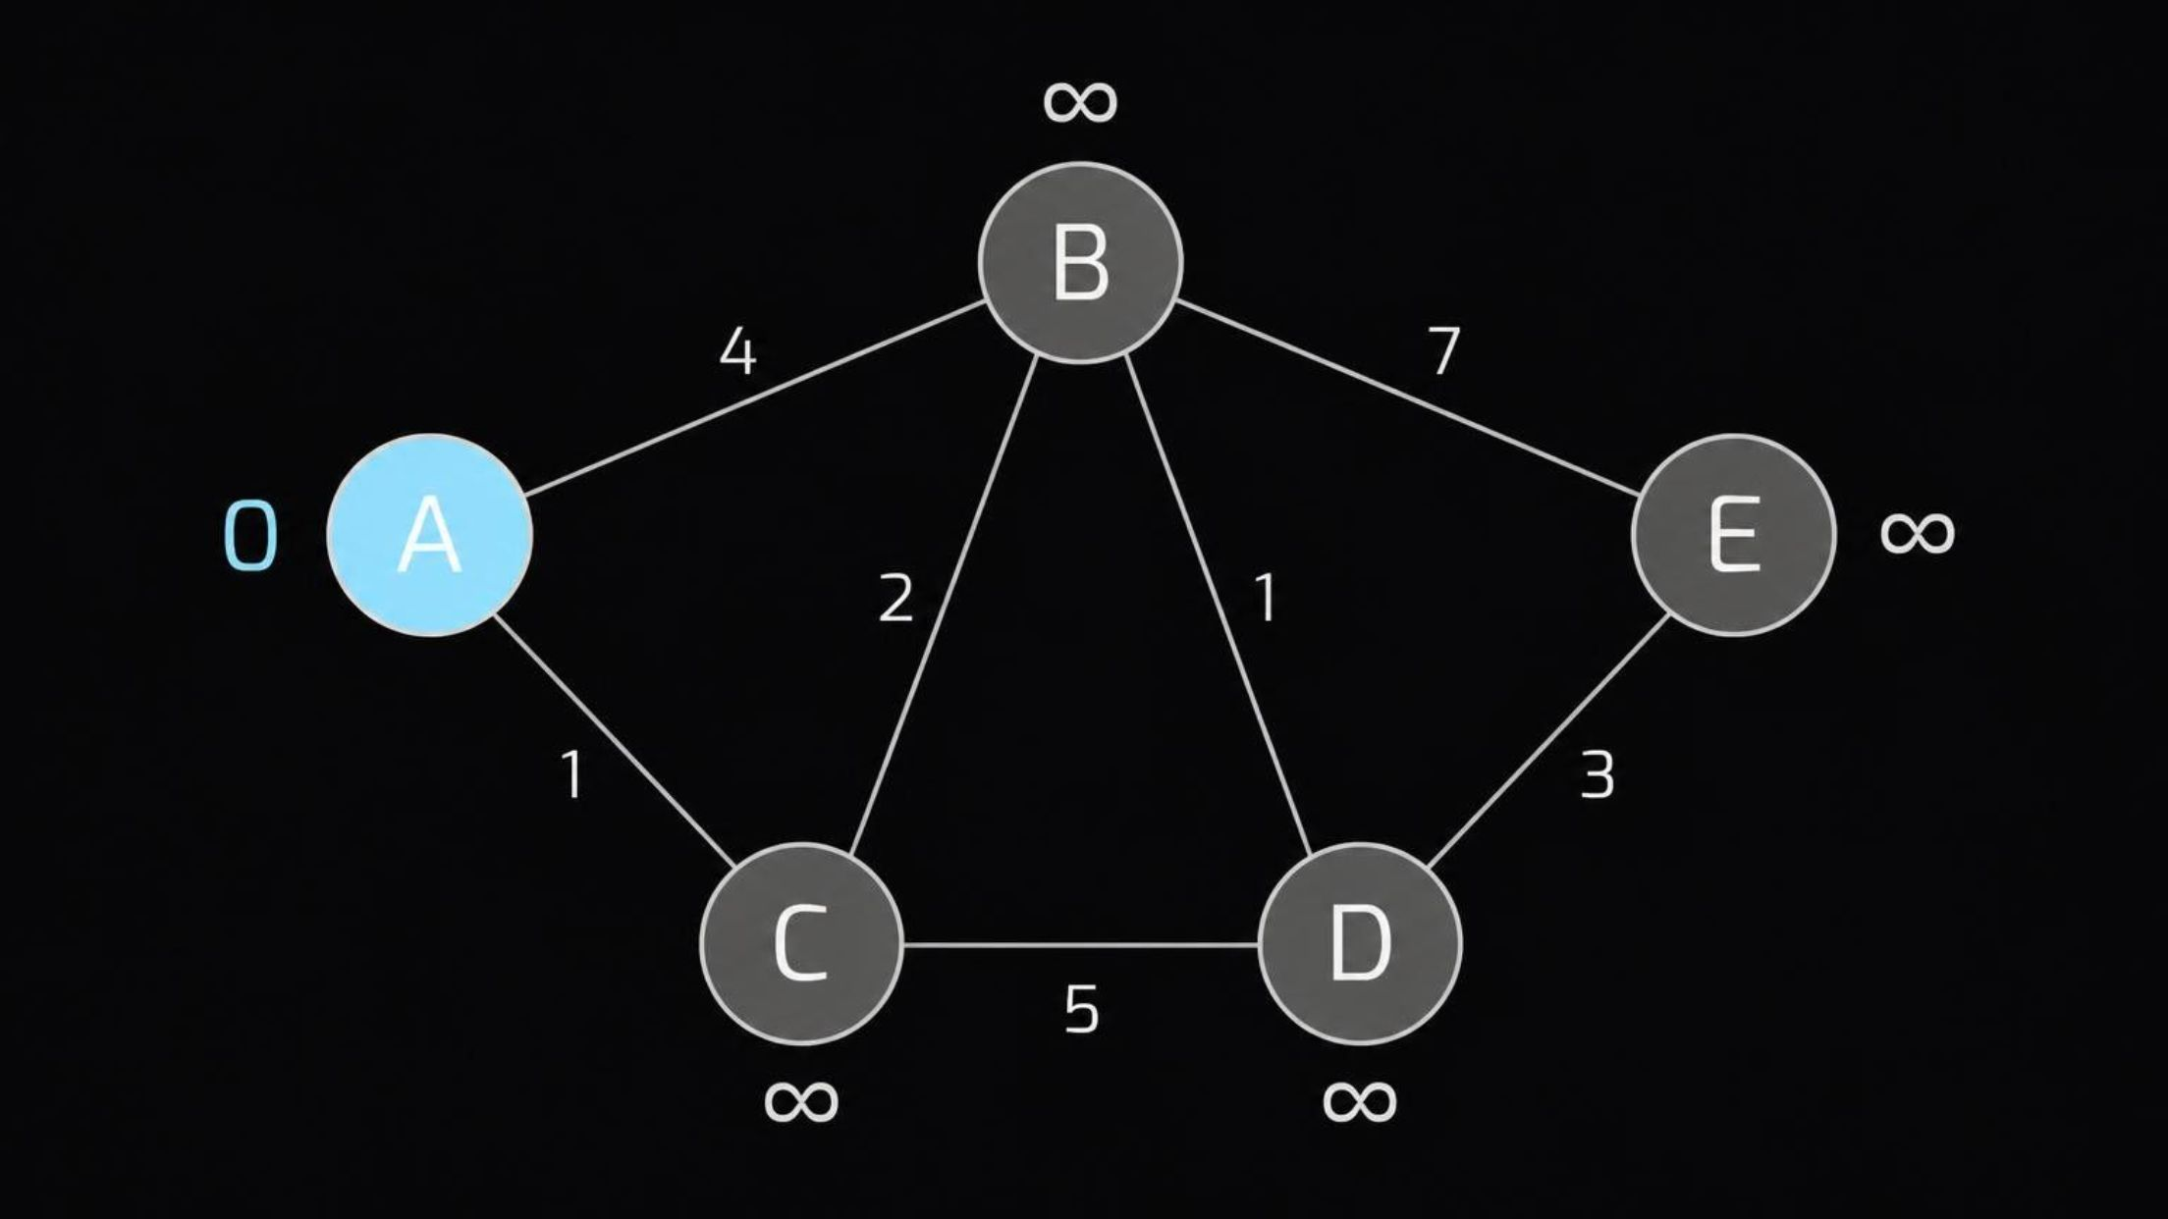
Generated using Gamma Ai
BEFORE THE FIRST RELAXATION
Initialization: only A is known
0
SOURCE DISTANCE
A is the source. All other vertices are unreachable in the current calculation.
∞ means no route has been discovered yet, not that no route exists.
05

Slide 6
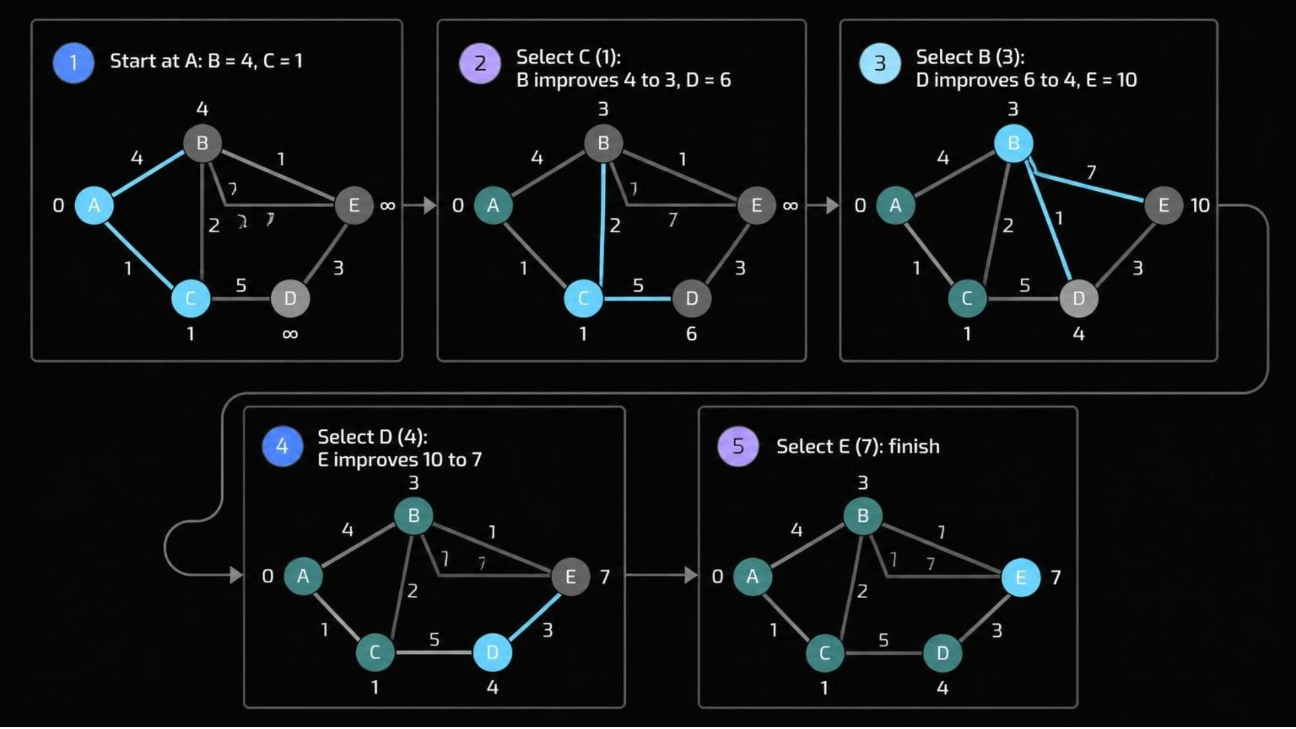
Generated using Gamma Ai
SELECT → RELAX → REPEAT
Step by step: distances improve as we go
Cyan marks the current vertex and relaxing edges. Teal marks finalized vertices.
Cyan marks the current vertex and relaxing edges. Teal marks finalized vertices.
06

Slide 7
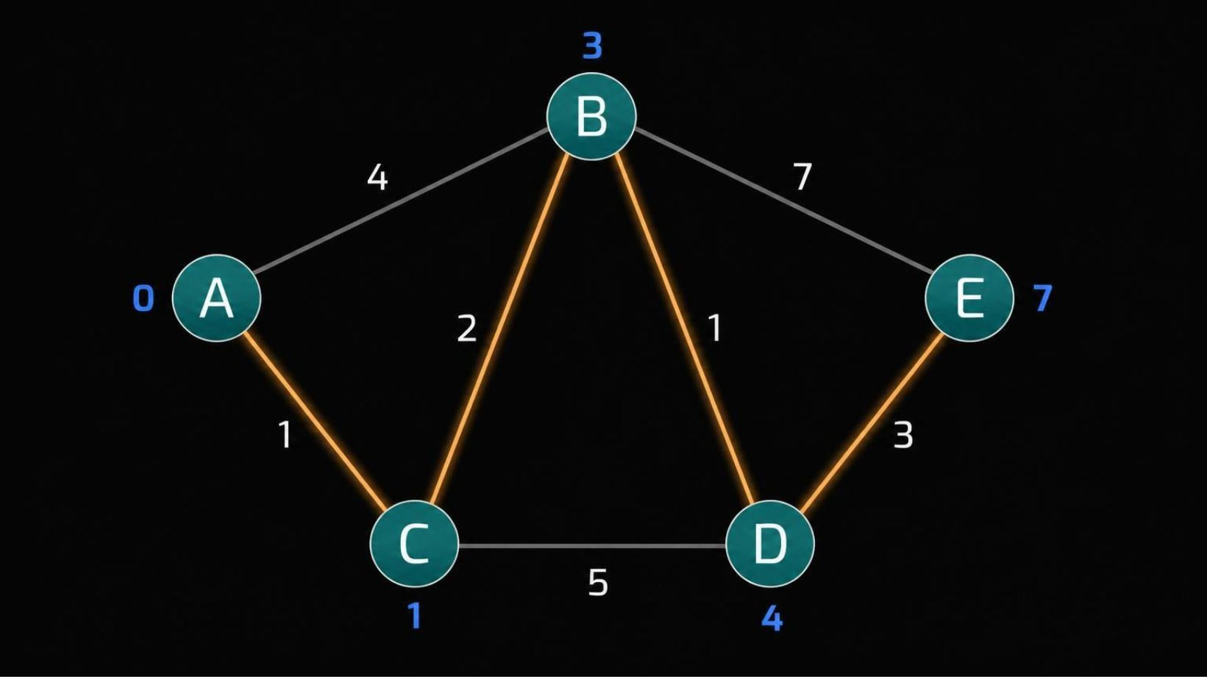
Generated using Gamma Ai
ALL REACHABLE VERTICES FINALIZED
Final results: shortest paths from A
VERTEX | DISTANCE | PATH
A | 0 | A
C | 1 | A → C
B | 3 | A → C → B
D | 4 | A → C → B → D
E | 7 | A → C → B → D → E
Amber traces the final shortest path to E.
07

Slide 8
Generated using Gamma Ai
MIN-PRIORITY QUEUE IMPLEMENTATION
Pseudocode
dist[source] = 0
dist[v] = infinity for every other vertex
Insert source into a min-priority queue
While the queue is not empty:
u = extract vertex with minimum distance
For each neighbor v of u with edge weight w:
If dist[u] + w < dist[v]:
dist[v] = dist[u] + w
parent[v] = u
Update the priority queue
Note: implementations that insert duplicate entries can skip stale queue entries.
08
Notes:
The parent array records the predecessor used by each improving route. Follow parent pointers backward from a destination to reconstruct its shortest path. For duplicate-entry heaps, skip an extracted entry whose stored distance differs from the current distance.

Slide 9


Generated using Gamma Ai
PERFORMANCE AND BOUNDARIES
Complexity and limitations
Adjacency list with binary min-heap
Adjacency matrix with linear minimum selection
As commonly stated for a standard heap implementation.
Space: for adjacency-list storage, plus algorithm state.
V = number of vertices; E = number of edges
Limitation: not suitable for negative edge weights; Bellman–Ford is the alternative.
09

Slide 10
Generated using Gamma Ai
DIJKSTRA'S ALGORITHM · DAA
Greedy choices, relaxed edges, shortest paths
Choose the closest
Improve the estimate
Greedy strategy: finalize the closest unvisited vertex each round.
Edge relaxation drives every distance improvement.
Applications: GPS routing, network routing, transport planning.
Thank You
Topic: Dijkstra's Algorithm | DAA
10

