Slide 1
Probability Distribution
Discrete and Continuous Distributions

Slide 2
Probability Distribution
Introduction to Distribution
Classification
Discrete Distributions
Continuous Distributions
Binomial Distribution
Bernoulli Distribution
Poisson Distribution
Normal Distribution
Standard Distribution

Slide 3
What is a Probability Distribution ?
Definition:
A distribution is a function which shows the possible values for a
random variable and how often they occur.
In statistics, when we use the term distribution, we usually mean
Probability Distribution.
Distribution ~ Probability Distribution

Slide 4
What is a Probability Distribution ?
Example:
Lets say, you have a single fair die (with 6 sides of course) numbered from
1 to 6. We roll the die:
probability of getting 1 = 1/6 ~ 0.17
probability of getting 2 = 1/6 ~ 0.17
probability of getting 3 = 1/6 ~ 0.17
probability of getting 4 = 1/6 ~ 0.17
probability of getting 5 = 1/6 ~ 0.17
probability of getting 6 = 1/6 ~ 0.17
We have an equal chance of getting all of the 6 outcomes.
Probability of getting any other result = 0
Lets tabulate this.

Slide 5
What is a Probability Distribution ?
Example:
Lets say, you have a single fair die (with 6 sides of course) numbered from
1 to 6. We roll the die:
Outcome | Probability
1 | 1/6
2 | 1/6
3 | 1/6
4 | 1/6
5 | 1/6
6 | 1/6
7 or other | 0

Slide 6
What is a Probability Distribution ?
Lets Generalize this:
The distribution of an event not only consist of the outcomes that can be
observed (outcome from 1 to 6), but it is made up of all the possible
Outcomes (i.e. outcome for 7 and others as well).
Thus,
Probability Distribution of Rolling a die:
Outcome | Probability
1 | 1/6
2 | 1/6
3 | 1/6
4 | 1/6
5 | 1/6
6 | 1/6
All else | 0

Slide 7
What is a Probability Distribution ?
Sum of Probabilities in a Distribution:
We are sure that we have exhausted all possible outcomes, when the sum
of probabilities of all the outcomes in a distribution equals to 1 (or 100%).
i.e.
The sum of probabilities in a distribution is always equal to 1
Lets add the probabilities in the below distribution
Outcome | Probability
1 | 1/6
2 | 1/6
3 | 1/6
4 | 1/6
5 | 1/6
6 | 1/6
All else | 0
1/6 +1/6 +1/6 +1/6 +1/6 +1/6+0 = 1
The total is 1,
Hence the given table is the probability
Distribution of a rolling die.

Slide 8
What is a Probability Distribution ?
Representation of Probability Distribution:
Each probability distribution has a visual representation.
It is a graph describing the likelihood of occurrence of every event.
Outcome | Probability
1 | 1/6
2 | 1/6
3 | 1/6
4 | 1/6
5 | 1/6
6 | 1/6
All else | 0

Slide 9
What is a Probability Distribution ?
Representation of Probability Distribution:
It is crucial to understand that the distribution is defined by the underlying probabilities and not the graph.
The graph is just a visual representation of distribution.
Outcome | Probability
1 | 1/6
2 | 1/6
3 | 1/6
4 | 1/6
5 | 1/6
6 | 1/6
All else | 0

Slide 10
Classification

Slide 11
Classification
Broadly we can categorize distribution as:
Discrete Distribution
Discrete Uniform Distribution (e.g. Bernoulli)
Discrete Non-Uniform Distribution (e.g. Binomial)
Continuous Distribution
Continuous Uniform Distribution
Continuous Non-Uniform Distribution (Normal, Standard etc.)

Slide 12
Discrete – Uniform Distribution
Consider the distribution of rolling a single fair die:
It is indeed a ‘Discrete Distribution’
Also, all the outcomes have equal chance of occurring. Which makes It a ‘Uniform Distribution’
Hence the probability distribution of rolling a single fair die is a
‘Discrete Uniform Distribution’
Outcome | Probability
1 | 1/6
2 | 1/6
3 | 1/6
4 | 1/6
5 | 1/6
6 | 1/6
All else | 0

Slide 13
Discrete Non-Uniform Distribution
Consider the distribution of rolling a two fair dice:
Lets calculate the probability of each outcome.
Probability = Sum of outcomes / Total Possibilities
Outcome | Probability
2 | 1/36 ~ 0.03
3 | 2/36 ~ 0.06
4 | 3/36 ~ 0.08
5 | 4/36 ~ 0.11
6 | 5/36 ~ 0.14
7 | 6/36 ~ 0.17
8 | 5/36 ~ 0.14
9 | 4/36 ~ 0.11
10 | 3/36 ~ 0.08
11 | 3/36 ~ 0.06
12 | 1/36 ~ 0.03
All else | 0

Slide 14
Discrete Non-Uniform Distribution
Looks like the probability of most of the outcomes are different.
This is a ‘Discrete Non-Uniform Distribution’
Outcome | Probability
2 | 1/36 ~ 0.03
3 | 2/36 ~ 0.06
4 | 3/36 ~ 0.08
5 | 4/36 ~ 0.11
6 | 5/36 ~ 0.14
7 | 6/36 ~ 0.17
8 | 5/36 ~ 0.14
9 | 4/36 ~ 0.11
10 | 3/36 ~ 0.08
11 | 3/36 ~ 0.06
12 | 1/36 ~ 0.03
All else | 0

Slide 15
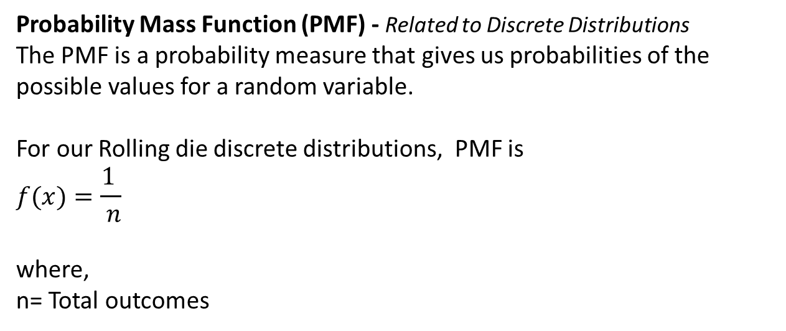
Discrete Distribution
Probability Mass Function (PMF) - Related to Discrete Distributions
The PMF is a probability measure that gives us probabilities of the possible values for a random variable.
For our Rolling die discrete distributions, PMF is
$$f(x)=\frac{1 }{ n}$$
where,
n= Total outcomes

Slide 16
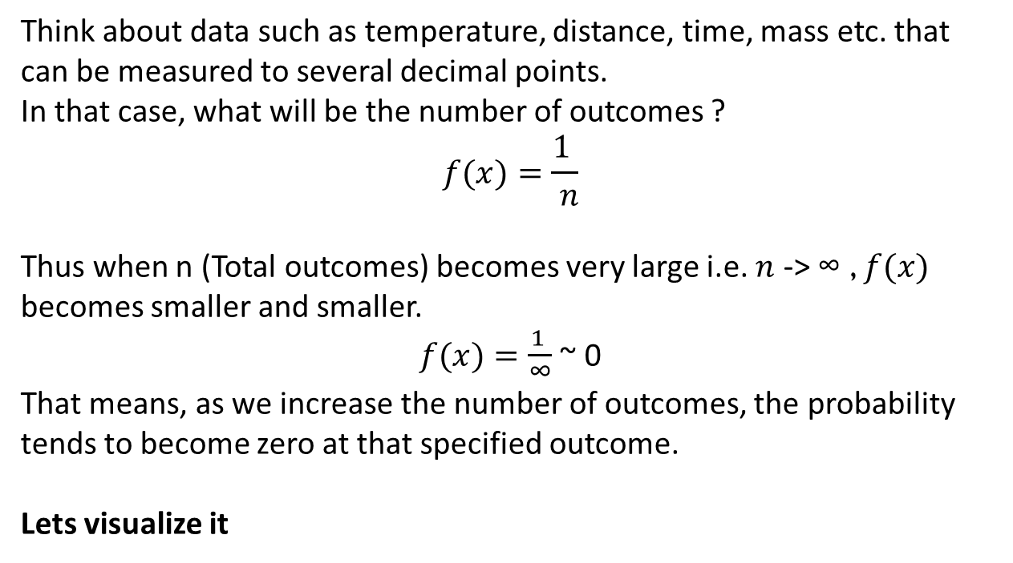
Continuous Distribution
Think about data such as temperature, distance, time, mass etc. that can be measured to several decimal points.
In that case, what will be the number of outcomes ?
$$f(x)=\frac{1 }{ n}$$
Thus when n (Total outcomes) becomes very large i.e. $n$ -> ∞ , $f(x)$ becomes smaller and smaller.
$f(x)=\frac{1 }{\text{∞}}$ ~ 0
That means, as we increase the number of outcomes, the probability tends to become zero at that specified outcome.
Lets visualize it

Slide 17
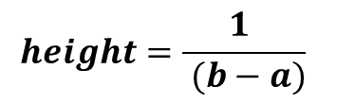

Continuous Distribution
Think of infinite number of bars placed side by side where area of each bar -> 0
Area = width x height
Total Area is always = 1
Hence,
1 = (b-a) x height
$$height=\frac{1 }{ (b−a)}$$
$$f(x)=\frac{1 }{ (b−a)}$$
a
b

Slide 18

Continuous Distribution
Probability Density Function (PDF) – Related to Continuous Distribution
A probability density function (PDF), or density of a continuous random variable, is a function that describes the relative likelihood for a random variable to take on a given value.
where,
[a , b] = Interval in which x lies.
P(a ≤ X ≤ b) = probability that some value x lies within this interval.
dx = b-a
In Continuous Distribution we calculate the probability distribution over a range and not a specific outcome.

Slide 19
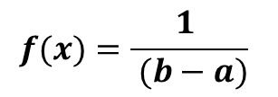

Continuous Distribution
Probability Density Function (PDF) for our example is:
$$f(x)=\frac{1 }{ (b−a)}$$
$$f(x)=\frac{1 }{ (b−a)}$$
a
b
Also, this is a ‘Continuous Uniform Distribution’
We will see the Continuous Non Uniform Distributions in details.

Slide 20
Binomial Distribution
Discrete Non-Uniform

Slide 21
Binomial Distribution
The probability distribution of a binomial random variable is called a binomial distribution.
“A binomial random variable is:
a type of discrete random variable used to count the number of occurrences of an event in a random sample in a binomial experiment.
can only be used to count whether a certain event occurs or does not occur, and cannot be used to measure partial states”
In simple terms:
A binomial distribution is a type of distribution that has only two possible outcomes (the prefix ‘bi’ means ‘two’)
e.g. A coin toss has only two possible outcomes, Heads or Tails

Slide 22
Binomial Distribution
Following are the characteristics of a binomial experiment:
The experiment contains ‘n’ repeated trials.
Each trial is independent; the outcome of one does not affect the outcome of the other trials.
Each trial can result in just two possible outcomes. We call on of those outcomes as ‘Success’ and other ‘Failure’.
The probability of ‘Success’, denoted by ‘p’ is the same on every trial.

Slide 23
Binomial Distribution
Example: Consider the following statistical experiment.
You flip a fair coin 2 times and count the number of times the coin lands on head.
This is a binomial experiment because:
The experiment consist of repeated trials - Flipping coin 2 times
Each trial results in just 2 possible outcomes – Heads or Tails
The probability of Success is constant – 0.5 on every trial
The trial are independent – Getting Heads on one trial does not affect if we get Heads on the second trial or not.
The distribution of this experiment is a Binomial distribution.

Slide 24


Binomial Distribution
Probability Mass Function (PMF) :
Where,
k = Number of success that result from the experiment
n = Total number of trials in the experiment
p = Probability of success of individual trial
(1-p) = q = Probability of failure of an individual trial

Slide 25
Binomial Distribution
Properties of Binomial Distribution:
The mean of distribution (μ_{x}) = n * p
The variance (σ²_{x}) = μ_{x} * ( 1 – p)
The Standard Deviation (σ_{x}) = sqrt[σ²_{x} ]

Slide 26
Binomial Distribution
Example: Suppose a die is tossed 5 times. What is the probability of getting exactly two Fours ?
Solution:
n = 5, k = 2, p = 1/6
Binomial Probability = 5 Choose 2 * (1/6) ⁵ * (1-1/6) ⁵⁻² = 0.161

Slide 27
Binomial Distribution
Cumulative Probability
A cumulative probability refers to the probability that the binomial variable falls within a specified range.
(e.g. is greater than or equal to a stated or lower limit
And less than or equal to a stated upper limit)
Example: Find the probability of getting 45 or fewer Heads in 100 toss of a coin.
Solution:
This would be the sum of individual probabilities.
n = 100, k = 45, p=0.5
P(X <= 45) = P(X=0) + P(X=1) + P(X=2) + ……………. + P(X=45)
We calculate the 46 individual probabilities from 0 to 45 using binomial formula and sum of those will give us the cumulative binomial probability.
P(X <= 45) = 0.184

Slide 28
Bernoulli Distribution

Slide 29
Bernoulli Distribution
A Bernoulli Distribution is a case of binomial distribution where
Experiment has only two possible outcomes viz. Success, Failure
Number of trial is ‘1’
(Or we can say Binomial Distribution is a case of n independent Bernoulli trials)
A random variable ‘X’ which has a Bernoulli distribution can take:
value ‘1’ with the possibility of Success, say ‘p’,
value ‘0’ with the possibility of Failure, say ‘1 – p’ or ‘q’
Thus the Probability Mass Function (PMF):
P(X) = p ^{x} * (1 – p) ^{1-x}
P(X) = p ^{x} * q^{1-x}
where, x is (1,0)
**Note ‘x’ is sometimes also denoted as ‘k’

Slide 30
Bernoulli Distribution
Properties of Bernoulli Distribution:
The mean of distribution (μ) = p
The variance (σ²) = μ * ( 1 – p)
The Standard Deviation (σ) = sqrt[σ² ]
Example: Lets say, We toss a single coin. The occurrence of Heads denoted Success and the Tails denoted Failure.
Hence: P(Heads) = 0.5, P(Tails) = 0.5

Slide 31
Bernoulli Distribution
However, the probability of success and Failure need not be equally likely. Lets say, a skydiver jumps out of airplane without parachute
Hence, In this case, the probability of him/her landing safe and alive is, may be 5% (0.05) while the failure can be 0.95.

Slide 32
Poisson Distribution
Discrete – Uniform for given time interval

Slide 33
Poisson Distribution
The Poisson distribution is the discrete probability distribution of the number of events occurring in a given time period, given the average number of times the event occurs over that time period.
Following are the characteristics of a Poisson experiment:
Outcome of an event/trial can be either Success or Failure. i.e. only two outcomes.
The average number of Success (μ or λ) in a specified range is known.
The trial are independent of each other. i.e. Outcome of one trial does not affect the outcome of subsequent ones.
The Probability that an event occur in a given length of time does not change through the time.
i.e. The expected number of occurrences in an interval is constant
i.e. say, if there are 5 cars crossing a signal during an hours of a day, then the probability of 5 cars crossing the signal during the rest of the hours for the day shall be more or less the same.

Slide 34
Poisson Distribution
Some examples of Poisson distribution:
Batting average of a player (considering time interval of one year)
Number of births in India per hour
Number of Roads constructed per day in India

Slide 35

Poisson Distribution
If those four conditions/properties hold true, then the number of events in a fixed unit of time (or continuum) has a Poisson distribution.
The Poisson situation is most often invoked for rare events.
The Probability Mass Function:
Where,
k = takes value 0,1,2,3,….., ∞ (sometimes also denoted as ‘x’)
λ = Average number of events per interval
e = is the number 2.71828

Slide 36
Poisson Distribution
Properties of Poisson Distribution:
The mean of distribution (λ) = μ
The variance (σ²) = λ
The Standard Deviation (σ) = sqrt[σ² ]
Poisson Distribution has some hint of right skewness , but it depends on the value of λ:
When λ is larger -> Distribution will be close to symmetric
When λ is small (close to zero) -> Distribution will be right skewed
Note:
Binomial Distribution tends toward the Poisson distribution as
n -> ∞, p -> 0 and n*p = constant
i.e. The Poisson distribution with λ=n*p closely approximate to binomial distribution if ‘n’ is large and ‘p’ is small.

Slide 37
Poisson Distribution
Example:
The mean number of people arriving per hour at a shopping center is 18.
Find the probability that the number of customers arriving in an hour is 20.
Solution:
r = 20
= 18
e = 2.7183
Find P(20)

Slide 38
Normal Distribution

Slide 39
Normal Distribution
“ The normal distribution is a probability function that describes how the values of a variable are distributed.“
The normal distribution is the most important probability distribution in statistics because it fits many natural phenomena.
For example, heights, blood pressure, measurement error, and IQ scores follow the normal distribution.
It is also known as the Gaussian distribution or the bell curve.

Slide 40
Normal Distribution
Often times, data is described as being ‘normal’ (In statistical sense);
But what does that mean ?
Say, we consider some natural or man-made events
Natural: Human Height, Weight, Temperature, blood-pressure etc.
Man-Made: Financial data, sales etc.
For these measures, and many more, the average (mean) tends to be very frequent or closely spaced while measures away from mean are less frequent.
i.e. The data in most of the phenomenon tends to clump around the mean

Slide 41
Normal Distribution
Properties of Normal Distribution Curve:
Lower tail and Upper tail
Probability Area: We are interested in everything underneath the curve.
Symmetric: Left area is equal to right when we talk about perfect theoretical normal distribution.
Mean = Median = Mode and lie in exact center of the graph.
Top point represents the mode

Slide 42
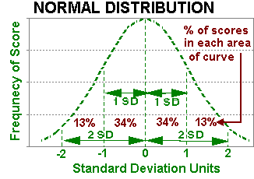
Normal Distribution

Slide 43

Normal Distribution
Parameters of Normal Distribution:
The normal distribution the two parameters viz. mean and standard deviation which gives the curve its shape and is denoted as follows:
where,
μ = Mean
σ = Standard Deviation
Significance of Parameters:
Mean give the curve its position on the axis
Standard Deviation gives the curve its shape.

Slide 44

Normal Distribution
Probability Density Function (PDF) :
where,
μ = Mean
σ² = Variance

Slide 45
Standard Distribution

Slide 46
Standard Distribution
Standard Distribution or Standard Normal Distribution or Z Distribution is a Normal Distribution with
Mean of distribution = 0
Standard Deviation = 1
Standard Distribution is the process of transforming, also called as Standardization, with the mean of zero and standard deviation of one.
Formula for Standardization:
z = (X_{i} - μ) / σ
where,
X_{i} = each element of sample/population

Slide 47
Standard Distribution
Standard Distribution is the process of transforming, also called as Standardization, with the mean of zero and standard deviation of one.
Formula for Standardization:
z = (X_{i} - μ) / σ
where,
X_{i} = each element of sample/population
Formula for Z score:
z = (X - μ) / σ (Population)
z = (X - x̅ ) / s (Sample)

Slide 48
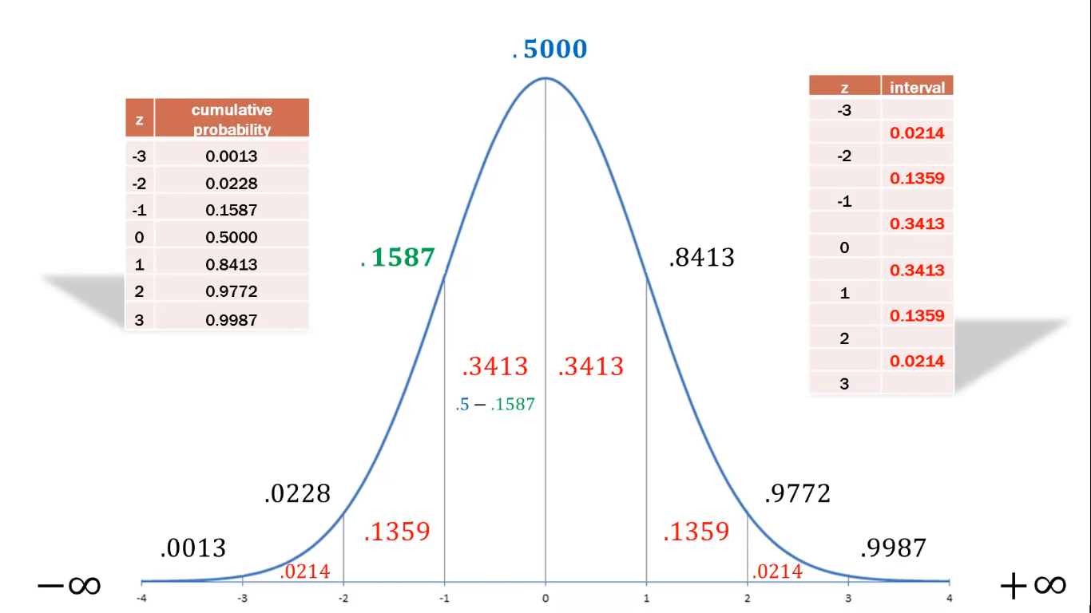
Standard Distribution

Slide 49
That’s all Folks

