Slide 1
Estimators & Estimates
Point and Confidence Estimates

Slide 2
Hypothesis Testing
Introduction to Estimates

Slide 3
Introduction

Slide 4
Introduction
A specific value is called an Estimate.
There are 2 types of Estimates
Point Estimates
Confidence Interval Estimates
Point Estimates is a single number
Confidence Interval Estimate is an interval
The Point Estimate and Confidence Intervals are very closely related.
Point Estimate is located exactly in the middle of ‘Confidence Interval’
However confidence intervals provide much more information and are preferred in making inferences.

Slide 5
Introduction
Examples:
A sample mean (x̅ ) is the point estimate of population mean (μ).
A sample variance (s²) is the point estimate of population variance (σ²)
Estimator (how to estimate) | Parameter (What to Estimate) | Estimate (Concrete Result)
x̅ (Formula) | μ | 52.55
S² (Formula) | σ² | 1724.93
Estimates have the following 2 properties
Bias
Efficiency (Efficiency denotes variance. So far, no problematic estimators in Statistics)

Slide 6
Confidence Interval
A confidence interval is a more accurate representation of reality.
Confidence Intervals have some level of uncertainty, these are measured in ‘Levels of Confidence’
Confidence Level = 1 – α
Where,
0 <= α <=1
α is called ‘Level of Significance’
Formula :
Confidence Interval
[ PointEstimate ± (Reliability Factor * Standard Error) ]
(Reliability Factor * Standard Error) also called ‘Margin of Error’

Slide 7
Confidence Interval
A confidence interval can be calculated for, when:
Population Variance is known (Z statistics)
Population Variance is Unknown (t statistics)

Slide 8
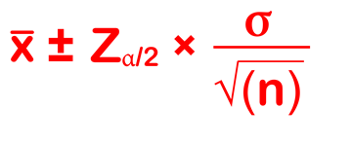
Confidence Interval : Z statistics
Assumptions:
Population is normally distributed. Even it is not, you should use large sample and normalize it using CLT.
Confident Interval Formula:
Where,
x̅ = sample mean
Z_{α/2} = static for standard normal distribution (Z ~ N(0,1))
σ/root(n) = Standard Error
α = significance level
i.e. for confidence level 95%, α = 5% or 0.05

Slide 9
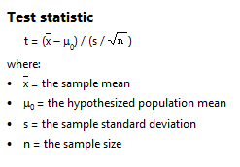
Confidence Interval : t statistics
It is used to get inference through small samples when population variance is unknown.
Named after an English statistician William Gosset.
Later Ronal Fischer introduced t-statistics.

Slide 10

Confidence Interval : t statistics
Degrees of Freedom: For a sample size ‘n’, degree of freedom is (n-1)
Formula:
Confidence Interval:
Where,
x̅ = sample mean
t_{(n-1),} _{α /2} = static for standard normal distribution (Z ~ N(0,1))
s/root(n) = Standard Error
α = significance level
i.e. for confidence level 95%, α = 5% or 0.05

Slide 11
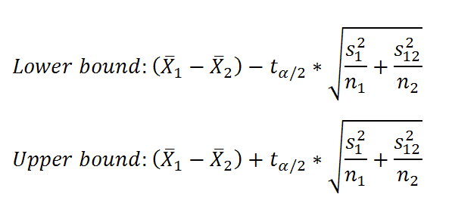
Confidence Interval : 2 Samples
t statistics:
Z statistics: Same as above, only difference is we use ‘z’ statistics here.

