Slide 1
Hypothesis Testing
Basics and Tests

Slide 2
Hypothesis Testing
Introduction to Hypothesis
Type I and Type II Errors
Test of Hypothesis

Slide 3
What is Hypothesis ?

Slide 4

What is Hypothesis ?
Example 1:
Pepsico India sells a soft drink in a can container having 250ml of the drink.
Since this information is on the label, we assume it to be true.
But is it really true ?

Slide 5
What is Hypothesis ?
Example 1:
Pepsico India sells a soft drink in a can container having 250ml of the drink.
As a customer:
We want the volume to be at least 250ml.
Quantity of Drink >= 250ml
As a manufacturer:
We want the volume of the drink to be exactly 250ml. No more, no less
Quantity of Drink = 250ml

Slide 6
What is Hypothesis ?
So we collected 100 Pepsi cans from all over India (to randomize the sample)
Then we measured the quantity of soft drink in each can in the sample and find the mean quantity for all 100 cans.
Using those sample means or measurements , we can TEST THE ASSUMPTION
(i.e. the STATUS QUO)

Slide 7

What is Hypothesis ?
Example 2:
An auto manufacturer had designed a new engine which claims to reduce the fuel consumption. It claims that the new engine makes more efficient use of fuel and performs better than the old engine which used to run at 30 miles per gallon.
Company now need to run some tests to look for statistical evidence to support the claim that the new engine offers better fuel efficiency.

Slide 8
What is Hypothesis ?
Company Claim:
Fuel Efficiency > 30
But it cold be well above or below 30 mpg.
The manufacturer is making a claim it wishes to test.
It is not testing an assumption
(i.e. Status Quo)
Notice
Assumption Vs. Claim

Slide 9
What is Hypothesis ?
When trying to formulate a statistical hypothesis, think about the following:
Are we testing an assumption (status quo) that already exists ? (Pepsi Can)
Or
Are we testing a claim (assertion) which may be true, if not then truth is something else ? (New Engine)
Say, if the manufacturer now tested the engine and fix it in a car and rolled it out in the market saying the car performs 35 mpg; and now we want to test it, we will be testing an assumption here and not a claim.

Slide 10
What is Hypothesis ?
Null Hypothesis:
The null hypothesis is the initial position. It is the status-quo position. It is the position that is rejected or fails to be rejected. It is the position that needs to be validated. It is the position that needs to be tested.
e.g.: Pepsi Can contains 250 ml of soft drink
Alternate Hypothesis:
The alternate hypothesis is the contrary position to NULL hypothesis. If there are statistically significant evidences that suggest that the alternate hypothesis is valid, then the NULL hypothesis is rejected.
e.g.: Pepsi Can does not contain 250 ml of soft drink (otherwise of NULL)

Slide 11
What is Hypothesis ?
By Definition, null and alternate hypothesis are opposite; mutually exclusive. They both cannot be true.
The null is either rejected or not. Only if the null is rejected can we move with the alternate hypothesis.
Null and alternate hypothesis depends on the question we are trying to ask. A person can start with either the null hypothesis or the alternate hypothesis, and then form the other as a complement to the first.

Slide 12
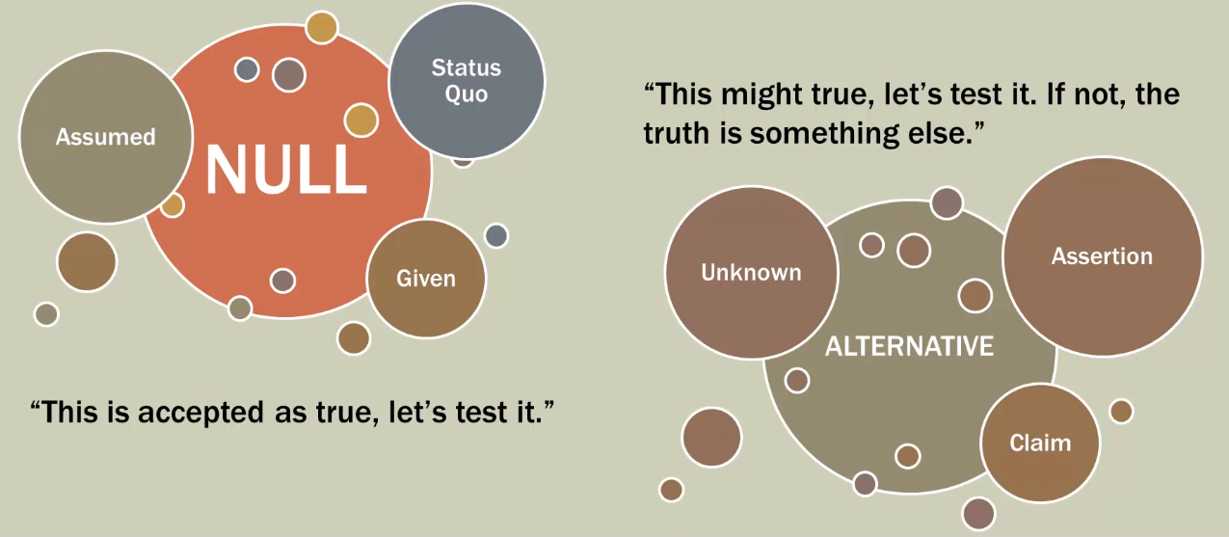
What is Hypothesis ?

Slide 13
What is Hypothesis ?
Hypothesis testing can be used to determine whether a statement about the value of a population parameter should or should not be rejected.
Null hypothesis: denoted by H₀ , is a tentative assumption about a population parameter.
Alternate hypothesis: denoted by H_{a} , is the opposite of what is stated in the null hypothesis.
e.g. Let’s say a court room trial:
H₀ : The accused is innocent
H_{a} : The accused is guilty

Slide 14
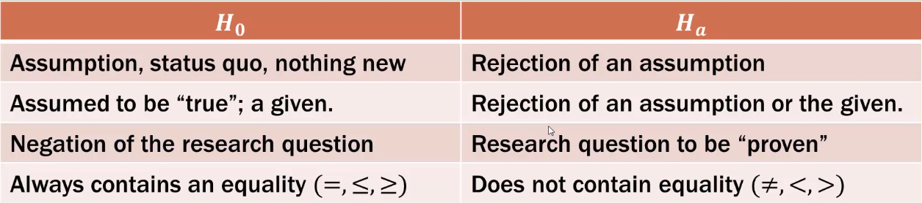
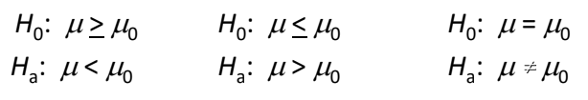
What is Hypothesis ?
Based on the last property, we can derive the possible null/alternative pairs:

Slide 15

What is Hypothesis ?
Example:
The NY city provides one of the most comprehensive emergency medical services in the world. Operating in a multiple hospital system with approximately 200 mobile medical units, the service goal is to respond to medical emergencies with a mean time of 12 minutes or less.
The director of medical services wants to formulate a hypothesis test that could use a sample of emergency response times to determine whether or not the service goal of 12 minutes or less is being achieved.

Slide 16
What is Hypothesis ?
Hypothesis | Conclusion & Action
H₀ : μ <= 12 | The response time goal is met by Emergency Service team. No action required
H_{a} : μ > 12 | The response time goal is not met by Emergency Service team. Appropriate follow up actions are required.
where,
μ = mean response time for the population of medical emergency response unit.

Slide 17
What is Hypothesis ?
Few Important Guidelines:
All statistical conclusions are made in reference to the null hypothesis.
We either reject the null hypothesis or fail to reject the null hypothesis; we do not accept the null hypothesis.
If we reject the null hypothesis, then we conclude the data supports the alternative hypothesis.
However, if we fail to reject the null hypothesis, it does not mean we have proven the null hypothesis is “true”

Slide 18

What is Hypothesis ?
Example 1:
Is there anything we can assume to be true ?
Yes. 250 ml in container can be assumed to be true
Which hypothesis pair to be selected ?
H₀ = 250ml
H_{a} ≠ 250 ml
If the cans are filled properly, then we fail to reject the null hypothesis.
We are not saying that we have proven the null.
Just our assumption has held up.

Slide 19

What is Hypothesis ?
Example 1:
According to the United States Department of Agriculture, in 2009 the average farm size in Texas was 2.3 sq. km. Due to large agriculture business in the past decade, the department wants to know if the current (2019) farm size is larger than it was in 2009.
Establish a null and alternative hypothesis.
Solution:
What is our assumption ?
We assume that there has been no change in the farm size since 2009.
This is our null hypothesis.
H₀ ≤ 2.3 sq. km
H_{a} > 2.3 sq. km

Slide 20
Type I and Type II Errors

Slide 21
Type I and Type II Errors
Since hypothesis tests are based on sample data, we must allow for the possibility of errors.
Type I error: False Positive
This error occurs when we reject the assumption (null hypothesis) when it should not have been rejected.
Type II error: False Negative
When we fail to reject the assumption (null hypothesis) when it should have been rejected.

Slide 22
Type I and Type II Errors
Example: NY Medical Emergency Unit
Our Hypothesis was:
H₀ : μ <= 12
Our Alternate Hypothesis was:
H_{a} : μ > 12
 | Population Condition
Conclusion | H₀ True (μ <= 12) | H₀ False (H_{a} True) (μ > 12)
Accept H₀ | True Positive | False Negative Type II Error
Reject H₀ | False Positive Type I Error | True Negative

Slide 23
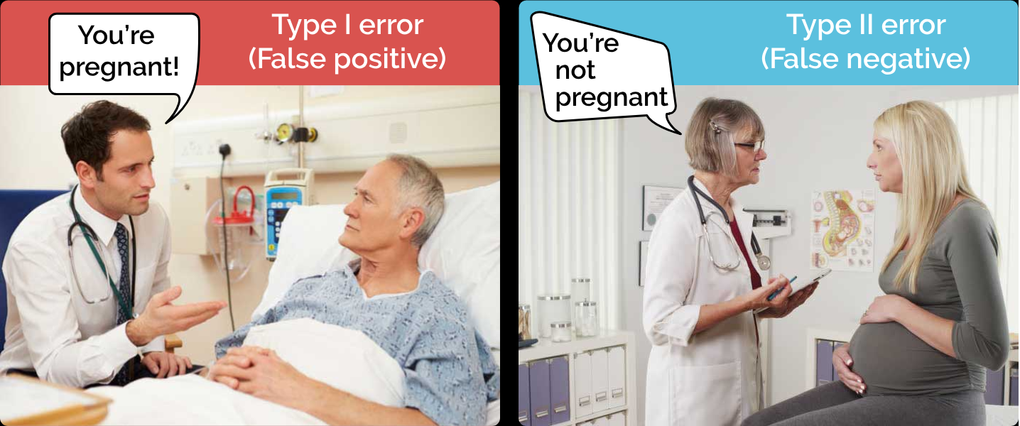
Type I and Type II Errors
Example:

Slide 24
Visualizing Type I and Type II Errors

Slide 25
Visualizing Type I and Type II Errors
Case:
Let’s say we have population mean μ for a population under analysis.
The hypothesized mean for the population under analysis is μ₀.
Test if the hypothesized mean comes from the same population under analysis.
H₀: μ = μ₀ H_{a}: μ ≠ μ₀

Slide 26
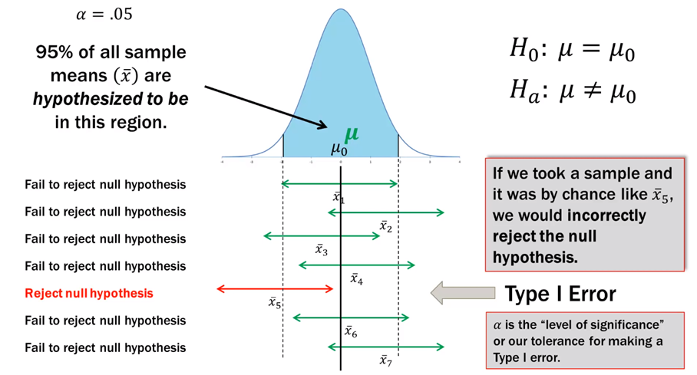
Visualizing Type I and Type II Errors

Slide 27
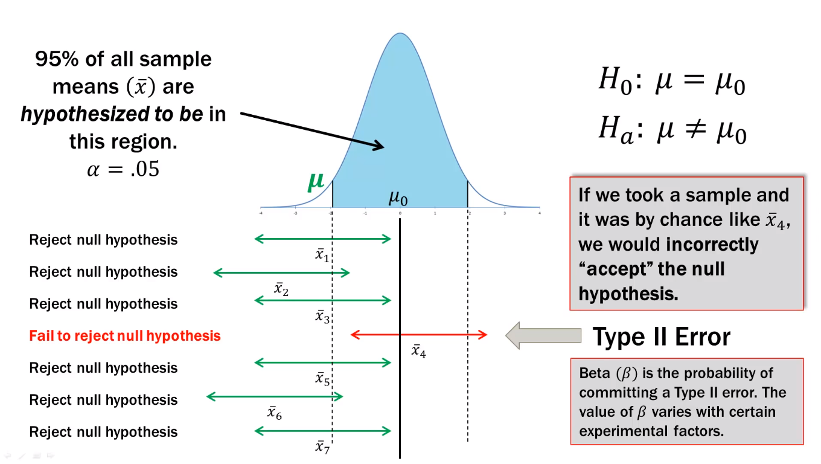
Visualizing Type I and Type II Errors

Slide 28
Two Tailed Test Rejection

Slide 29
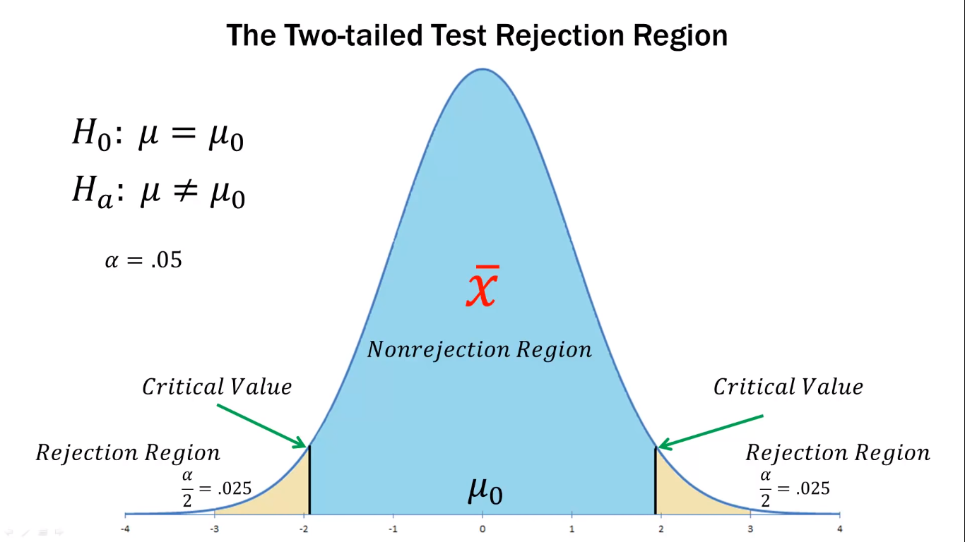
Two Tailed Test Rejection

Slide 30
Test of Hypothesis

Slide 31
Test of Hypothesis
Test of Hypothesis
Large Sample Tests
Testing Population Mean
(One Sample)
Testing Population Mean
(Two Sample)
Small Sample Test
F - test
t-test
One Sample
Two Sample
Paired t-test
Chi-square test

Slide 32
Test of Hypothesis
Large Sample Test
Tests are based on large sample on which hypothesis is test
(sample size n at least >30)
Exact Sampling Distributions are not available.
Test are based on C.L.T distribution.
Small Sample Test
Tests are based on small sample on which hypothesis is test
Exact Sampling Distributions are available.
The exact sampling distribution is the sampling distribution of a statistic (estimator, e.g. sample mean x bar) over all the possible sample drawn from a population (finite or infinite).

Slide 33
Large Sample Test

Slide 34

Testing Population Mean (μ) : One Sample
When to use ?
If you want to test whether or not a given sample is taken from a population whose mean value is specified (μ₀)
How to calculate statistics:
Where,
x̅ = Sample mean of ‘n’ observations.
σ = Population S.D. (known)
μ₀ = Population mean

Slide 35
Hypothesis on One Sample z test
Here we test whether the given sample belongs to population having
mean = μ₀
μ₀ =Specified value of mean
H₀: Mean is equal to μ₀
H_{a}: Mean is not equal to μ₀

Slide 36
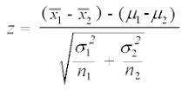
Testing Population Mean (μ) : Two Sample
When to use ?
If you want to test whether if two population means are equal or
unequal.
How to calculate statistics:
Where,
x̅ = Sample mean of ‘n’ observations.
σ1 = Population S.D. (known) of sample one
μ1 = Population mean of sample one
2 = Sample mean of ‘n2’ observations.
σ2 = Population S.D. (known) of sample two
μ2 = Population mean of sample one

Slide 37
Small Sample Test

Slide 38
Small Sample Test
In small sample test, the sampling distribution that the test statistic follow are majorly classified in three distributions:
Χ² distribution (chi-square)
t-distribution
F-distribution

Slide 39

Small Sample Test: One Sample t-test
When to use ?
If you want to test whether a given sample is coming from a
population or not whose mean is specified value and population
variance is unknown.
Where,
x̅ = Sample mean of ‘n’ observations.
s = S.D. of sample of ‘n’ observations.
μ₀ = Population mean.

Slide 40
Hypothesis on : One Sample t test
Here we test whether the given sample belongs to population having
mean = μ₀
μ₀ =Specified value of mean
H₀: Mean is equal to μ₀
H_{a}: Mean is not equal to μ₀

Slide 41
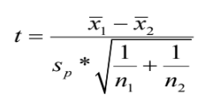
Small Sample Test: Two Sample t-test
When to use ?
If you want to test whether given two samples belongs to same
population or not. This can be tested by checking equality of means of
two samples.
Where,
x̅₁ = Sample mean of n₁ observations
x̅₂ = Sample mean of n₂ observations
S_{p} = Pooled S.D. of two samples

Slide 42
Hypothesis on : Two Sample t test
Here we test whether the given two sample belongs to same population.
H₀: Mean of two samples is same.
H_{a}: Mean of two samples is not same.
H₀: Two samples belongs to same population.
H_{a}: Two samples belongs to different population.

Slide 43

Small Sample Test: Paired t-test
When to use ?
If you want to check, effectiveness of a new treatment, a new method
employed or a training one can apply paired t-test. Here observations
on every unit are made before and after applying the treatment or
method. Hence if treatment or method is effective, there will be
significant difference in observations before applying it and after
applying it.
Where,
x̅_{D} = Mean of differences of ‘n’ paired observations.
S_{D} = S.D. of differences of ‘n’ paired observations.
μ₀ = Mean of differences of ‘n’ paired observations under H₀.

Slide 44
Hypothesis on : Paired t-test
Here we test whether the given two sample belongs to same population
or not. This can also be taken as there is no significant difference in
samples before and after applying some treatment or method.
H₀: Mean of samples before and after treatment is same.
H_{a}: Mean of samples before and after treatment is not same.

Slide 45

Small Sample Test: Chi-square test
When to use ?
If you have attribute data and if you want to test whether any two
attributes are associated with each other or they are independent of
each other, we can use Chi-Square test for checking independence of
attributes.
Where,
O_{i} = Observed frequency or Cell count
E_{i} = Expected frequency or Cell count

Slide 46
Hypothesis on : Chi-Square test
Here we test whether attributes in the given data are independent of each other or not.
H₀: Two attributes are independent of each other.
H_{a}: Two attributes are not independent of each other.

Slide 47

Small Sample Test: F test
When to use ?
If you have two different samples and you want to know whether
these two sample have same population variance or not, one can use
F test.
Where,
S₁² = Sample variance of first sample of size n₁
S₂² = Sample variance of second sample of size n₂

Slide 48
Hypothesis on : F test
Here we test whether two samples have same variance or not.
H₀: Variance ratio is one
H_{a}: Variance ratio not equal to one

