Slide 1

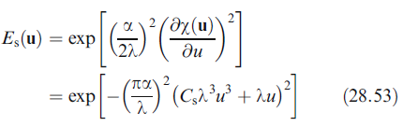

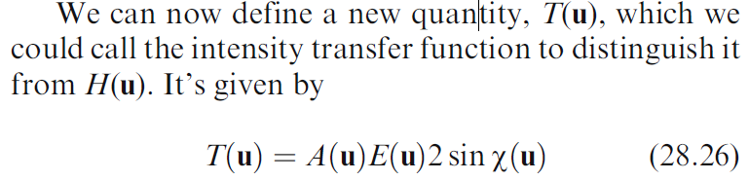
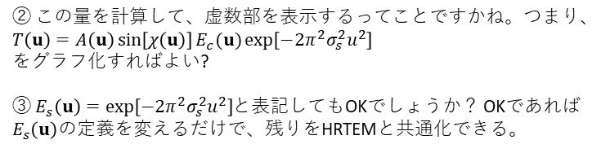

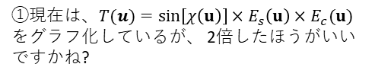
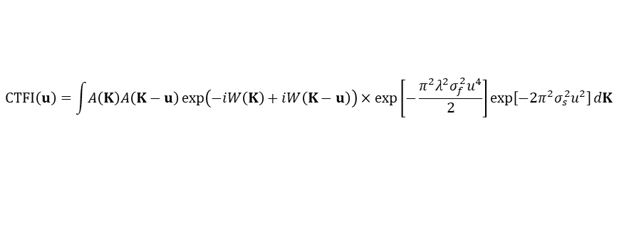

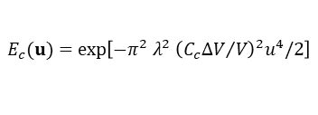
HRTEM
STEM
(William and Carter 2009, 28章の表記で統一)
CTF
$$\sin\left[χ\left(u\right)\right]=\sin\left[π λ u^{2}\left(Δf+C_{s}u^{2}λ^{2}\right)/2\right]$$
$T\left(u\right)=A\left(u\right)$ $\exp\left(−iW\left(u\right)\right)\exp\left[−\frac{π^{2}λ^{2}σ_{f}^{2}u^{4}}{2}\right]\exp\left[−{2π}^{2}σ_{s}^{2}u^{2}\right]$
where $W\left(K,Δf\right)=πλ{\left|K\right|}^{2}\left(Δf+\frac{C_{s}λ^{2}{\left|K\right|}^{2}}{2}\right), σ_{f}=C_{c}\frac{σ_{E}}{E_{0}}$
$$E_{s}(u)=\exp\left[−π^{2} β^{2} u^{2}{\left(Δf+C_{s}u^{2}λ^{2}\right)}^{2}\right]$$
② この量を計算して、虚数部を表示するってことですかね。つまり、 $T\left(u\right)=A\left(u\right)\sin\left[χ\left(u\right)\right]E_{c}(u)\exp\left[−{2π}^{2}σ_{s}^{2}u^{2}\right]$
をグラフ化すればよい?
③ $E_{s}\left(u\right)=\exp\left[−{2π}^{2}σ_{s}^{2}u^{2}\right]$と表記してもOKでしょうか？ OKであれば$E_{s}\left(u\right)$の定義を変えるだけで、残りをHRTEMと共通化できる。
$$E_{c}(u)=\exp\left[−π^{2} λ^{2} {\left({C_{c}ΔV}/V\right)}^{2}u^{4}/2\right]$$
$$T(u)=\sin\left[χ\left(u\right)\right]×E_{s}\left(u\right)×E_{c}(u)$$
CTFI
$$CTFI\left(u\right)=\int{A\left(K\right)A\left(K−u\right)\exp\left(−iW\left(K\right)+iW\left(K−u\right)\right)}×\exp\left[−\frac{π^{2}λ^{2}σ_{f}^{2}u^{4}}{2}\right]\exp\left[−{2π}^{2}σ_{s}^{2}u^{2}\right]dK$$
①現在は、$T(u)=\sin\left[χ\left(u\right)\right]×E_{s}\left(u\right)×E_{c}(u)$
をグラフ化しているが、 2倍したほうがいいですかね?
④この量を計算して、虚数部を表示したらいいのでしょうか？

Slide 2
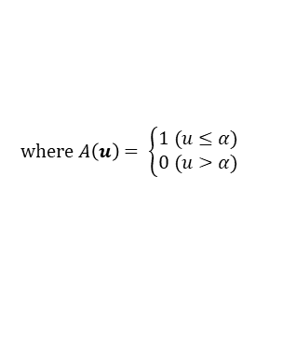
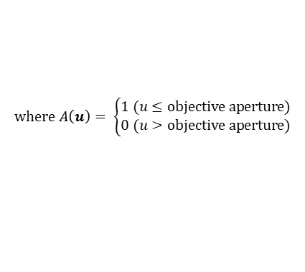

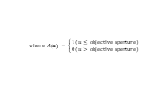
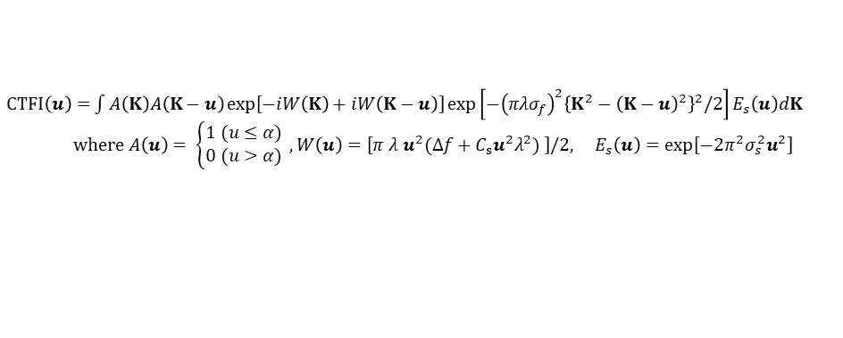
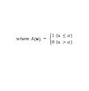
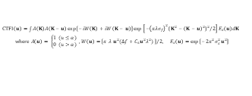

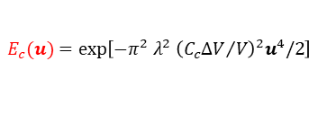
HRTEM
STEM
(William and Carter 2009の流儀)
EquationSinW.png
$$\sin\left[W\left(u\right)\right]=\sin\left[π λ u^{2}\left(Δf+C_{s}u^{2}λ^{2}\right)/2\right]$$
$$\sin\left[W\left(u\right)\right]=\sin\left[π λ u^{2}\left(Δf+C_{s}u^{2}λ^{2}\right)/2\right]$$
EquationCosW.png
$$\cos\left[W\left(u\right)\right]=\cos\left[π λ u^{2}\left(Δf+C_{s}u^{2}λ^{2}\right)/2\right]$$
$$E_{s}(u)=\exp\left[−{2π}^{2}σ_{s}^{2}u^{2}\right]$$
$$\cos\left[W\left(u\right)\right]=\cos\left[π λ u^{2}\left(Δf+C_{s}u^{2}λ^{2}\right)/2\right]$$
$$E_{s}(u)=\exp\left[−{2π}^{2}σ_{s}^{2}u^{2}\right]$$
EquationEs_HRTEM.png
$$E_{s}(u)=\exp\left[−π^{2} β^{2} u^{2}{\left(Δf+C_{s}u^{2}λ^{2}\right)}^{2}\right]$$
$$where A\left(u\right)= \left\{\begin{aligned}1 (u≤objective aperture) \\ 0 (u>objective aperture)\end{aligned}\right.$$
$$E_{s}(u)=\exp\left[−π^{2} β^{2} u^{2}{\left(Δf+C_{s}u^{2}λ^{2}\right)}^{2}\right]$$
$$where A\left(u\right)= \left\{\begin{aligned}1 (u≤α) \\ 0 (u>α)\end{aligned}\right.$$
EquationEc.png
$$E_{c}(u)=\exp\left[−π^{2} λ^{2} {\left({C_{c}ΔV}/V\right)}^{2}u^{4}/2\right]$$
$$where A\left(u\right)= \left\{\begin{aligned}1 (u≤α) \\ 0 (u>α)\end{aligned}\right.$$
$$where A\left(u\right)= \left\{\begin{aligned}1 (u≤objective aperture) \\ 0 (u>objective aperture)\end{aligned}\right.$$
$$E_{c}(u)=\exp\left[−π^{2} λ^{2} {\left({C_{c}ΔV}/V\right)}^{2}u^{4}/2\right]$$
EquationCTF_HRTEM.png
$$PCTF\left(u\right)=A\left(u\right)×\sin\left[W\left(u\right)\right]×E_{s}\left(u\right)×E_{c}\left(u\right)$$
$CTFI\left(u\right)=$ $\int{A\left(K\right)A\left(K−u\right)\exp\left[−iW\left(K\right)+iW\left(K−u\right)\right]}\exp\left[−{\left(πλσ_{f}\right)}^{2}{\left\{{K^{2}−\left(K−u\right)}^{2}\right\}}^{2}/2\right]E_{s}\left(u\right)dK$
$where A\left(u\right)= \left\{\begin{aligned}1 (u≤α) \\ 0 (u>α)\end{aligned}\right. ,W\left(u\right)=\left[π λ u^{2}(Δf+C_{s}u^{2}λ^{2}) \right]/2, E_{s}\left(u\right)=\exp\left[−{2π}^{2}σ_{s}^{2}u^{2}\right]$
$$PCTF\left(u\right)=A\left(u\right)×\sin\left[W\left(u\right)\right]×E_{s}\left(u\right)×E_{c}\left(u\right)$$
$$ACTF\left(u\right)=A\left(u\right)×\cos\left[W\left(u\right)\right]×E_{s}\left(u\right)×E_{c}\left(u\right)$$
$$ACTF\left(u\right)=A\left(u\right)×\cos\left[W\left(u\right)\right]×E_{s}\left(u\right)×E_{c}\left(u\right)$$
$CTFI\left(u\right)=$ $\int{A\left(K\right)A\left(K−u\right)\exp\left[−iW\left(K\right)+iW\left(K−u\right)\right]}\exp\left[−{\left(πλσ_{f}\right)}^{2}{\left\{{K^{2}−\left(K−u\right)}^{2}\right\}}^{2}/2\right]E_{s}\left(u\right)dK$
$$where A\left(u\right)= \left\{\begin{aligned}1 (u≤α) \\ 0 (u>α)\end{aligned}\right. ,W\left(u\right)=\left[π λ u^{2}(Δf+C_{s}u^{2}λ^{2}) \right]/2, E_{s}\left(u\right)=\exp\left[−{2π}^{2}σ_{s}^{2}u^{2}\right]$$

