Slide 1
Coordination of Autonomous Aerial Vehicles
ACCESS Summer Project
June - August 2015

Slide 2
Project overview
Aim: Design a computer program to fly one/multiple quadcopters
Flexible software architecture
Safe flying
Simulator with same interface
User friendly GUI
Trajectory following
More advanced tasks

Slide 3
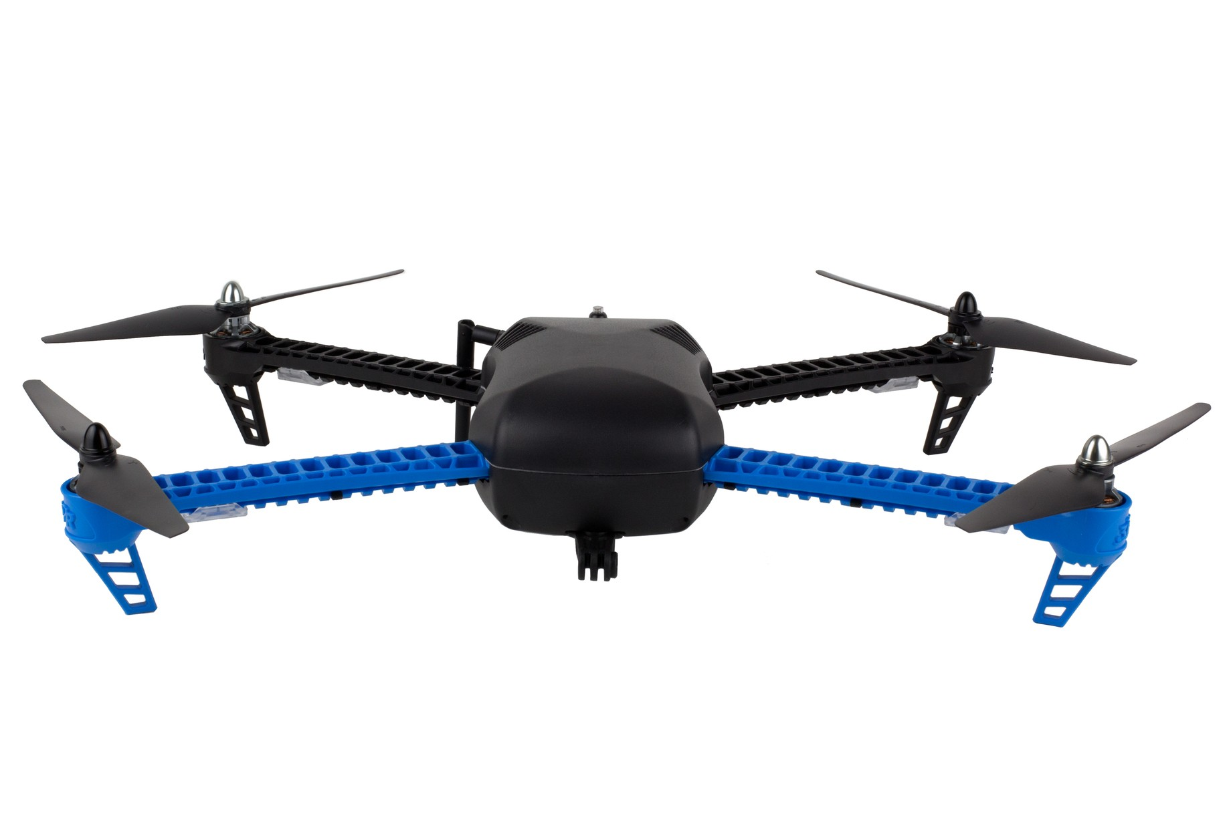
IRIS⁺
Has internal software that transforms roll, pitch, throttle and yaw to motor speeds
Can fly for 15 min
Able to carry about 500 g

Slide 4
Architecture overview
Mocap
Security Guard
Blender
Controller

Slide 5
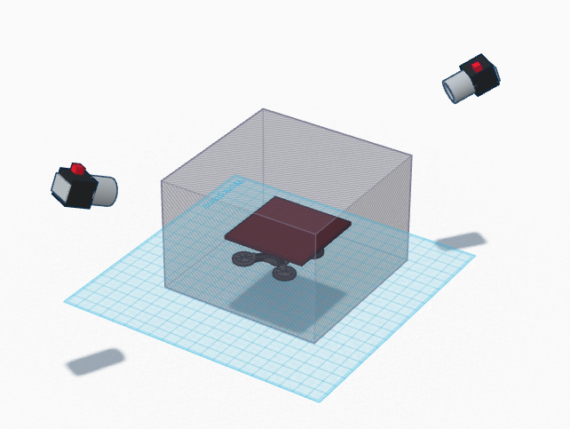
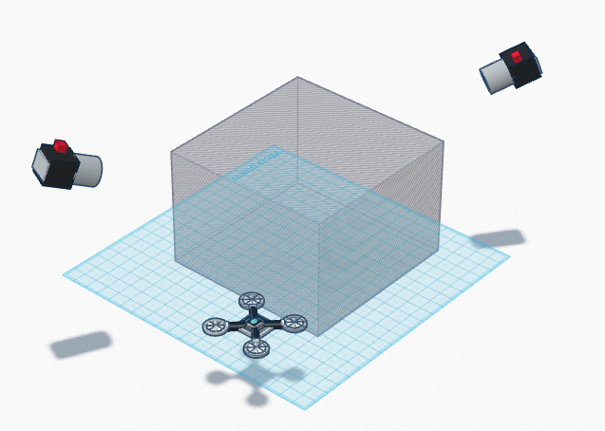
Security features
Will land if
Motion caption signal is lost
Out of safety zone
Landing requested

Slide 6
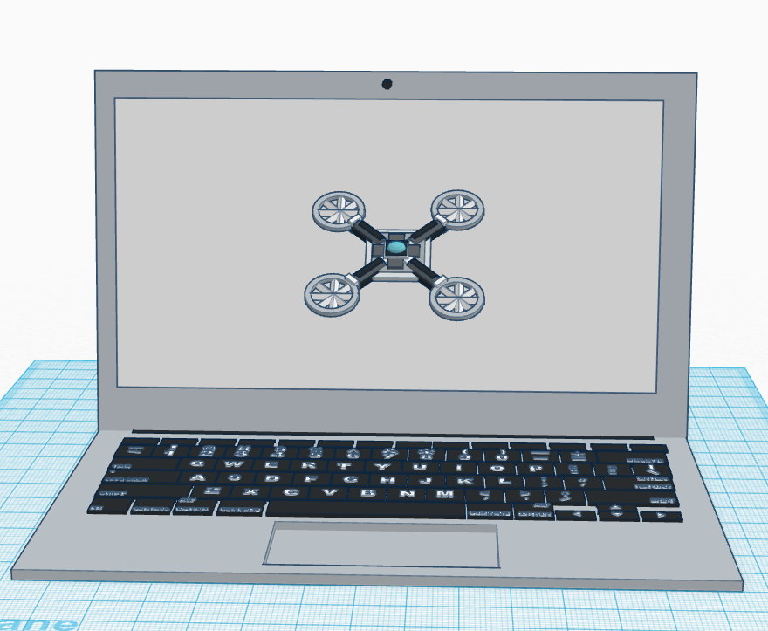
Simulator
Same interface as real quadcopter
Test code in simulation before real world
Can handle both one and multiple quadcopters

Slide 7
GUI
Different plugins for different things – more flexible
The GUI should be able to
Take inputs from user
Show outputs to the quadcopter
Show status of quadcopter

Slide 8
Some pictures of GUI

Slide 9
Trajectory following
Generate points for the quad with
Position
Velocity
Acceleration

Slide 10
PID
Quadcopter largely affected by battery voltage, making integral part important
Performance?
Error around a couple of centimeters are required for finer tasks

Slide 11
Cool RViz picture?

Slide 12
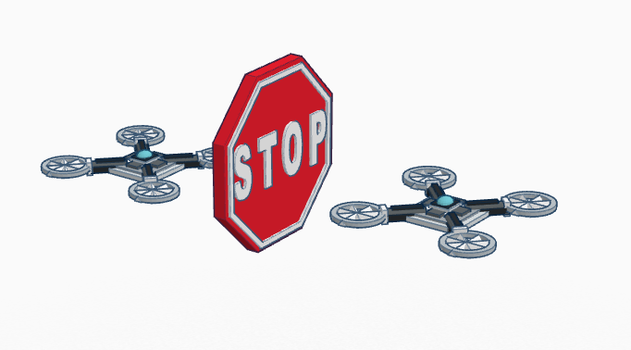
Obstacle avoidance
Potential between quadcopter and obstacle
Pushes the quadcopter away from the obstacle, to a lower potential

Slide 13
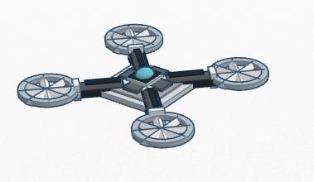
Obstacle avoidance
Simple version: Ignoring z-direction, resulting in a 2D problem

Slide 14
Obstacle avoidance

Slide 15
Leader following
First quadcopter: Follow trajectory
Second quadcopter: Keep constant offset to first quadcopter
Demo!

Slide 16
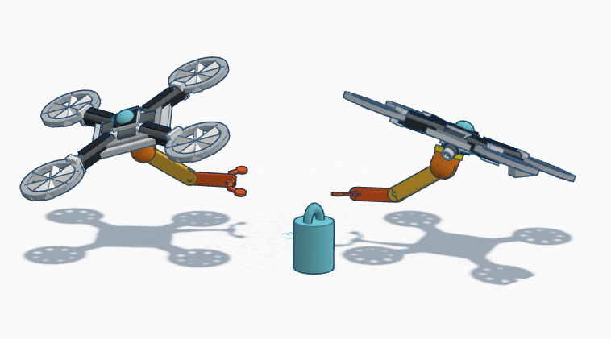
Load lifting
A quadcopter with a gripper can transport a load by
Read and go to position of load
Grip load
Lift and transport load through a given trajectory
Release load

Slide 17
Load lifting

Slide 18
Load lifting
Film!

Slide 19
Thanks for your attention!
Questions?
Look forward to the demonstration!

