Slide 1
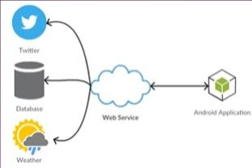
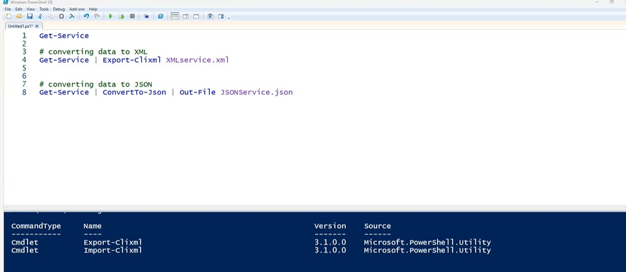
WHAT ARE THE WEB SERVICES ?
-Web services are a standard way of integrating web based applications using open standard over an internet protocol
-protocols are like HTTP,JSON,SOAP,WSDL,REST,SWAGGER/openAPI,GraphQL,
Converting data to XML and json

Slide 2
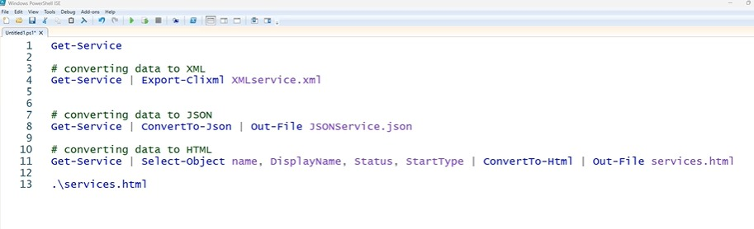
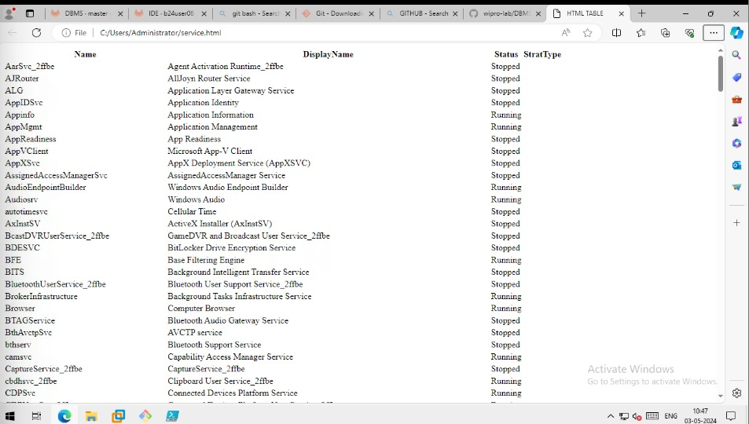
Convert data to html

Slide 3
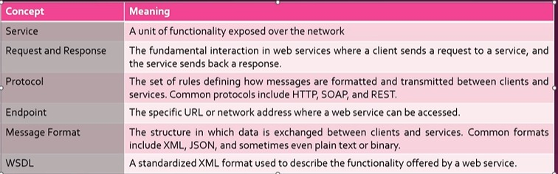
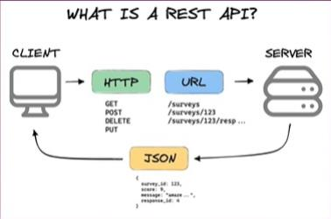
Basic concepts
Examples of Everyday Web Services •Weather API • Messaging and Communication APIs •Social Media APIs • File Storage and Sharing APIs •Payment Gateways •Travel and Booking APIs •Mapping and Geolocation APIs • Health and Fitness APIs •E-commerce Platforms •News and Content APIs
Over view of REST
Run this url in your machine
Client GET https://simple-books-api.glitch.me/ https://simple-books-api.glitch.me/books https://simple-books-api.glitch.me/books/2 Server:-JSON (as return)

Slide 4
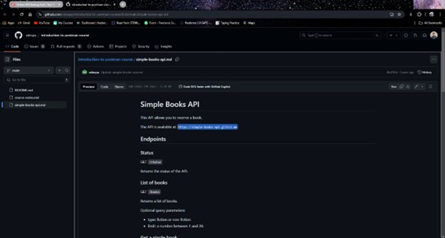
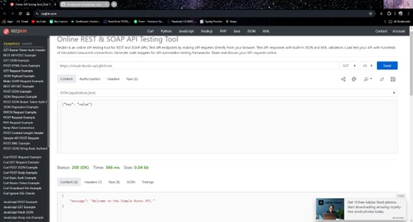
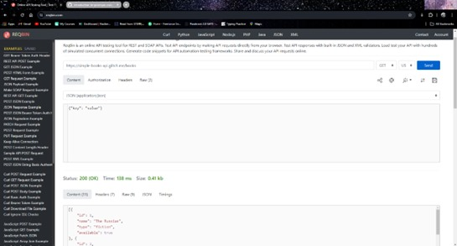
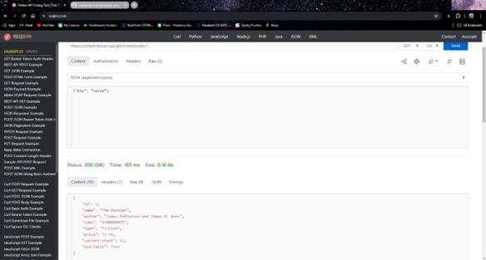

Slide 5
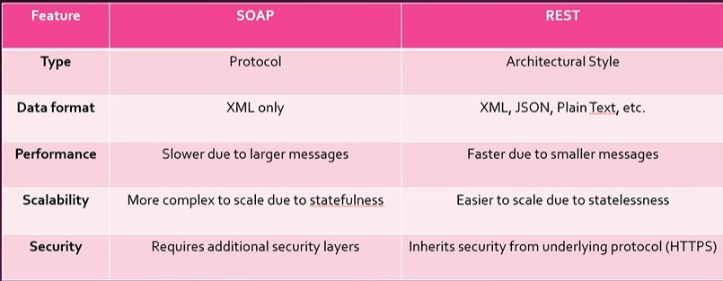
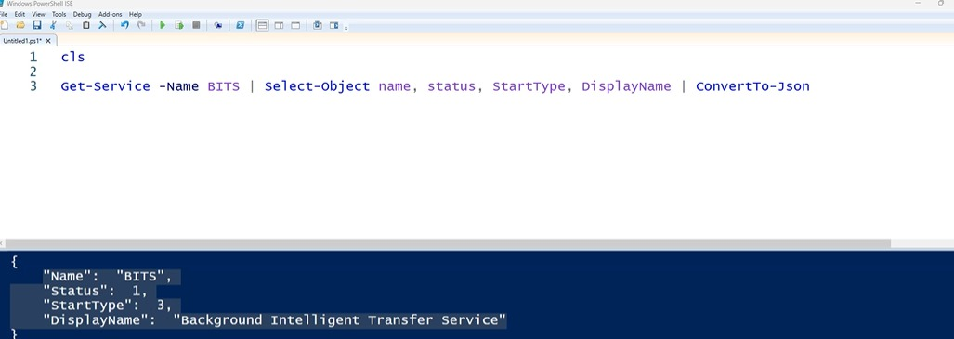

Slide 6
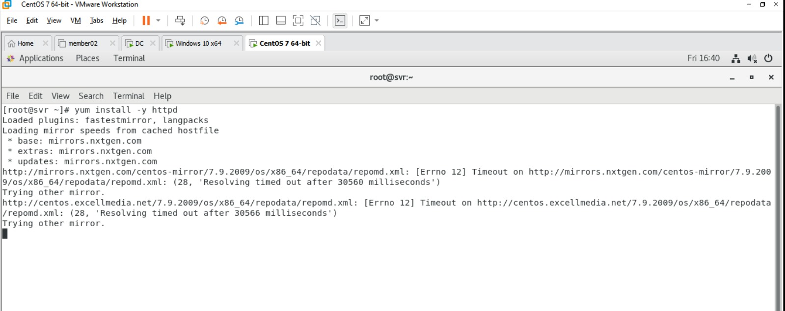
Instaling Apache on linux

Slide 7
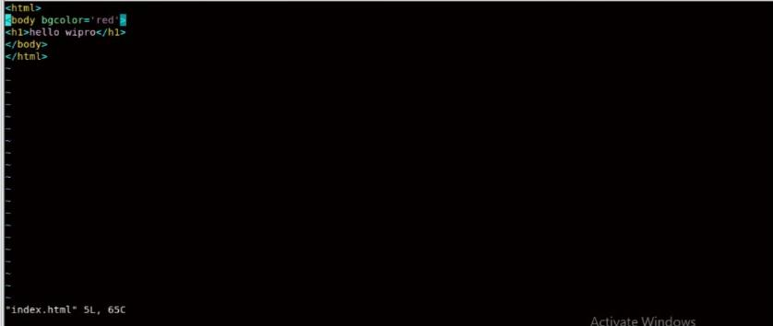

Slide 8


