Slide 2






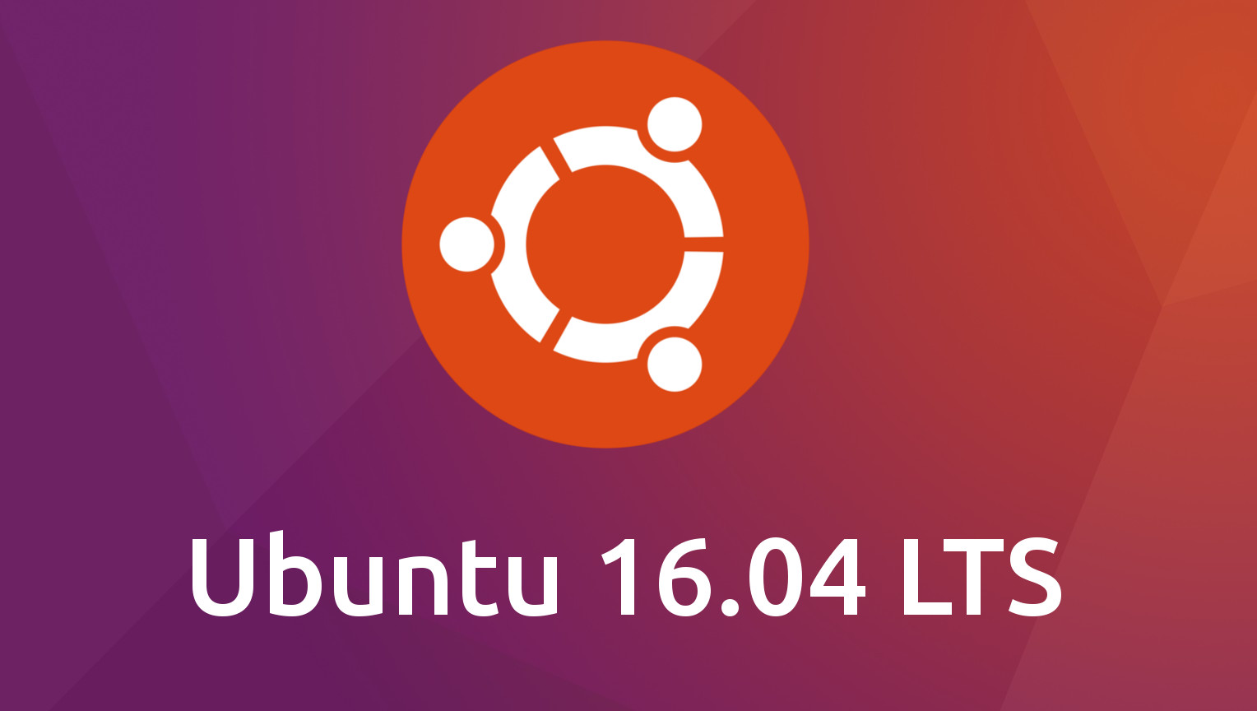
Package Layer
Simulation Layer
Framework Layer
OS Layer

Slide 3
Package Layer
Simulation Layer
Framework Layer
OS Layer

Slide 4
Other Applications
Application Layer
OS Layer

Slide 5

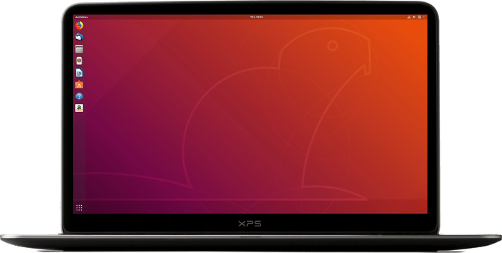
How to install Omnet++
on the Ubuntu 18.04

Slide 6
What is Omnet++?

