Slide 1
Introduction to working with the OMOP CDM
“Observational Medical Outcomes Partnership” “Common Data Model”

Slide 2
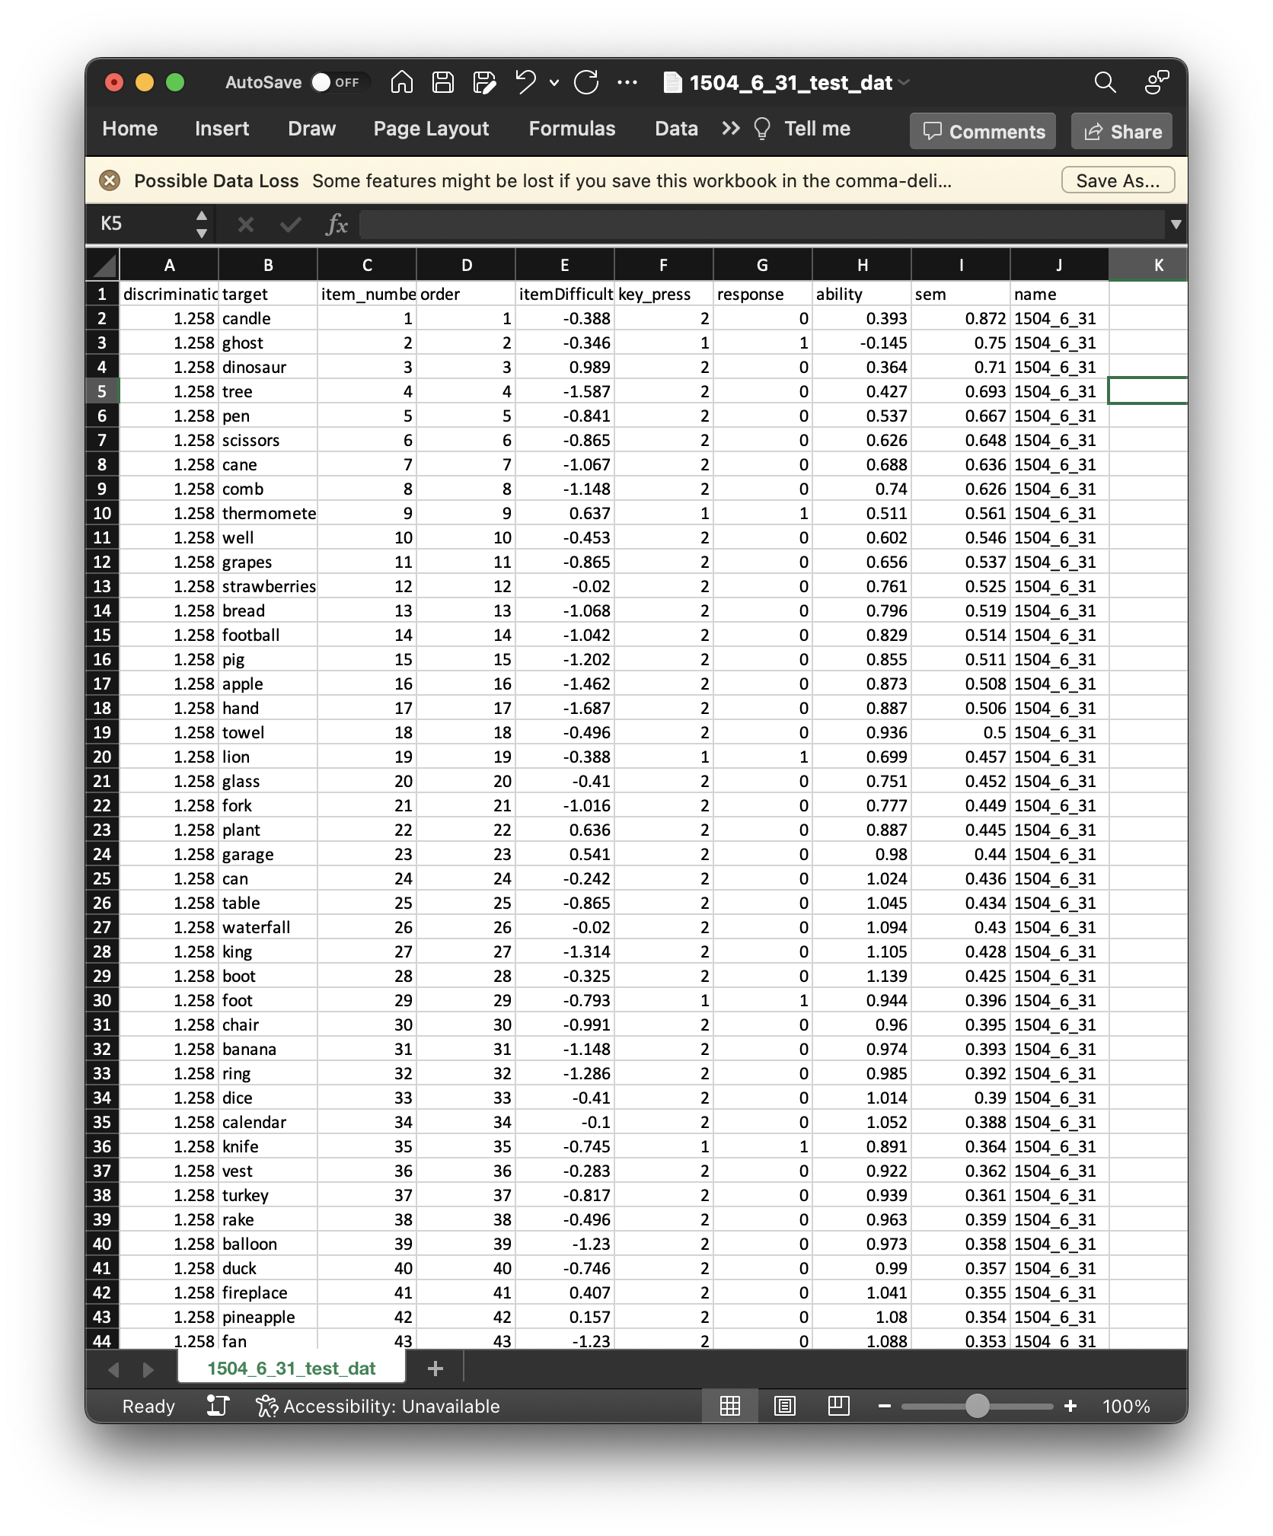
Typical data
Rectangular & tidy (hopefully)
Single file contains most information
Saved locally on your computer
e.g., read.csv() and write.csv()

Slide 3
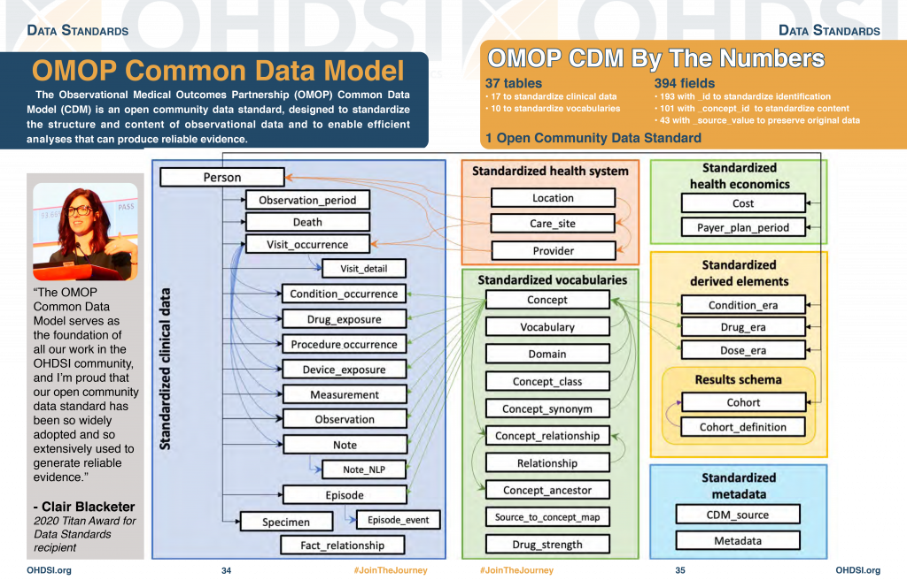
OMOP CDM DATA
Common format allowing for collaborative research and shared tools
Too much data for a single table
Information spread across many tables with linking columns
Saved in an SQL database
e.g., redshift, big query
Access via SQL or R {dbplyr}
Lots of (SQL) joins to get final dataset
Then, “collect” data to local computer
https://www.ohdsi.org/data-standardization/

Slide 4
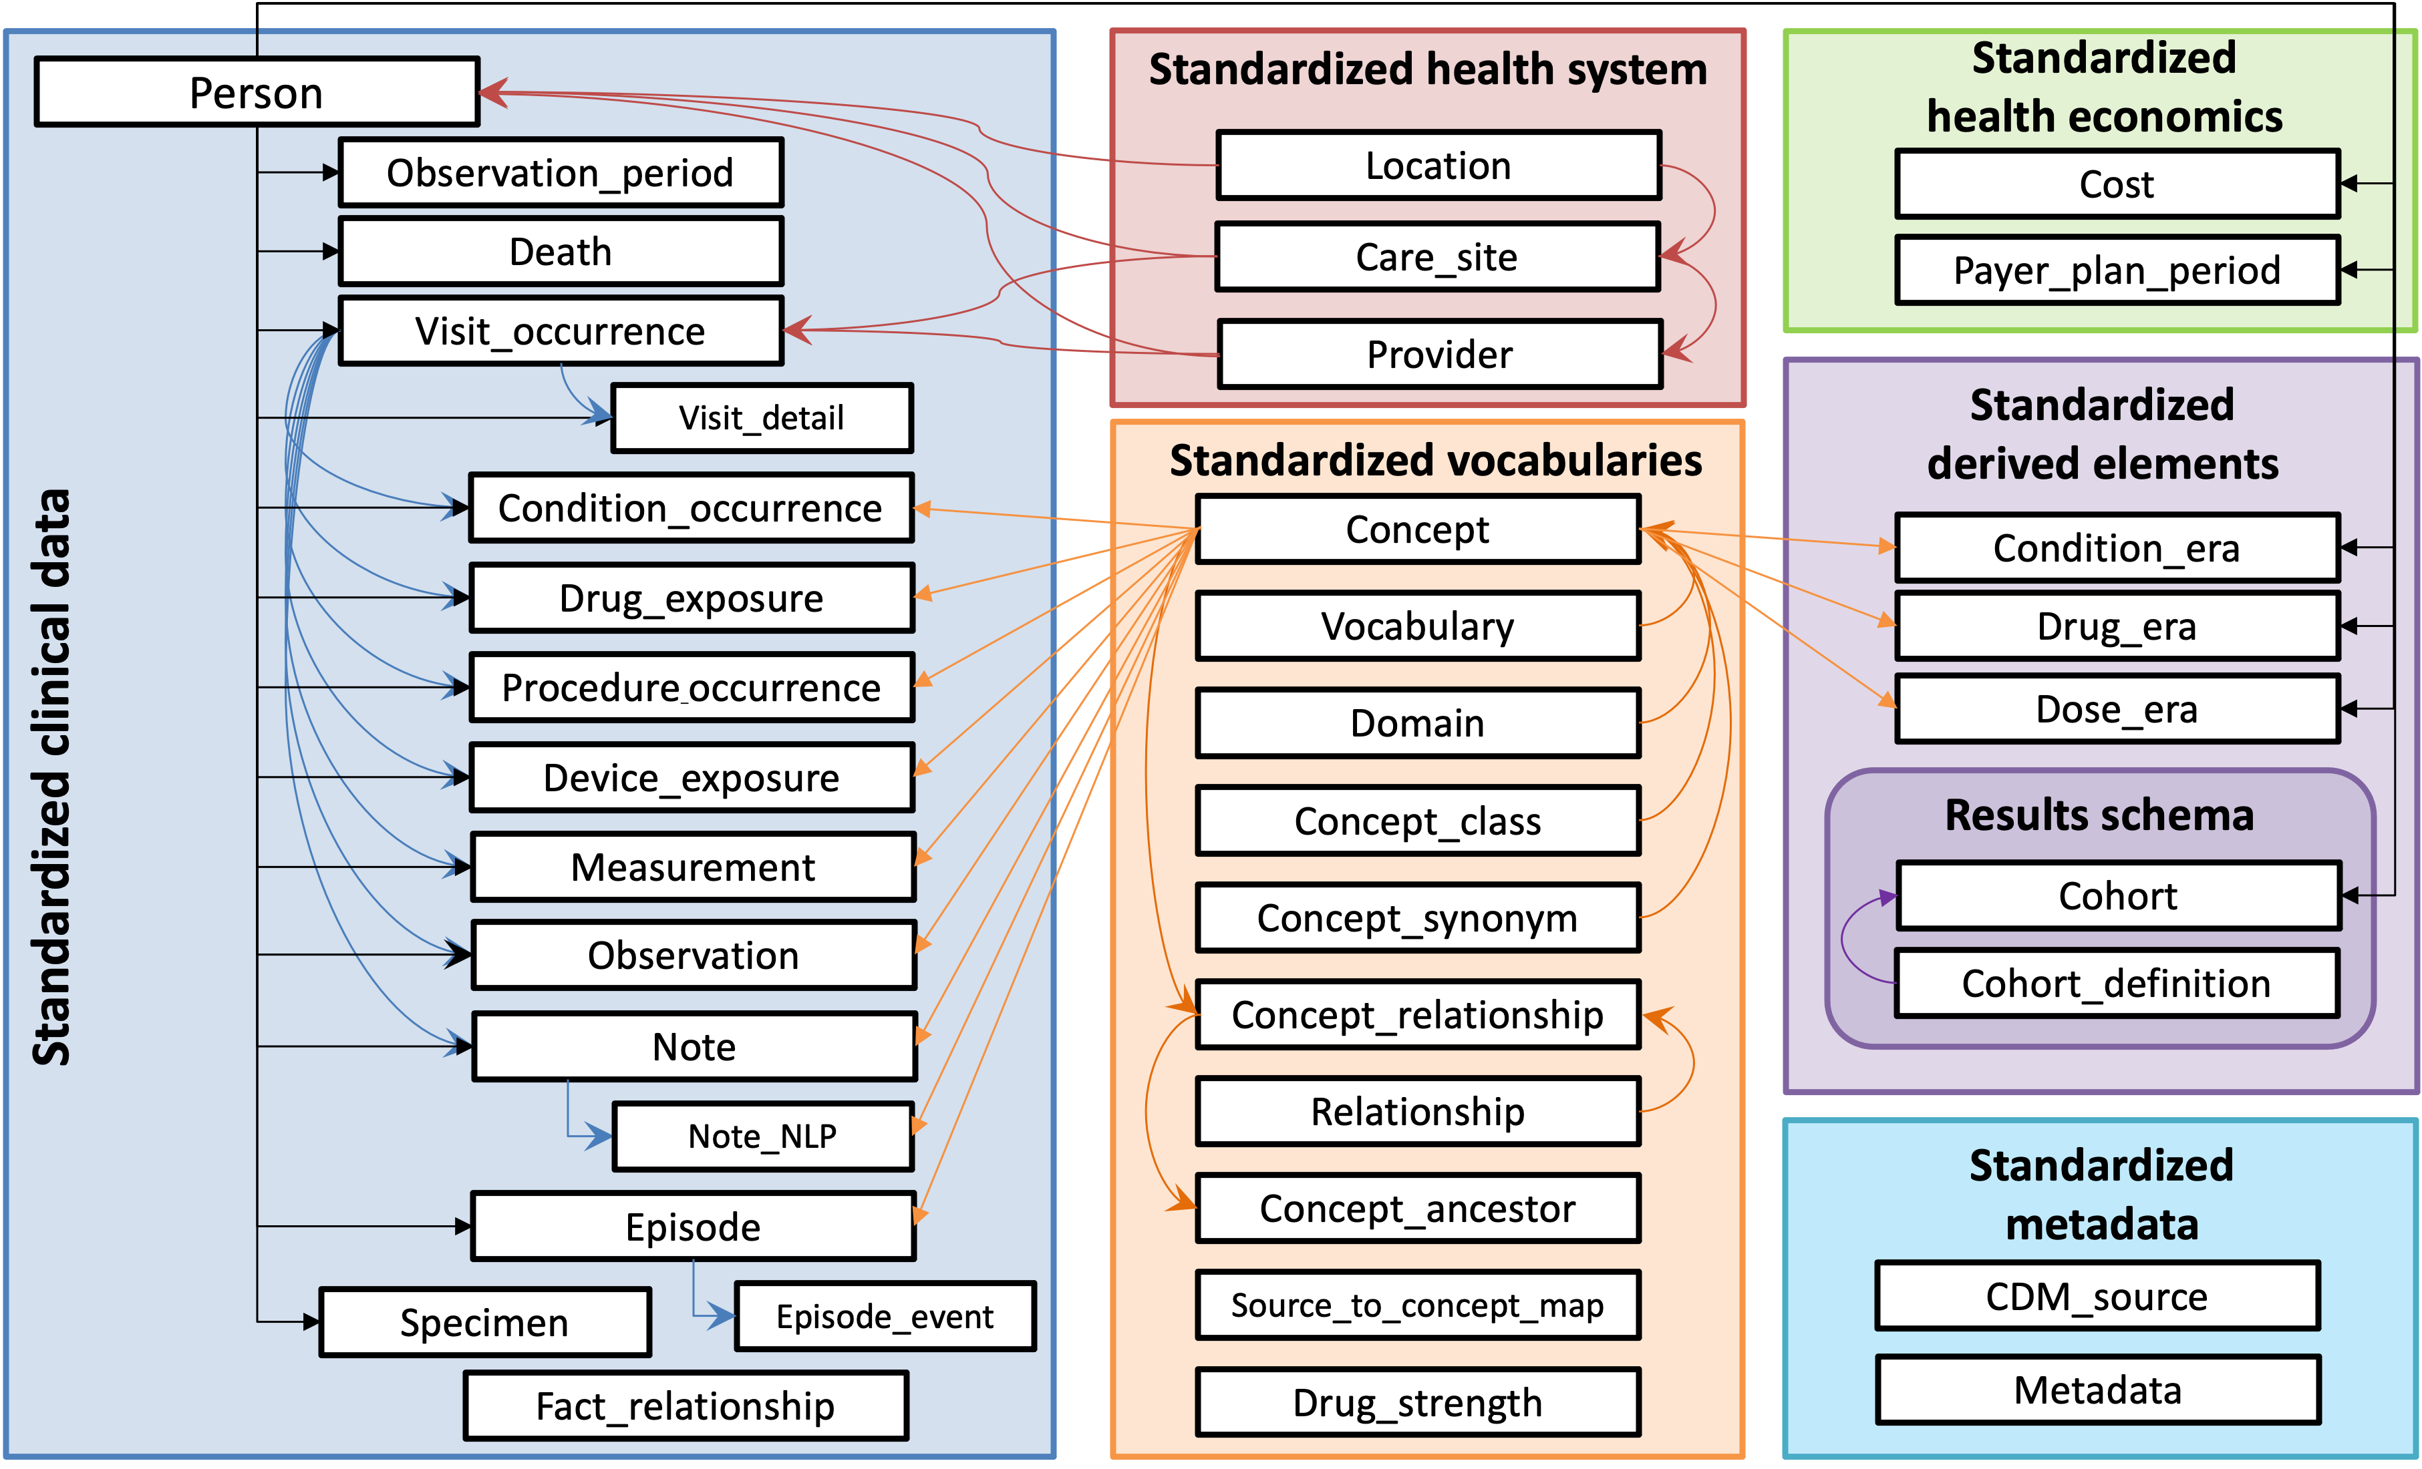
https://ohdsi.github.io/CommonDataModel/

Slide 5
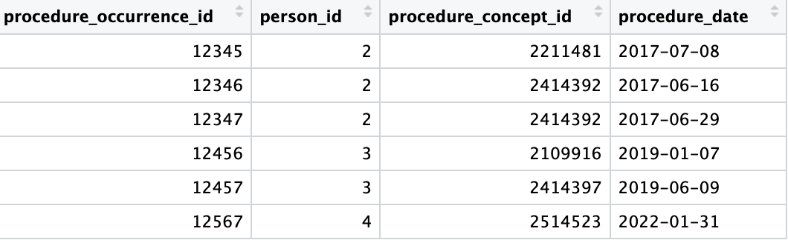
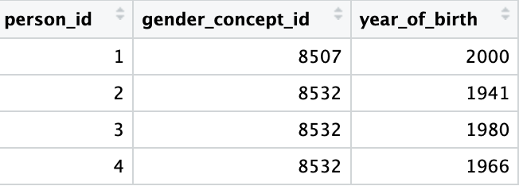
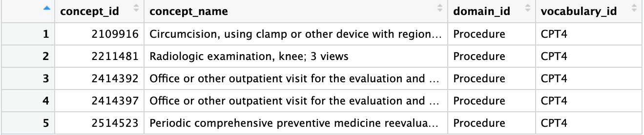
Toy Example
Question: Where are the data elements that I want located and can I put them together?
procedure_occurrence table
person table
concept table

Slide 6
OMOP CDM DATA
https://ohdsi.github.io/CommonDataModel/

Slide 7
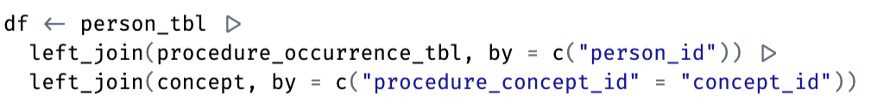
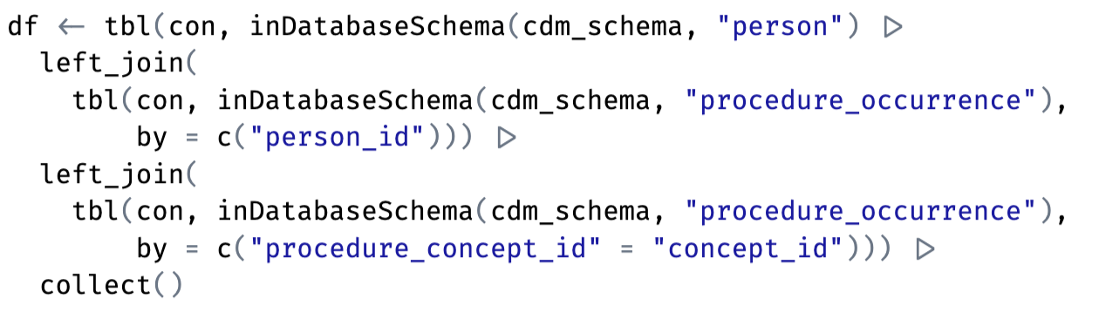
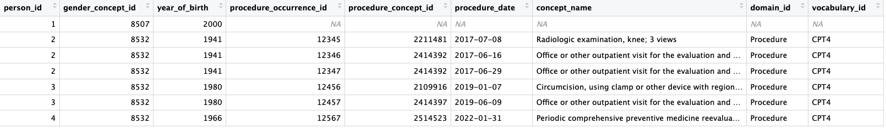
Toy Example
Regular R join
R dbplyr join
concept
output

Slide 8
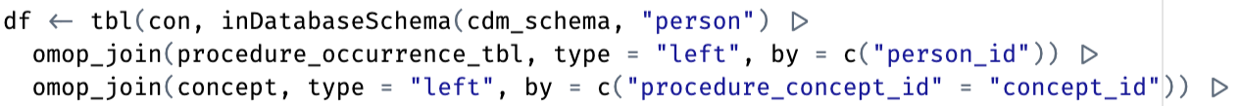
Toy Example
Regular R join
R dbplyr join using {ohdsilab}
output

Slide 9
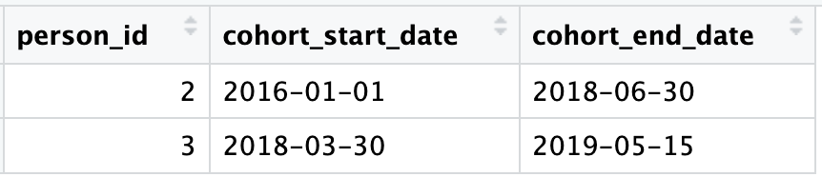
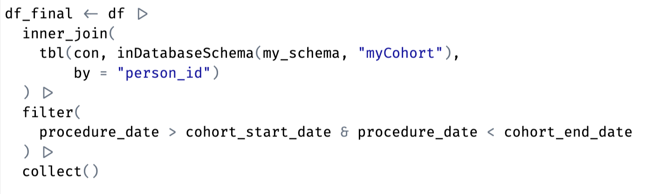
Toy Example
Cohort of Interest:
Regular R join

Slide 10
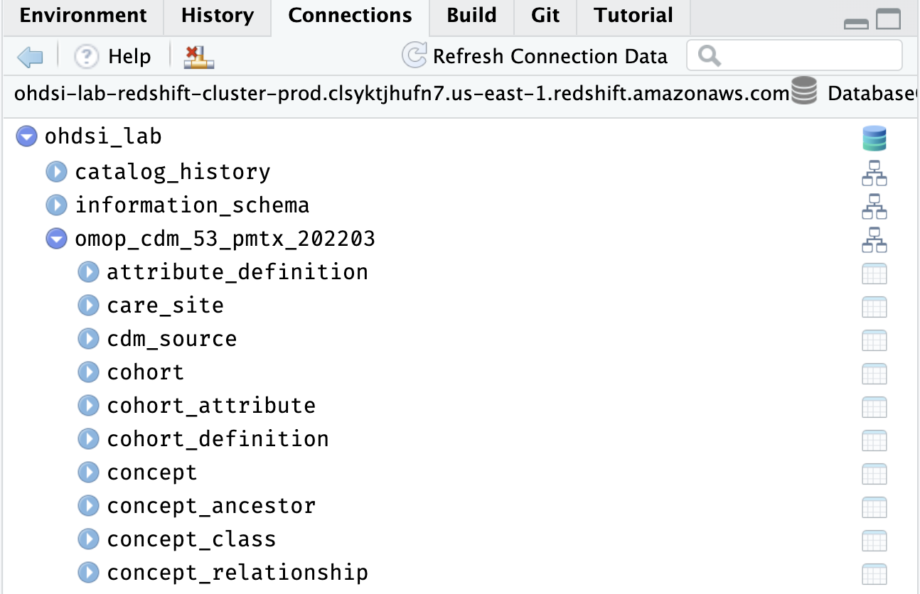
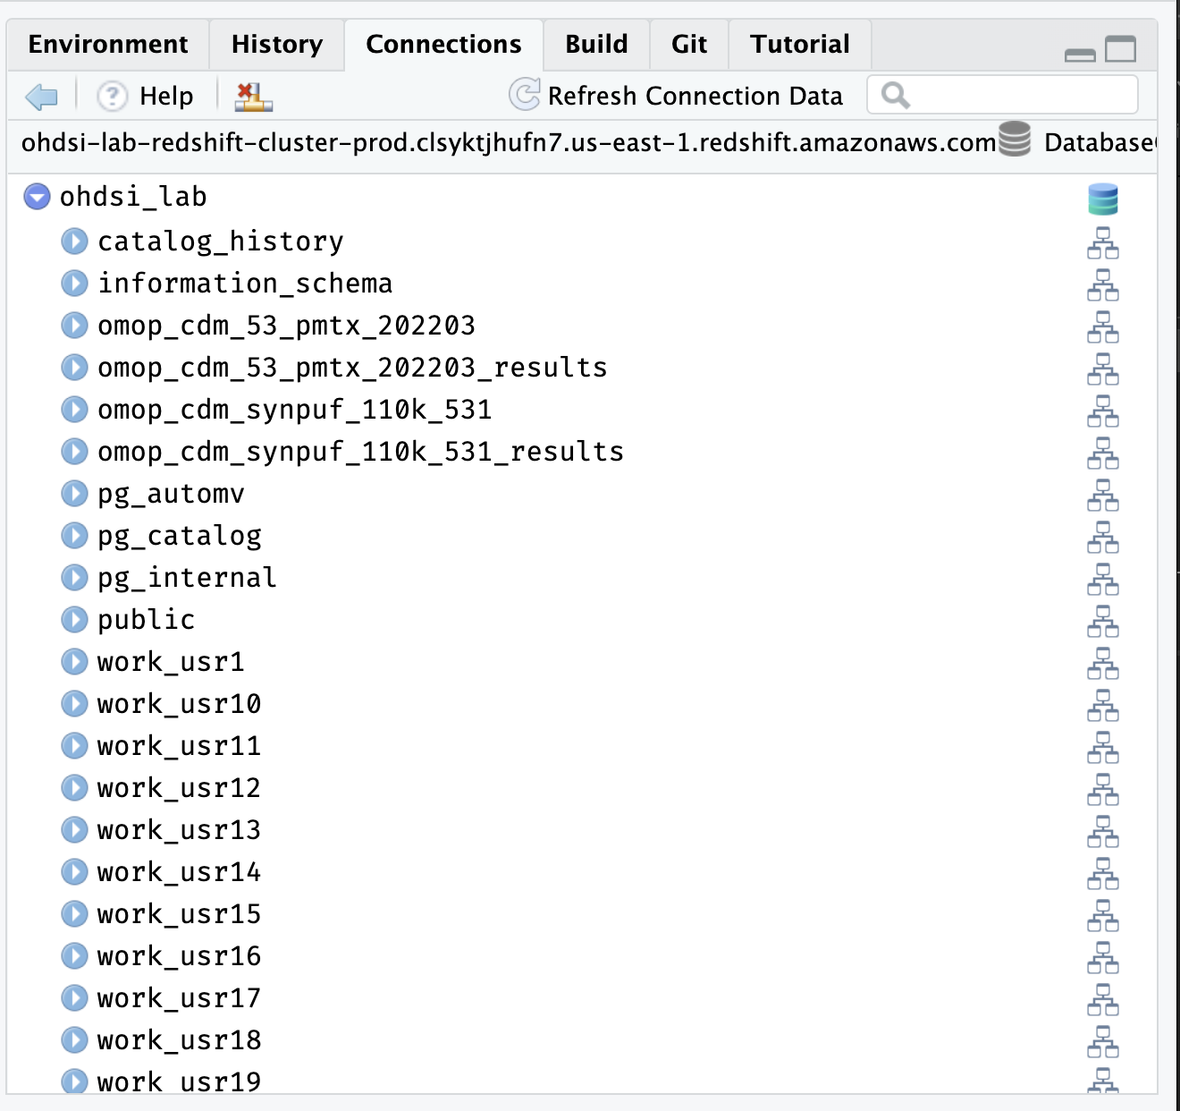
Database organization
Schema ~ subfolder
ohdsi_lab = database name
omop_cdm_53_pmtx_202203 = a schema
The one that holds the omop cdm data
We usually call this “cdm_schema”
read only

Slide 11
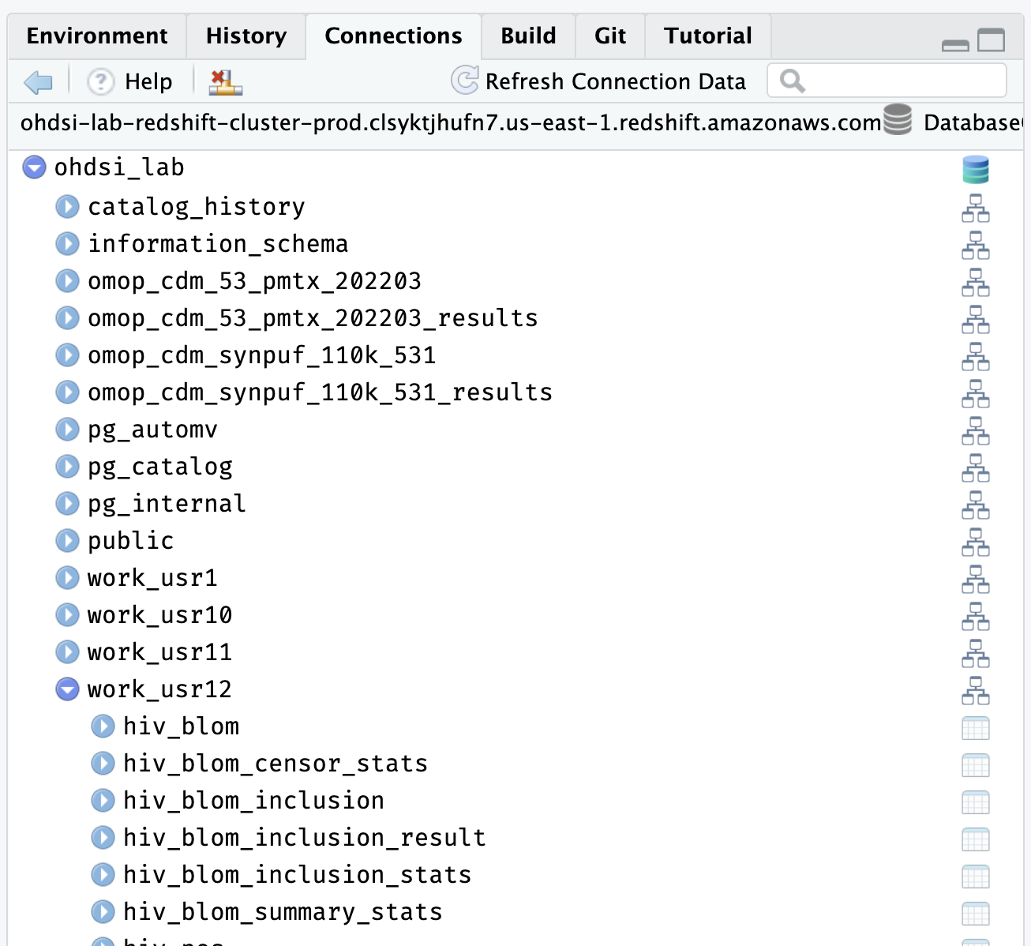
Database organization
work_usr12 = also a schema
Holds my tables that I create usr12 = me = has write access

Slide 12
Frequently used terms
OMOP CDM: the common data model (database structure) we’re using
OHDSI: multi-stakeholder, interdisciplinary collaborative/international network of researchers and observational health databases
Redshift: the version of SQL used by ohdsilab database
Big Query: the version of SQL used by AllofUs
SQL: structured query language. Like R or python but for SQL databases and giant datasets
R dbplyr: R package that converts R code into SQL so you don’t have to be an expert in SQL
Amazon box: the “virtual machine” you can access to access the ohdsilab database
Virtual Machine (VM): imagine your laptop, but its in the cloud, and you can access it through your browser, or the amazon workspaces app.
Collect: pulling data from the remote database to your local computer (your laptop or the box virtual machine)
Schema: essentially, a subfolder of the database. If referencing a table in a schema, you need to make sure you specify the database AND the schema

Slide 13
Further reading
ohdsi lab (pharmetrics)
AllofUs
OMOP CDM tables: https://ohdsi.github.io/CommonDataModel/cdm54
{ohdsilab} package vignette #1: https://roux-ohdsi.github.io/ohdsilab/articles/01-intro-to-ohdsilab.html
CDM background: https://ohdsi.github.io/CommonDataModel/background
Youtube: https://www.youtube.com/channel/UC2RFIQnptl-nk8GbjFfqztw
EHDEN Academy: https://academy.ehden.eu
{ohdsilab} AllofUs vignette: https://roux-ohdsi.github.io/ohdsilab/articles/working-in-allofus.html
Data dictionary (Registered): https://docs.google.com/spreadsheets/d/1HNxLGGKCJFWi5dBXiFgu3nZlV6klMLiHVjqANCu03UY/edit#gid=183931508
Data dictionary (controlled): https://docs.google.com/spreadsheets/d/1XLVq84LLd0VZMioF2sPwyiaPw3EFp5c8o1CTWGPH-Yc/edit#gid=183931508
Workbench: https://workbench.researchallofus.org/login

