Slide 1
Selling in King County
Timing, location and renovation — what a year of sales shows
Rouzbeh Enayatzadeh · Exploratory Data Analysis · September 2026
Notes:
Good morning. I'm Rouzbeh. I looked at a year of house sales in King County for a client who is about to sell, and I have three answers for him: when to sell, where the value sits, and whether it is worth renovating first.

Slide 2
THE CLIENT
Charles has three questions
1
2
3
When should I sell?
Which neighborhood?
Should I renovate?
A seller looking for large returns.
Notes:
My client is Charles Christensen. He is a seller, he wants a big return, and he asked three very practical questions. Everything I did was aimed at answering these three, and each one gets its own slide.

Slide 3
THE DATA
One year of the whole county
21,597
21,420
70
12
house sales
individual houses
zipcodes
months
Every recorded sale in King County, Washington, from May 2014 to May 2015.
Notes:
The data covers every sale in the county for one year. 21,597 sales of 21,420 houses — a few houses sold twice. I checked those: the shortest gap between two sales is 61 days and no date repeats, so they are genuine resales, not duplicate records. For each house I have size, rooms, build quality, year built, year renovated and exact coordinates. For each sale, the date and the price. Nothing was sampled and no rows were dropped.

Slide 4
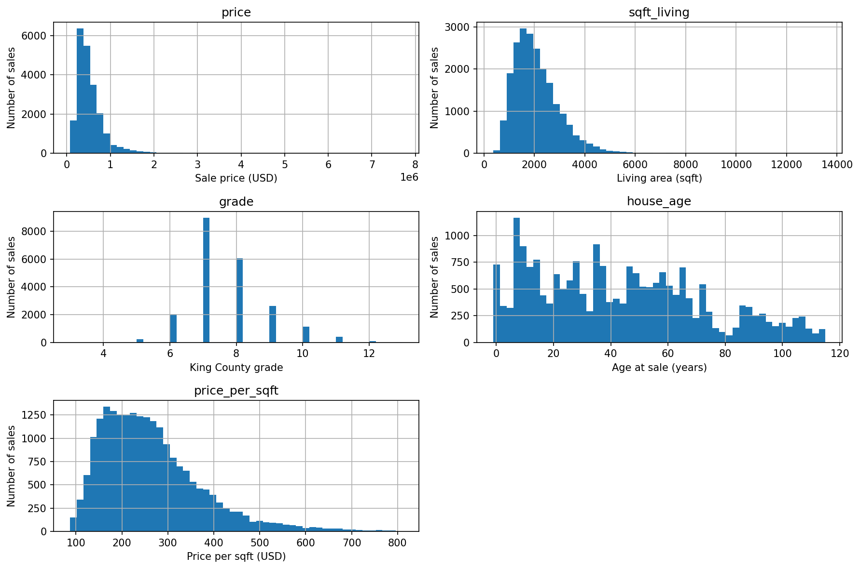
HOW I READ THE DATA
Three choices behind every number
1
Neighborhood means zipcode
2
Value means price per square foot
3
Every figure is a median
A few multi-million-dollar sales would drag any average upward.
Price, size and value per square foot all lean to the right.
Notes:
Three choices shape everything that follows. Neighborhood is zipcode, because that is the only geographic unit the data has. Value is price per square foot, so that house size does not drive the answer — comparing total prices would mostly compare how big the houses are. And every figure is a median rather than an average, because as the histograms show, the price distribution has a long tail of expensive homes that would pull an average upward.

Slide 5
HYPOTHESES
What I expected to find
1
Houses sold in spring sell for more than houses sold in winter.
2
Neighborhoods near the water and the city centre carry a higher price per square foot than outlying ones.
3
Recently renovated homes sell for more than comparable ones never renovated — and old renovations show no premium.
Notes:
Before touching the results I wrote down three hypotheses, one for each of Charles's questions. Each one names a direction, so it can actually be wrong. The next three slides test them in order — and one of them does not survive.

Slide 6
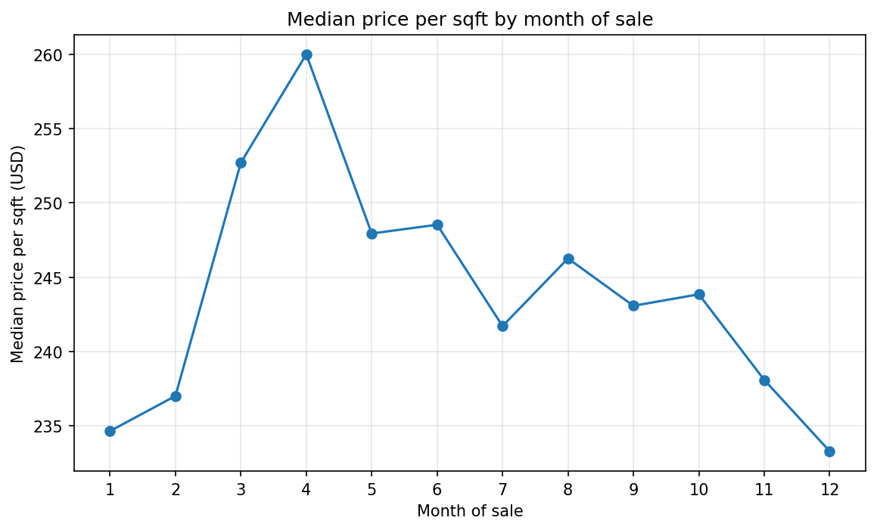
SUPPORTED
QUESTION 1 — WHEN TO SELL
April sells. December does not.
+11%
April over December
$260
median sqft in April
$233
median sqft in December
Notes:
This is the median price per square foot for each month of the year. April peaks at 260 dollars, December bottoms out at 233 — an eleven percent difference on the same house for doing nothing but waiting. Averaged across the three spring months against the three winter months the gap is about eight percent. Note that the line rises and falls smoothly rather than jumping around, which is what makes me read this as a real seasonal cycle rather than noise.

Slide 7
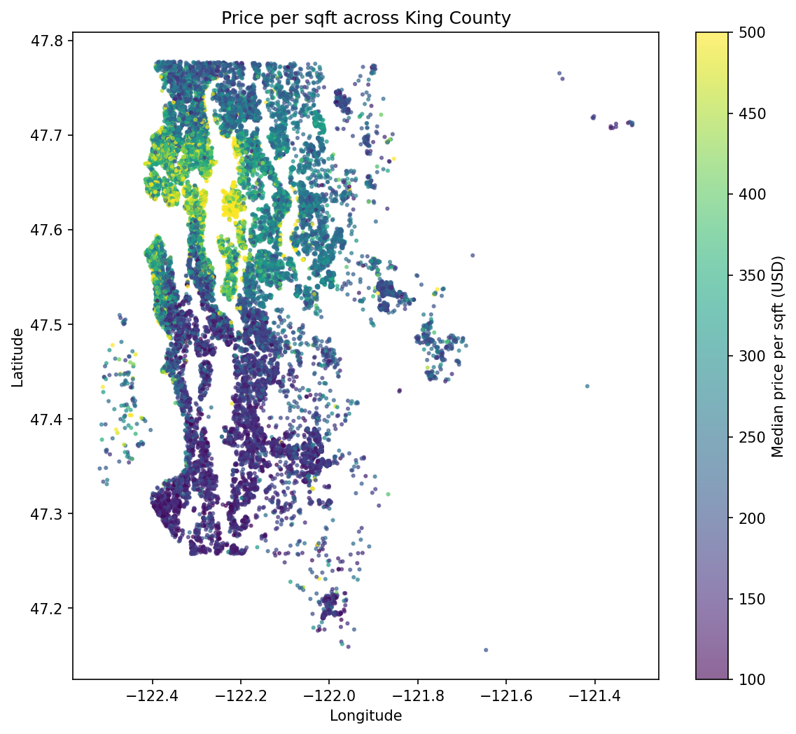
SUPPORTED
QUESTION 2 — WHERE THE VALUE IS
The map does the talking
Highest | $/sqft
Medina 98039 | 565
Bellevue 98004 | 457
Queen Anne 98109 | 428
Lowest | $/sqft
Auburn 98001 | 147
Kent 98032 | 146
Federal Way 98023 | 145
2.76x
top ten zipcodes over
the bottom ten
One cluster around Lake Washington and central Seattle. Another, far cheaper, in the southern suburbs.
Notes:
Every dot is a sale, placed by its real coordinates and coloured by price per square foot. The bright cluster in the north-west is Lake Washington and central Seattle. The dark band in the south is Auburn, Kent and Federal Way. Top ten zipcodes against bottom ten: 2.76 times the value for the same square foot. Medina at 565 dollars, Federal Way at 145 — a fourfold gap between the single best and worst zipcode.

Slide 8
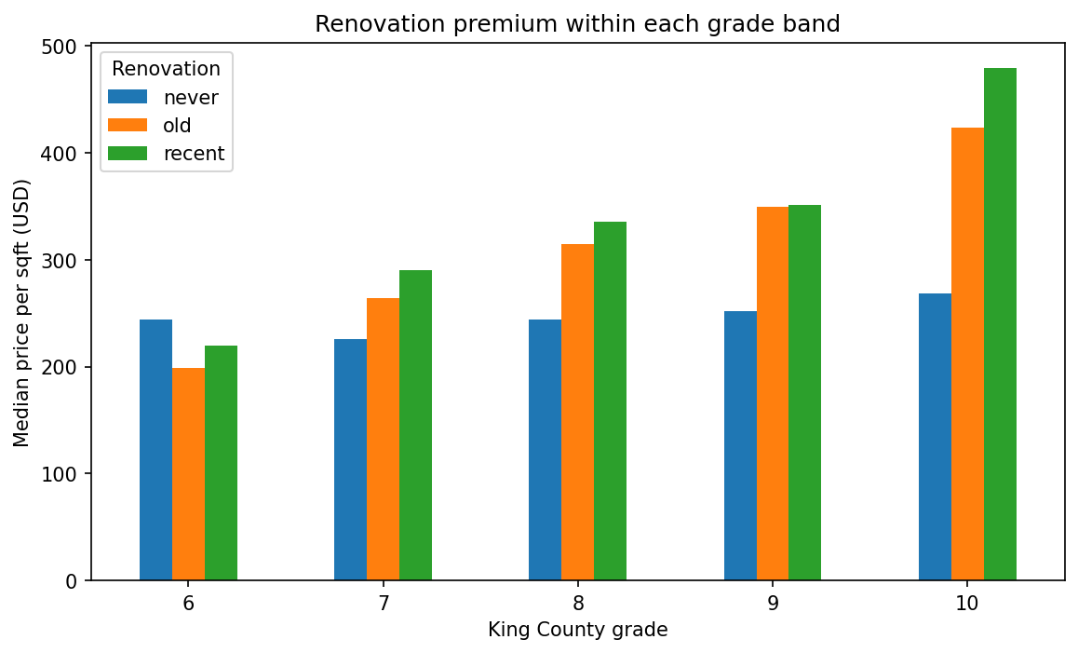
NOT SUPPORTED
QUESTION 3 — DOES RENOVATING PAY?
The premium that wasn't there
+2.7%
inside the same zipcode
Grade holds build quality constant. It does not hold location constant.
39 / 68
zipcodes where it paid
Notes:
This is where the analysis turned on me. Comparing houses of the same build grade, renovated homes look dramatically more valuable — twenty-nine percent at grade seven, rising to seventy-nine percent at grade ten. But grade controls for how well a house was built, not for where it stands, and renovated homes happen to cluster in expensive areas. When I repeated the comparison inside each individual zipcode, the premium collapsed to a median of 2.7 percent, and it was positive in only 39 of 68 zipcodes — barely better than a coin flip. Most of what looked like a renovation premium was simply the neighbourhood.

Slide 9
RECOMMENDATIONS
Three things Charles should do
List in early spring, close in April
1
Worth about 10% against a December sale. It costs nothing but patience.
Judge any property by its zipcode first
2
Location sets value per square foot far more than anything about the house.
Do not renovate as a price play
3
Against comparable homes in the same neighbourhood, it shows no reliable return.
Notes:
So, three things. One: sell in spring and aim to close in April — that is roughly ten percent on the same house for waiting, the cheapest return available, and he should avoid closing between November and January. Two: choose what to hold, sell or buy by zipcode, because the Lake Washington and central Seattle cluster carries about three times the value density of the southern suburbs. Three: do not spend on renovation expecting it back at the sale. Renovate because the house needs it, not as an investment.

Slide 10
HONEST LIMITS
What this cannot tell you
One year of data
May 2014 to May 2015
Association, not cause
renovated homes sell higher — not proof that renovating caused it
A small renovated group
744 sales out of 21,597
Notes:
Three honest limits. The data covers one year, so a seasonal pattern within that year is visible but no multi-year trend can be claimed. Everything here is association, not proof of cause — I can show that renovated homes sell higher, not that renovating caused it. And the renovated group is small, 744 sales out of 21,597, with the zipcode-level test resting on grades seven and eight alone, so individual zipcode figures carry wide uncertainty.

Slide 11
Questions
Sell in spring · Buy by zipcode · Skip the renovation
github.com/rouzbeh-enayatzadeh/eda-project
Notes:
Happy to take questions.

