Slide 1
Lie detection
Scenario 1 Opinioni
Alejandra Olivia Cruces Andrews Mario Alejandro Tapia Montero
Chelise Adelle Renessa Romain Rovena Llapushi

Slide 2
Agenda
Overview
Scenario 1 Opinioni: paper summary and results
GPT-n overview and architecture
Model & interpretation
GPT 3.5 Fine - tuning results
Paper results vs our results
Conclusions

Slide 3
Scenario 1 details
Goal
Setup

Slide 4
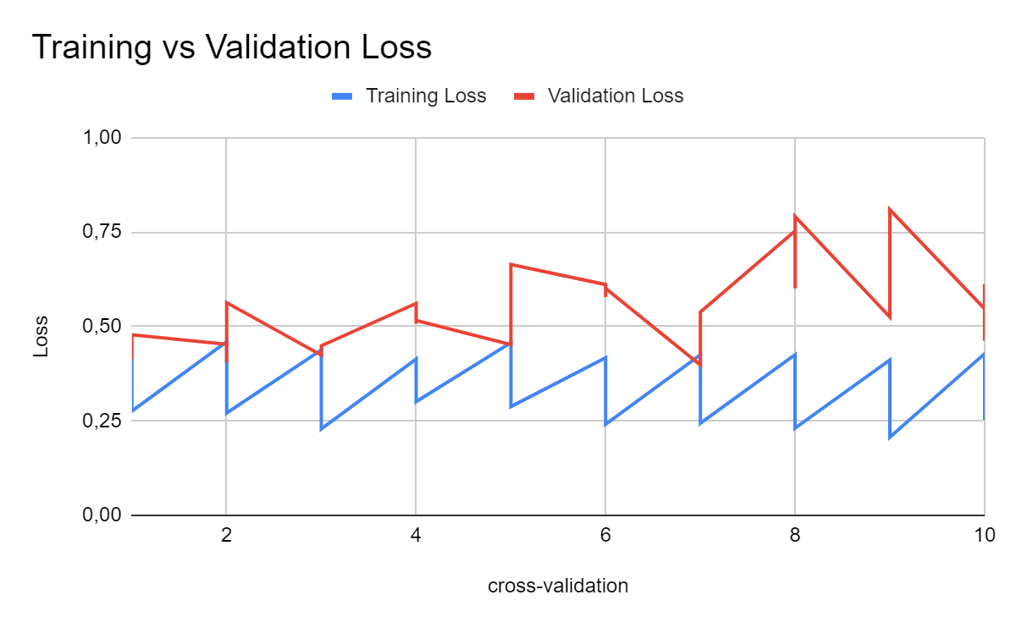
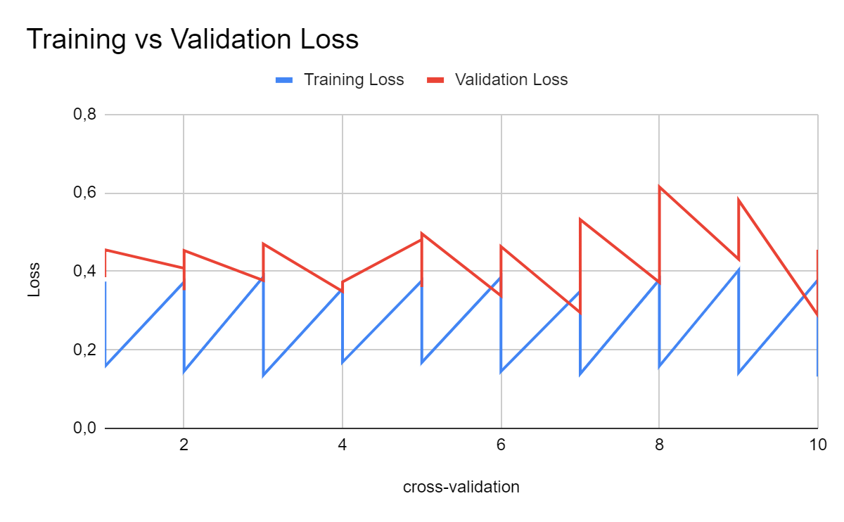
Experiment results
Base model
Small model

Slide 5
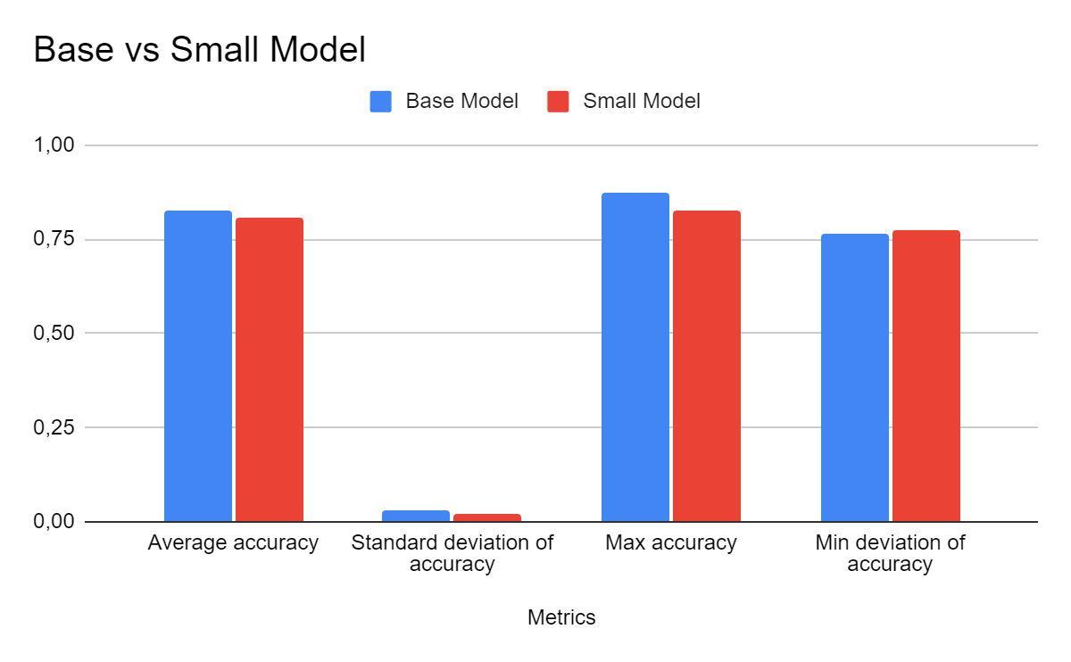
Experiment results

Slide 6
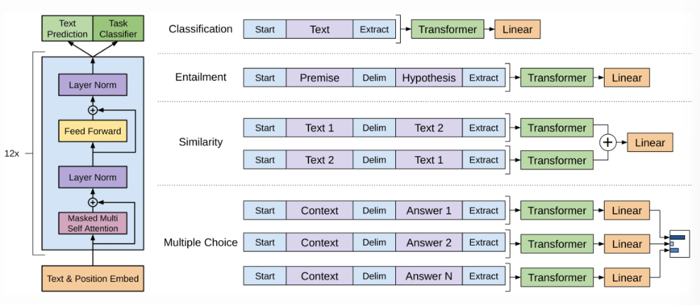
GPT-n fine-tuning
Notes:
GPT-n: Left-to-right language model.
Based on transformer’s decoder-only, no cross-attention layer.
Starts with word embedding and positional encodings.
Applies attention mechanisms.
Uses feed-forward layers and regularization steps.
Trained using standard cross-entropy loss.
Fine-tuning loss: Combination of task-specific loss and language modeling loss.
Model architecture: Unchanged during fine-tuning, except for the final linear layer.
Focus: Single sentence classification.
Classification process: Feed data as in training, predict label from final representation of last input token.

Slide 7
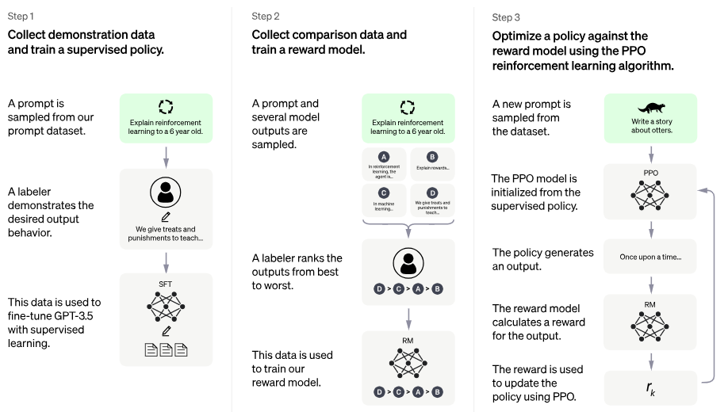
GPT-3.5 architecture
https://openai.com/blog/chatgpt
Notes:
GPT-3 introduces in the paper three big concepts:
First: in-context learning uses a single, large, frozen language model for various purposes.
Types of n-shot learning: Zero-shot, One-shot, and Few-shot
Second: Self-supervision: Powerful mechanism for acquiring rich representations, requires minimal human effort.
Final component: human feedback: Fine-tuning on human-level supervision and ranking of model outputs.
Step 2 of diagram: the language model if fine-tuned on human-level supervision making binary distinctions about good and bad generations
Step 3 of diagram: the model generates output and humans rank all of the output the model has produced. This feedback goes into a lightweight reinforcement learning mechanism

Slide 8
GPT-3.5 model setup

Slide 9
GPT-3.5 results

Slide 10
FLAN-T5 vs GPT 3.5

Slide 11
Conclusions

Slide 12
Final thoughts

Slide 13
Thanks!

