Slide 1
JRxD
An Image Search Engine

Slide 2
Introduction
JRxD is a project based on python language development. It is a search engine by example image search, used to find and retrieve all images that contain the content users submitted, and furthermore, it also places the most relevant images at the top of the search results list. The project is based on UK Bench and Paris dataset and under maintenance. The currently available version is v1.0.0.

Slide 3
JRxD Animation

Slide 4
JRxD Structure
|--- Feature Extraction and Indexing
| |--- index_features.py
| |--- cluster_features.py
| |--- visualize_centers.py
| |--- extract_bovw.py
|--- Building an Inverted Index
| |--- build_redis_index.py
|--- Performing a Search
| |--- search.py

Slide 5
JRxD Structure
In order to do the content-based information Retrieval, it requires 5 steps:
Extracting the features from the documents (Image dataset)
2. Building the dictionary (Codebook) by clustering the extracted features using K-mean.
3. Using the dictionary to form the Bag-of-Visual-Words (BOVW) which is represented as a histogram by quantizing the feature vectors and telling how many features each document has.

Slide 6
JRxD Structure
4. Building the Redis-index that key is feature and the values are images that containing this feature.
5. Performing the search by forming the BOVW representation of the query.

Slide 7
How do I use JRxD
Package:
1. openCV-python, openCV-contrib-python
2. imutils
3. h5py
Required Installing:
1. Redis, a fast and scalable key-value data structure database, that we use to build an inverted index for BOVW model.
To check Redis is working by $ redis-cli ping, if you receive a PONG then the server is correctly running.

Slide 8
How to execute the file – step 1
Step 1: Extracting features by 'index_features.py'.
Line 25, 26 use to choose the detectors and descriptors. In order to use SIFT and SURF, openCV have to be built!! Otherwise, it can use binary-descriptors such as BRISK, Fast and so on.
Example:
$ python index_features.py -d ukbench
-f BRISK_BRISK/features.hdf5

Slide 9
How to execute the file – step 1 contd
Here we define four arguments to specify the information required, which are,
‘-d’: The path to the directory containing our datasets images.
‘-f’: The path to the HDF5 database on disk.
(optional)‘-a’: The number of images in our dataset.
(optional)‘-b’: The number of feature vectors can be stored in memory until the buffer is flushed to HDF5.
After finish the feature indexing process we have the HDF5 dataset containing the image filename, keypoints, and descriptors.

Slide 10
How to execute the file – step 2
Step 2: Creating Codebook by 'cluster_features.py'
Example:
$ python cluster_features.py -f BRISK_BRISK/features.hdf5
-c BRISK_BRISK/vocab.cpickle -k 1536 -p 0.25
Each of the arguments detail are as below:
‘-f’: The path to HDF5 database that contains features information.
‘-c’: The path to the dictionary that stored the resulting cluster centers on disk.
‘-k’: The number of clusters will be generated.
‘-p’: The size of the feature vector sample size.
After executed the cluster_features.py script, we have a .cpickle file contains the visual vocabulary.

Slide 11
How to execute the file – step 3
Step 3: Forming the Bag-of-Visual-Words(BOVW) by 'extract_bovw.py‘
Example:
$ python extract_bovw.py -f BRISK_BRISK/features.hdf5
-c BRISK_BRISK/vocab.cpickle -b BRISK_BRISK/bovw.hdf5
-d BRISK_BRISK/idf.cpickle

Slide 12
How to execute the file – step 3 contd
We’ll also need to specify several arguments to extract BOVW histogram representations from each image and store in to the HDF5 dataset.
‘-f’: The path to the HDF5 dataset containing the extracted keypoints and local invariant descriptors
‘-c’: The path to the codebook.
‘-b’: The path of the HDF5 database storing the BOVW representations.
‘-d’: The path to inverse document frequency counts will be stored.
‘-s’: The size of managing a buffer of BOVW histograms.
Now, each feature vector has been quantized using the codebook we construct to build the resulting histogram.

Slide 13
How to execute the file – step 4
Step 4: Building the Redis-index by 'build_redis_index.py‘
Example:
$ python build_redis_index.py -b BRISK_BRISK/bovw.hdf5
We only need to specify the argument ‘-b’ , the path to the BOVW database, to build the inverted index using the Redis data stored. Once we have built the inverted index, find all image IDs that contain the visual word IDs, then take these image IDs and use them to perform the search.

Slide 14
How to execute the file – step 5
Step 5: Search by 'search.py‘
Example:
$ python search.py -d ukbench -f BRISK_BRISK/features.hdf5
-b BRISK_BRISK/bovw.hdf5 -c BRISK_BRISK/vocab.cpickle
-r ukbench/relevant.json -q ukbench/ukbench00258.jpg
Make sure the value uses in Line 29 and 30 is the same as step 1.

Slide 15
How to execute the file – step 5 contd
Extract all image IDs out of an inverted index and compute the distance between images that have a sufficient number of visual words in common.
To perform a search, the following arguments are required:
‘-d’: The path to dataset (UKBench). Use this path to load results from disk and display them.
‘-f’: The path to the HDF5 dataset storing the raw features.
‘-b’: The path to the BOVW HDF5 dataset.
‘-c’: The path to the codebook.
‘-i’: The inverted index array, but we’ll simply ignore this switch for now.
‘-r’: The path to the file that holds relevant images mappings, allowing us to determine the accuracy of the result.
‘-q’: The path to our query image.

Slide 16
How to execute the file – step 6
Step 6: Evaluate by ‘evaluate.py’
Example:
$ python search.py -d ukbench -f BRISK_BRISK/features.hdf5 -b BRISK_BRISK/bovw.hdf5 -c BRISK_BRISK/vocab.cpickle
-r ukbench/relevant.json
JRxD adopts a points-based metric that each point for each correct result in the top results to evaluate the result quality of a query. Finally a score over 3 is considered to be very good. Then computes the mean and standard deviation of the accuracies.

Slide 17
How to execute the file – step 7
Step 7: Apply spatial verification to original search results returned by the search engine by ‘search_spatial_verify.py’.
Example:
$ python search_spatial_verify.py -d ukbench
-f BRISK_BRISK/features.hdf5 -b BRISK_BRISK/bovw.hdf5
-c BRISK_BRISK/vocab.cpickle -r ukbench/relevant.json
-q ukbench/ukbench00258.jpg
All the arguments are identical to search.py

Slide 18
Evaluation
Metric
1 point for each relevant image in the top 4 results, so for example only one relevant image in the top 4 results gives 1 point whereas 4 relevant images in the top 4 results gives 4 points.
This is the same scoring system as used by Nistér and Stewénius (the creators of the UKBench dataset) in their 2006 paper ‘Scalable Recognition with a Vocabulary Tree’.

Slide 19
Evaluation
Detector + Descriptor | Feature Size | Extracting Time | Evaluation - Precision | Evaluation - Time
SIFT+SIFT | 128 | 32.14 | 2.17 | 0.22
SURF+SURF | 64 | 18.92 | 2.35 | 0.24
SIFT+ROOTSIFT | 128 | 32.18 | 2.29 | 0.21
SURF+ROOTSIFT | 128 | 47.90 | 2.79 | 0.15
FAST+BRIEF | 32 | 9.38 | 1.58 | 0.44
ORB+ORB | 32 | 10.03 | 2.27 | 0.22
BRISK+BRISK | 64 | 19.41 | 1.49 | 0.30

Slide 20
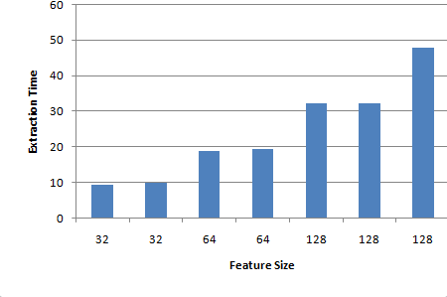
Evaluation
Extraction Time increases directly with Feature Size

Slide 21
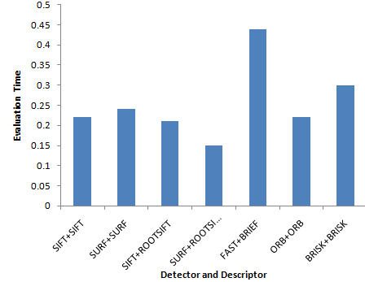
Evaluation
FAST+BRIEF and BRISK+BRISK have both poor (slow) Evaluation Time
SURF+ROOTSIFT is quickest

Slide 22
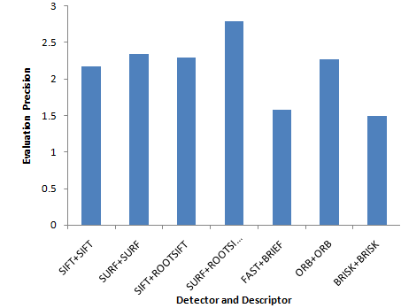
Evaluation
FAST+BRIEF and BRISK+BRISK also have both poor (low) Evaluation Precision
SURF+ROOTSIFT is again best

Slide 23
Evaluation
Summary
FAST+BRIEF and BRISK+BRISK have slow evaluation time and low evaluation precision
SURF+ROOTSIFT has the fastest Evaluation Time and highest Precision but comes with a high Extracting Time
ORB+ORB offers the best combination of a fast Extracting Time but still with good Precision and Evaluation Time

