Slide 1

STUDYTRACK SOFTWARE
STUDYTRACK SOFTWARE
Stay on Track. Keep Improving.
Rovena Nako · CEO & Software Architect
CMPSC 460 · Penn State Abington · November 2026
CMPSC 460 / FINAL PROJECT / STUDYTRACK SOFTWARE
01
Notes:
Timing: 20 seconds
StudyTrack Software is my proposed education software company. Its working product connects grades, lecture notes and study time. I will explain the company, the four programming paradigms, the audit and a short demonstration. The project is a student prototype, not an operating staffed company.

Slide 2
StudyTrack Software: Corporate Identity
Education software with transparent calculations and student control
MISSION
VISION
Turn coursework and uploaded lectures into focused study sessions.
Make academic planning understandable, adaptable and useful.
CORE VALUES
STRATEGIC OBJECTIVES
Clarity · privacy · accessibility · human judgment · testable code
Deliver a reliable local workflow; verify AI; gather student feedback.
Stay on Track. Keep Improving.
CMPSC 460 / FINAL PROJECT / STUDYTRACK SOFTWARE
02
Notes:
Timing: 25 seconds
My chosen field is education. Students can have scores and lecture files without a clear next study action. The product makes its calculation rules visible and lets students review the result. Core values are clarity, privacy, accessibility, human judgment and testable code. Near-term objectives are to verify the live AI path and collect feedback; no learning gains have been measured.

Slide 3
StudyTrack Software: Company Structure
The proposed hierarchy and responsibilities of the eight departments
Rovena Nako · CEO / Software Architect
DEVELOPMENT
RESEARCH & AI
QUALITY
OPERATIONS
General Software
Frontend + backend
Technological R&D
Research and prototypes
Quality Assurance
Tests and defect checks
Administration
Schedule and documents
Racket Development
Grade and planner DSLs
Artificial Intelligence
Optional study assistance
Paradigm Auditing
Review paradigm usage
Marketing & Sales
Student feedback
All eight departments report to the CEO. This student prototype combines these roles in one person.
CMPSC 460 / FINAL PROJECT / STUDYTRACK SOFTWARE
03
Notes:
Timing: 35 seconds
All eight required departments report to the CEO. The four headings group responsibilities; they are not extra management layers. General Software builds the web app; Racket owns the DSLs; R&D evaluates ideas; AI owns the assistant adapter. QA checks correctness; Paradigm Auditing checks style fidelity and coordinates with QA and Racket. Administration manages documentation; Marketing and Sales studies user needs. These roles are proposed and currently combined in this individual project. Machine Learning, Cybersecurity, Customer Support and Data Science are optional future departments. Two callable AI drafting assistants support company structure and Racket development; their live outputs still need verification.

Slide 4
Research: Five Official Company Reports
A bounded basic SLR of selected 2025–2026 reports · reviewed November 8, 2026
Deloitte · Tech Trends 2026
Prioritize measurable impact and governance → local workflow first.
Google Cloud / DORA · 2025
AI amplifies existing engineering strengths and weaknesses → QA + audits.
Microsoft · Work Trend Index 2025
Human–agent roles need clear responsibilities → reviewed AI drafts.
Stack Overflow · Developer Survey 2025
Developer trust remains limited → source checks and student review.
GitHub · Octoverse 2025
AI is part of development workflows → modular API integration.
Research informs engineering choices; it does not prove StudyTrack improves grades.
CMPSC 460 / FINAL PROJECT / STUDYTRACK SOFTWARE
04
Notes:
Timing: 40 seconds
The final basic review uses five identifiable official company reports, as the assignment permits. Nine candidate publications were considered, including the original draft sources. Four were excluded because report status or publication metadata was insufficiently clear. This is a bounded review, not an exhaustive research census. The common design implication is that AI needs clear responsibility, reliable engineering and human verification. Education is our selected application field; these industry reports do not demonstrate student learning outcomes.
Sources: https://www.deloitte.com/us/en/insights/topics/technology-management/tech-trends.html ; https://research.google/pubs/dora-2025-state-of-ai-assisted-software-development-report/ ; https://www.microsoft.com/en-us/worklab/work-trend-index/2025-the-year-the-frontier-firm-is-born ; https://survey.stackoverflow.co/2025/ai ; https://github.blog/news-insights/octoverse/octoverse-a-new-developer-joins-github-every-second-as-ai-leads-typescript-to-1/

Slide 5
Four Working Paradigm Prototypes
Three grade calculations and one related deadline query
IMPERATIVE · Python
Explicit loop and totals
imperative.py → 86.0%
OBJECT-ORIENTED · Python
Gradebook owns assignments and methods
object_oriented.py → 86.0%
FUNCTIONAL · Racket
Pure list transformations in Grade DSL
functional.rkt → 86.0%
DECLARATIVE · SQLite
Declare unfinished work in a date range
declarative.sql → assignment A
Grade fixture: 80 × 40% + 90 × 60% = 86% · All four examples executed successfully
CMPSC 460 / FINAL PROJECT / STUDYTRACK SOFTWARE
05
Notes:
Timing: 35 seconds
The first three prototypes solve the same complete-course grade fixture: 80 at 40 percent and 90 at 60 percent produce 86. The SQL prototype solves the related deadline-selection part of student progress. It returns assignment A from a controlled fixture. All four were executed and asserted, with outputs in evidence/prototype-results.json. The imperative proof uses accumulated totals, the OOP proof owns assignments in a Gradebook, the functional proof calls the pure Racket interpreter and SQL describes the desired rows. Sources: prototypes/ and work/final-submission/run_prototypes.py, bundled as evidence/run_prototypes.py.

Slide 6
Four Paradigms: Prototype Comparison
Choose the paradigm that fits each component’s responsibility
Criterion | Imperative | Object-oriented | Functional | Declarative
Structure | Ordered steps | Objects + methods | Transformations | Query + relations
State | Local accumulators | Encapsulated data | New immutable values | Database relations
Readability | Explicit flow | Domain vocabulary | Compact math | Concise selection
Maintainability | Order-sensitive | Centralized rules | Isolated functions | Schema-dependent
Advantage | Easy to trace | Rules stay together | Repeatable results | Express desired data
Limitation | Mutable complexity | More structure | I/O boundary needed | Not a full workflow
CMPSC 460 / FINAL PROJECT / STUDYTRACK SOFTWARE
06
Notes:
Timing: 35 seconds
This comparison explains the tradeoff rather than declaring one paradigm best. Ordered steps are useful for form processing. Objects keep domain validation close to the data. Functional code makes calculations independent of the database and easier to reproduce. SQL expresses selection and ordering, leaving execution strategy to SQLite. Each has a limit: control-flow complexity, extra structure, a separate I/O boundary or inability to express the whole user workflow alone. Sources: the four prototypes and docs/IMPLEMENTATION.md.

Slide 7
Our Flagship Product: StudyTrack
Target grades and uploaded lectures guide the next study session
THE PROBLEM
OUR SOLUTION
OUR VALUE
Students may know individual grades and due dates but still struggle to interpret progress or decide what to study next.
Set a target grade, upload lectures, and choose a topic and study time. Create a guide with cited passages and recall questions.
See the average needed to reach a target. Study from your own notes, then edit, save, and download the guide.
Proposed services: education web apps · custom DSLs · AI-assisted code audits
CMPSC 460 / FINAL PROJECT / STUDYTRACK SOFTWARE
07
Notes:
Timing: 30 seconds
The main product is StudyTrack. Students set a target, upload lecture text, choose a topic and a time budget, then review and save a cited guide. The target affects a transparent practice-time heuristic; it does not predict a future grade. Proposed services include education web applications, custom DSL development and AI-assisted code audits. These are a business model proposal, with no claimed customers or revenue. The differentiator is human-verifiable calculations and reviewed AI assistance.

Slide 8
StudyTrack: Application Architecture
Flask coordinates the components; storage, calculations and AI are separate services
Browser UI
HTML · CSS · JavaScript
Imperative workflow · Flask
routes.py / learning.py
OOP domain
Course / Assignment
Functional calculations
JSON bridge → Racket
Declarative storage
SQL → SQLite
Validation and rules
Grade DSL + allocation DSL
Coursework, lectures, guides
Optional AI adapter → Responses API
Selected excerpts only, after explicit opt-in
Result → student review → save / download
Local guide also works without AI
Flask ↔ each component · AI source checks before display · live AI verification pending
CMPSC 460 / FINAL PROJECT / STUDYTRACK SOFTWARE
08
Notes:
Timing: 40 seconds
This is a logical dependency diagram, not a mandatory linear pipeline. Browser forms reach Flask, which validates requests and coordinates domain objects, SQL storage and pure calculations. The fixed Racket runner accepts JSON data, not executable user code. Python selects passages before allocating time. Optional AI receives selected excerpts after opt-in and returns structured assistance through the same backend. Source checks happen before display. The student reviews and saves the result. SQL and the Racket bridge are used as needed; the local guide does not depend on an AI service. Sources: routes.py, learning.py, domain.py, storage.py, guidance.py, racket_bridge.py and ai.py.

Slide 9
Four Paradigms: Integration Evidence
Each paradigm performs a working role inside the final web application
Paradigm | App component | Technology | Purpose | Working evidence
Imperative | routes.py learning.py | Python / Flask | Validate, order steps, save | Workflow + upload tests
Object-oriented | domain.py | Python dataclasses | Course and Assignment rules | Domain / constructor tests
Functional | DSL_1.rkt DSL_2.rkt | Racket + pure Python | Grades and time allocation | 16 RackUnit checks + parity
Declarative | storage.py UPCOMING_SQL | SQL / SQLite | Filter and order deadlines | Date-window query tests
November 8 verification: 33 Python tests passed · 16 Racket tests passed
CMPSC 460 / FINAL PROJECT / STUDYTRACK SOFTWARE
09
Notes:
Timing: 35 seconds
This matrix maps paradigm names to concrete app files and evidence. Show the imperative route that validates and commits form changes; show Course and Assignment constructors; show the Racket map/filter or allocation recursion; then show the SQL deadline query. The complete Python suite passed 33 tests and Racket passed 16 checks. The tests include mocked AI behavior, not live provider acceptance. Sources: evidence/python-tests.txt, evidence/racket-tests.txt and the named files.

Slide 10
StudyTrack: Two Working Racket DSLs
Small domain-specific languages express grades and study-time allocation
GRADE DSL
STUDY-PLAN DSL
(course
(item 80 40)
(item 90 60))
(study-plan
(available 120)
(task 1 60)
(task 2 90))
Result: 86.0%
Result: 60 + 60 minutes
map and filter transform grade data.
#f means ungraded. Zero still counts.
The plan stays within the time budget.
Pure functions leave inputs unchanged.
CMPSC 460 / FINAL PROJECT / STUDYTRACK SOFTWARE
10
Notes:
Timing: 35 seconds
DSL 1 is a restricted grade language. Its forms represent percentage weights and scores; false means ungraded, while zero is a real grade. DSL 2 allocates available minutes in supplied priority order and returns new values recursively. The fixed runner converts JSON into these forms and returns results; it never evaluates submitted code. The samples produce 86 percent and two 60-minute sessions. Invalid weights, nonfinite values, unknown forms and duplicate IDs are rejected. Sources: racket/DSL_1.rkt, DSL_2.rkt, runner.rkt and studytrack/racket_bridge.py.

Slide 11
StudyTrack: Frontend, Backend & Database
The technologies used to build the working application
FRONTEND
BACKEND
DATABASE
HTML + CSS + JavaScript
Course pages, lecture uploads, and study guides.
Students reveal answers, edit guides, and download text.
Python + Flask
materials.py extracts text.
guidance.py builds the guide.
learning.py handles forms.
Racket calculates grades and allocates study minutes.
SQLite
Stores courses, assignments, lectures, and study guides.
Guides keep source excerpts and the student’s reviewed text.
Browser forms → Flask request handling → SQLite / Racket → Updated page
CMPSC 460 / FINAL PROJECT / STUDYTRACK SOFTWARE
11
Notes:
Timing: 25 seconds
HTML, CSS and JavaScript provide course pages, uploads, recall controls and downloads. Python and Flask coordinate extraction, guide creation and forms. SQLite stores coursework, extracted lecture text and saved guide snapshots. Racket calculates grades and budgets. The source is organized into these responsibilities so the code can be explained and tested. The local application is intended for a single-user prototype, not a deployed multi-user service.

Slide 12
StudyTrack: AI and Human Verification
Working integration code; live provider verification remains pending
LOCAL GUIDE
OPTIONAL STUDY AI
Keyword passage selection, grade arithmetic and timed recall work without AI.
Selected excerpts support explanations and practice questions. IDs and quotes are checked.
TWO COMPANY ASSISTANTS
HUMAN RESPONSIBILITY
Company Structuring Assistant and DSL Racket Builder have separate prompts and callable commands.
Review answers against lectures; inspect generated code. No automatic code execution or approval.
Explicit opt-in · server-side credentials · limited excerpt sharing · reviewed output
CMPSC 460 / FINAL PROJECT / STUDYTRACK SOFTWARE
12
Notes:
Timing: 40 seconds
Traditional software performs deterministic arithmetic, passage retrieval and time allocation. AI is appropriate for flexible explanations and practice prompts grounded in the selected lecture passages. The adapter checks required fields, source IDs and quoted evidence, but those checks do not establish that every claim is correct. Students verify explanations against the lecture. The two company assistants are single-request drafting assistants with distinct prompts, not autonomous agents. Their commands do not execute generated Racket code. Live AI has not been verified because no API credential is configured. The included verification tool uses fictional notes and records output for human review. Sources: ai.py, company_assistants.py, agents/, tools/verify_live_ai.py and tests/test_assistants.py.

Slide 13
Paradigm Audit: Findings and Rubric
Real deliverable: studytrack/functional.py · original preserved for reproduction
87 / 100
Provisional self-assessment
THREE VALIDATION DEFECTS
Score 110 → rejected
Negative time budget → rejected
Duplicate task IDs → rejected
Pure transformations retained; no paradigm violation found.
Fidelity 28/30 · Correctness 23/25
Analysis 22/25 · AI process 5/10
Comparison 9/10
Original prompt and code retained. Corrections and before/after evidence are documented.
Not an instructor grade. Rovena’s review is pending; the original focused generation prompt and model metadata were not captured.
CMPSC 460 / FINAL PROJECT / STUDYTRACK SOFTWARE
13
Notes:
Timing: 45 seconds
The audit examined the real pure-Python fallback module. The original already used transformations without I/O or input mutation, so the findings concern correctness rather than invented paradigm violations. It accepted an out-of-range score, a negative time budget and duplicate task IDs. Corrections validate these inputs while retaining pure returned values. The reproduced before/after cases are included. The provisional self-assessment uses the Canvas weights: 30 fidelity, 25 correctness, 25 analysis, 10 AI process and 10 cross-paradigm comparison. It is 87 out of 100, not an instructor grade or a completed human approval. AI process loses points because only the broad initiating prompt and confirmation were preserved; a focused generation prompt and model identifier were not captured. Sources: docs/AUDIT.md, docs/audit/functional_original.py, evidence/audit-results.txt and Canvas assignment 18821812.

Slide 14
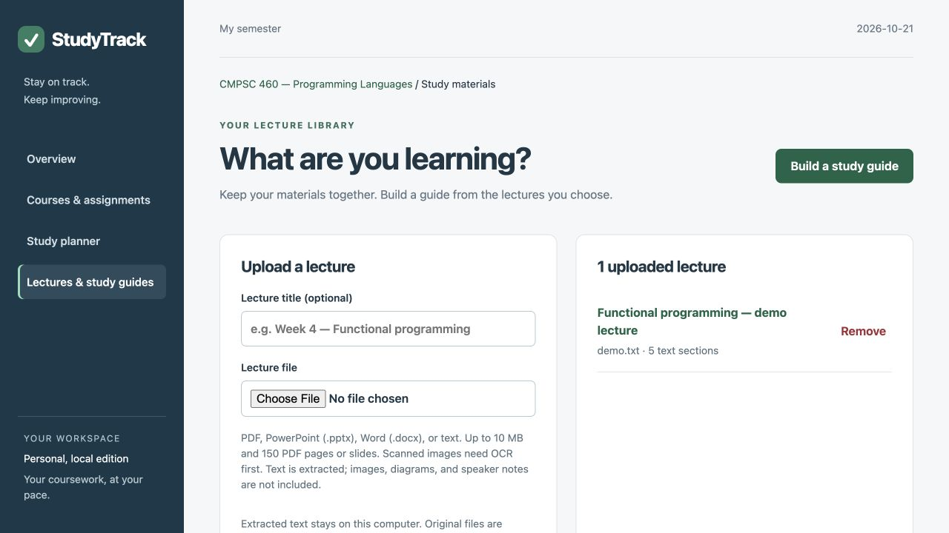
StudyTrack: Lecture Uploads & Live Demo
Actual application with fictional demonstration data
LIVE DEMO SCRIPT
1. Set a target grade
2. Upload lecture notes
3. Choose a focus topic
4. Enter available minutes
5. Build the study guide
http://127.0.0.1:5055
Local app on this computer
CMPSC 460 / FINAL PROJECT / STUDYTRACK SOFTWARE
14
Notes:
Timing: 35 seconds
Open http://127.0.0.1:5055 while the app is running. This is a local address, not a public hosting link. Set a target in the fictional CMPSC 460 course. Upload examples/functional-programming-lecture.txt, select recursion and enter 60 minutes. Build a guide. Explain that PDF, PPTX, DOCX, TXT and Markdown extraction is supported; scanned pages need OCR and visual diagrams are not understood. Show the route, object validation, Racket calculation and SQL query in the source. Screenshot is from the actual October 21 local demonstration with fictional data.

Slide 15
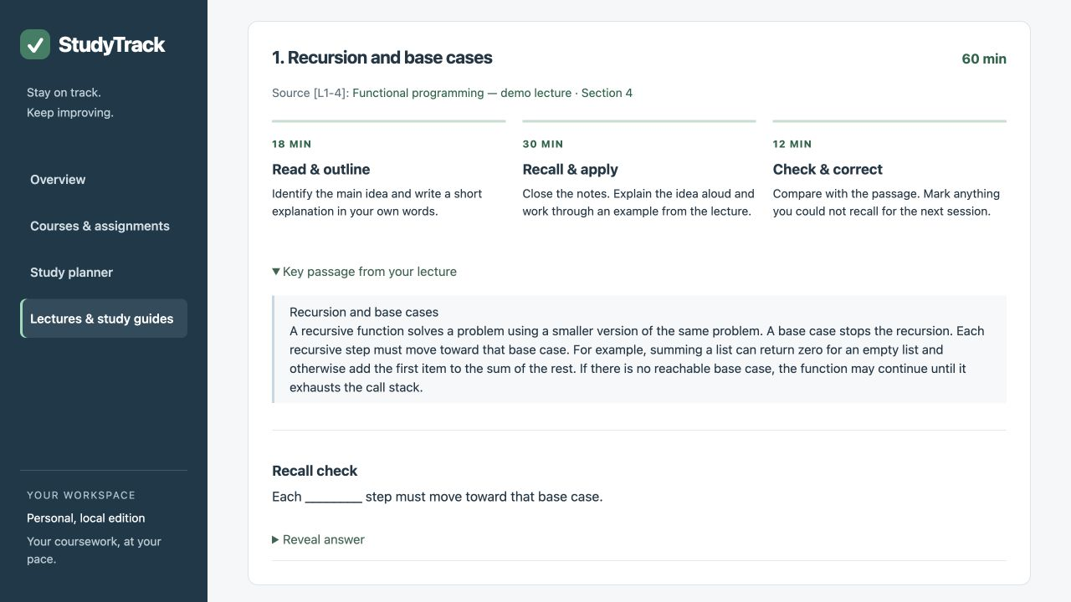
StudyTrack: Lecture Guide, Recall & Save
A 60-minute recursion session uses the uploaded lecture
60-minute guide
18 min: read & outline
30 min: recall & apply
12 min: check & correct
Reveal the answer, edit the guide, then save and download.
Stay on Track. Keep Improving.
Local guide shown; live AI pending.
CMPSC 460 / FINAL PROJECT / STUDYTRACK SOFTWARE
15
Notes:
Timing: 45 seconds
Show the source excerpt and recall question. This example uses a demanding required average and assigns 30 minutes to practice, 18 to reading and 12 to checking. Explain that this is a planning heuristic, not a guarantee of a grade. Reveal the answer, edit the guide, save it and download the reviewed text. If live AI has been verified before the presentation, opt in and compare its explanation with the cited passage; otherwise disclose the limitation and demonstrate the working local guide. Conclude that the project combines four identifiable paradigms with two DSLs and human review. Screenshot: actual October 21 local app with fictional demonstration data.

