Slide 1

A THREE-LANE WEBCAM CONTROLLED ENDLESS RUNNER
Notes:
Introduce this as an endless runner that players can control with a keyboard or by moving in front of a webcam. Cover art: project D4C menu artwork.

Slide 2
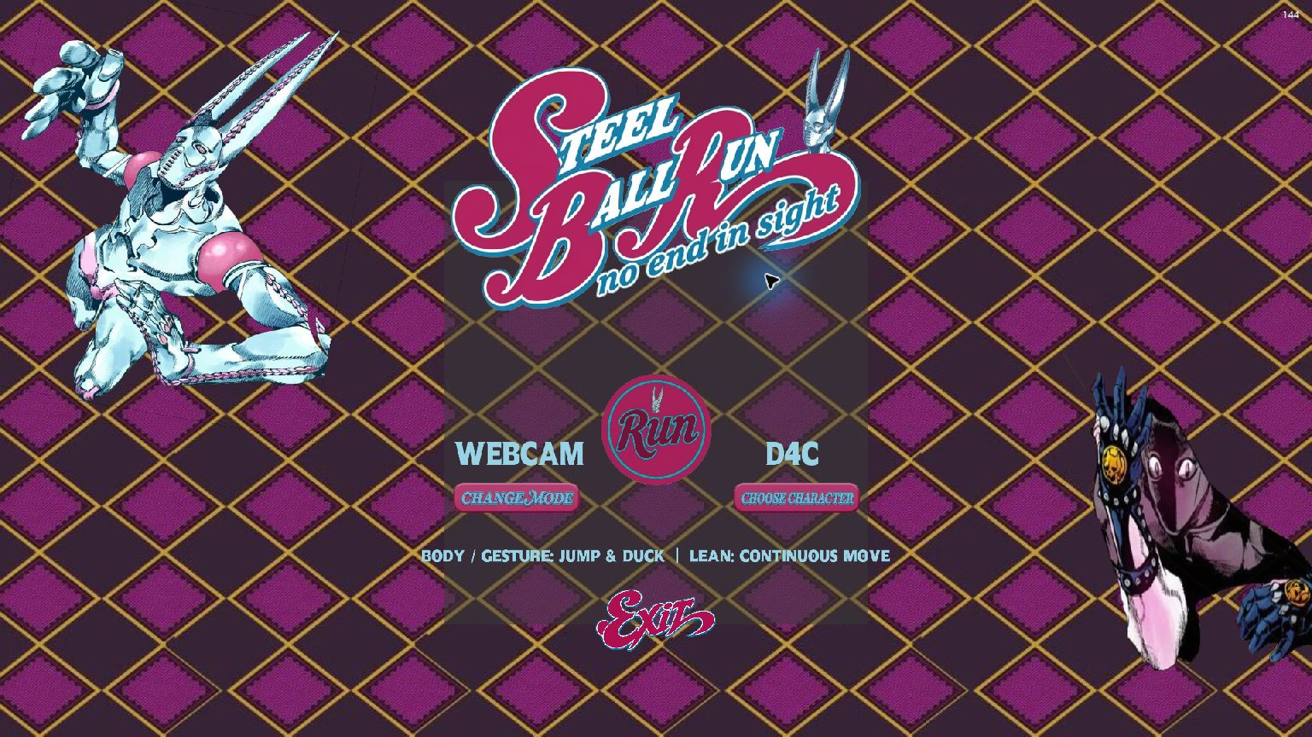
01 BEFORE THE RUN
PICK YOUR
RUNNER
Choose D4C or Killer Queen.
Then pick how you want to play.
KEYBOARD
Use familiar movement keys.
WEBCAM
Lean, jump and duck to steer
your runner and clear obstacles.
THE MAIN MENU
02 / 08
Notes:
Show the illustrated start screen. The active menu offers D4C and Killer Queen. Pick an input mode and press Run. Source: SteelBallRun_v5, local keyboard demo and game menu. Current scene routing: ProjectSettings/EditorBuildSettings.asset.

Slide 3
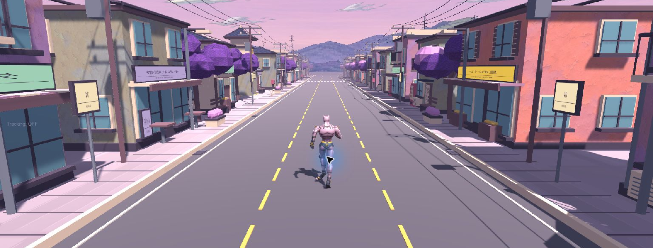
02 THE OPENING STRETCH
The runner moves forward on its own.
You pick a lane, dodge obstacles and
collect coins as the pace picks up.
The Run Starts
03 / 08
Notes:
Point out the three lanes and the changing street scenery. The character runs forward automatically and the pace increases. The HUD shows distance, coins, score and speed. Source: SteelBallRun_v5, local keyboard demo and game menu. Current scene routing: ProjectSettings/EditorBuildSettings.asset.

Slide 4
03 THE FIRST OBSTACLES
THREE MOVES KEEP YOU RUNNING
MOVE
KEYBOARD
WEBCAM
CHANGE LANES
A / D or Left / Right
Lean left or right
JUMP
W, Up or Space
Jump
DUCK
S or Down
Crouch
Jump over low hazards, duck under overhead barriers, or switch to a clear lane.
04 / 08
Notes:
Describe the same actions in both modes. In webcam mode the main menu specifically describes leaning as continuous movement. Keyboard labels and webcam movement guidance come from the v5 menu and ActiveMotion3D README.

Slide 5
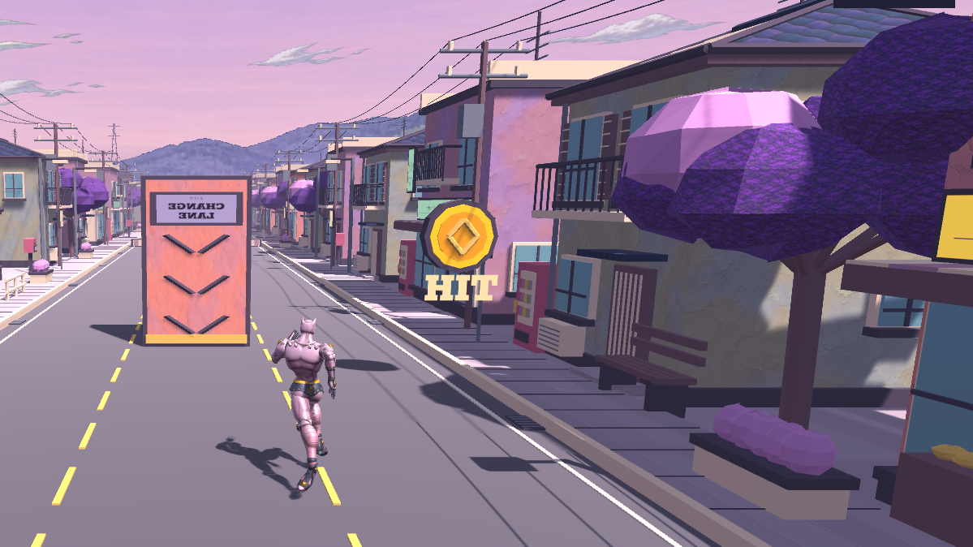
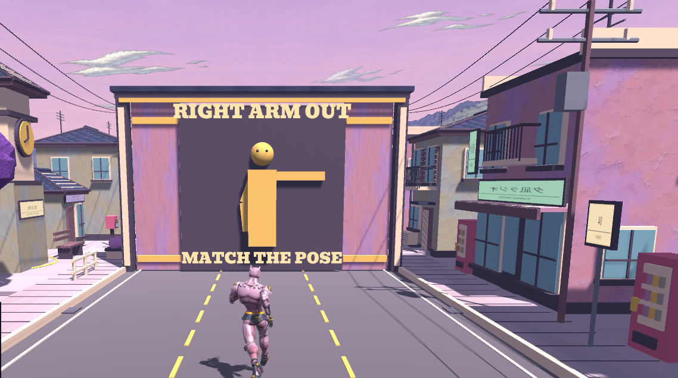
04 WEBCAM CHALLENGES
THE TRACK ASKS YOU TO MOVE
PUNCH TARGETS
HUMAN TETRIS
Raise the arm when
a target lights up to earn a coin.
Copy the pose on the approaching
wall before it reaches you.
05 / 08
Notes:
With pose tracking, raise the matching arm when a target lights up. A successful hit gives one coin. For Human Tetris, copy the wall’s silhouette before it reaches you. The runtime has six arm poses. Sources: Assets/ActiveMotion3D/README.md and local v5 screenshots.

Slide 6
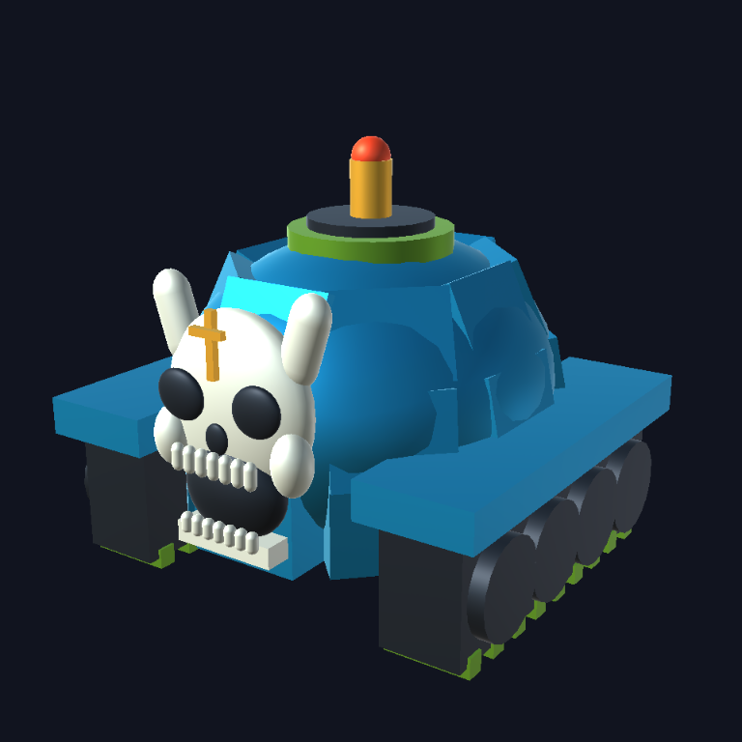
05 SPECIAL ENCOUNTER
SHEER HEART
ATTACK
A small tank locks onto your lane
and rushes toward you faster
than the other hazards.
Jump over it or get out of its lane
before it reaches you.
ENEMY MODEL
06 / 08
Notes:
The encounter clears previous hazards and commits to the player’s lane when it spawns. It can be jumped or dodged and detonates on impact. Render and behavior: Docs/SheerHeartAttack and PROJECT_HANDOFF.md, November 5 update.

Slide 7
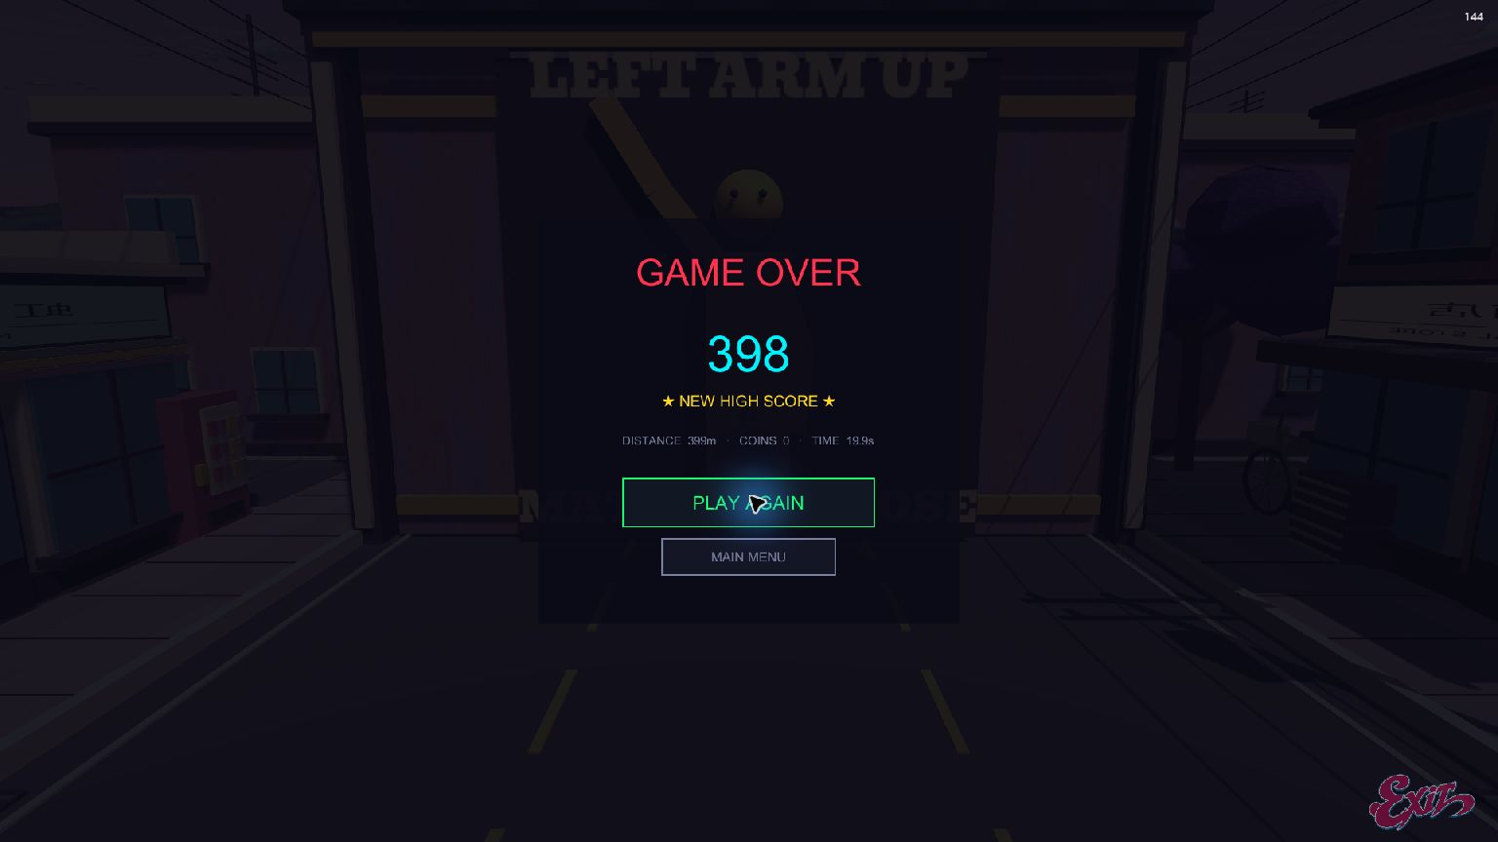
06 AFTER THE RUN
ONE MORE TRY
See how far you got, how many
coins you collected and how long
you lasted.
PLAY AGAIN
Start another run right away.
MAIN MENU
Change character or input mode.
07 / 08
Notes:
The results screen shows score, distance, coins and time. Use Play Again for an immediate retry or Main Menu to change character or input mode. Source: v5 keyboard demo.

Slide 8
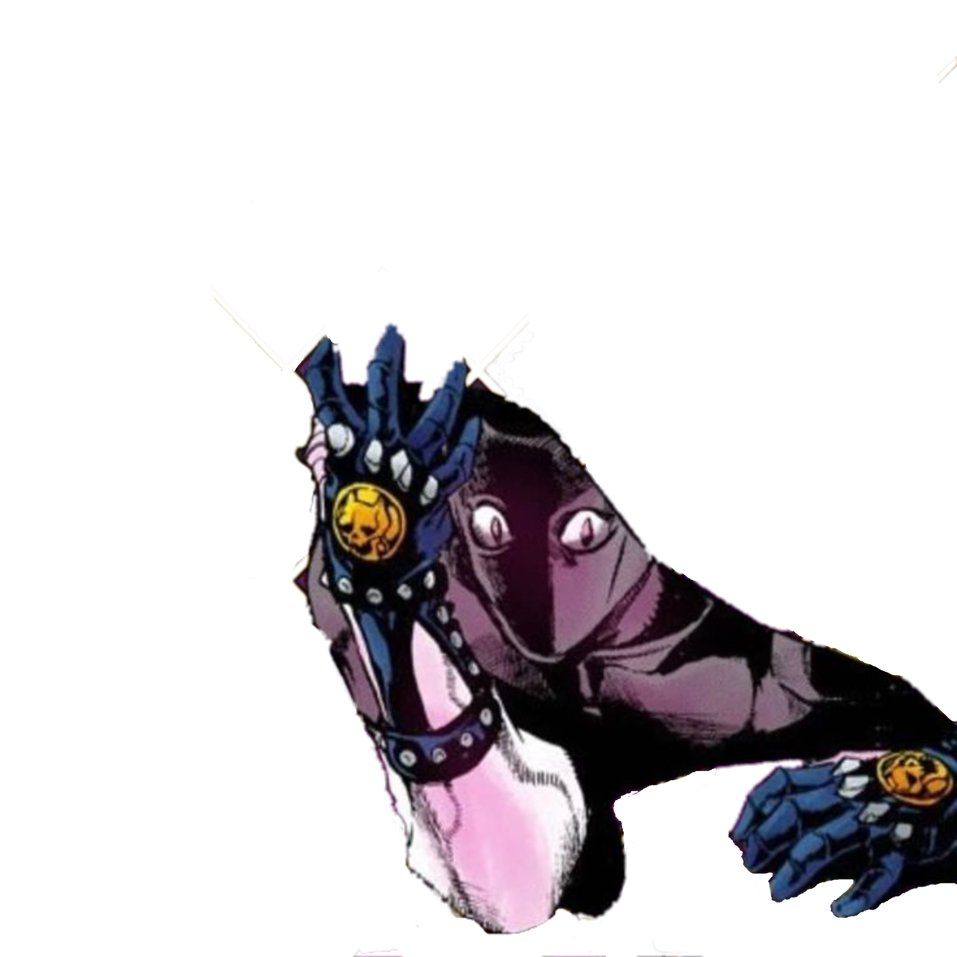
HOW FAR CAN
YOU GET?
The current build includes both control modes,
The course and the tank encounter.
You can pause mid-run or retry from results.
STEEL BALL RUN / ROWAAN & ROHAN
08 / 08
Notes:
Close by demoing the current local build. Start with a short keyboard run so the audience sees the lane changes and the results screen, then show webcam actions if the demo setup is ready. Art: project Killer Queen menu artwork.

