Slide 1

STEEL BALL RUN
NO END IN SIGHT
A body-controlled endless runner
Created by Rowan & Rohan
01

Slide 2
STEEL BALL RUN
Run as far as you can
Move between three lanes, avoid obstacles and collect coins.
A collision ends the run. Try again and beat your score.
02

Slide 3

STEEL BALL RUN
Choose how to play
KEYBOARD
Change lanes with A / D or the arrow keys. Jump with W, Up or Space; duck with S or Down.
WEBCAM
Use your body to move, jump and duck.
03

Slide 4
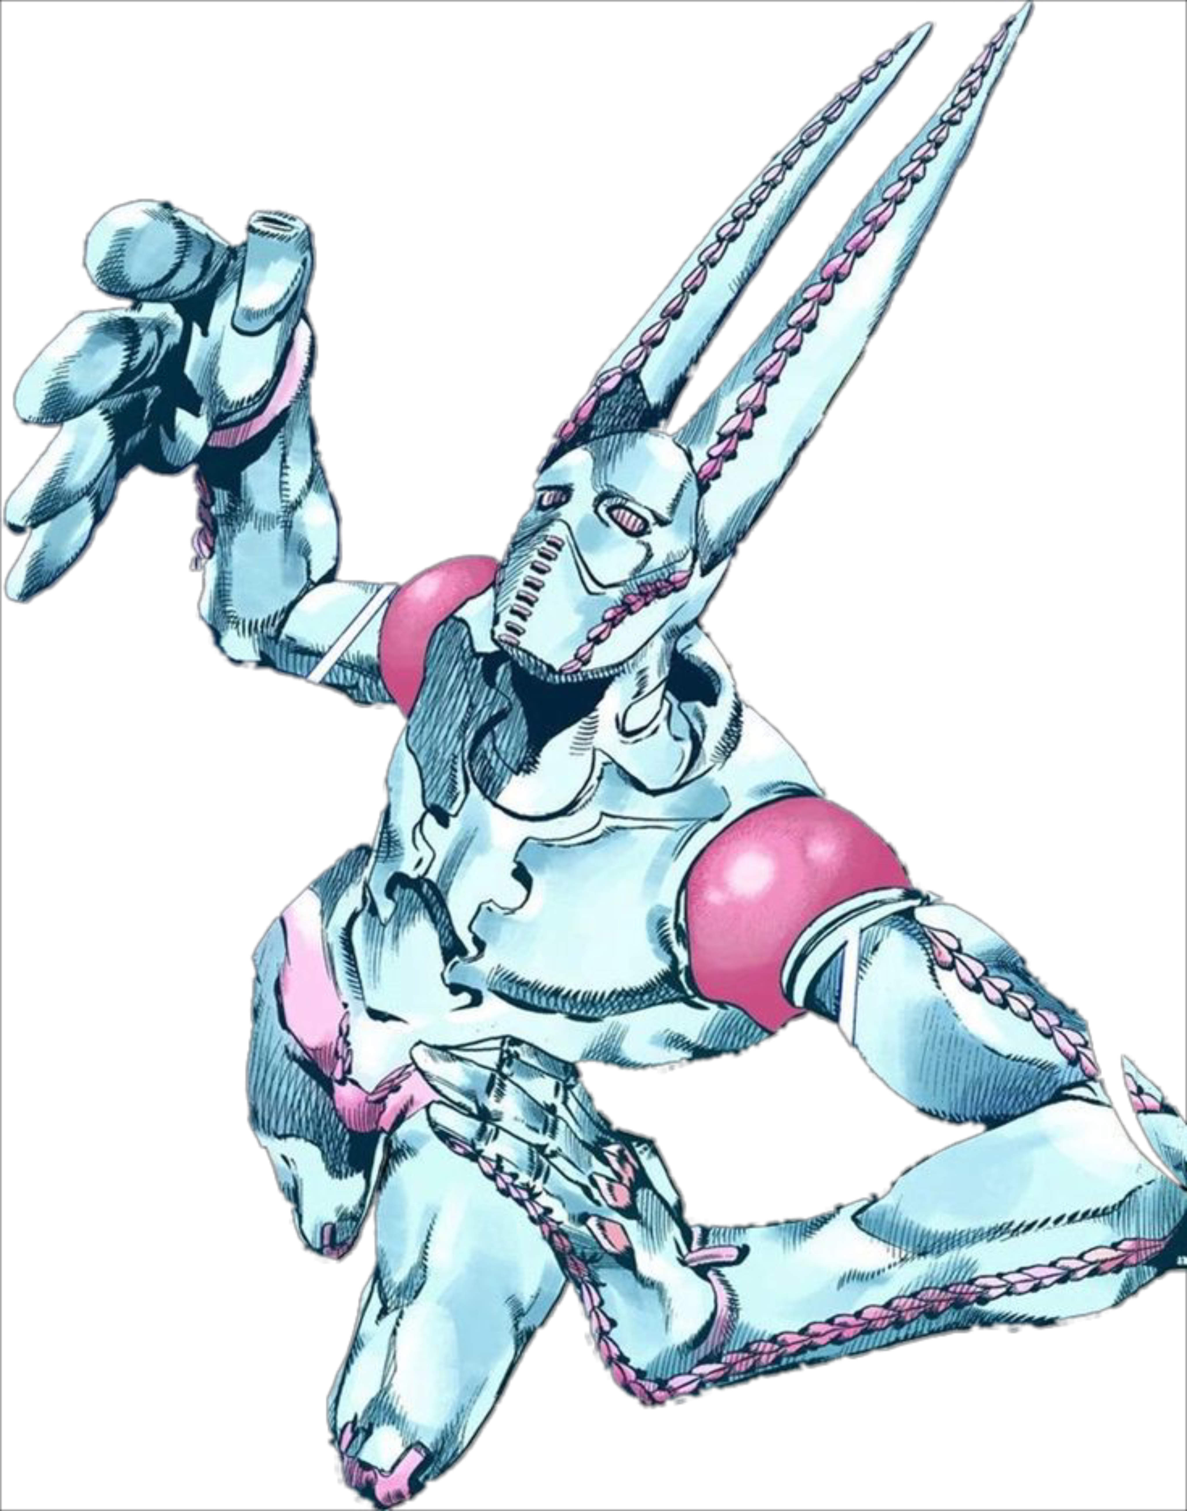
STEEL BALL RUN
More than dodging
PUNCH TARGETS
Raise the matching arm when a target lights up to earn a coin.
HUMAN TETRIS
Match the pose shown by an approaching wall to pass through.
04

Slide 5

STEEL BALL RUN
Your run
Choose a character and input mode in the menu.
Start running, collect coins and react to obstacles.
After a collision, play again or return to the menu.
05

Slide 6
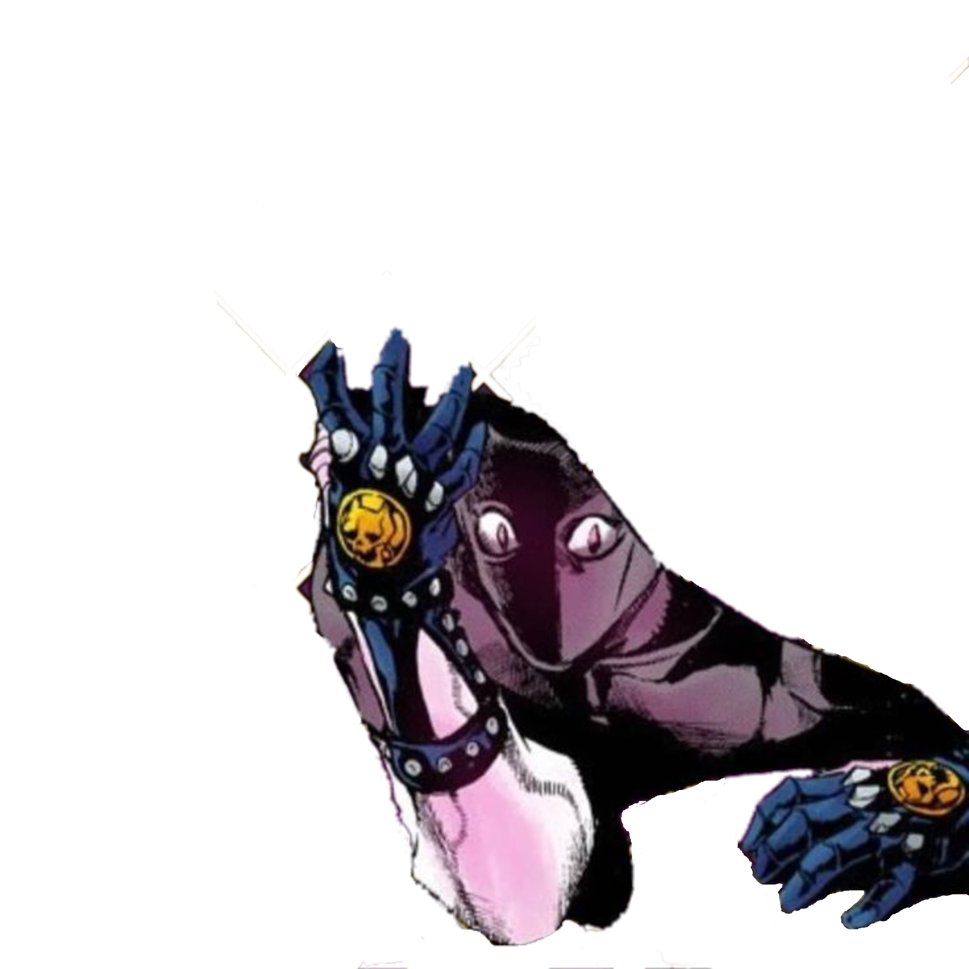
STEEL BALL RUN
Where the project stands
The core game flow and activities are in place.
Next up: pause and settings, clearer webcam guidance, visual polish and release testing.
06

Slide 7
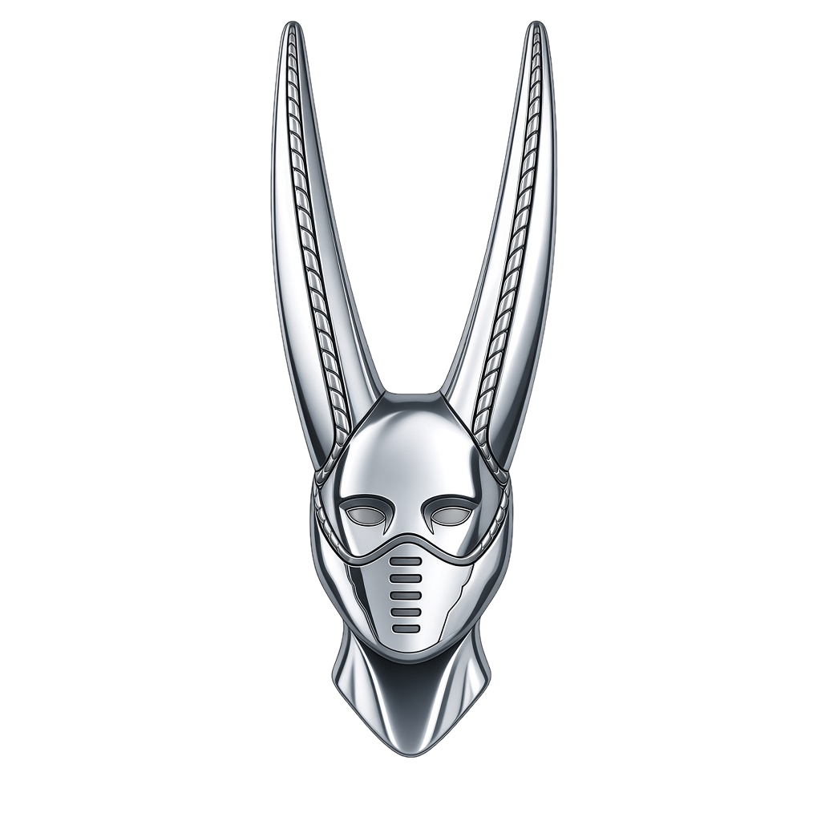
STEEL BALL RUN
Ready to run?
Pick a character, choose your controls and see how long you can survive.
07

