Slide 1
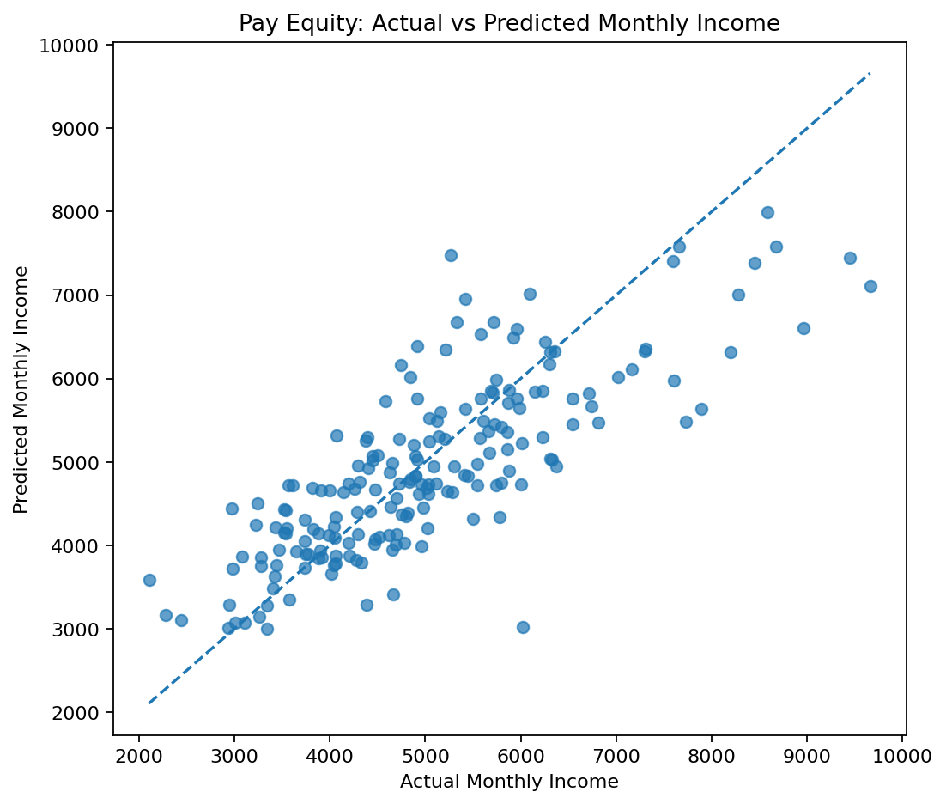
EMPLOYEE ATTRITION ANALYSIS
Why these
preprocessing steps
and models?
A short methodology walkthrough for the final project
A careful workflow turns messy HR records into explainable decisions.
Data Analytics Bootcamp • Instructor presentation
Notes:
[Sources]
Internal project evidence: employee_attrition_analysis2.ipynb
Internal figure: figures/pay_equity_actual_vs_predicted.png

Slide 2
THE STARTING POINT
The data needed preparation before any model could be trusted
01
02
03
Raw export
Prepared data
Decision-ready outputs
→
→
1,045 HR records
Inconsistent text, duplicate employees, hidden missing values
Standardise → impute → remove unusual records
960 analysis-ready employees
Pay review flags, attrition probabilities, high-potential screening, segments
Why it matters: models learn patterns in the data they receive. Cleaning protects every result that follows.
02
Notes:
[Sources]
Internal project evidence: employee_attrition_analysis2.ipynb, sections 2–4 and 9

Slide 3
PREPROCESSING CHOICE 1
We cleaned meaning, duplicates, and missing values—not just blank cells
Standardise text
Department and education categories had inconsistent spelling and casing. Standardisation prevents one real category being split into several false groups.
Why not simply use the mean?
A mean makes different employees look artificially alike. KNN estimates a value from the five nearest employee profiles after scaling the numeric fields.
Remove duplicates
Repeated employee records would overweight the same person in every model. We retained one record per employee.
Use KNN imputation (k = 5)
Distance metric: nan_euclidean
Missing numeric values appeared as blanks, “?” and −999. KNN uses similar employees rather than a single mean, preserving local patterns.
Works even when some values are missing.
03
Notes:
[Sources]
Internal project evidence: employee_attrition_analysis2.ipynb, sections 3.1–3.4

Slide 4
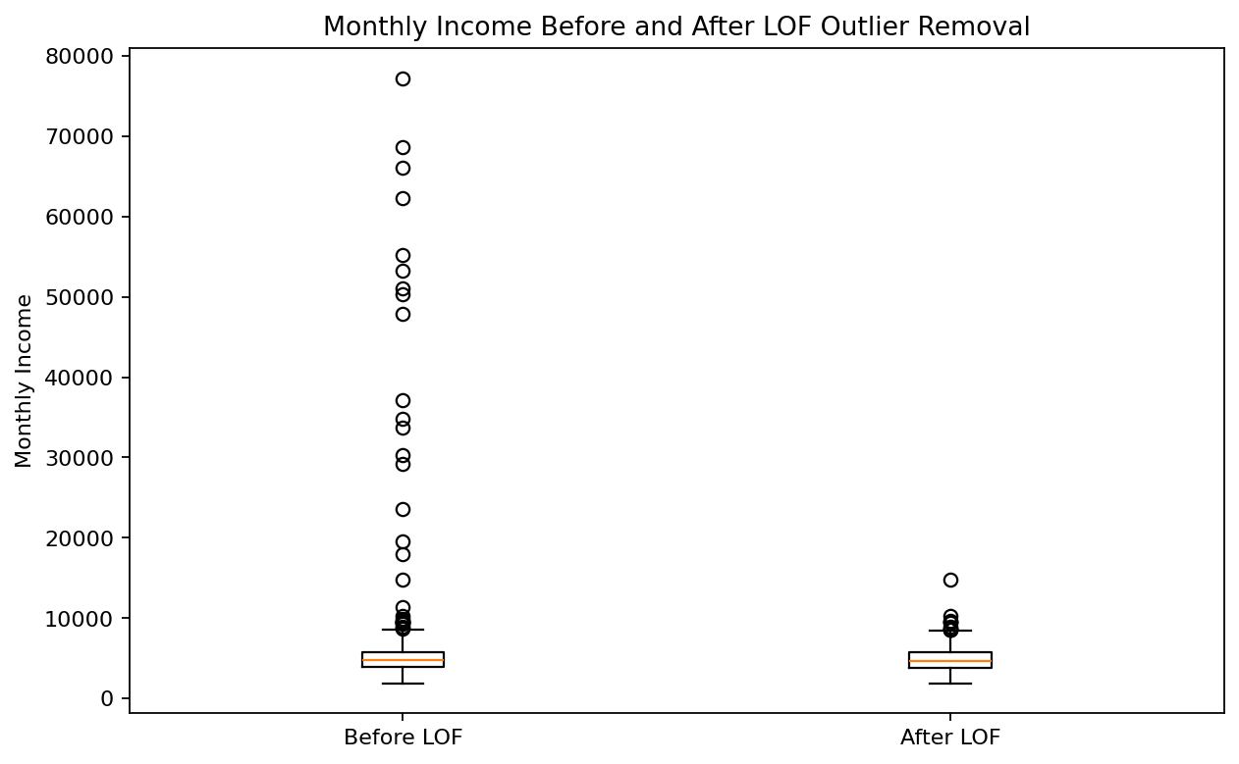
PREPROCESSING CHOICE 2
We prepared the data according to each algorithm’s assumptions
Encode categories correctly
Education has a natural order, so it is ordinal-encoded. Department and Job Role have no order, so they are one-hot encoded.
Scale distance-sensitive features
KNN, LOF, SVM and K-Means use distances. Scaling stops Monthly Income from dominating Age or Tenure simply because its numbers are larger.
Balance the attrition classifier
Attrition is less common than non-attrition. Logistic Regression uses balanced class weights so the minority “Yes” cases are not ignored.
LOF outlier removal
Local Outlier Factor flagged 40 unusual records; removing them prevents data-entry errors from distorting model boundaries.
04
Notes:
[Sources]
Internal project evidence: employee_attrition_analysis2.ipynb, sections 3.5 and 4
Internal figure: figures/lof_before_after.png

Slide 5
MODEL CHOICE 1
Linear Regression makes the pay-equity analysis explainable
Question
Is actual monthly income aligned with an employee’s profile?
Why Linear Regression?
Income is a continuous amount. Linear Regression provides a clear expected-income benchmark and understandable residuals: actual minus predicted pay.
Why this is useful
It shows the actual-versus-predicted relationship directly and flags employees beyond ±2 standard deviations for review.
Use as a screening signal—not proof of unfair pay.
05
Notes:
[Sources]
Internal project evidence: employee_attrition_analysis2.ipynb, section 5
Internal figure: figures/pay_equity_actual_vs_predicted.png

Slide 6
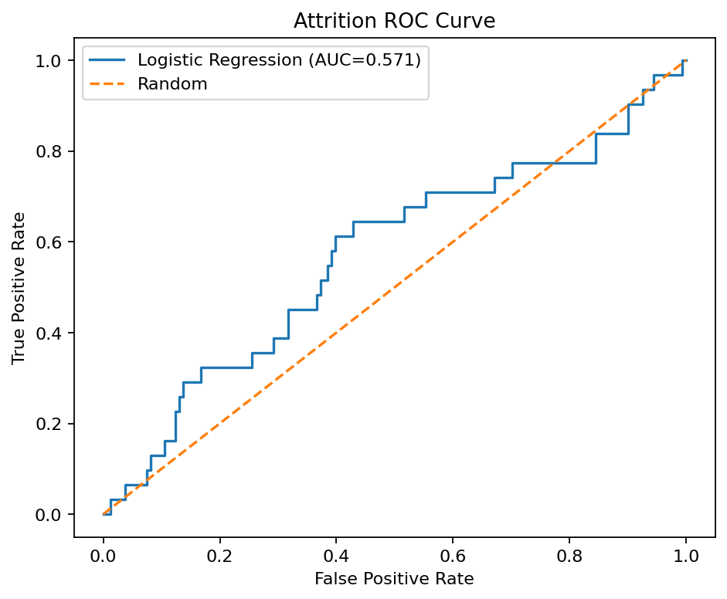
MODEL CHOICE 2
Classification models match the two yes/no HR questions
Attrition prediction
Talent identification
Logistic Regression
Linear SVM vs. RBF SVM
Why chosen: Attrition is Yes/No, and Logistic Regression outputs a probability that HR can rank and interpret. Class weights address imbalance.
Why chosen: the target is binary (high performer or not), while SVM tests both a simple linear boundary and a flexible non-linear boundary. We select by F1 score—not accuracy alone.
Critical safeguard: Performance_Score is excluded from the inputs because it defines the target.
06
Notes:
[Sources]
Internal project evidence: employee_attrition_analysis2.ipynb, sections 6–7
Internal figure: figures/attrition_roc_curve.png

Slide 7
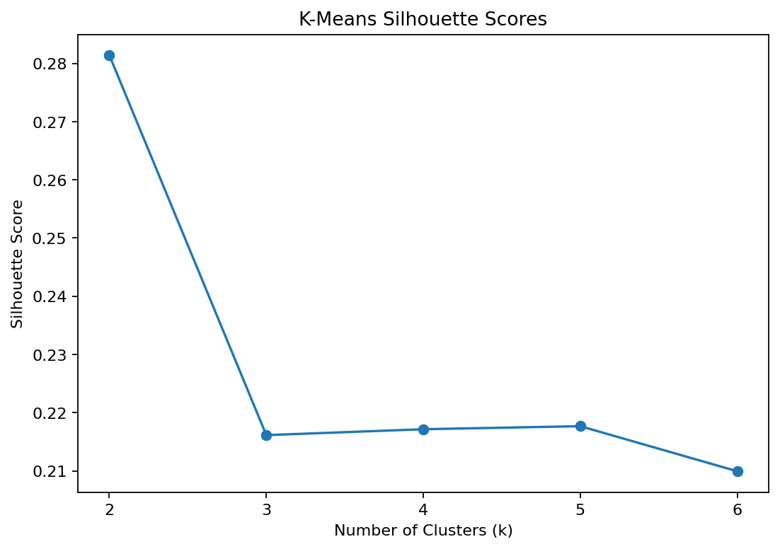
MODEL CHOICE 3
K-Means converts a complex workforce into two actionable segments
Why k = 2?
The strongest silhouette score supports two simple, distinct and explainable employee groups.
01
02
Short-Tenure,
Lower-Income Employees
Established,
Higher-Income Employees
Focus: onboarding, check-ins, career and pay progression.
Focus: recognition, succession, growth and retention conversations.
Why K-Means?
Final takeaway: every preprocessing and model choice was selected to produce results that are valid, explainable, and usable in Power BI.
There is no segment label to predict. K-Means discovers natural groups using age, tenure, income and performance—without using Attrition.
07
Notes:
[Sources]
Internal project evidence: employee_attrition_analysis2.ipynb, section 8
Internal figure: figures/kmeans_silhouette.png

