Slide 1

TEAM 201
SPRINT 7

Slide 2
What went well
Sprint was very well planned out in the initial meeting.
Some tasks were already completed in previous sprints.
Most tasks were well broken down.

Slide 3
What did not go as well
Most tasks were open throughout the week.
More people could have made contributions to the code throughout the week.
Updates from some team members were given around the end of the week.

Slide 4
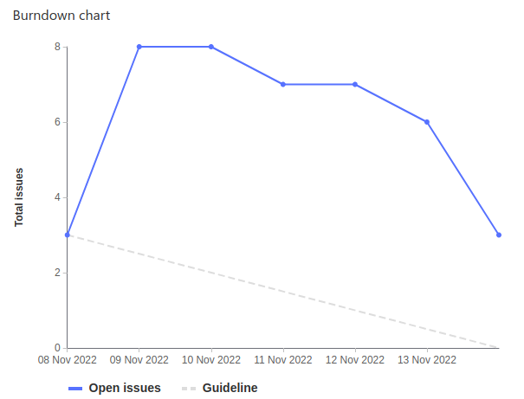
Burndown Chart

Slide 5
Team Member Contributions

Slide 6
Sahil
Developed tests for various front-end components
Paired with Ameer to clean up code for conflict checking
Total Weight: 10pts

Slide 7
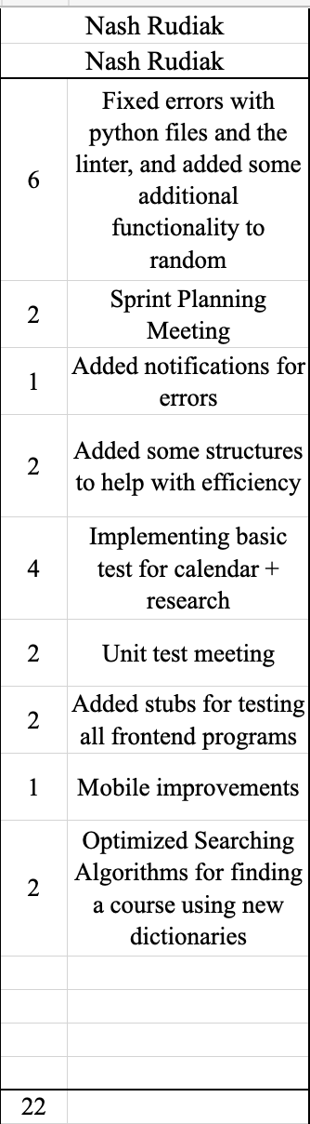
Nash
Refactored significant of backend code to no longer cause linter errors and to be more efficient (10pts)
Implementing/Learning test cases (8pts)
Error notifications visible to user (2pt)
Total Weight: 22pts

Slide 8
Ethan
Set up linters and unit testing locally and in the CI/CD pipeline (GL143, GL146, GL147, GL153) [6h]
Created basic unit tests (GL158) [1.5h]
Total weight: 20

Slide 9
Ameer
Developed tests for various front-end components
Cleaned up code for conflict checking
Weight: 10

Slide 10
Dogu
Wrote unit tests for front end
Wrote unit tests for back end
CI/CD research, code review
Planning, group meetings

Slide 11
Cameron
CI/CD research
Team meetings

Slide 12
Kalindu
Wrote tests for backend
CI/CD Research
Selenium testing research
Total weight: 10

Slide 13
Demo

