Slide 1
Sprint 9 Retrospective Team 201

Slide 2
What went Well
Everything we wanted to add ended up getting added
Spread out approach
Each task was distinct enough that they could be worked on separately

Slide 3
What could be Improved upon
Burnout
Members working at the end of the week only had a small amount of tasks left to fill their times

Slide 4
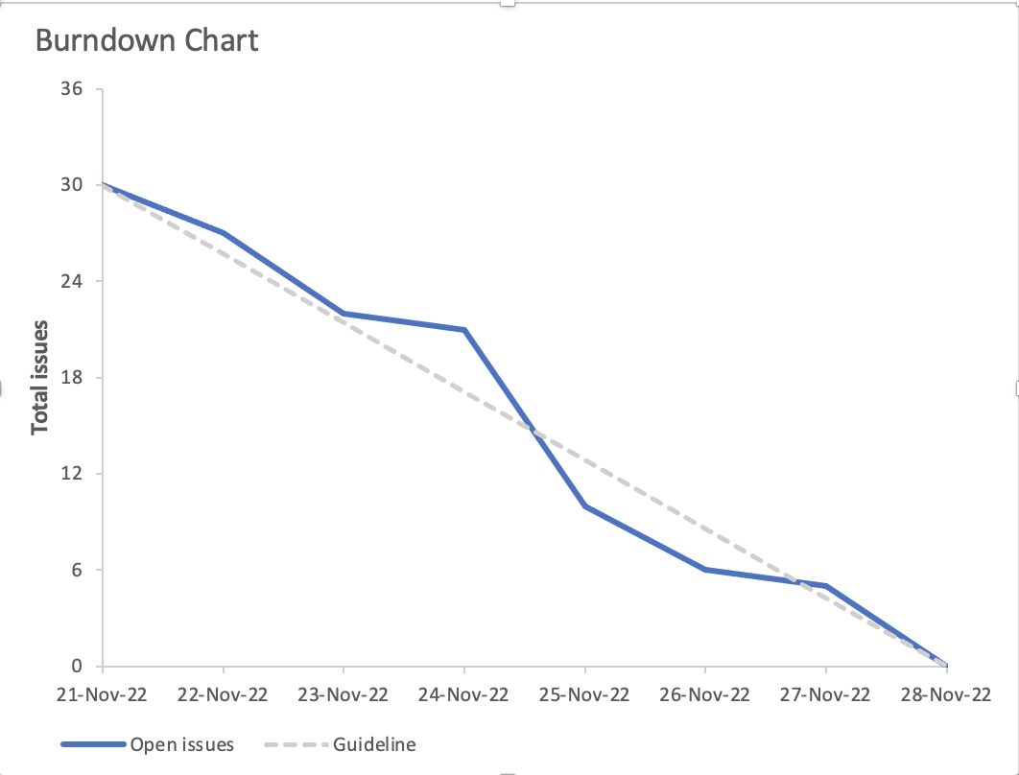
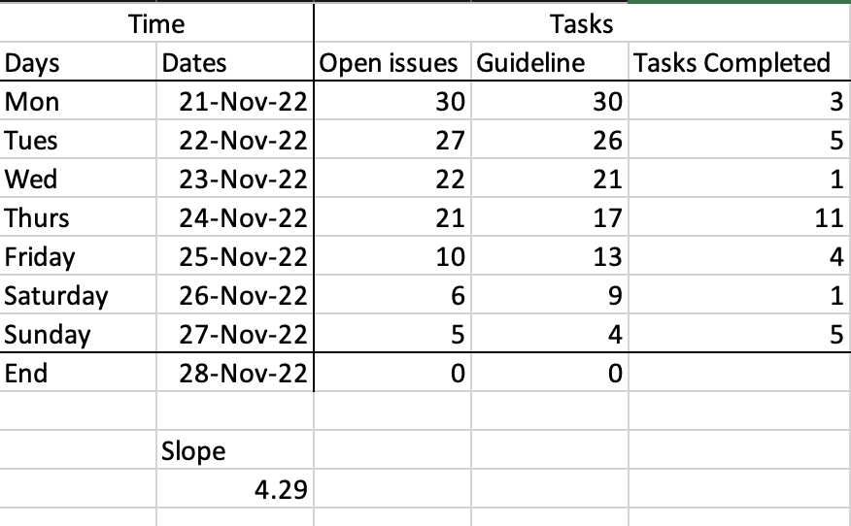
Burndown Chart
Gitlab burndown chart removed tasks created then completed on the same day on Monday/Tuesday, so custom chart was used instead

Slide 5
Team member Contributions

Slide 6
Ethan Rowan
UI improvements (GL198, GL200, GL208, GL210, GL211) [5.5h]
Bug fixes (GL193, GL196) [2h]
Total weight: 23

Slide 7
Kalindu Kehel Baddarage
Developed Cypress tests for new functionality
React router setup
Landing page optimization for mobile devices
Updated Cypress tests for landing page
Total weight: 14

Slide 8
Nash Rudiak
Fixed Schedule Helper and added algorithms [6.5h]
Paired programming for fixing bugs [1h]
Extra planning for sprint [2h]
Total Weight: 25pts

Slide 9
Dogu Gerger
Developed Add/Remove functionality for course info box.
Worked on the development of the "Clear schedule" buttons.
Worked on the development of Course tags.
Developed Cypress tests for the new functionality.

Slide 10
Cameron Norrie

Slide 11
Ameer Mushani
Set up react router
Designed Custom Landing Page
Weight: 18

Slide 12
Sahil Gogia
Worked on fixing duplicate color bug.
Paired with team members to add clear schedule button.
Paired with team members to add tags to course list.
Planning and discussion meetings.
Added some CSS for mobile and updated cypress tests.

Slide 13
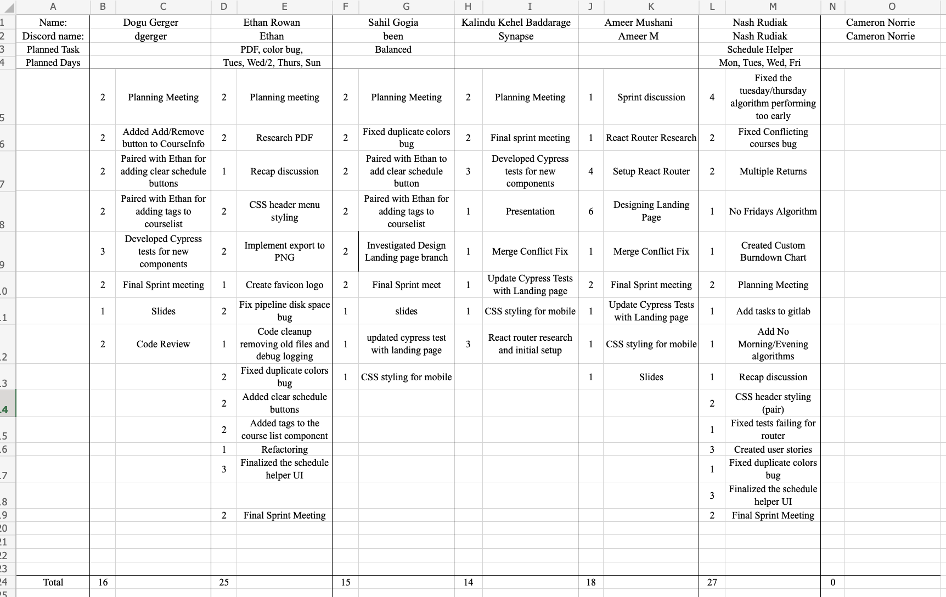
Timing Chart

Slide 14
Demo

Slide 15
Use Case 1: Basic Search
Actor
1st Year Undergraduate Students at University of Guelph
Basic Flow
The student has just enrolled into Guelph and has done their research beforehand on what courses they want to add. In this case, the student is a first year that wants to add all these W2023 courses: MCS*1000, IDEV*1000, GEOG*1220, ACT*1220, BIOL*1500. They will add these courses to their own schedule by using the search bar with the code and choosing the first available section

Slide 16
Use Case 2: Find Course By Name
Actor
3rd Year Computer Science student
Basic Flow
The student so far has enrolled in 4 W23 courses so far: CIS*3760, STAT*2050, ECON*2310, and CIS*3490. However, they were going to enroll in Computer Networks but the course isn’t offered in the Winter. In a quick scramble, they search “Computer” to find a course that is related to computers that might fit their schedule. They then browse through the courses by clicking them for info. Once they find the course they like, the student adds it to their schedule.

Slide 17
Use Case 3: Find Professor Courses
Actor
University Advisor
Basic Flow
An advisor for the university has been looking to balance workload for professors. Before they decide what the professor should do during the Winter 2023 semester, the advisor wants to look at what courses they taught in Fall 2022. Right now, they are looking for courses G. Klotz taught, so they will search their name to find the courses in particular.

Slide 18
Use Case 4: No Tuesday/Thursday
Actor
Graduate Student at the University of Guelph
Basic Flow
A graduate student coming back to Guelph has enrolled in 2 W23 courses: CIS*3750, and CIS*2750. They are both 1hr 20min lectures on Tuesday and Thursday. The student doesn’t want to have any more courses on those days, but doesn’t know what courses they should choose. They therefore use the button that says “No Tuesday/Thursday” to get some ideas for courses, and will add them to the schedule.

Slide 19
Use Case 5: No Friday
Actor
Graduate Student at the University of Guelph
Basic Flow
Another graduate student just only recently enrolled again at Guelph. They planned on taking their required courses next year and filling their W23 semester with courses that are interesting and will get their credit up. They want all their classes to be in person and are very adamant about having their Fridays free. Therefore, the student will click the No Fridays button to generate courses that don’t conflict and are not on Friday, then will add all those courses

Slide 20
Use Case 6: No Mornings
Actor
4th year undergraduate student
Basic Flow
A 4th year student is going to decide their W23 courses soon, however they don’t really have a plan. They know one thing for sure: they are not a morning person. They therefore generate a schedule using the No Mornings button and add all the courses. Additionally, they do not like online courses so they select the checkbox to have only courses with meeting times.

Slide 21
Use Case 7: Export
Actor
Undergraduate Living in Housing with others
Basic Flow
The student has been in Guelph for a decent amount of time and has already decided on their Fall 2022 schedule: CIS*4510, MUSC*2100, POLS*6950, MCS*3000, and SART*4090. However, their roommates need their help with things from time to time. To solve this, the student clicks the hamburger menu for options and notices they can export it to an image. This gives them a file they can print and put up on their door so their schedule is always known.

