Slide 1
Team 201
Sprint6

Slide 2
The Good:
Finished large weight tasks quickly
Team was very happy with end product and design
Team adapting to React environment

Slide 3
The Bad:
Time tracking chart wasn’t being filled by people after finishing tasks
Task Estimates were weighted improperly
One that was 6pts turned into 18 pts

Slide 4
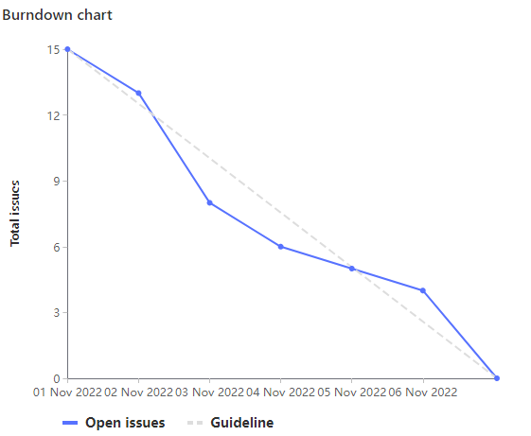
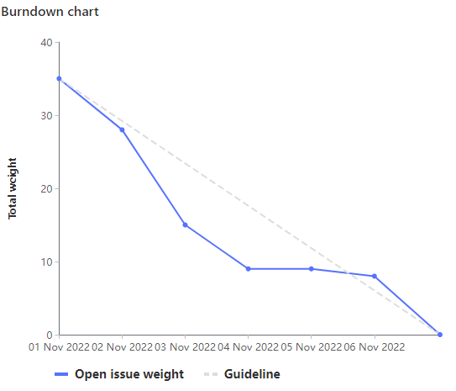
The (not so ugly) Burndown Chart

Slide 5
Team Contributions
1

Slide 6
Ameer
Worked on passing courses object between App.js and Calendar
Developed Conflict Checking
Added a colour pallette 😎
Total Weight: 21

Slide 7
Cameron
Meetings initial/final
Testing the app across different browsers
Documenting the tests on wiki
Total weight: 15

Slide 8
Ethan
Course searching and UI design/setup (GL125, GL127, GL139) [12.5h]
Setup linting (GL133) [2h]
Total weight: 35

Slide 9
Nash
Created code to translate Event data into data structure and display data (15pts)
Fixed a Merge Conflict, made (2pts)
Total weight: 21pts

Slide 10
Dogu
Sprint planning meetings
Testing, cross-browser testing
Documentation
Code review & Clean up

Slide 11
Sahil
Improved Calendar CSS [1.5h]
Paired with Ameer to Add colours and conflict detection to the schedule [4h]
MR reviews [1h]
Testing the app and Documenting the tests [2h]
Total Weight: 20

Slide 12
Kalindu
Researched FullCalendar React Component
JSX and CSS code cleanup
Testing app on different browsers and documenting results
Total Weight: 17

Slide 13
Let’s take a
look!

