Slide 1
Team 201
Sprint 2

Slide 2
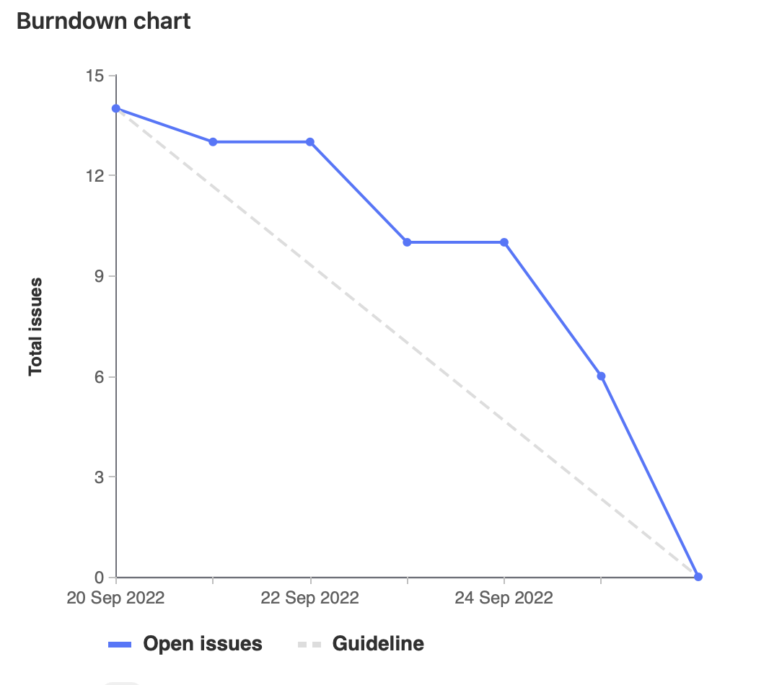
Burndown Chart
max growth

Slide 3
Retrospective

Slide 4
What went well and not well
Well
Sprint planning meeting
Assigning tasks as team members are ready to work on it
Quickly got started on coding in VBA
Completed all our planned tasks
Not Well
Difficulty working on the same file
Testing could not be automated

Slide 5
Team Member Contributions

Slide 6
Kalindu
Researched VBA [1h45m]
Meetings (Sprint Planning, Check-in, Code Review) [3h15m]
Code cleanup [45m]
Manual Testing (MacOS & Windows) [1h30m]
Wiki Documentation [1h30m]
Code Review & MR Testing [1h35m]

Slide 7
Nash
Created code to generate empty chart [30min]
Created code to:
Find time based on time given [30min]
Find a column given a day [30min]
Colour and fill in data [30min]
Alert if a conflict occurs [30min]
Automatically monitor for changes in cells [30min]
Minor bug fixes
No search occurs if nothing is entered [30min]
Exams not conflicting [30min]
I also attended meetings (1hr on Monday, 1hr on Thursday) and created these slides
I got a lot of tasks done in a (surprisingly) short amount of time, so I ended up with only about 12 points, however even then I was hogging lots of development

Slide 8
Ameer
Attempted using ActiveX ComboBox for search
Updated documentation
Wrote error handling for input
Developed dropdown for courses
Weight: 16

Slide 9
Ethan
Setting up Windows/Excel environment (GL37) [40m]
Researched VBA (GL26) [1h]
Create the data sheet and function for reading it (GL30) [2h]
Error handling and code cleanup (GL46) [1h]
Meetings (GL27, GL43, GL45) [3.25h]
Pair programming (GL42, GL47, GL48) [2h]
Code review [20m]

Slide 10
Sahil
Researched VBA (GL26) [1h]
Manual Testing of the CourseLoader spreadsheet [2h]
Meetings and Brainstorming sessions [2h]
Pair programming with Ethan and Ameer [3h]
Experimented creating a search box to display all the courses [1h]
Code review [1h]

Slide 11
Dogu
Sprint2 planning meeting and code review session.
Researched VBA.
Added documentation on wiki
Tested the code on different platforms Windows, Linux, Mac.
Improved error handling and cleanup

Slide 12
Demo

