Slide 1

Team 201 Sprint 5

Slide 2
What went well
Had good structure start with flask as blank endpoints were set up last week
Able to get extra work done on docker and CI/CD
Sprint was very well planned out in initial meeting
Tasks were completed + closed accordingly and weighted correctly

Slide 3
What did not go as well
Through a majority of the week, not much work was being completed (was discussed in planning meeting)
More people could have made contributions to the code throughout the week

Slide 4
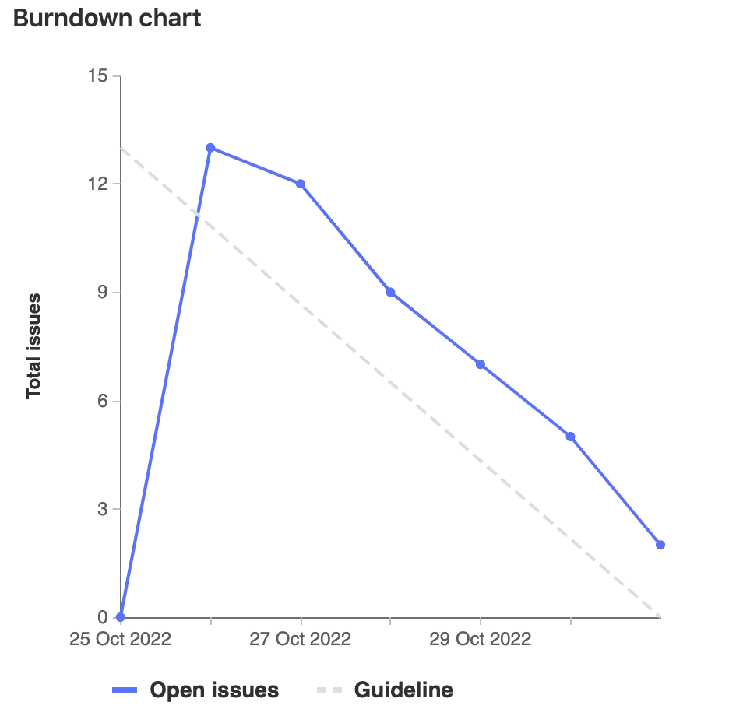
Burndown Chart

Slide 5
Team Member Contributions

Slide 6
Cameron
Assisted in adding display for flask results
Meetings initial and end/wrap-up
Presentation preparation
Total Weight: 16

Slide 7
Ethan
Set up Docker (GL96) [4.5h]
Fixed issues with communication between NGINX and Flask (GL120) [2h]
Set up CI/CD (GL106) [4.5h]
Total weight: 31

Slide 8
Nash
Created basic Flask application for getting data and returning data [2hr]
Added missing documentation and extra wiki pages [2.5hr]
Added buttons for basic AXIOS requests [2hr]
* buttons will be integrated in a more natural way. For this sprint, they are buttons merely meant to showcase flask requests working *
Helped with partial fix for how NGINX communicated with Flask [1hr]
Improved website look [1hr]
Overall weight: 17 pts

Slide 9
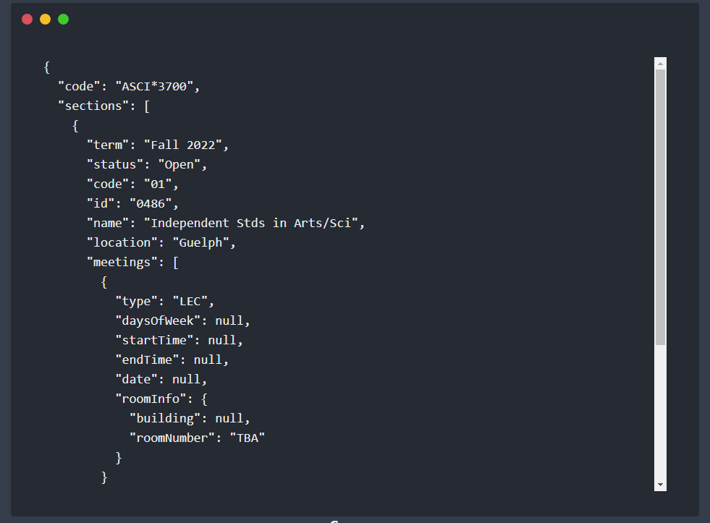
Ameer
Added cool terminal display for flask results
Cleaned up CSS stylings and file structure
Total Weight: 16

Slide 10
Dogu
Learning documenting CI/CD
Flask research
Docker research
Code review
Meetings & Preparation

Slide 11
Sahil
Flask research for the sprint
Docker research
Merge request reviews
Understanding project CI/CD
Paired to work on implementing flask search
Total Weight: 20 points

Slide 12
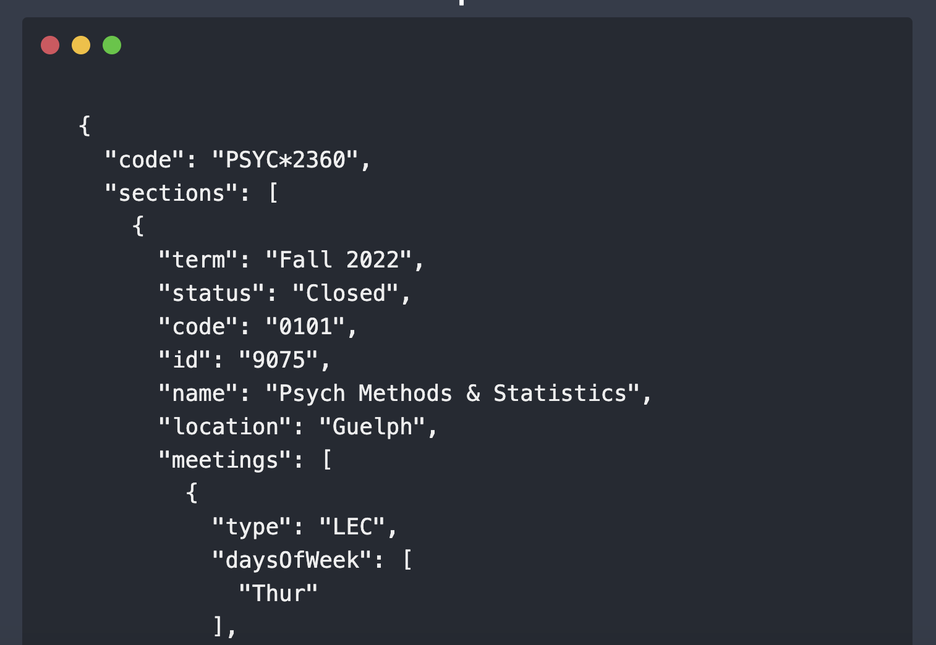
Kalindu
Added terminal to display flask endpoint results
Added state to store data from endpoints
Total weight: 16

Slide 13
Demo

