Slide 1
Team 201 Sprint 4

Slide 2
Retrospective
What went well and not well

Slide 3
What went well
Not as well
Was able to setup the basics quick.
Completed all the main tasks
Everyone on the same page with what technologies to use.
Unfamiliarity with some of the technologies used.
Some tasks were harder to estimate
Some issues were left open after they were completed.

Slide 4
Burndown Chart
Graphical representation of our progress

Slide 5
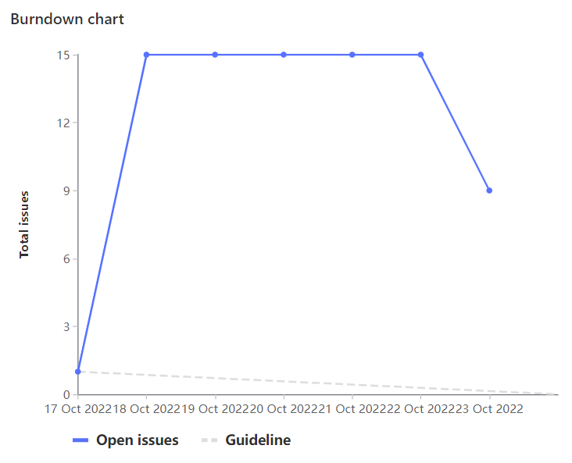
Burndown Chart

Slide 6
Team Member Contributions
What we worked on this sprint

Slide 7
Dogu
NGINX
Flask deployment into NGINX
React research
Documentation
Meetings & Preparation

Slide 8
Ethan
Set up VM on Google Cloud (GL81) [3h]
Set up NGINX, Gunicorn, HTTPS with install scripts (GL82, GL89, GL98, GL100) [8h]

Slide 9
Nash
Taught basic Flask to group and created basic backend application [1hr]
Researched a Calendar library for use in later sprints [1hr]
Provided react file for implementing a weekly calendar [2hr]
Assisted members with developing NGINX, Flask, React App, and Project structure [5hr]
Small comments and MR review to clean up code [2hr]
Overall weight total: 22

Slide 10
Ameer
Set up React project for front-end
Set up flask to interface with react build folder
Showed Team Members how to get up and running
Reduced length of code significantly with JSX
Total Weight: 19

Slide 11
Sahil
Assisted in setting up the React application [2.5h]
Developed the UI of the course loader webpage [3.5h]
Learned about ReactJs and some other web development concepts [3h]
Investigated the new project structure [1h]
Total Weight: 20

Slide 12
Kalindu
Participated in sprint planning
Research React and Flask
Helped with documentation
Code review

Slide 13
Cameron
Assisted in the React application set up [2.5h]
Researched/learned about React [1.5h]
Meetings initial and end/wrap-up [2.5h]
Installing/setting up GCP CLI tool on my system, understanding new project structure [1.5h]
Total Weight: 17

Slide 14
Demo
A live demonstration of our work

