Slide 1
Mobile Experience

Slide 2
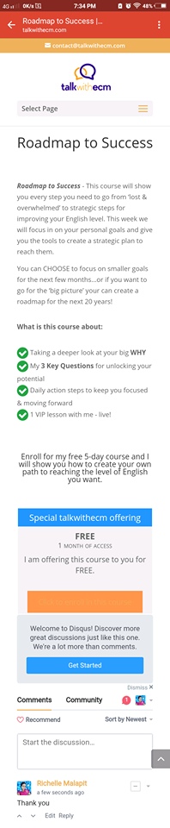
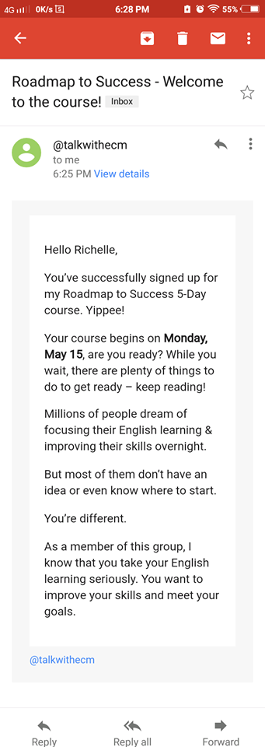
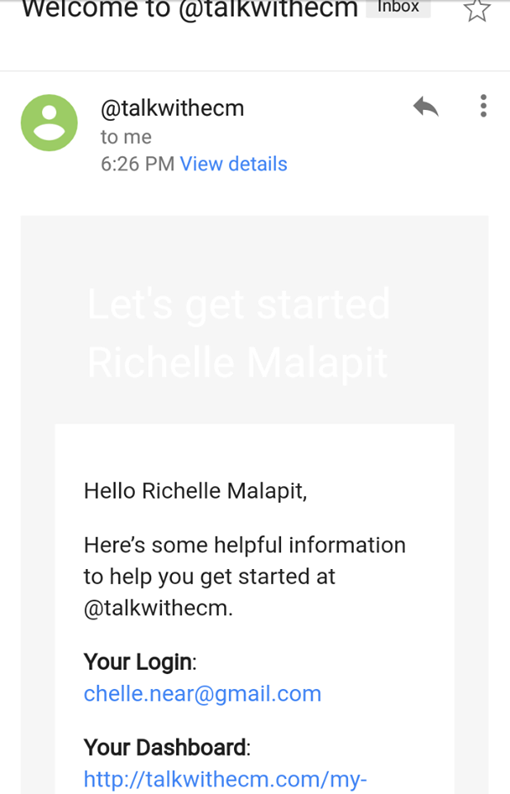
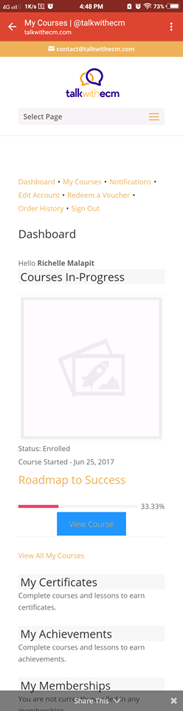
I can’t see the text.
I can’t see the text in the button?
I can’t see the text in the button?

Slide 3
Web based User Experience

Slide 4
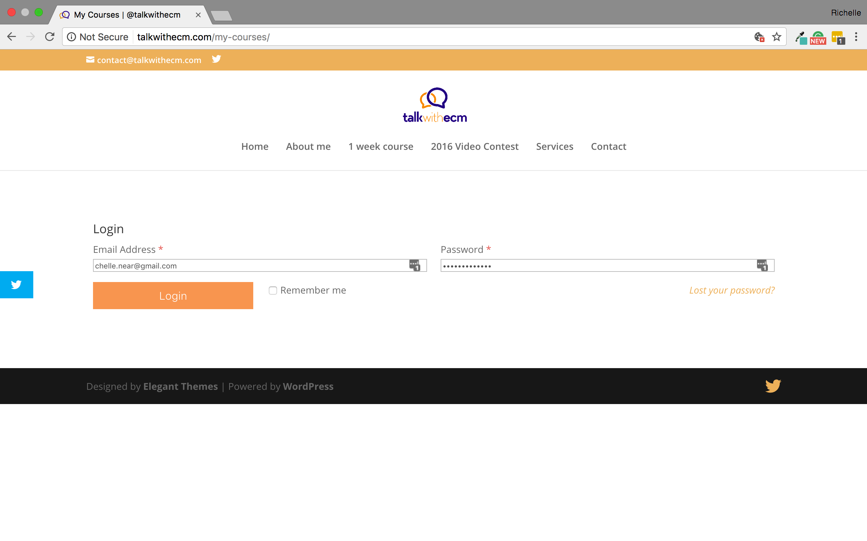
The boxes was so small.
It looks weird to me.

Slide 5
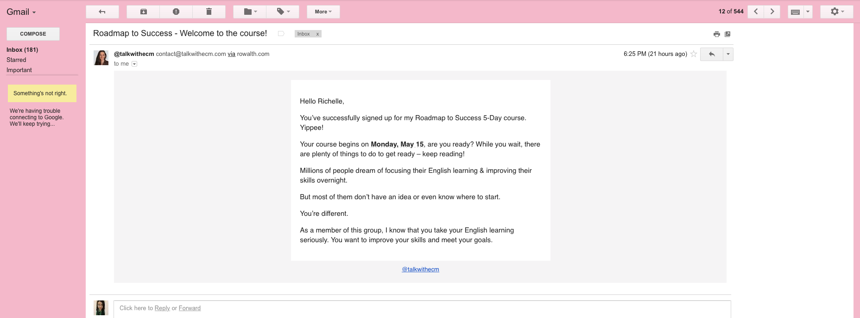

Slide 6
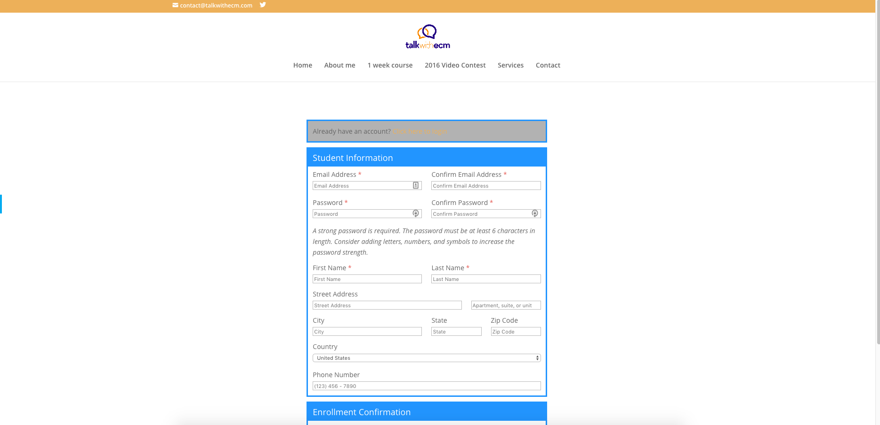
I can’t see the text in the button?

Slide 7
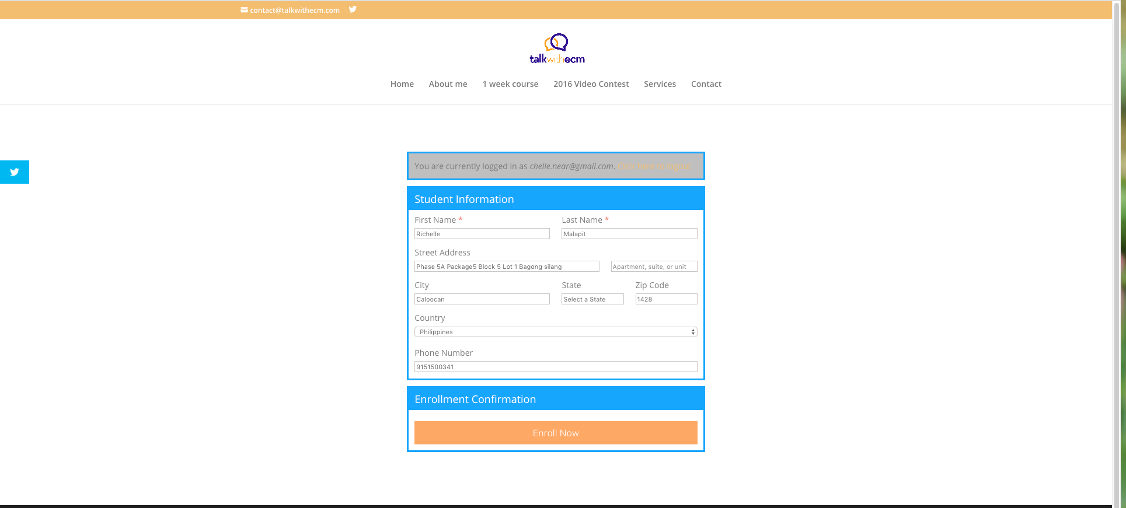
I can’t see the text in the button?

Slide 8
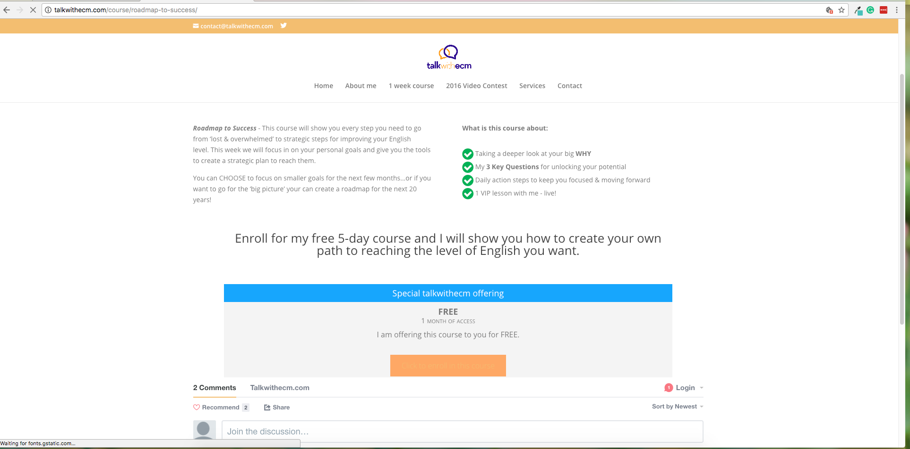
I can’t see the text in the button?

Slide 9
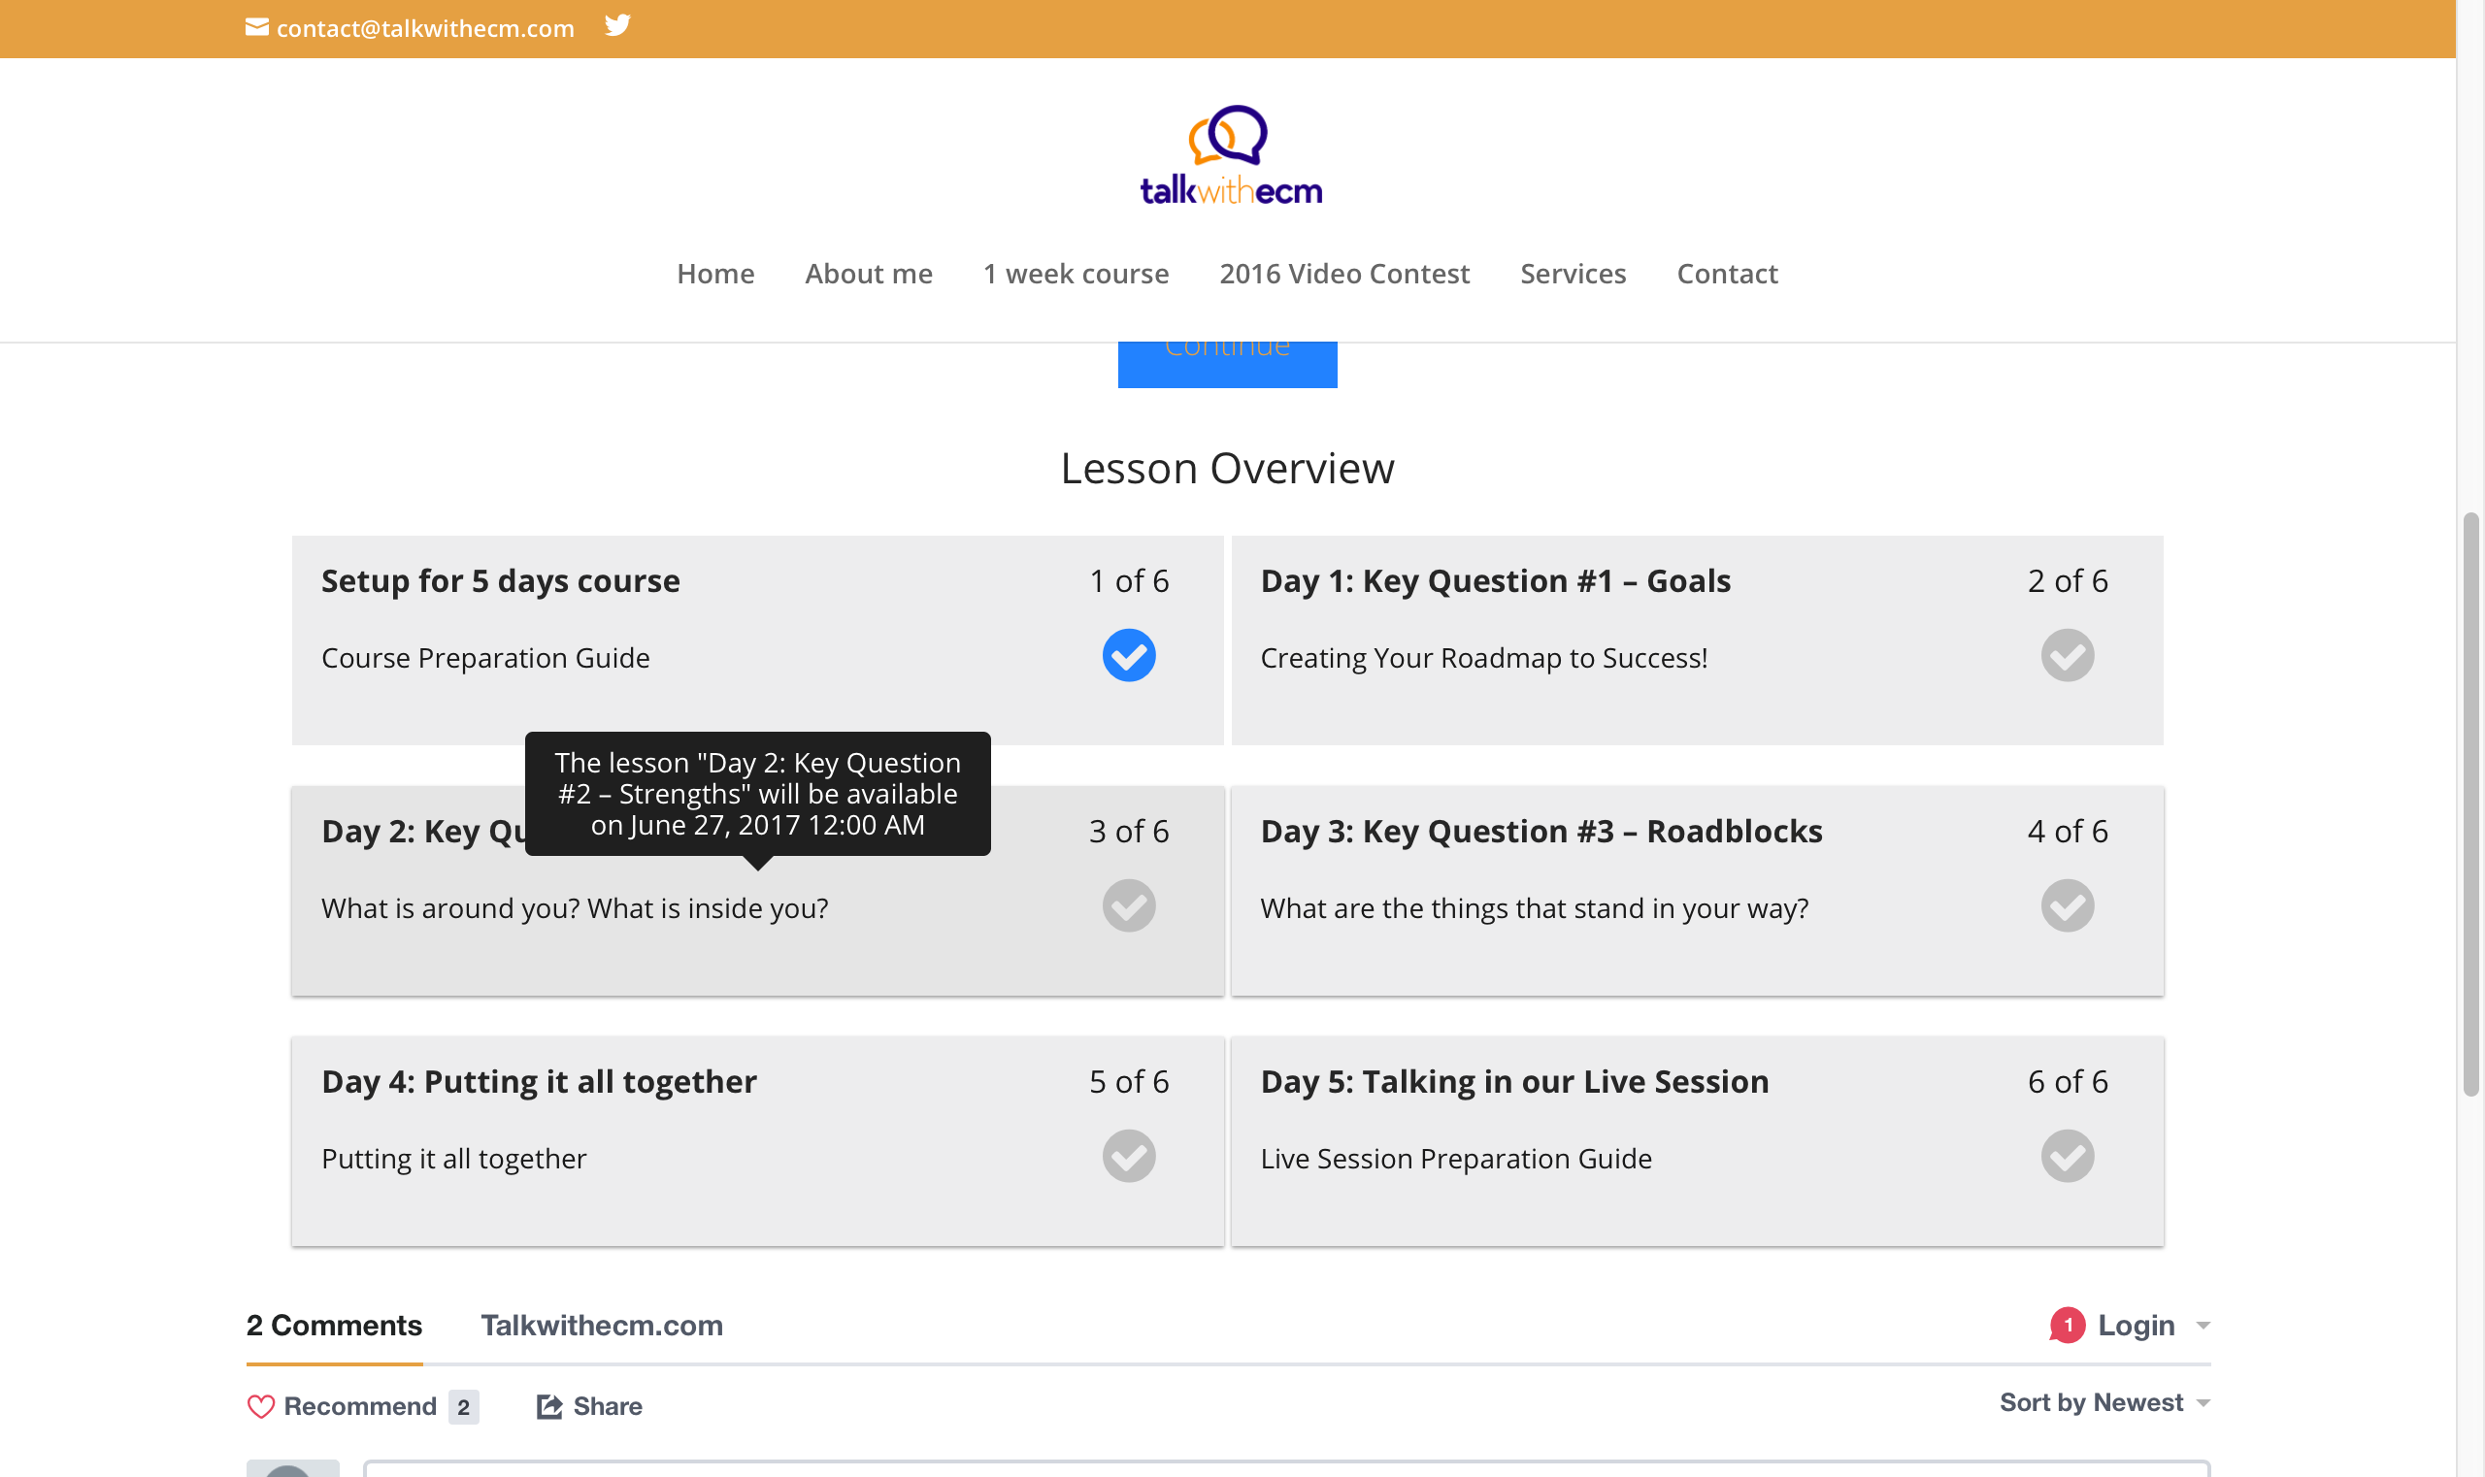
If you could make it a bit darker, to represent those lessons that are not yet accessible. Please check the slide for the suggestions

Slide 10
Suggested design

Slide 11
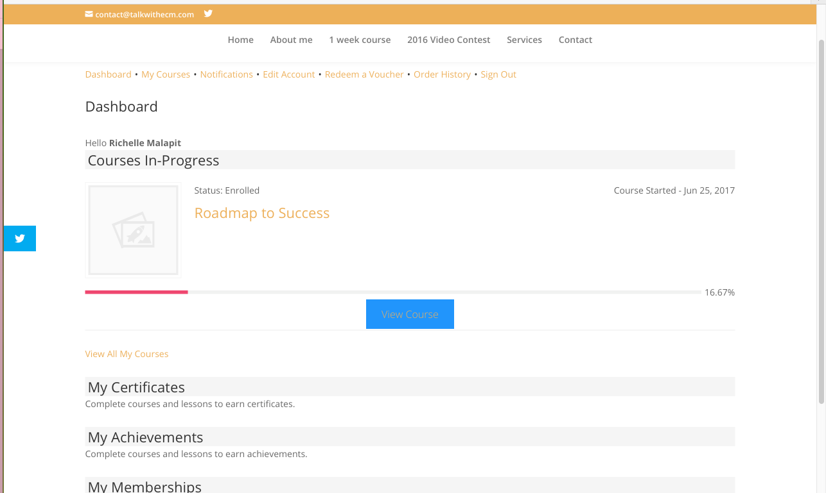
I can’t see the text in the button?

Slide 12
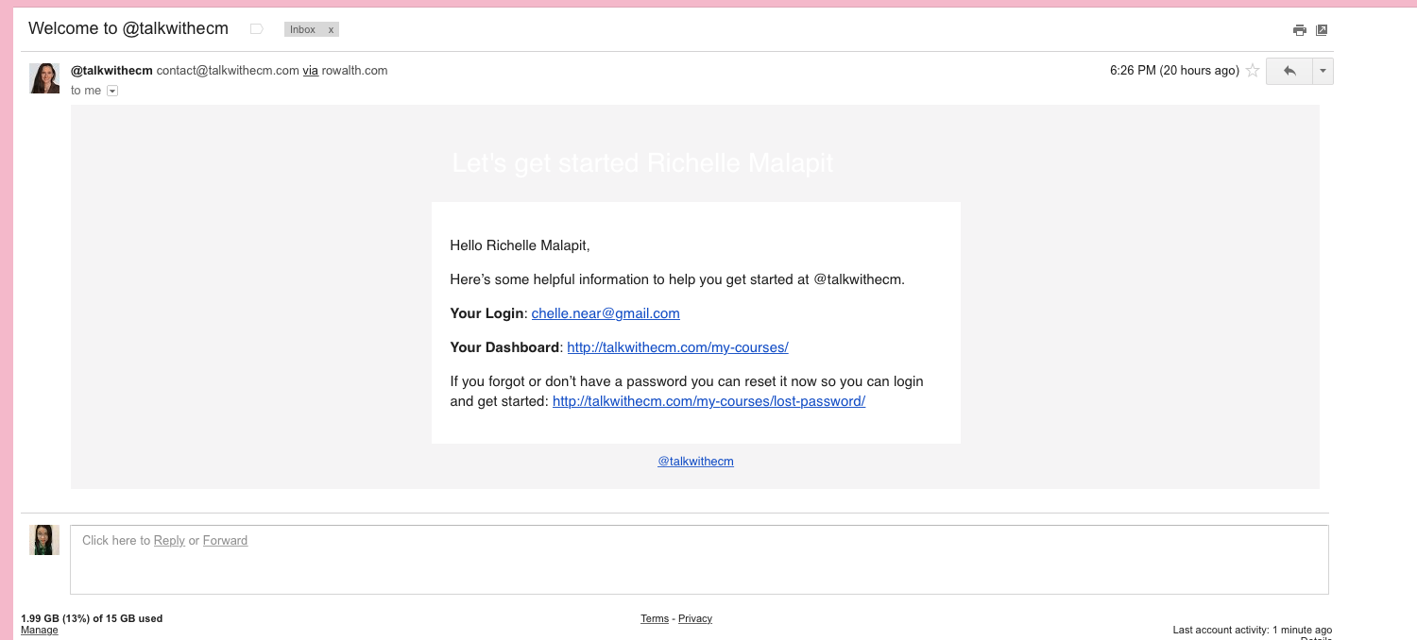
I can’t see the text?

Slide 13
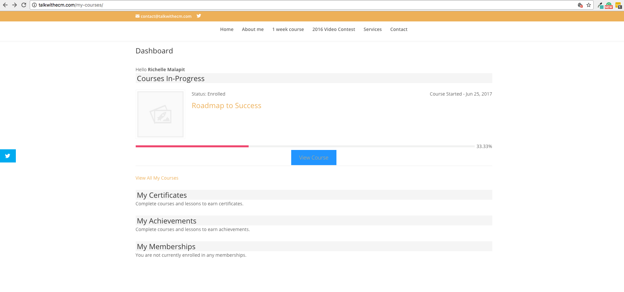
I thought it was place holder for user profile pic but it’s not.
The photo is for the course itself so better add one.

Slide 14
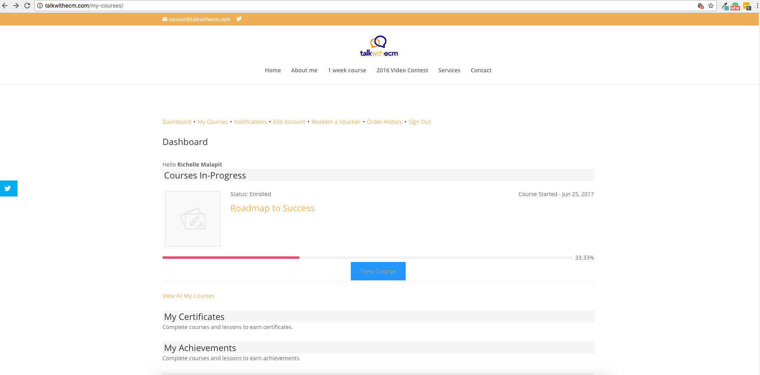

If I click the view course I will be redirected to the course but with no sub menu. Please check the next slide

Slide 15
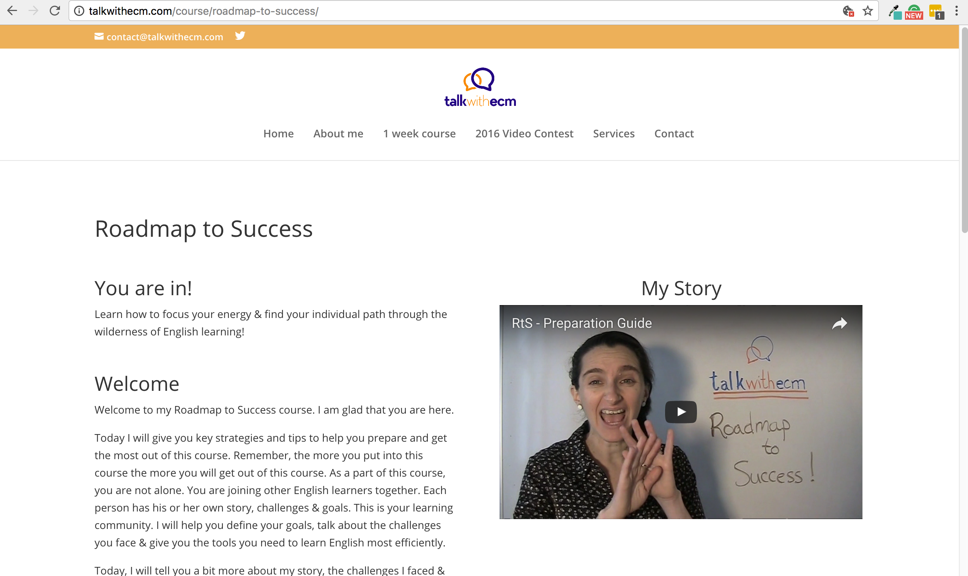
From here? I’m clue less,
How would I go back to my dashboard? How would I log out?

Slide 16
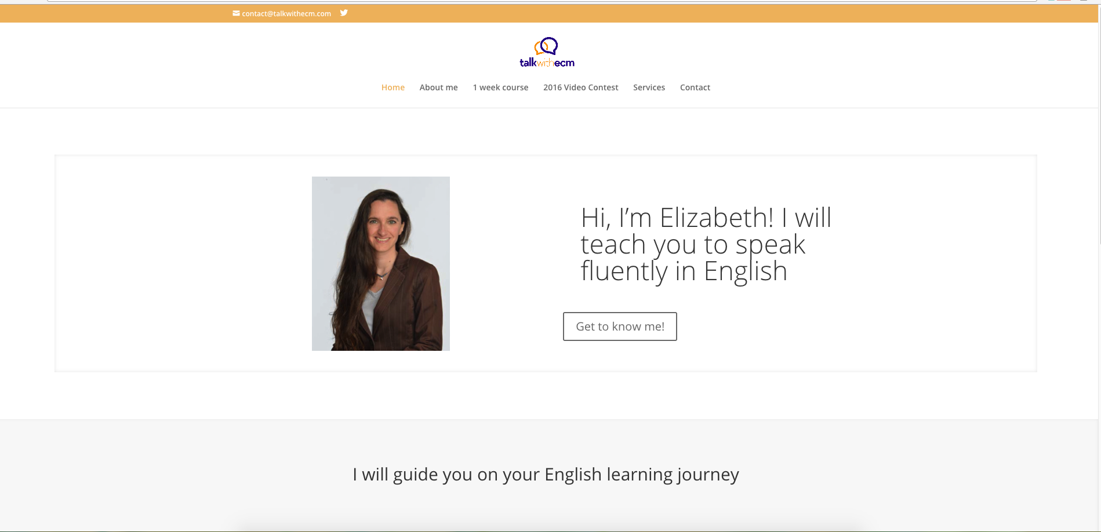
I think it’s really beneficial to add a “member corner” log in page for the module So we won’t copy paste the link for the membership site
Members Corner

