Slide 1
Kademlia
Distributed Hash Table

Slide 2
What Are DHTs?
Just like a regular hash table, but on a network!
How do we hash a value?
Anyway we like, just use ‘b’ bits!
How do we identify nodes?
ID, IP, port number
How do we find and store values?
We hash values to other nodes!

Slide 3
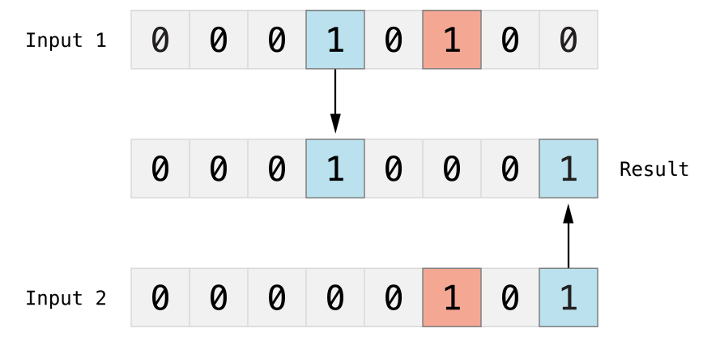
XOR distance function
Core mathematical principle of Kademlia → What other DHTs don’t get right
( A ^ A ) = 0
( A ^ B ) = ( B ^ A )
Triangle Inequality: ( A ^ B ) ^ ( B ^ C ) >= ( A ^ C )
A = 111, B = 011, C = 001
A ^ B = 100, B ^ C = 010
(A^B) ^ (B^C) = 110
A ^ C = 110

Slide 4
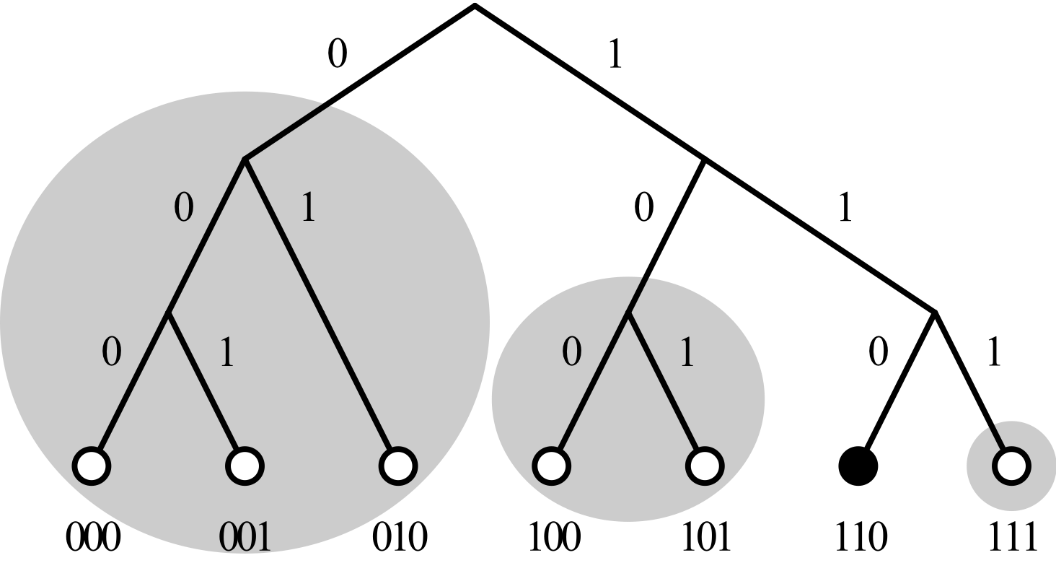
Routing Tables
In-software routing table
Nodes are identified by a bit string
How far apart are different nodes?

Slide 5
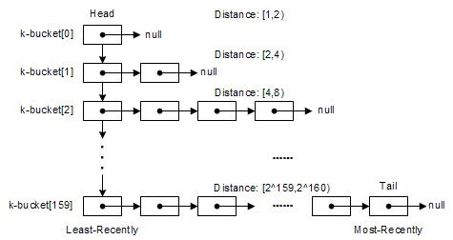
Buckets
Where do we store our Contacts?

Slide 6
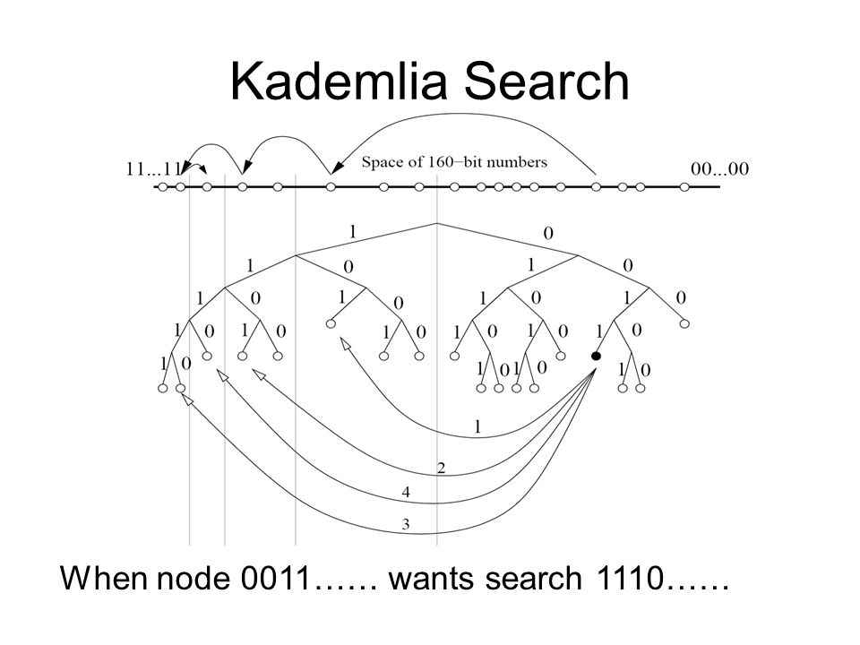
RPCs
PING/PONG
STORE
FIND VALUE
FIND NODE
Iterative, parallel algorithm
Each iteration halves the distance to the target value/node

Slide 7

Find Node Algorithm
Shortlist: the list of nodes selected from to search with
Alpha: the parameter for concurrency (how many nodes selected at once)
Handled by the asyncio library
Ends when: node found, k nodes have been searched, or the shortlist is empty
Returns the k-closest contacts found
The Find Value search is similar to Node Search

Slide 8
Technical Issues
We want our DHT to be redundant
Some nodes can go down but the network and its data are protected
Can nodes suffer from hash collisions?
Hardly, with a 160-bit hash key
Our implementation dealt only with single, small values. What should we do with really big files?
Bittorrent breaks them up into ‘chunks’
Key-space partitioning and remapping.
What does Kademlia do?

