Slide 1
Pair Sum Search

Slide 2
Definition
“
The "Pair Sum Search" algorithm is a problem-solving technique used to find a pair of elements in a given set (such as an array) that adds up to a specified sum. The algorithm aims to identify whether there exist two distinct elements in the set whose sum equals the given target sum. If such a pair is found, the algorithm typically returns the indices or values of the elements constituting the pair.
”

Slide 3
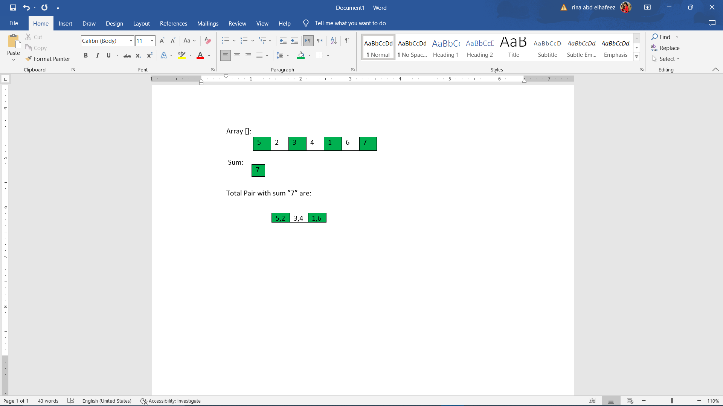
Implementation
“
The idea is to find pairs in a given array when added together satisfy given sum, Frist the elements of the array will be sorted using binary search tree. For every element w will check if the sum – the element number “i” results into a number that exist in the array, If so the algorithm will return true

Slide 4
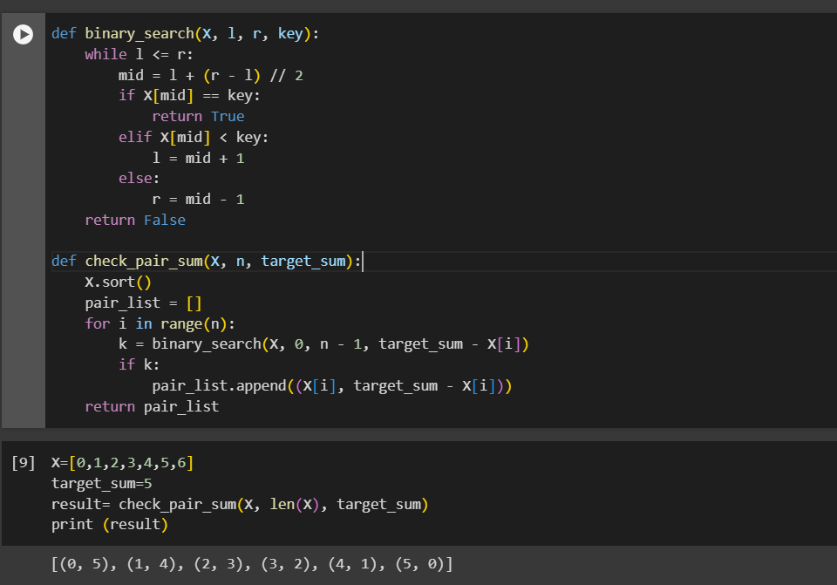
Implementation
“
”

Slide 5
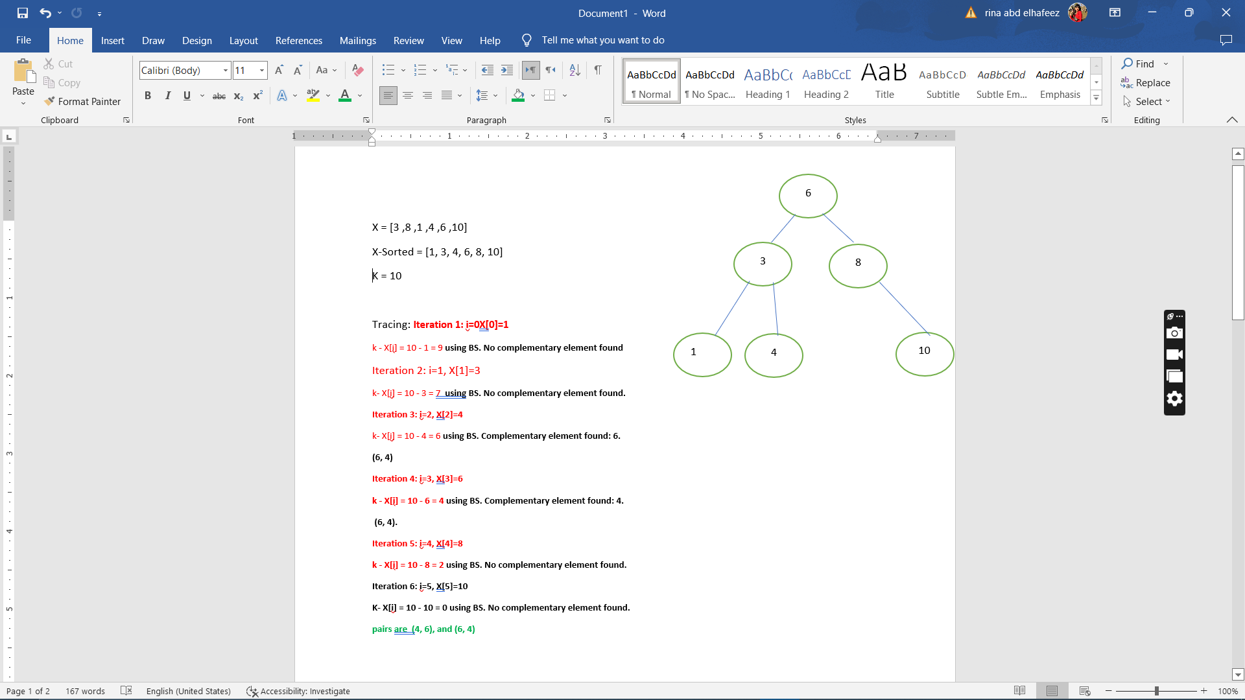

Slide 6
Analysis
T= Time of sort + n* Time of binary search
Size = n so, time complexity of the binary search algorithm is O(log n)
Time Complexity of heap sort = 0(n log n)
T= O(n log n) + n* O(log n) = O(n log n) + 0(n log n) = 0(n log n)
Space complexity = 0(1) + 0(1) = 0(1)

