Slide 1

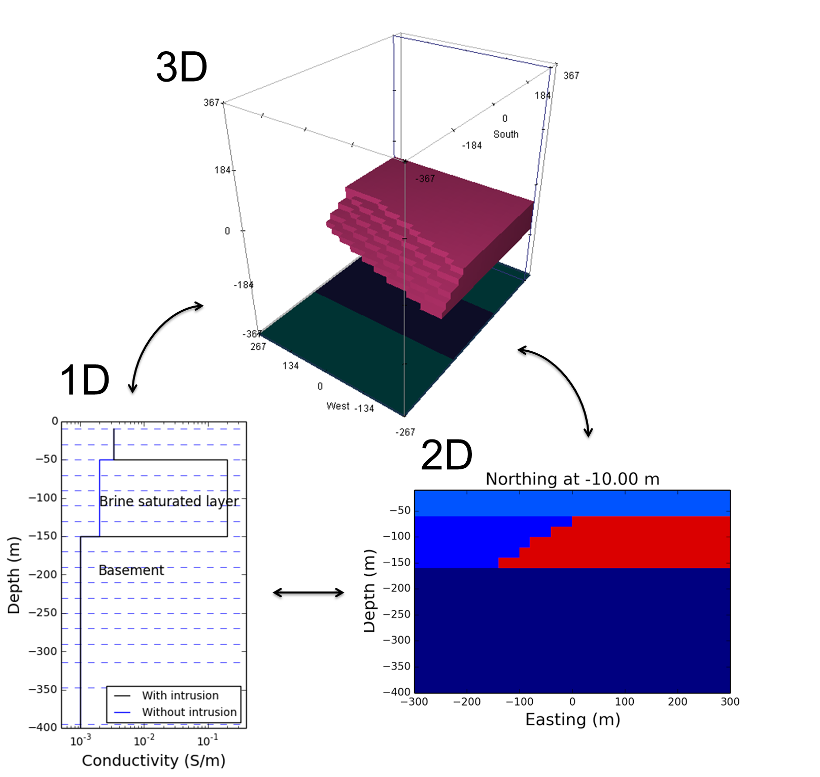
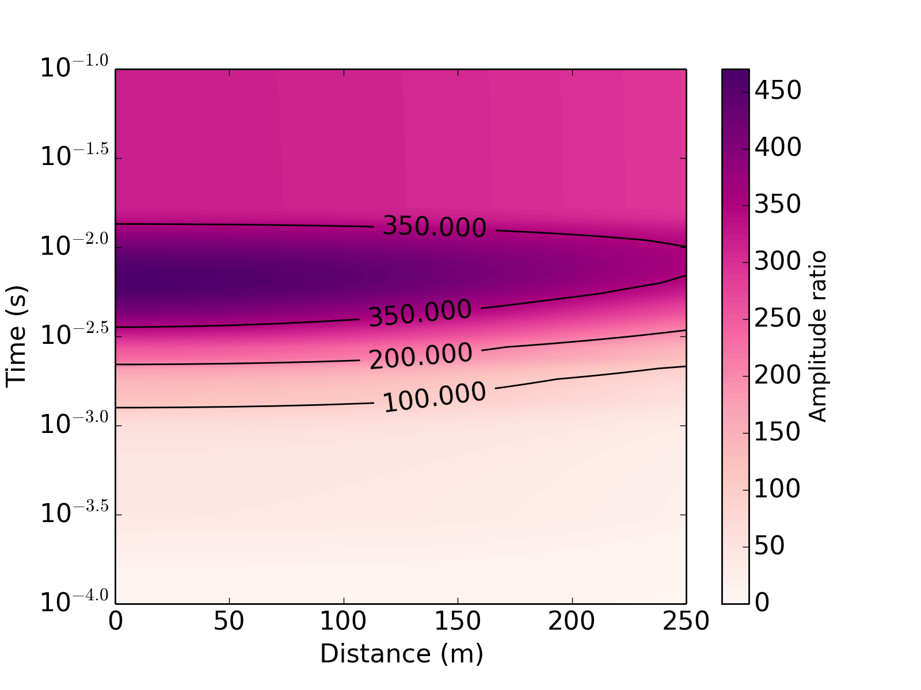
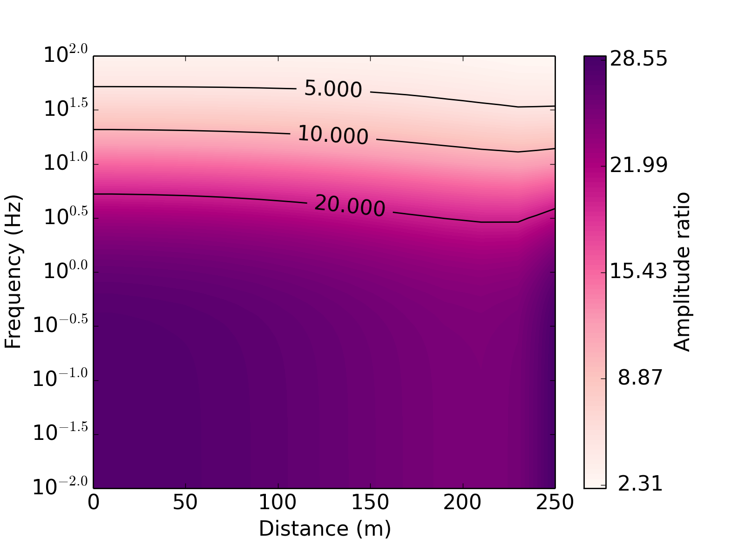
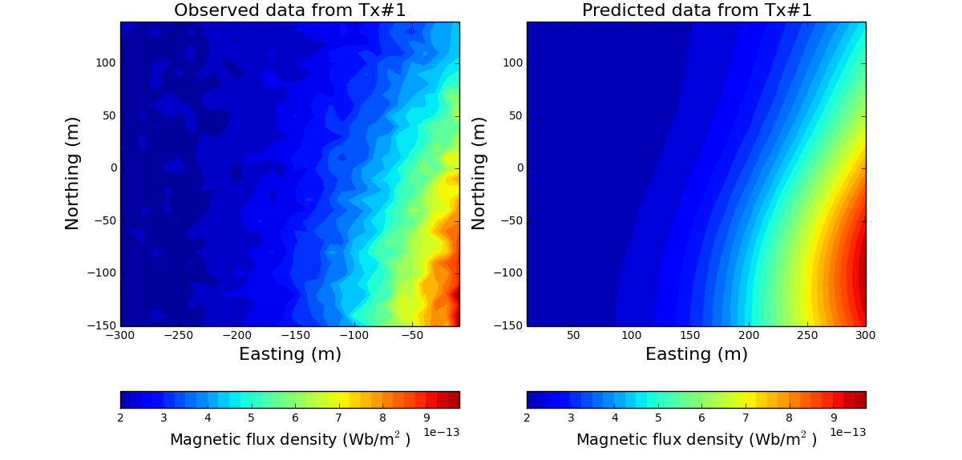
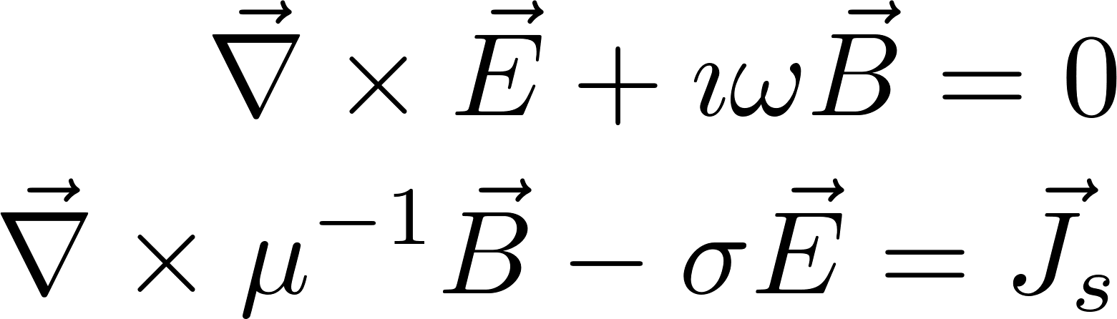
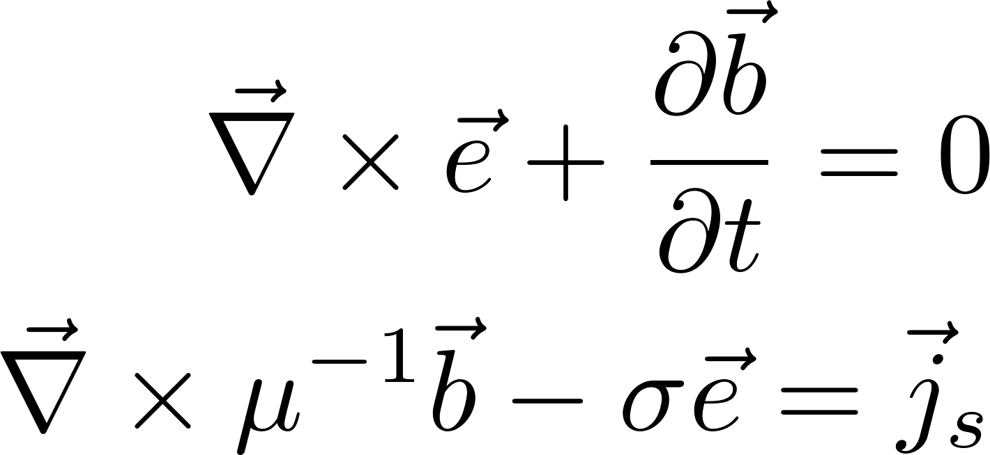
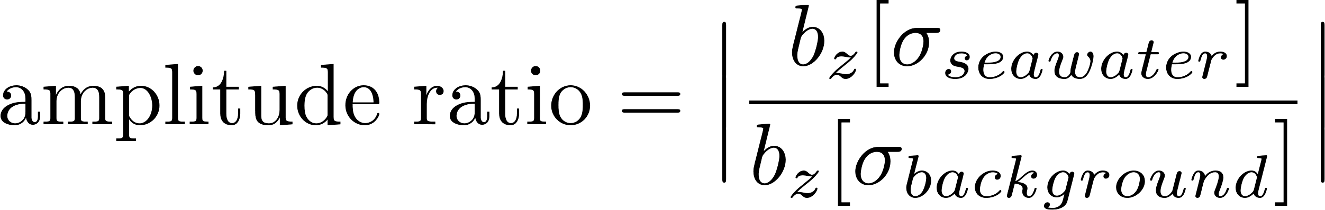

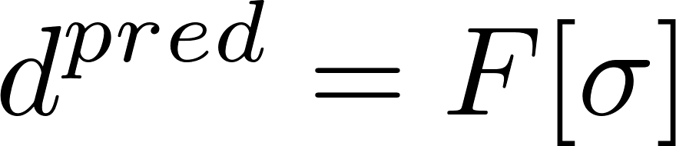
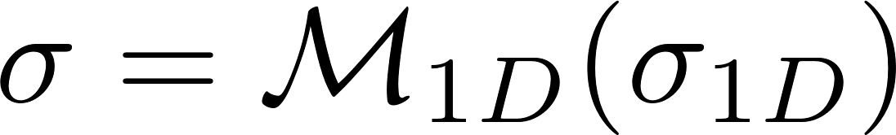
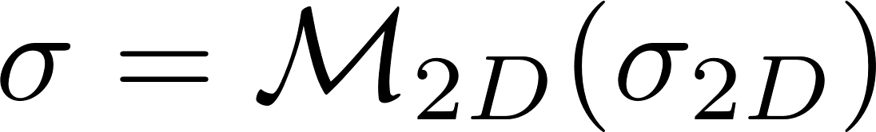

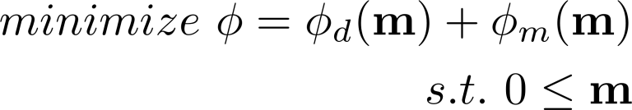
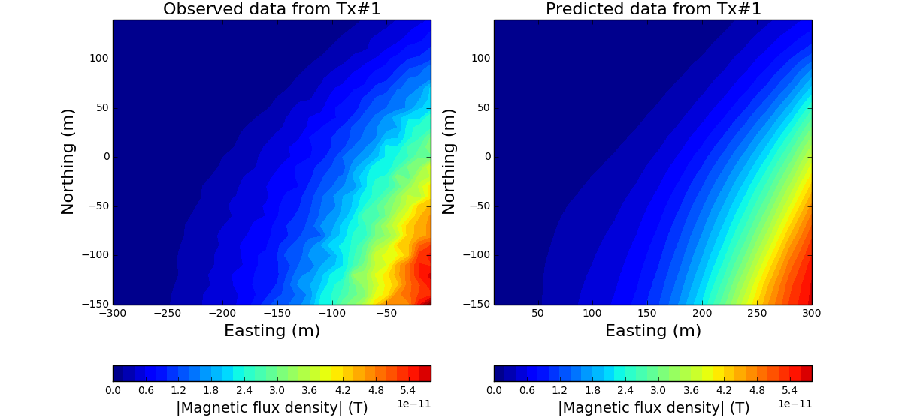
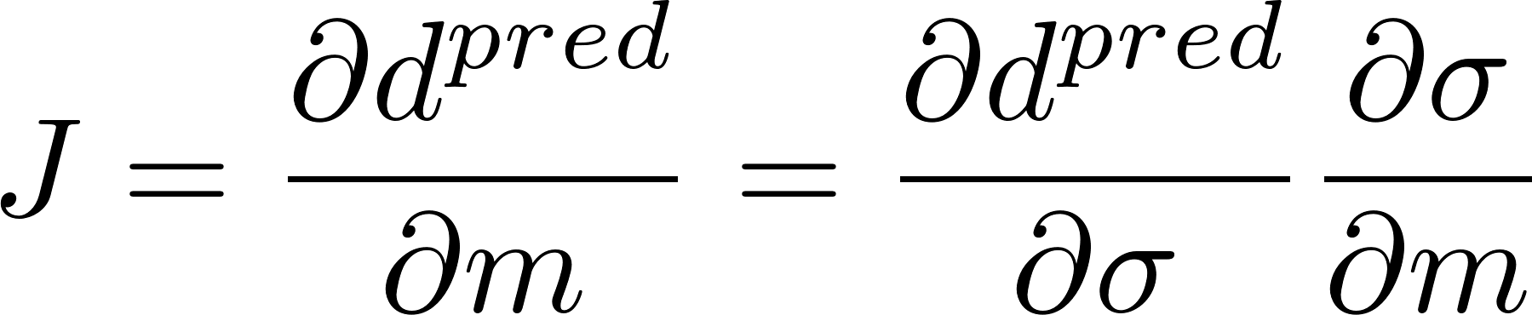
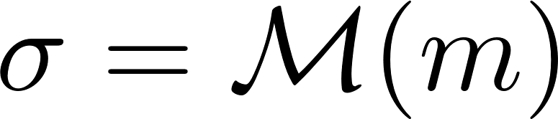
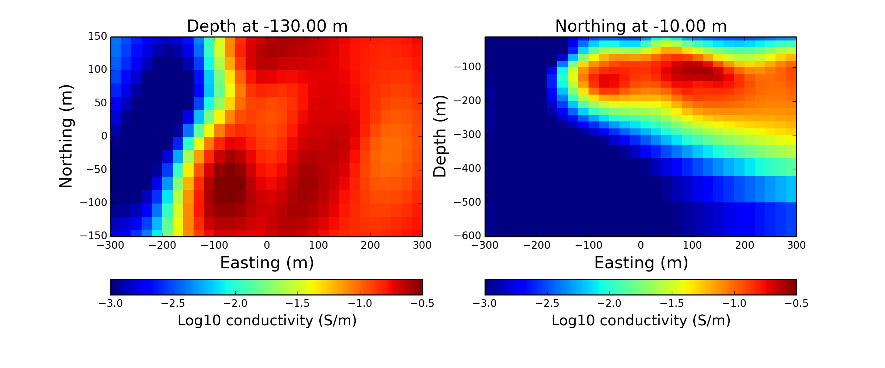
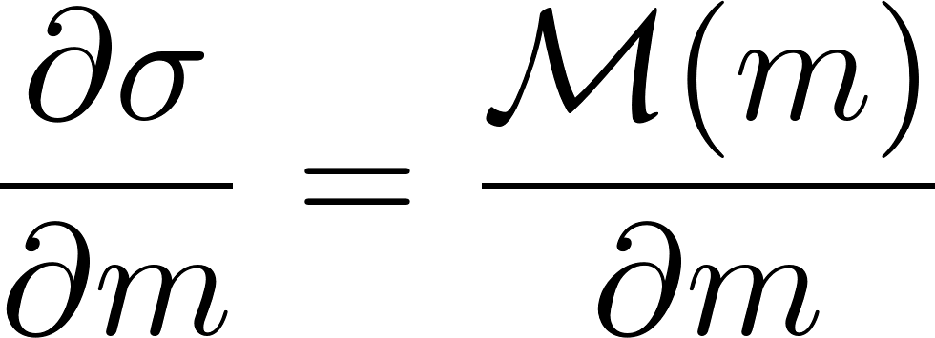
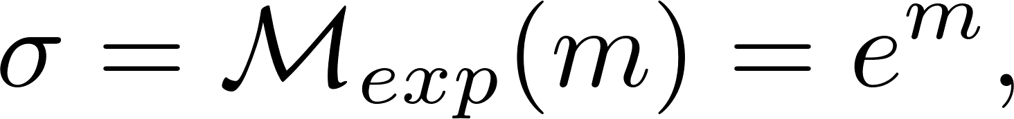
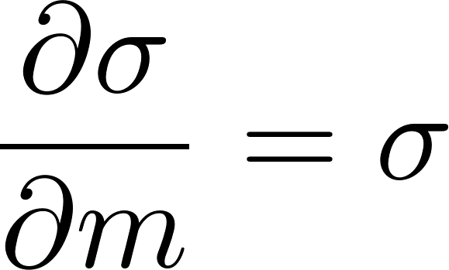
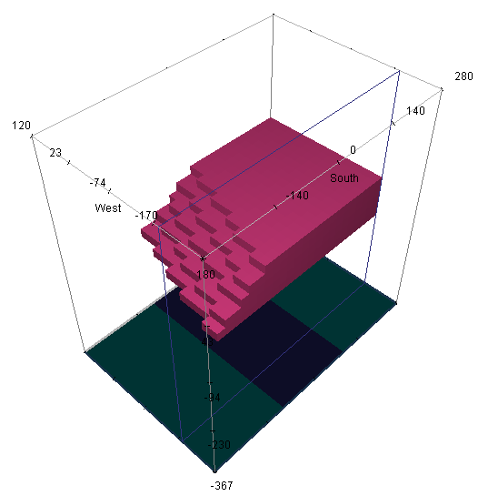
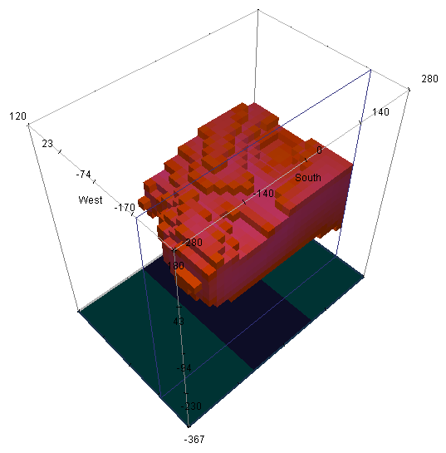
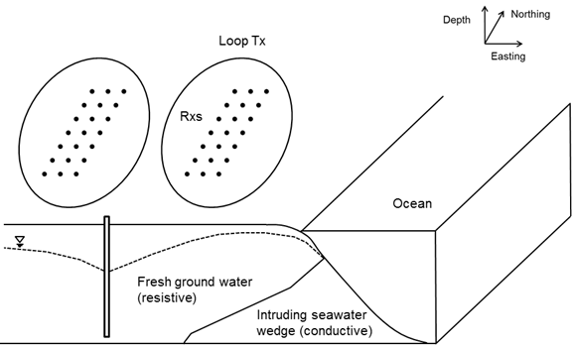
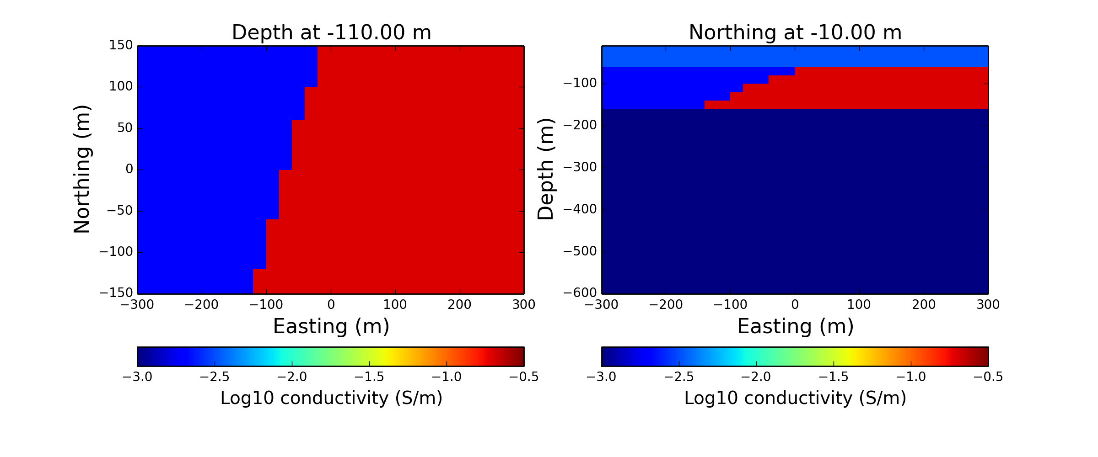
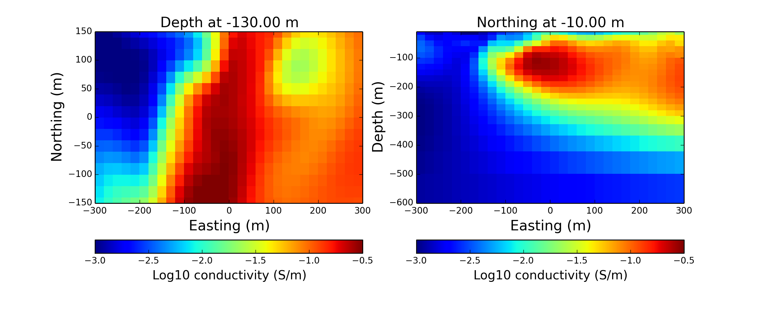
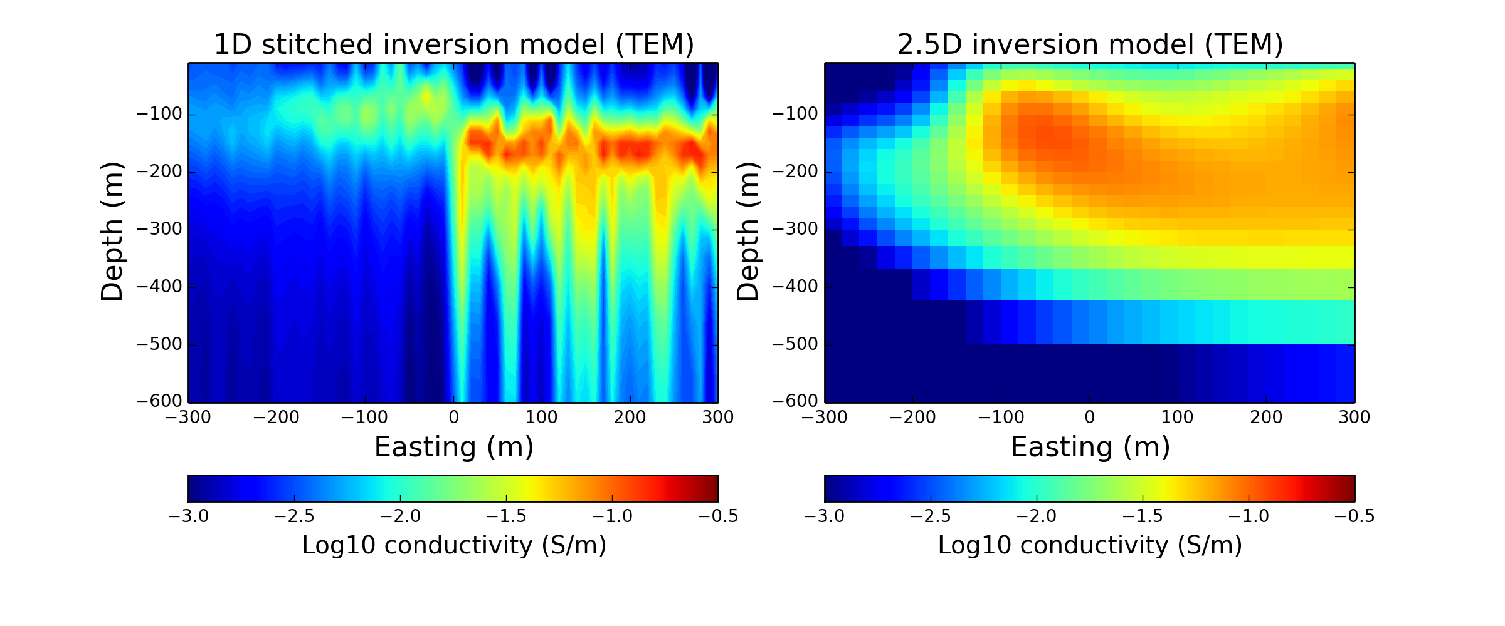
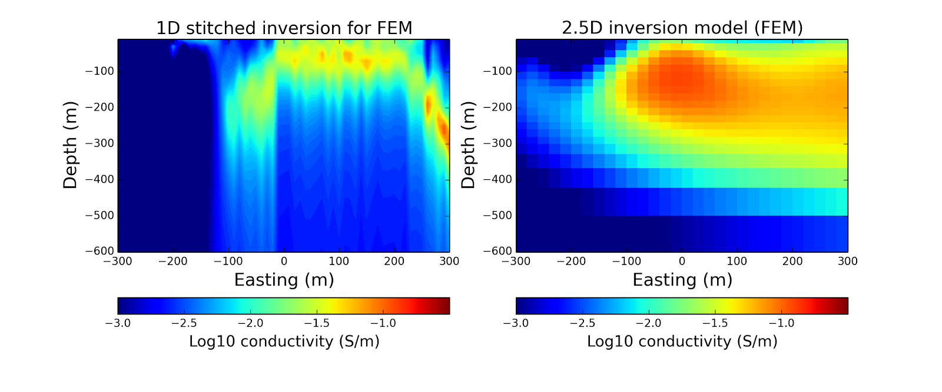
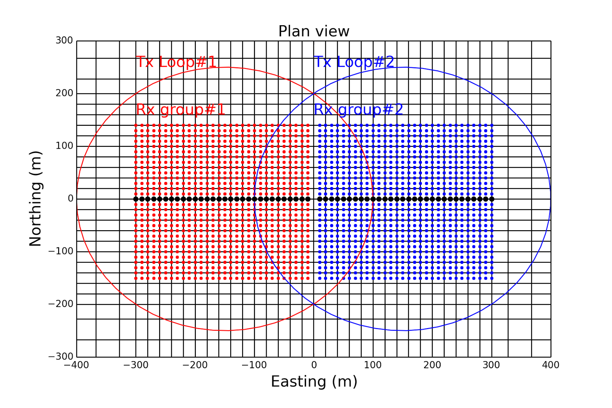
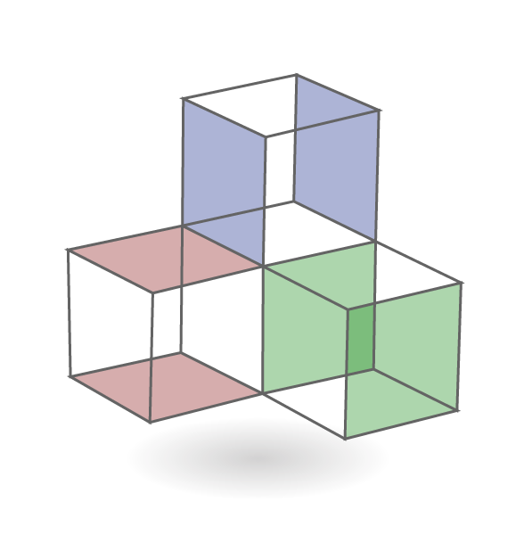
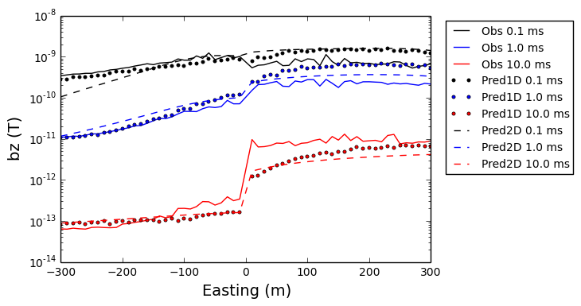
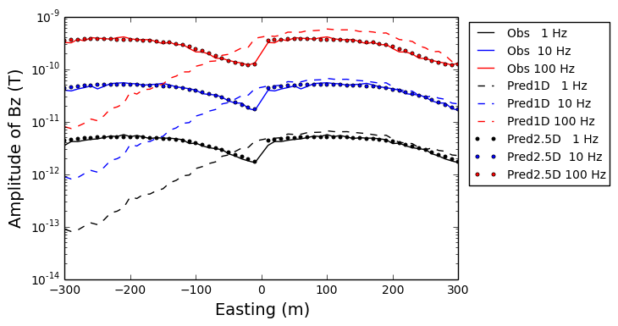
Moving between dimensions in electromagnetic inversions
Seogi Kang, Rowan Cockett, Lindsey J. Heagy and Douglas W., Oldenburg
Geophysical Inversion Facility (GIF), University of British Columbia, Canada
Simulation and Parameter Estimation in Geophysics (SimPEG)
www.simpeg.xyz
What is the model?
Maxwell’s equations in time and frequency domain can be expressed as
Compute forward responses:
is Maxwell’s operator
is electrical conductivity
Set up an optimization problem:
The core of our optimization is the sensitivity function:
Model space can be generalized using mapping function:
And it’s derivative:
Feasibility test: anomalous responses
Inverse problem: 3D model
For 3D inversion we use 2D grid of receiver points, which are only located in the circular loops
3D inversions are much more non-unique problems when compared to 1D and 2.5D inversions:
“We need a good initial guess and reference model and proper regularization”
Inversion results from 1D and 2.5D inversion can be valuable information for a 3D inversion
Exponential and active mappings are used:
Shows better data misfit compared 1D and 2D cases
We can reasonably recover 3D distribution of conductive seawater plume with both 3D TEM and FEM inversions
TEM: 7.3ms
We need responses sensitive to the intruded seawater
Use 1D model (with and without seawater)
Amplitude ratio:
Parameters:
time or frequency
Distance from the center of the loop (r)
Optimal parameters:
0.1-10 ms; 1-100 Hz (t and f)
0-200 m (distance from the center)
TEM
FEM
Frequency
Time
FEM: 10 Hz
Forward problem: 3D model
3D mesh is used:
The # of cells: Nx × Ny × Nz = 54 × 44 × 54 = 128304
Core cell size: dx, dy, dz = 20, 20, 20 m
Conductivity model includes intruded seawater, which is much more conducive (0.2 S/m) than surrounding (0.0033 S/m)
Two ground circular loops are deployed:
Radius of the loop: 250 m
Receivers are deployed only in the loop
Measure vertical component of b-field
Use optimal parameters:
Time range: 0.1-10 ms (Step-off waveform)
Tx frequency: 1, 10, 100 Hz
We use SimPEG-EM package, which uses SimPEG’s framework
Provides FEM and TEM forward modeling and inversions
Inverse problem: 1D and 2D model
For 1D and 2.5D inversion, use a profile line in the loops (black dots)
Exponential and 1 or 2D mappings used with active mapping:
1D stitched inversion (Conventional)
Recover 1D conductivity model for every stations and to make 2D-like model
Only recover reasonable model when we do not have multi-dimensional structures
2.5D inversion (Use 2D mapping function)
Shows better resolution in lateral variation of the conductivity model
Better data misfit, especially for frequency domain case
Still cannot explain responses from 3D structure
Thus, we need to change our model to 3D
Typical example:
TEM
Hydrological problem
Near the ocean, sea water intrusion is serious problem due to the contamination of groundwater.
The generic question that we ask here: “What is 3D distribution of the intruded seawater?”
Conductivity contrast between fresh groundwater and seawater is dramatic: ~3.03 S/m (sea water), ~0.01 S/m(ground water)
True intruded seawater
Estimated intruded seawater
FEM
Conclusions
We are gearing towards recovering a 3D conductivity distribution of the earth from EM data:
3D inversions are extremely non-unique inverse problems: “Important to set right model space”
Geophysical inversions should be iterative processes: “Not one-click” process
Model space of geophysical inversions can be different from discretizations for the forward problem
3D forward modeling mesh – model space can be 1D, 2D or 3D with mapping function:
We can easily move from 1D to 3D or 2D to 3D with this mapping
With this flexibility in model space of the EM inversion, we can effectively perform iterative inversion procedures
Ground Loop EM survey
Due to the sensitivity of EM induction methods for a conductive body, loop EM surveys can be used to detect intruded seawater (Mills et al., 1988)
Time domain EM (TEM) is conventionally used
Measure vertical component of b-field (bz)
Mostly considered as 1D problem:
Data acquisition: ground loop source with multiple profile lines
Frequency domain EM (FEM) systems can be used as well
Multi-dimensional inversion can help to recover 3D distribution of the seawater saturation
Acknowledgements
Thank you for Klara Steklova for helpful discussion about hydrological problem and SimPEG developers. Generating 3D distribution of seawater intrusion model was performed using GIFtools.
Notes:
Interestingly, wrong acitvecell mapping helps inversion… in this case
Font bigger for anomalous responses

Slide 2
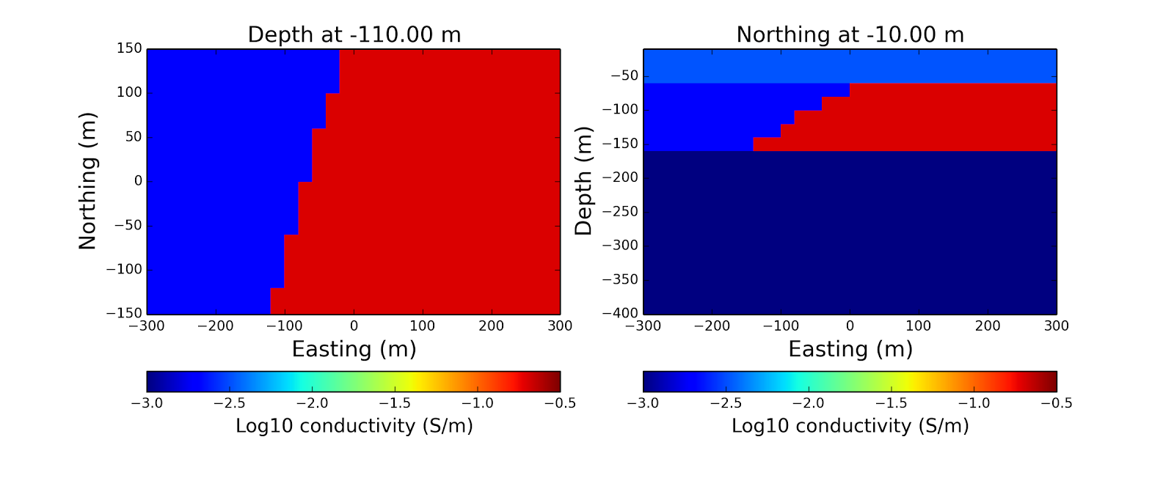
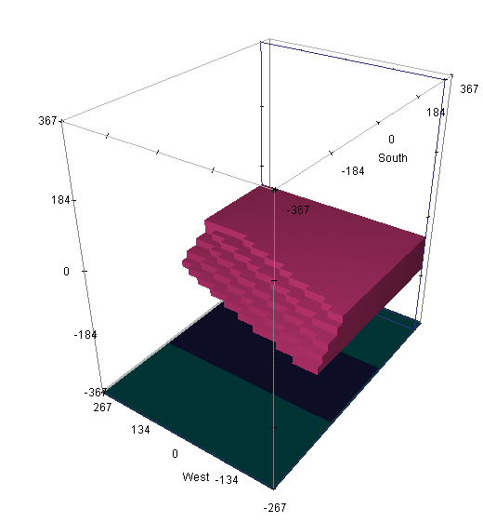
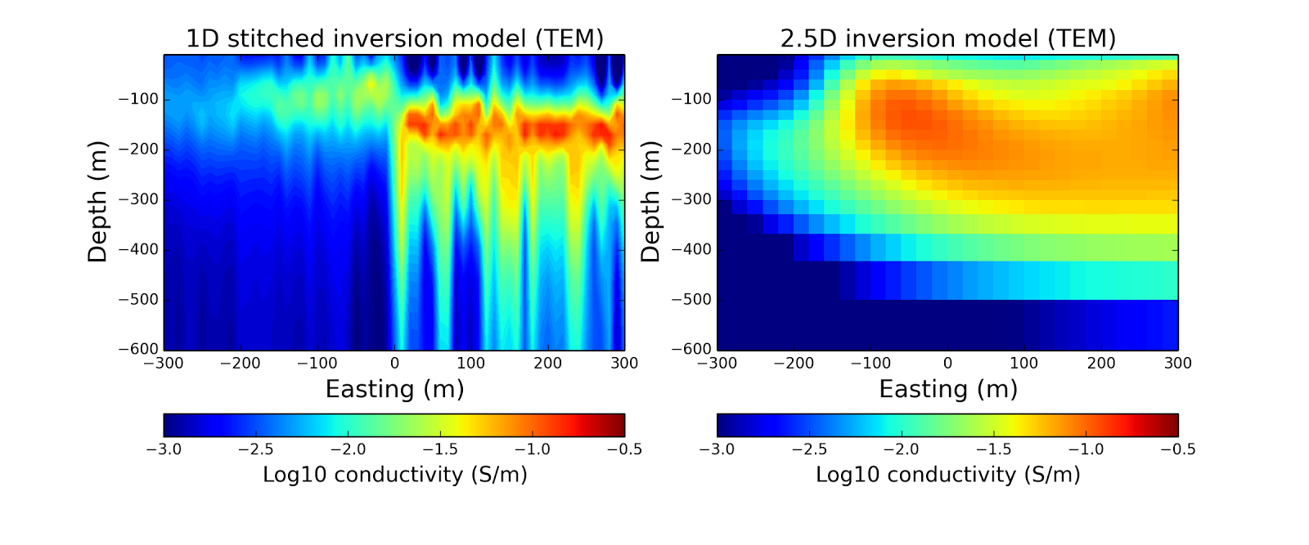
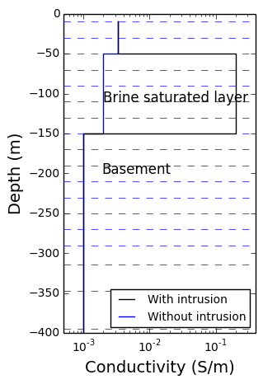
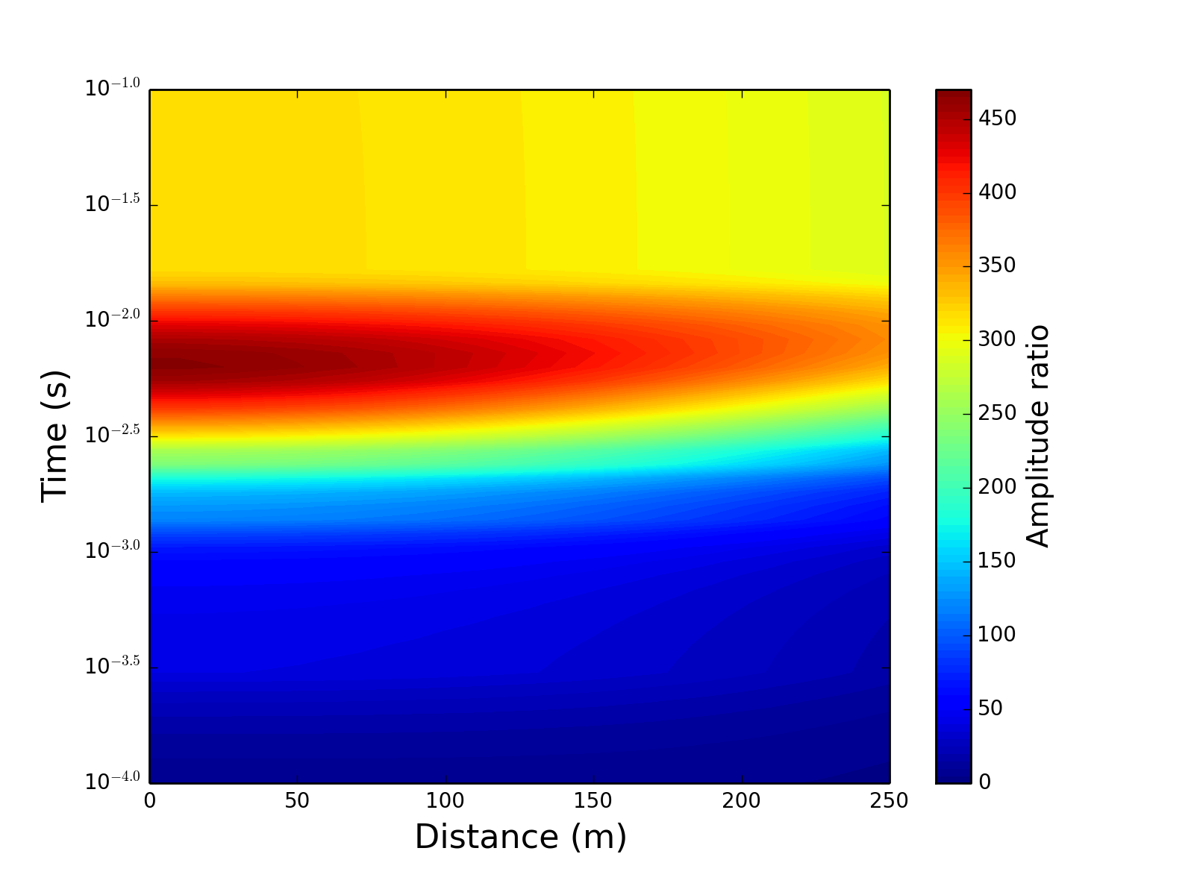
3D
1D
2D

Slide 3
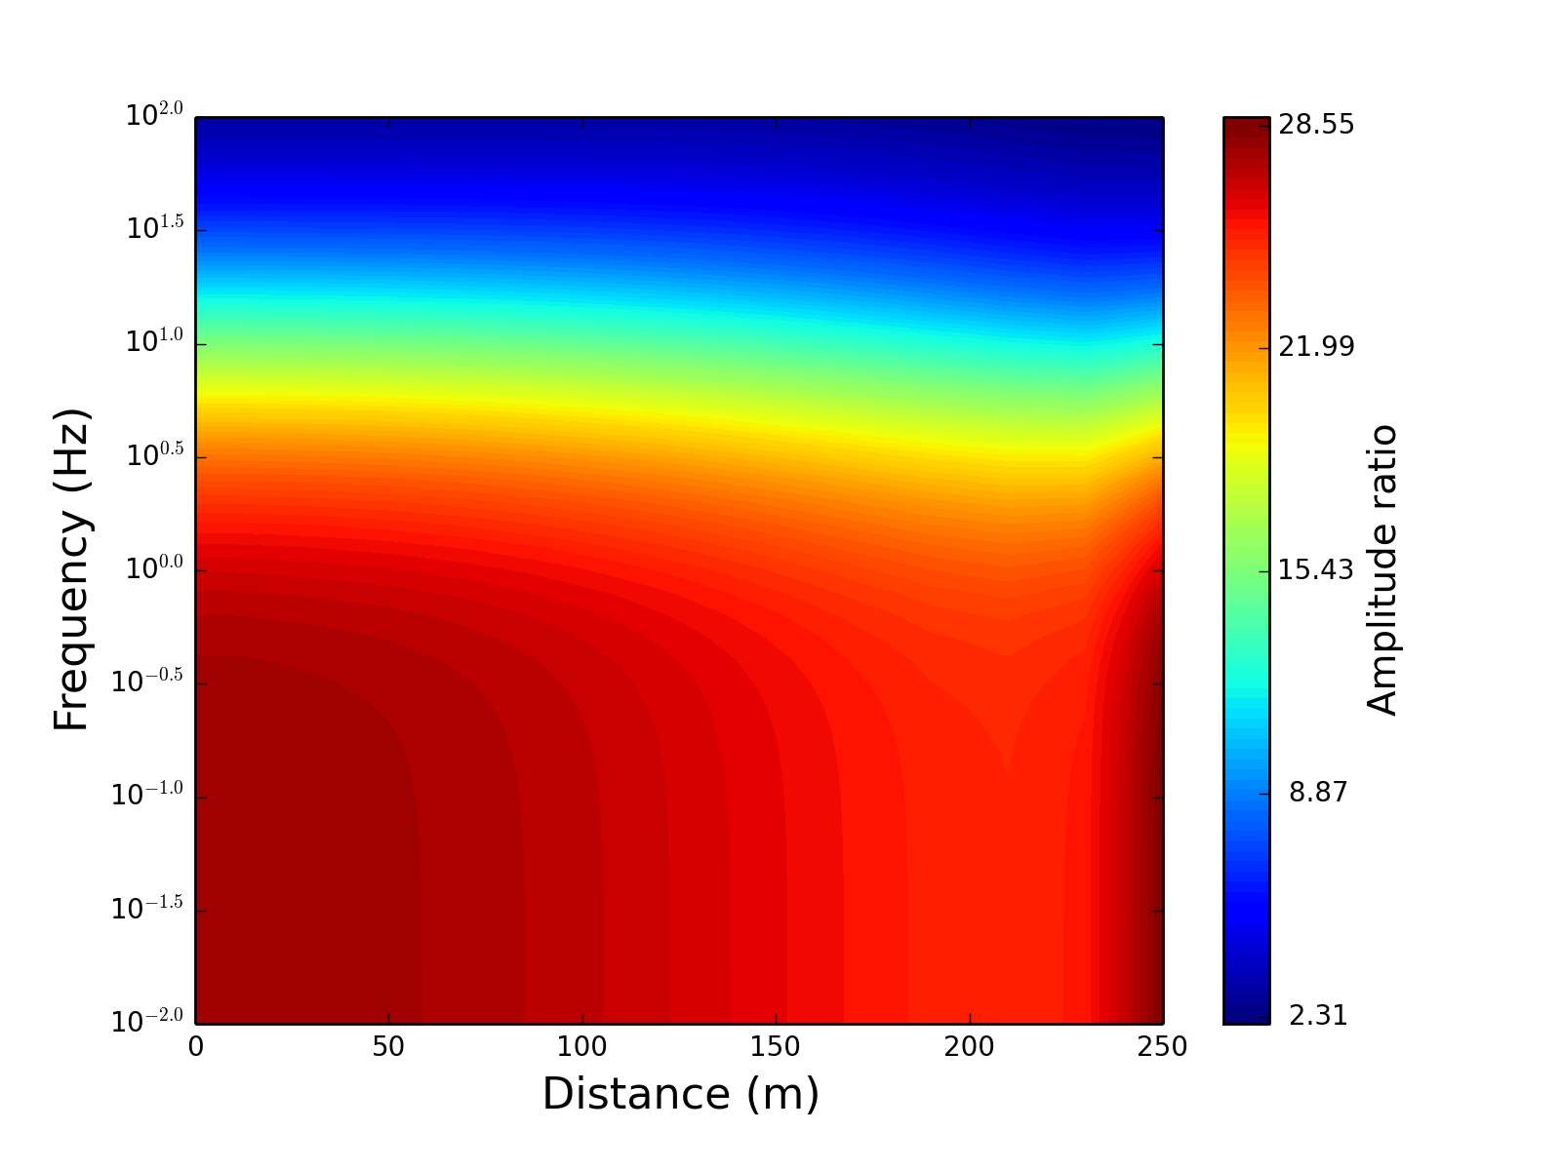
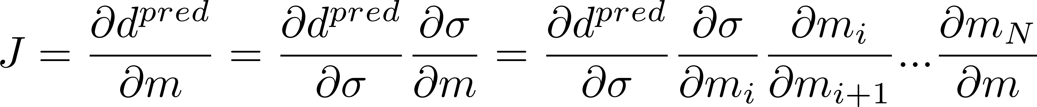

Moving between dimensions in electromagnetic inversions
Seogi Kang, Rowan Cockett, Lindsey J. Heagy and Douglas W. Oldenburg
Geophysical Inversion Facility (GIF), University of British Columbia, Canada
Simulation and Parameter Estimation in Geophysics (SimPEG)
www.simpeg.xyz
??
Maxwell’s equations in time and frequency domain can be expressed as
Compute forward responses:
is Maxwell’s operator
is electrical conductivity
Set up an optimization problem:
The core of our optimization is the sensitivity function:
The model space can be generalized in any types of form in the inversion using mapping function:
And it’s derivative:
Simple feasibility test: anomalous responses
Inverse problem: 3D model
For 3D inversion we use 2D grid of receiver points, which are only located in the circular loops
3D inversion is much more non-unique problem compared to 1D and 2.5D inversion: “We need a good initial guess and reference model and proper regularization”
Inversion results that we have got from 1D and 2.5D inversion can be valuable information for 3D inversion
Exponential and active mappings are used:
Shows better data misfit compared 1D and 2D cases
We can reasonably recover 3D distribution of conductive seawater plume with both 3D TEM and FEM inversions
TEM: 7.3ms
Feasibility of EM methods should be tested by computing anomalous responses
Use 1D model (with and without seawater)
Amplitude ratio:
Parameters:
time or frequency
Distance from the center of the loop (r)
Optimal parameters:
0.1-10 ms; 1-100 Hz (t and f)
0-200 m (distance from the center)
TEM
FEM
Frequency
Time
FEM: 10 Hz
Forward problem: 3D model
3D mesh is used to discretize the earth:
The # of cells: Nx × Ny × Nz = 54 × 44 × 54 = 128304
Core cell size: dx / dy / dz = 20 / 20 / 20 m
Conductivity model includes intruded seawater, which is much more conducive (0.2 S/m) than surrounding (0.0033 S/m)
Two ground circular loops are deployed:
Radius of the loop: 250 m
Receivers are deployed only in the loop
Only measure vertical component of b-field
Use optimal parameters:
Time range: 0.1-10 ms (Step-off waveform)
Tx freqency: 1, 10, 100 Hz
We use SimPEG-EM package, which uses SimPEG’s framework
Provides FEM and TEM forward modeling and inversions
Inverse problem: 1D and 2D model
For 1D and 2.5D inversion we only use a profile line in the loops (black dots)
Exponential and 1 or 2D mappings are used with active mapping:
1D stitched inversion (Conventional)
Recover 1D conductivity model for every stations and stitch together to make 2D-like model
Recover reasonable model when we do not have multi-dimensional structures
2.5D inversion (Use 2D mapping function)
Shows better resolution in lateral variation of the conductivity model
Better data misfit, especially for frequency domain case
Still, cannot explain responses from 3D structure
Thus, we need to change our model as 3D
Typical example:
TEM
Hydrological problem
Near the ocean, sea water intrusion is serious problem due to the contamination of groundwater.
The generic question that we ask here: “What is 3D distribution of the intruded seawater in the earth”
Conductivity contrast between fresh groundwater and seawater is dramatic: ~3.03 S/m (sea water), ~0.01 S/m(ground water)
True intruded seawater
Estimated intruded seawater
FEM
Conclusions
We are gearing towards recovering 3D conductivity distribution of the earth from EM data:
3D inversion is extremely non-unique inverse problem: “Important to set right model space”
Geophysical inversion should be iterative process: “Not one-click” process
Model space of geophysical inversion can be different from discretization for the forward problem
3D forward modeling mesh – model space can be 1D, 2D or 3D with mapping function:
We can easily move from 1D to 3D or 2D to 3D with this mapping
With this flexibility in model space of EM inversion, we can effectively perform iterative inversion procedure in practice
Ground Loop EM survey
Due to the sensitivity of EM induction method for conductive body, loop EM survey has been used to detect intruded seawater (Mills et al., 1988)
Time domain EM (TEM) is conventionally used
Measure vertical component of b-field (bz)
Mostly considered as 1D problem:
Data acquisition: ground loop source with couple profile lines
Frequency domain EM (FEM) system can be used as well
Multi-dimensional inversion can help to recover 3D distribution of the seawater saturation
Acknowledgements
Thank you for Klara Steklova for helpful discussion about hydrological problem and SimPEG developers. Generating 3D distribution of seawater intrusion model was performed using GIFtools.
Notes:
Interestingly, wrong acitvecell mapping helps inversion… in this case

