Slide 1
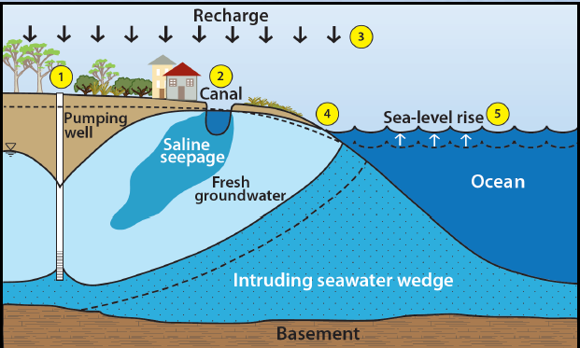

Slide 3
Depth
Northing
Easting

Slide 4
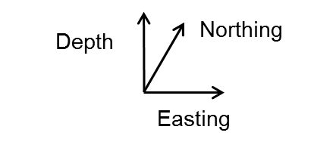
Loop Tx
Rxs
Ocean
Fresh ground water
(resistive)
Intruding seawater
wedge (conductive)

Slide 5
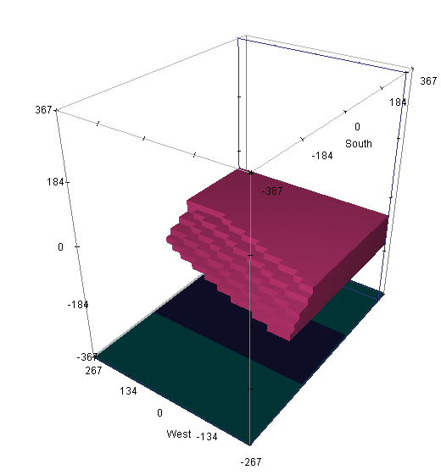

Slide 6
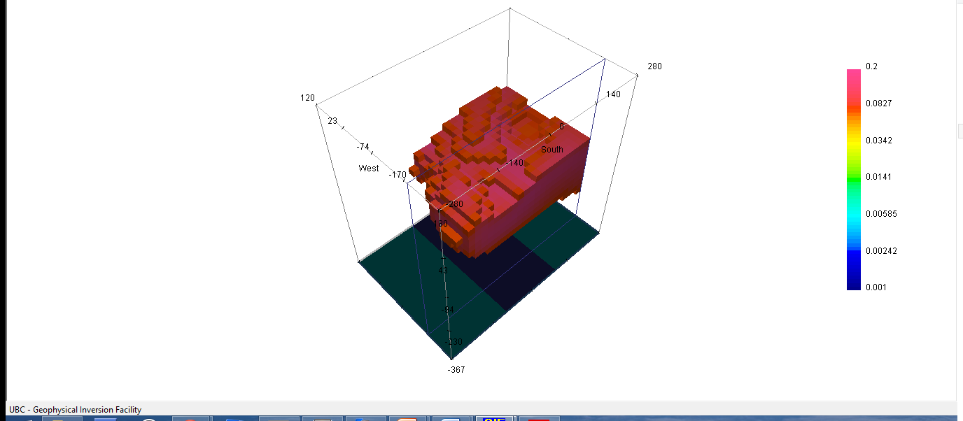

Slide 7
