Slide 1
Scenario X
Real Time Audio Descrambler
By Matthew Tam, Muhammad Bin Amir, Minh Nguyen Nhat, Tea Stoilkovska & Rowan Shah
Outline
Introducing the problem
Digital Solution
Analogue Solution
Conclusion

Slide 2
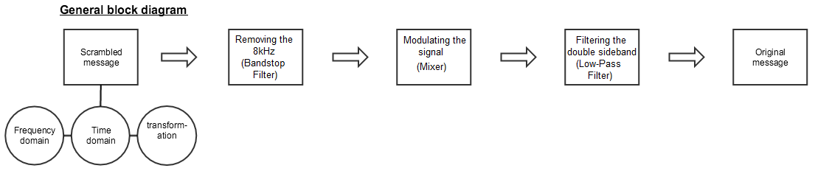
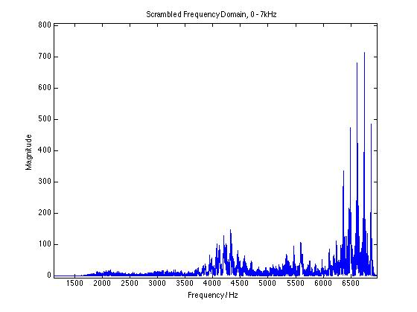
Introduction
General Block Diagram
SHOW GRAPH (....) Original frequency spectrum & Scrambled frequency spectrum

Slide 3
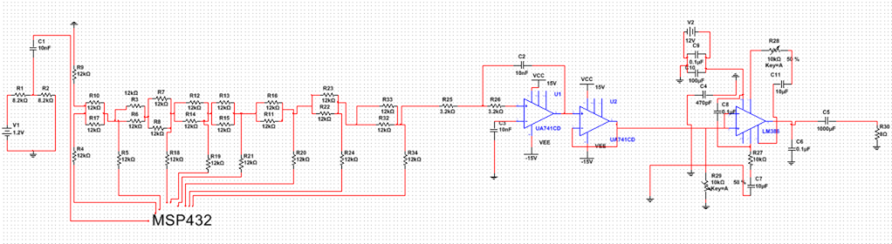
Solution
Figure 1: Complete Multisim model of the circuit used
Notes:
Block diagram for both systems + introduce the problem + our initial observations in the time and frequency domain via Matlab analysis.
Reference to professor Peach and Benny Hill (computer expert ->traffic jam for robbery)

Slide 4
Digital Solution
Similar approach used
3 distinct stages: ADC – Filtering – DAC
DC biasing before ADC
ADC software based
Filtering done through ‘fdatool’ Matlab
Matlab code → C code
DAC (R-2R)

Slide 5
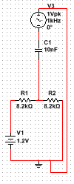
DC Biasing
Before ADC is implemented we introduce a DC offset circuit
The MSP432 cannot read negative voltages
Shifted the signal ~0.6V upwards in the time domain.
Entire signal only positive.
Figure 2: Simple biasing circuit to give the output from 0 to ~1.2V

Slide 6
Analog to Digital Conversion
Sys_Tick Interrupt function runs every time counter reaches 960
Pin P5_0 reads analogue value from input circuit
Analogue signal mapped to 10-bit digital value
10-bit digital value changed to 8-bit digital signal for outputs

Slide 7
Filtering
Implemented Butterworth 2nd order digital filter in MATLAB
Attained coefficients using ‘fdatool’ on Matlab
Implemented the coefficients into Main.C
Implemented the difference function in Main.C inside function bandstop(float input)
Filter is essential to remove 8kHz tone

Slide 8
Descrambling- Spectral Reversal
After signal has been filtered, multiply by 7kHz sinusoidal waveform to modulate the waveform- essentially “mirroring” the signal in the frequency spectrum.
This spectral reversal obtains upper and lower sidebands. We want the lower sideband spectrally reversed signal. The upper sideband will be removed in a low pass analogue filter at a later stage.
We create array of the 7kHz signal over 7 cycles to match the 50kHz frequency at which the sys_tick interrupt executes. There are 50 samples of the sine wave created in this array.
Array iterated through and the sample multiplied with the corresponding input signal at that time.

Slide 9
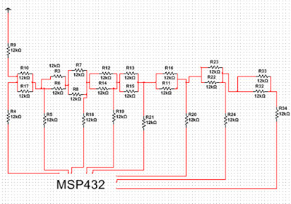
Digital to Analog Conversion - R-2R Ladder

Slide 10
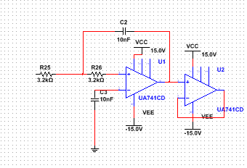
Final Stages of Analogue Solution
Low Pass Filter

Slide 11
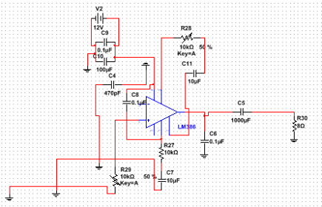
Final Stages of Analogue Solution
Power Amplifier
Very low output current from MSP432
Due to many resistors from R-2R
Current not large enough to drive the loudspeaker
Class AB amplifier built (power amplifier)

Slide 12
Challenges
Analogue:
Non ideal properties of the circuit (in contrast to Multisim based circuit)
Gain losses as we implemented stages
Capacitor coupling! (higher values than simulation)
Digital:
DC biasing needed to be accurate to feed in the correct range of Voltage values to be read by the MSP432
Very low current from the output stage of the DAC (in the range of microamps)

Slide 13
Conclusion
Overview / best solution to date
Advantages and disadvantages of one solution over the other
Could have used AB power amplifier instead

