Slide 1
Beginners’ Python
Day 1

Slide 2
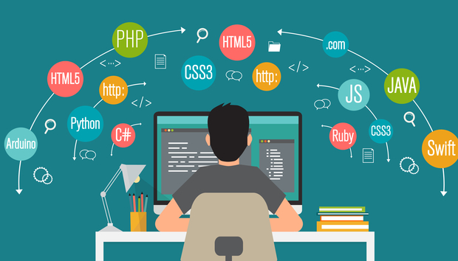
PROGRAMMING

Slide 3
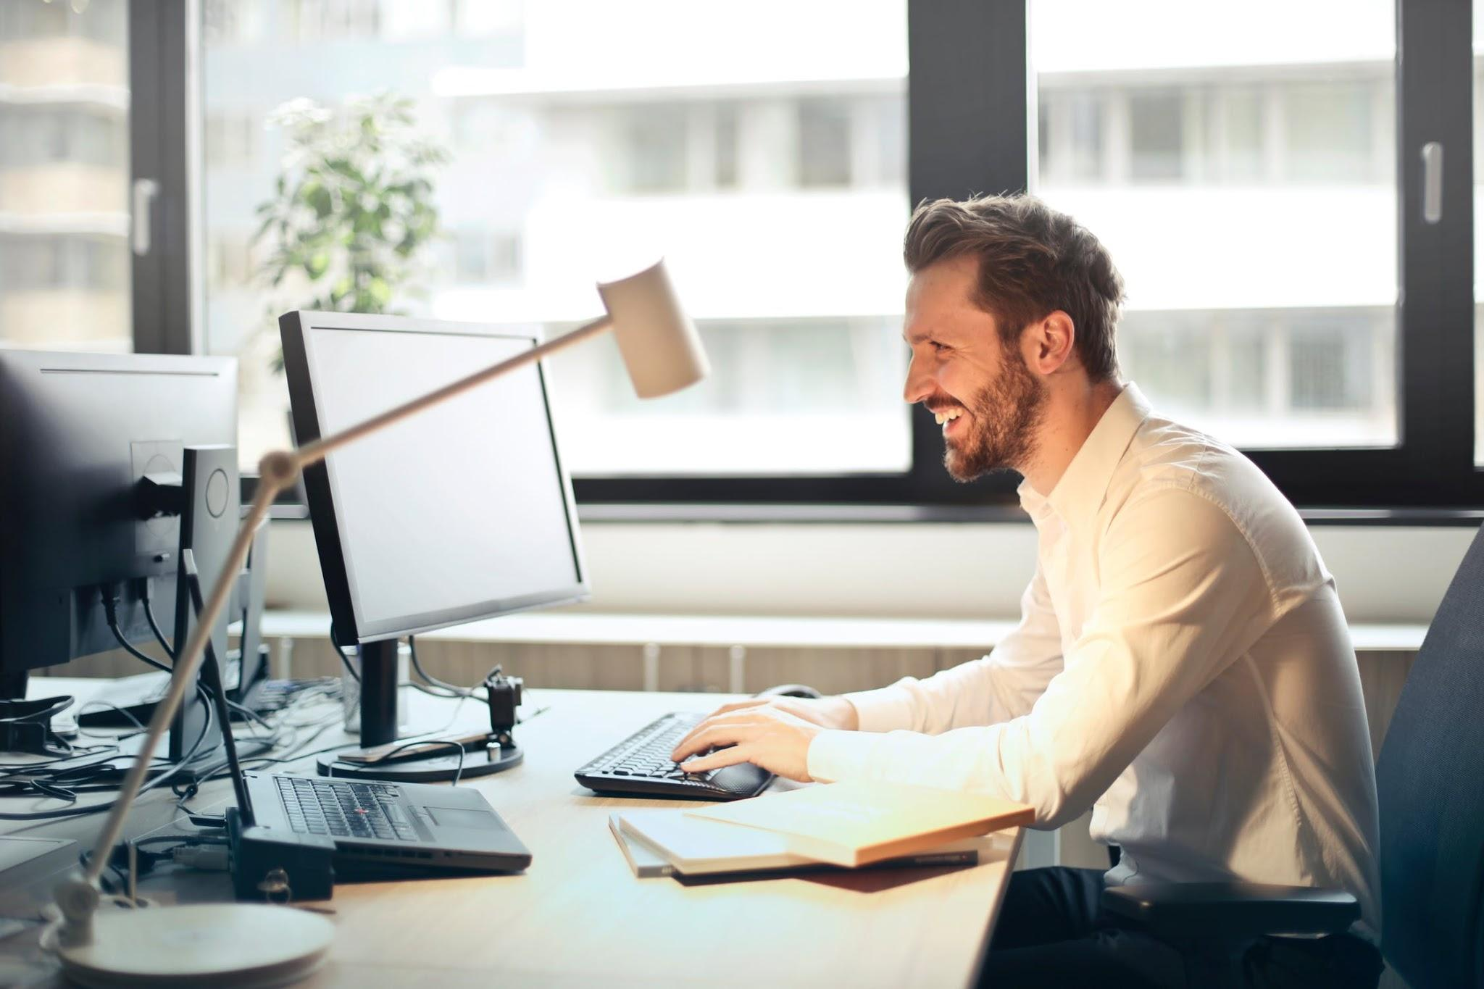
What is Programming?
Talk to your computer
Man having a conversation with his computer

Slide 4
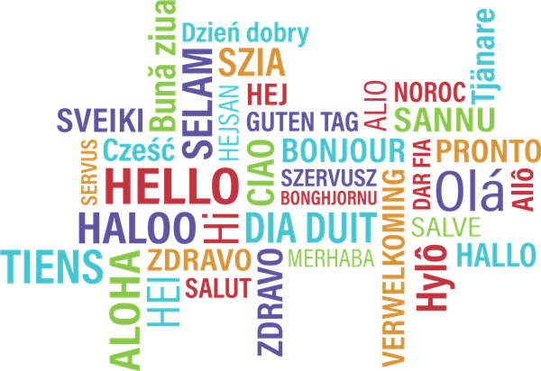
Programming Languages
Different ways to talk to the computer
Computers can understand all programming languages!

Slide 5

Python!
The language we’ll be using
Perfect language for beginners

Slide 6
Let’s set up Trinket
https://trinket.io/sign-up
Sign in with (???)

Slide 7

Using Python
First up: functions
Our first function: print()

Slide 8

Hello World
print("Hello World!")

Slide 9
Talking to the User
favorite_number = raw_input("What's your favorite number? ") print("I like " + favorite_number + " too!")

Slide 10
Beginners’ Python
Day 2

Slide 11
Data

Slide 12
Types of Data

Slide 13
Control Flow

Slide 14
If …

Slide 15
While …

Slide 16
For

Slide 17
Games!

Slide 18
Game: Guess My Number

Slide 19
Beginners’ Python
Day 3

Slide 20
More Features

Slide 21
Modules

Slide 22
Using Modules

Slide 23
Graphics

Slide 24
Turtle

Slide 25
Game: Turtle Run

Slide 26
Making Your Own Game

