Slide 1
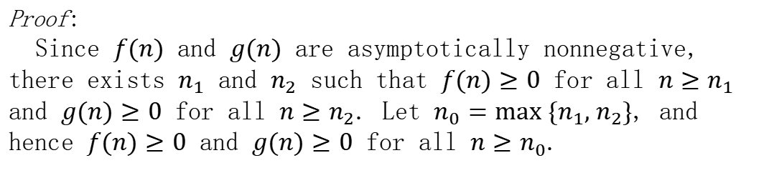
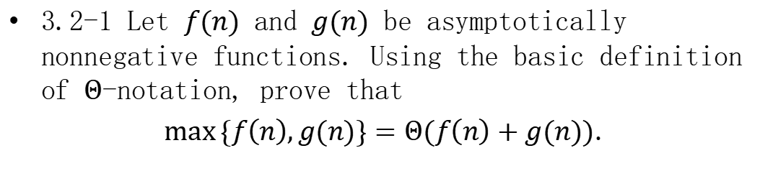
Homework
3.2-1 Let $f(n)$ and $g(n)$ be asymptotically nonnegative functions. Using the basic definition of $Θ$-notation, prove that
$\max{\{f\left(n\right),g(n)\}}=Θ(f\left(n\right)+g(n))$.
Proof:
Since $f(n)$ and $g(n)$ are asymptotically nonnegative, there exists $n_{1}$ and $n_{2}$ such that $f(n)≥0$ for all $n≥n_{1}$ and $g(n)≥0$ for all $n≥n_{2}$. Let $n_{0}=max \{n_{1}, n_{2}\}$, and hence $f(n)≥0$ and $g(n)≥0$ for all $n≥n_{0}$.

Slide 2

Homework
For all $n≥n_{0}$, we have
$$0≤f(n)≤max \{f(n), g(n)\},$$
$$0≤g(n)≤max \{f(n), g(n)\},$$
$$0≤max \{f(n), g(n)\}≤f(n)+g(n).$$
Adding the first two inequalities, it can be derived that
$$0≤{(f(n)+g(n))}/2≤max \{f(n), g(n)\}.$$
According to the definition of $Θ$-notation, $c_{1}=1/2$ and $c_{2}=1$, for all $n≥n_{0}$,
$$0≤{(f(n)+g(n))}/2≤max \{f(n), g(n)\}≤f(n)+g(n).$$
Therefore, $max \{f(n), g(n)\}=Θ(f\left(n\right)+g(n))$.

Slide 3
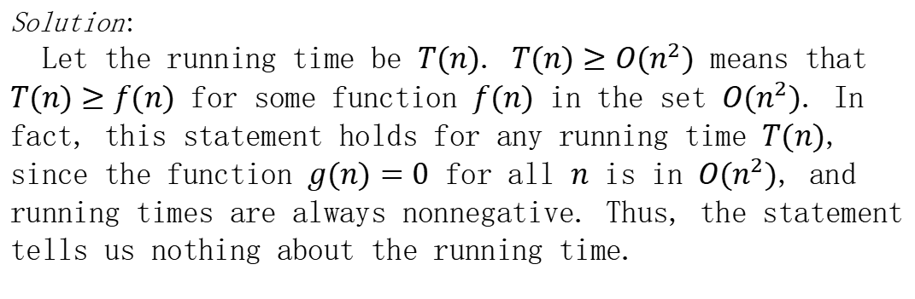
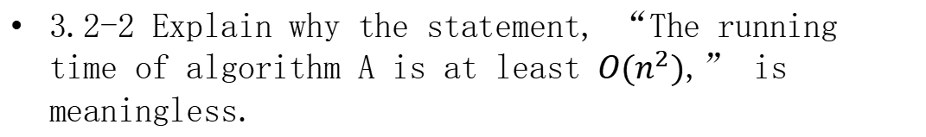
Homework
3.2-2 Explain why the statement, “The running time of algorithm A is at least $O(n^{2})$,” is meaningless.
Solution:
Let the running time be $T(n)$. $T(n)≥O(n^{2})$ means that $T(n)≥f(n)$ for some function $f(n)$ in the set $O(n^{2})$. In fact, this statement holds for any running time $T(n)$, since the function $g(n)=0$ for all $n$ is in $O(n^{2})$, and running times are always nonnegative. Thus, the statement tells us nothing about the running time.

Slide 4
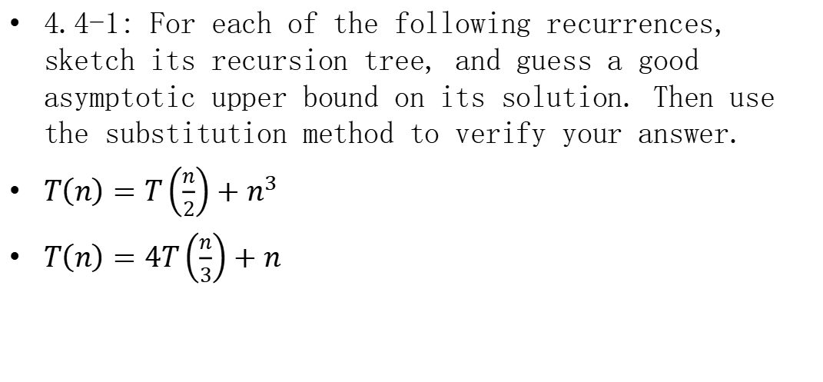
Homework
4.4-1: For each of the following recurrences, sketch its recursion tree, and guess a good asymptotic upper bound on its solution. Then use the substitution method to verify your answer.
$T\left(n\right)=T\left(\frac{n}{2}\right)+n^{3}$
$T\left(n\right)=4T\left(\frac{n}{3}\right)+n$

Slide 5









Homework
$T\left(n\right)=T\left(\frac{n}{2}\right)+n^{3}$
Recursion tree:
Substitution method: to verify $T(n)≤cn^{3}$
$T(n)=T(\frac{n}{2})+n^{3}≤c{(\frac{n}{2})}^{3}+n^{3}=(\frac{c}{8}+1)n^{3}≤cn^{3}$, for $c≥\frac{8}{7}$.
$$T(n)=c_{1}+n^{3}+{(\frac{n}{2})}^{3}+{(\frac{n}{4})}^{3}+⋯+{(\frac{n}{2^{\log{n}}})}^{3}$$
$$n^{3}$$
$$=c_{1}+n^{3}(1+\frac{1}{8}+{(\frac{1}{8})}^{2}+{(\frac{1}{8})}^{3}+⋯+{(\frac{1}{8})}^{\log{n}})$$
$${(\frac{n}{2})}^{3}$$
$$<c_{1}+\frac{1}{1−\frac{1}{8}}n^{3}=c_{1}+\frac{8}{7}n^{3}=O(n^{3})$$
$$\log{n}$$
$${(\frac{n}{4})}^{3}$$
$$⋮$$
$$c_{1}$$

Slide 6


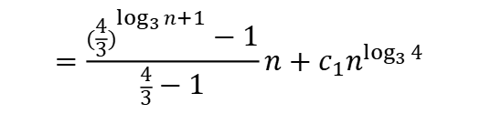











Homework
$T\left(n\right)=4T\left(\frac{n}{3}\right)+n$
Recursion tree:
Substitution method: to verify $T(n)≤cn^{\log_{3}{4}}$
$$T(n)=4T(\frac{n}{3})+n≤4c{(\frac{n}{3})}^{\log_{3}{4}}+n=cn^{\log_{3}{4}}+n$$
Substract a lower-order term: $T(n)≤cn^{\log_{3}{4}}−dn$, $d≥0$
$T(n)≤4c{(\frac{n}{3})}^{\log_{3}{4}}−\frac{4}{3}dn+n=cn^{\log_{3}{4}}−(\frac{4}{3}d−1)n≤cn^{\log_{3}{4}}−dn$, for $d≥3$.
$$T(n)=n+\frac{4}{3}n+{(\frac{4}{3})}^{2}n+⋯+{(\frac{4}{3})}^{\log_{3}{n}}n+c_{1}n^{\log_{3}{4}}$$
$$n$$
$$n$$
$$=\frac{{(\frac{4}{3})}^{\log_{3}{n}+1}−1}{\frac{4}{3}−1}n+c_{1}n^{\log_{3}{4}}$$
$$\frac{n}{3}$$
$$\frac{n}{3}$$
$$\frac{n}{3}$$
$$\frac{n}{3}$$
$$\frac{4}{3}n$$
$$\log_{3}{n}$$
$$\frac{n}{9}$$
$$\frac{n}{9}$$
$$⋯$$
$$\frac{n}{9}$$
$$\frac{16}{9}n$$
$$=4n^{\log_{3}{4}−1}n+c_{1}n^{\log_{3}{4}}−3n$$
$$⋮$$
$$⋮$$
$$=Θ(n^{\log_{3}{4}})$$
$$c_{1}$$
$$c_{1}$$
$$c_{1}$$
$$⋯$$
$$c_{1}$$
$$4^{\log_{3}{n}}c_{1}$$

Slide 7
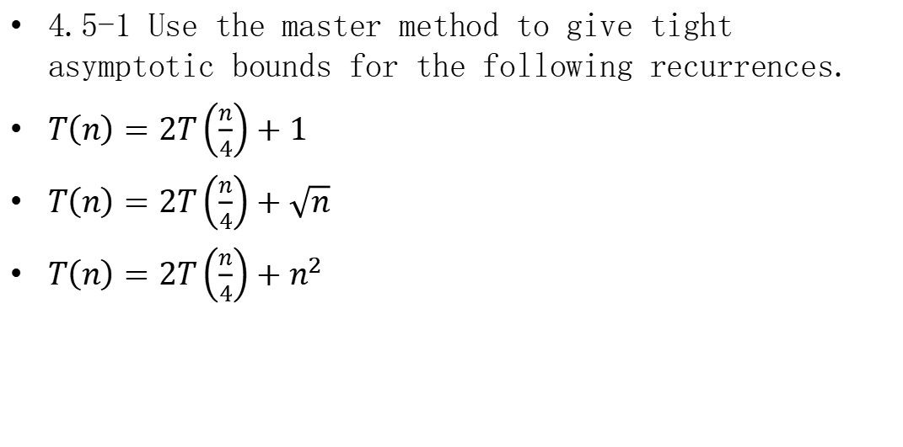
Homework
4.5-1 Use the master method to give tight asymptotic bounds for the following recurrences.
$T\left(n\right)=2T\left(\frac{n}{4}\right)+1$
$T\left(n\right)=2T\left(\frac{n}{4}\right)+\sqrt{n}$
$T\left(n\right)=2T\left(\frac{n}{4}\right)+n^{2}$

Slide 8
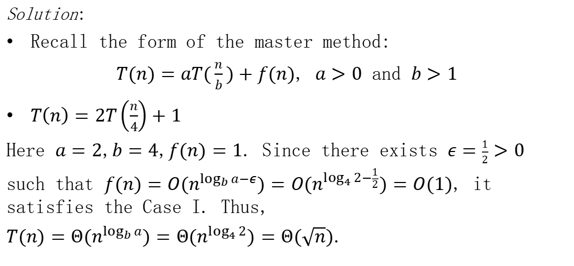
Homework
Solution:
Recall the form of the master method:
$T(n)=aT(\frac{n}{b})+f(n)$, $a>0$ and $b>1$
$T\left(n\right)=2T\left(\frac{n}{4}\right)+1$
Here $a=2$,$b=4$,$f(n)=1$. Since there exists $ε=\frac{1}{2}>0$ such that $f(n)=O(n^{\log_{b}{a}−ε})=O(n^{\log_{4}{2}−\frac{1}{2}})=O(1)$, it satisfies the Case I. Thus,
$T(n)=Θ(n^{\log_{b}{a}})=Θ(n^{\log_{4}{2}})=Θ(\sqrt{n})$.

Slide 9
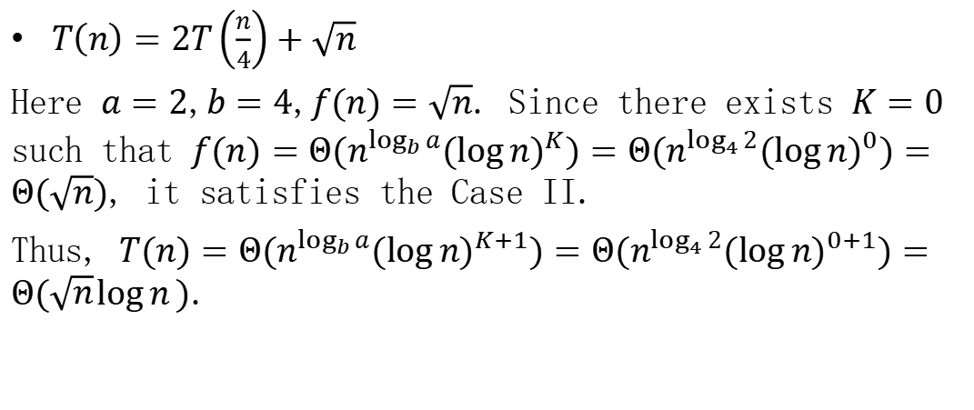
Homework
$T\left(n\right)=2T\left(\frac{n}{4}\right)+\sqrt{n}$
Here $a=2$,$b=4$,$f(n)=\sqrt{n}$. Since there exists $K=0$ such that $f(n)=Θ(n^{\log_{b}{a}}{(log{n)}}^{K})=Θ(n^{\log_{4}{2}}{(log{n)}}^{0})=Θ(\sqrt{n})$, it satisfies the Case II.
Thus, $T(n)=Θ(n^{\log_{b}{a}}{(log{n)}}^{K+1})=Θ(n^{\log_{4}{2}}{(log{n)}}^{0+1})=Θ(\sqrt{n}\log{n})$.

Slide 10
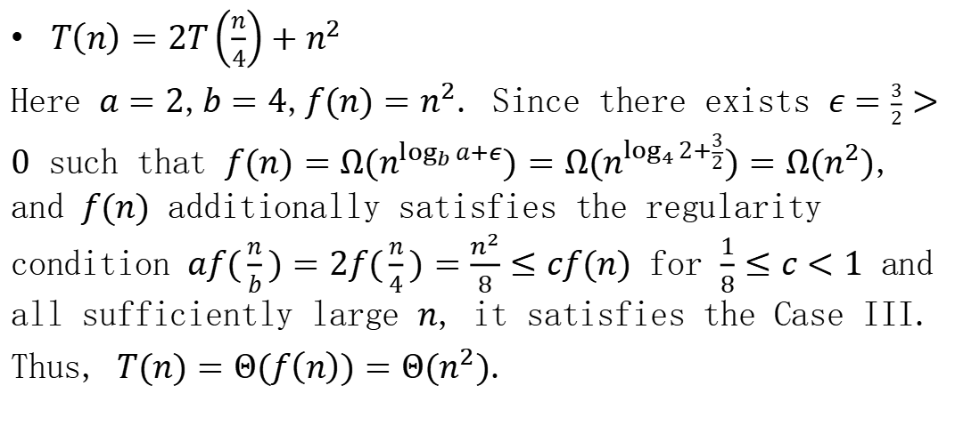
Homework
$T\left(n\right)=2T\left(\frac{n}{4}\right)+n^{2}$
Here $a=2$,$b=4$,$f(n)=n^{2}$. Since there exists $ε=\frac{3}{2}>0$ such that $f(n)=Ω(n^{\log_{b}{a}+ε})=Ω(n^{\log_{4}{2}+\frac{3}{2}})=Ω(n^{2})$, and $f(n)$ additionally satisfies the regularity condition $af(\frac{n}{b})=2f(\frac{n}{4})=\frac{n^{2}}{8}≤cf(n)$ for $\frac{1}{8}≤c<1$ and all sufficiently large $n$, it satisfies the Case III.
Thus, $T(n)=Θ(f\left(n\right))=Θ(n^{2})$.

