Slide 1
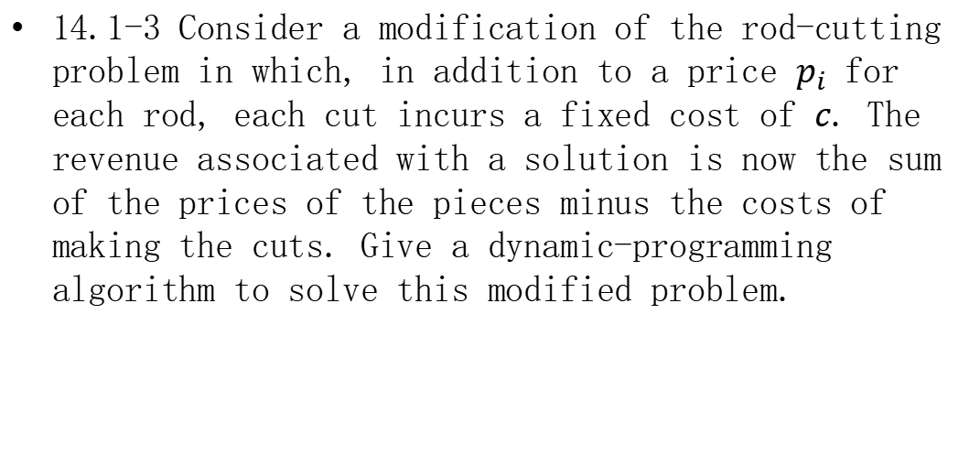
Homework
14.1-3 Consider a modification of the rod-cutting problem in which, in addition to a price $p_{i}$ for each rod, each cut incurs a fixed cost of $c$. The revenue associated with a solution is now the sum of the prices of the pieces minus the costs of making the cuts. Give a dynamic-programming algorithm to solve this modified problem.
$$r_{n}=max\left\{p_{1}+r_{n−1}−c, p_{2}+r_{n−2}−c, ⋯, p_{n−1}+r_{1}−c, p_{n}\right\}$$
$$=max\left\{p_{i}+r_{n−i}−c | 1≤i≤n, r_{0}=c\right\}$$

Slide 2
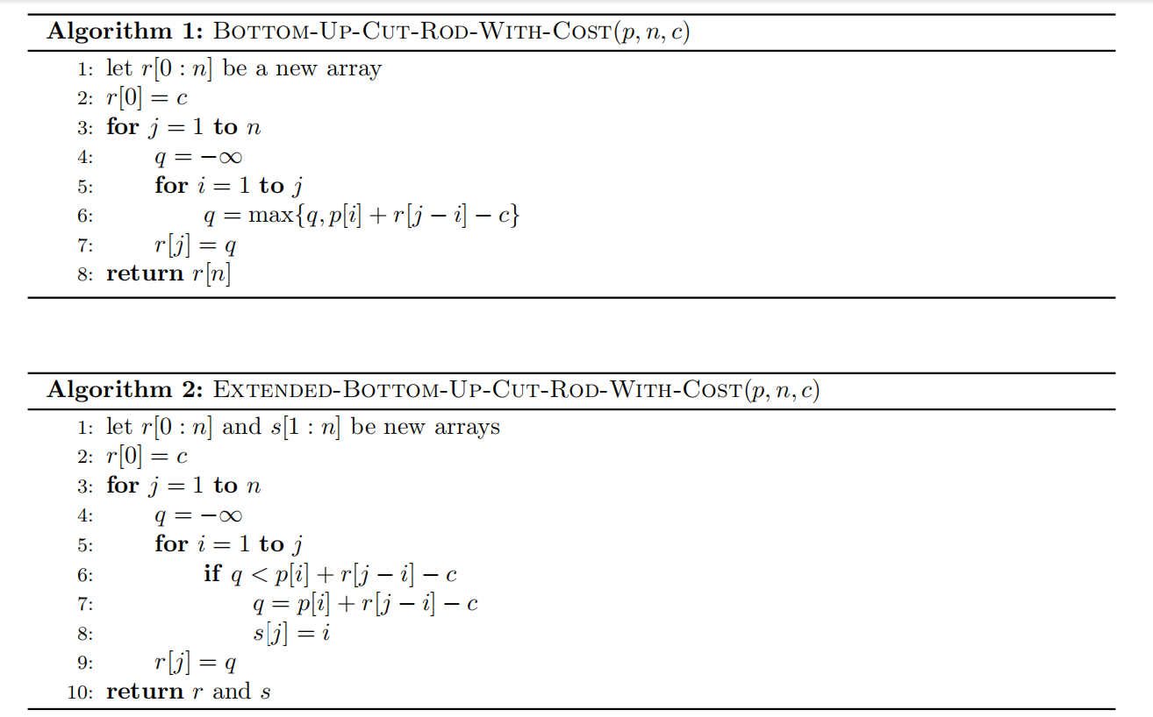
Homework
Both correct:
Algorithm 1 returns the maximal revenue.
Algorithm 2 returns the maximal revenue and the best cut locations for reconstruction.

Slide 3
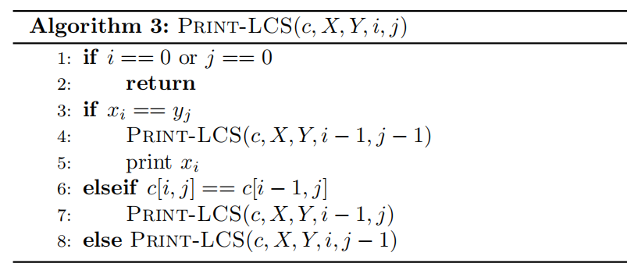

Homework
14.4-2 Give pseudocode to reconstruct an LCS from the completed $c$ table and the original sequences $X=<x_{1},x_{2},…,x_{m}>$ and $Y=<y_{1},y_{2},…,y_{n}>$ in $O(m+n)$ time, without using the $b$ table.
The procedure takes $O(m+n)$ time.

Slide 4
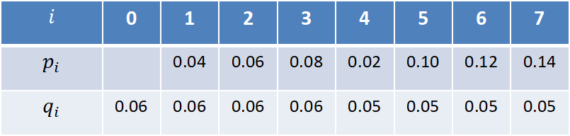

Homework
14.5-2 Determine the cost and structure of an optimal binary search tree for a set of $n=7$ keys with the following probabilities:
$$i$$ | 0 | 1 | 2 | 3 | 4 | 5 | 6 | 7
$$p_{i}$$ |  | 0.04 | 0.06 | 0.08 | 0.02 | 0.10 | 0.12 | 0.14
$$q_{i}$$ | 0.06 | 0.06 | 0.06 | 0.06 | 0.05 | 0.05 | 0.05 | 0.05

Slide 5


































































Homework
$$e$$
$$w$$
$$7$$
$$1$$
$$7$$
$$1$$
$$6$$
$$3.12$$
$$2$$
$$6$$
$$1.00$$
$$2$$
$$5$$
$$2.44$$
$$2.61$$
$$3$$
$$5$$
$$0.81$$
$$0.90$$
$$3$$
$$j$$
$$1.83$$
$$1.96$$
$$2.13$$
$$i$$
$$j$$
$$0.64$$
$$0.71$$
$$0.78$$
$$i$$
$$4$$
$$4$$
$$4$$
$$4$$
$$1.34$$
$$1.41$$
$$1.48$$
$$1.55$$
$$0.49$$
$$0.54$$
$$0.59$$
$$0.64$$
$$3$$
$$5$$
$$3$$
$$5$$
$$2$$
$$1.02$$
$$0.93$$
$$1.04$$
$$1.01$$
$$1.20$$
$$6$$
$$2$$
$$0.42$$
$$0.39$$
$$0.42$$
$$0.45$$
$$0.56$$
$$6$$
$$1$$
$$0.62$$
$$0.68$$
$$0.57$$
$$0.57$$
$$0.72$$
$$0.78$$
$$7$$
$$1$$
$$0.28$$
$$0.32$$
$$0.27$$
$$0.28$$
$$0.37$$
$$0.41$$
$$7$$
$$0$$
$$0.28$$
$$0.30$$
$$0.32$$
$$0.24$$
$$0.30$$
$$0.32$$
$$0.34$$
$$8$$
$$0$$
$$0.16$$
$$0.18$$
$$0.20$$
$$0.13$$
$$0.20$$
$$0.22$$
$$0.24$$
$$8$$
$$0.06$$
$$0.06$$
$$0.06$$
$$0.06$$
$$0.05$$
$$0.05$$
$$0.05$$
$$0.05$$
$$0.06$$
$$0.06$$
$$0.06$$
$$0.06$$
$$0.05$$
$$0.05$$
$$0.05$$
$$0.05$$
The cost is $3.12$

Slide 6




















Homework
$$k_{5}$$
0.10
$$k_{2}$$
$$k_{7}$$
$$0.06$$
0.14
$$k_{1}$$
$$k_{3}$$
$$k_{6}$$
$$d_{7}$$
$$0.04$$
$$0.08$$
0.12
$$0.05$$
$$d_{0}$$
$$d_{1}$$
$$d_{2}$$
$$k_{4}$$
$$d_{5}$$
$$d_{6}$$
$$0.06$$
$$0.06$$
$$0.06$$
$$0.02$$
$$0.05$$
$$0.05$$
$$d_{3}$$
$$d_{4}$$
$$0.06$$
$$0.05$$

