Slide 1
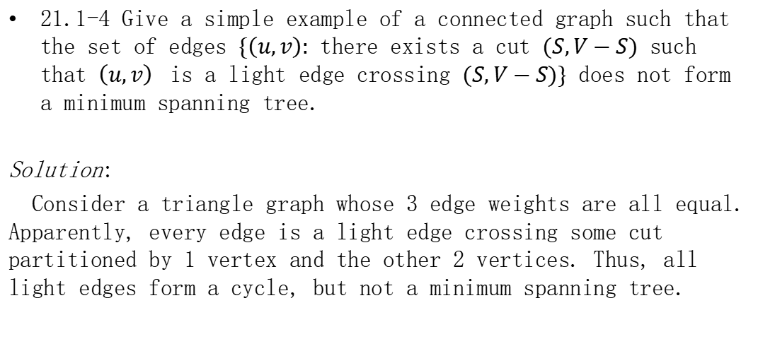
Homework
21.1-4 Give a simple example of a connected graph such that the set of edges $\{\left(u,v\right):$ there exists a cut $(S,V−S)$ such that $\left(u,v\right)$ is a light edge crossing $(S,V−S)\}$ does not form a minimum spanning tree.
Solution:
Consider a triangle graph whose 3 edge weights are all equal. Apparently, every edge is a light edge crossing some cut partitioned by 1 vertex and the other 2 vertices. Thus, all light edges form a cycle, but not a minimum spanning tree.

Slide 2
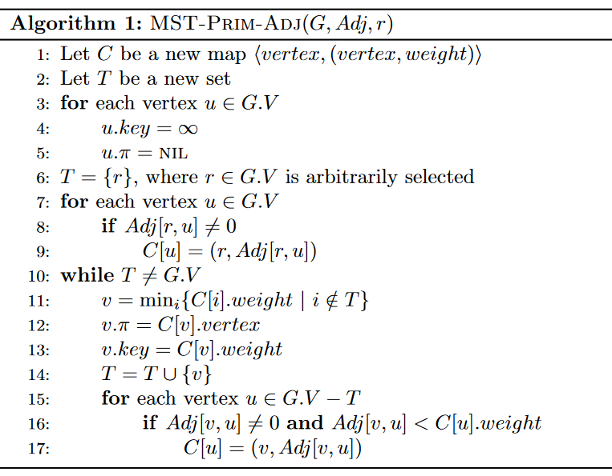

Homework
21.2-2 Give a simple implementation of Prim’s algorithm that runs in $O(V^{2})$ time when the graph $G(V,E)$ is represented as an adjacency matrix.

