Slide 1
Homework
22.3-2 Give a simple example of a directed graph with negative-weight edges for which Dijkstra's algorithm produces an incorrect answer.
Solution:
Consider a graph with a negative-weight cycle reachable from the source. The distance to any vertex reachable from the cycle is -∞, but RELAX algorithm is called only finite times, and hence Dijkstra's algorithm cannot produce a correct answer.

Slide 2
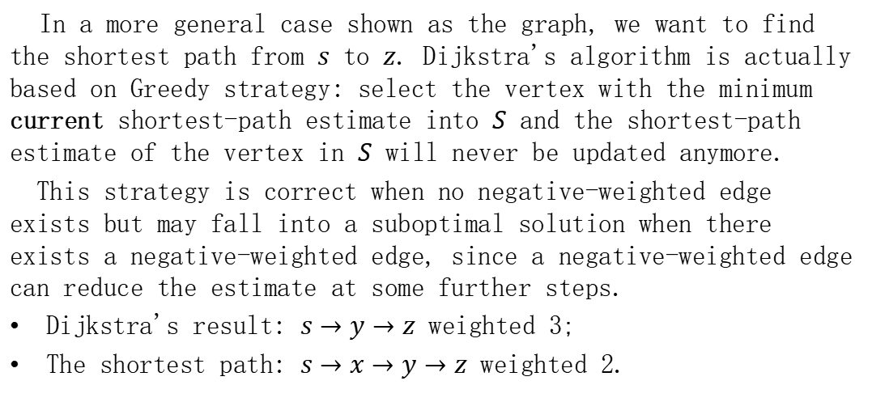
Homework
In a more general case shown as the graph, we want to find the shortest path from $s$ to $z$. Dijkstra's algorithm is actually based on Greedy strategy: select the vertex with the minimum current shortest-path estimate into $S$ and the shortest-path estimate of the vertex in $S$ will never be updated anymore.
This strategy is correct when no negative-weighted edge exists but may fall into a suboptimal solution when there exists a negative-weighted edge, since a negative-weighted edge can reduce the estimate at some further steps.
Dijkstra's result: $s→y→z$ weighted 3;
The shortest path: $s→x→y→z$ weighted 2.
x
4
-3
s
y
z
2
1

Slide 3
Homework
23.2-6 Show how to use the output of the Floyd-Warshall algorithm to detect the presence of a negative-weight cycle.
Solution:
If the output of the Floyd-Warshall algorithm has a negative number on the diagonal (the shortest path from a vertex to itself), then there exists a negative-weight cycle.

