Slide 1
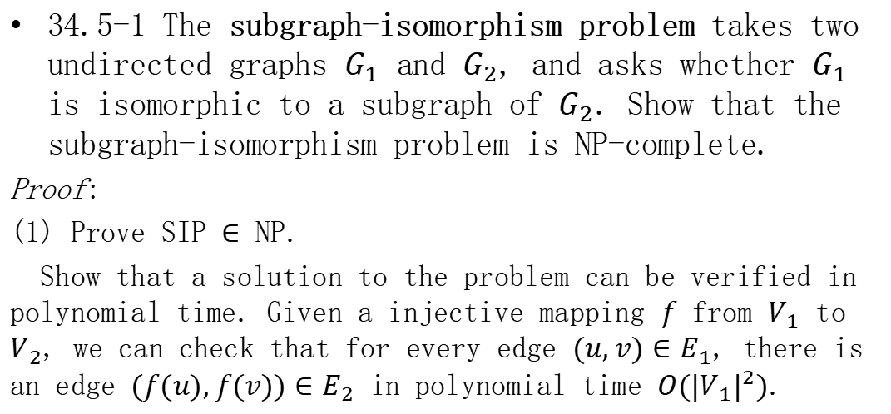
Homework
34.5-1 The subgraph-isomorphism problem takes two undirected graphs $G_{1}$ and $G_{2}$, and asks whether $G_{1}$ is isomorphic to a subgraph of $G_{2}$. Show that the subgraph-isomorphism problem is NP-complete.
Proof:
(1) Prove SIP $∈$ NP.
Show that a solution to the problem can be verified in polynomial time. Given a injective mapping $f$ from $V_{1}$ to $V_{2}$, we can check that for every edge $(u, v)∈E_{1}$, there is an edge $(f(u), f(v))∈E_{2}$ in polynomial time $O({|V_{1}|}^{2})$.

Slide 2
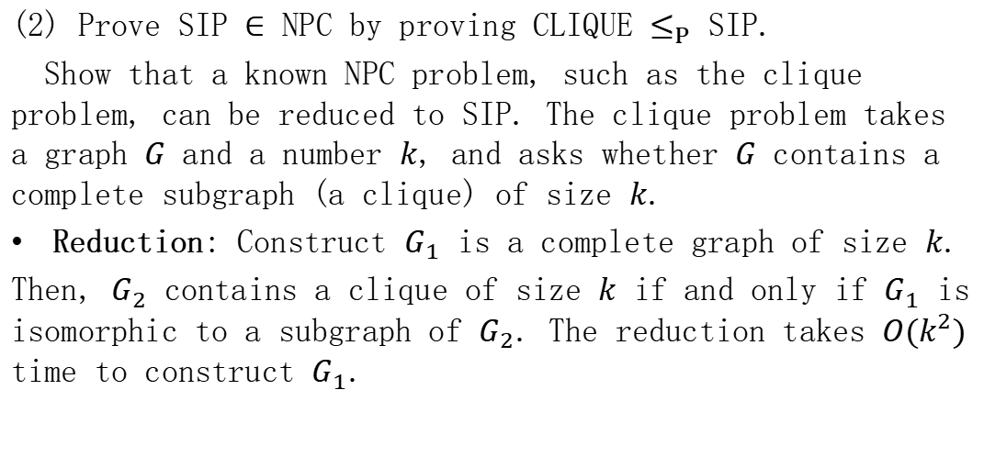
Homework
(2) Prove SIP $∈$ NPC by proving CLIQUE $≤_{P}$ SIP.
Show that a known NPC problem, such as the clique problem, can be reduced to SIP. The clique problem takes a graph $G$ and a number $k$, and asks whether $G$ contains a complete subgraph (a clique) of size $k$.
Reduction: Construct $G_{1}$ is a complete graph of size $k$.
Then, $G_{2}$ contains a clique of size $k$ if and only if $G_{1}$ is isomorphic to a subgraph of $G_{2}$. The reduction takes $O(k^{2})$ time to construct $G_{1}$.

Slide 3
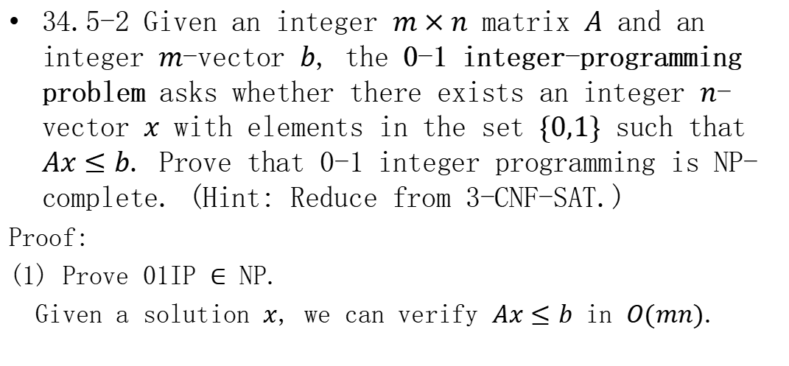
Homework
34.5-2 Given an integer $m×n$ matrix $A$ and an integer $m$-vector $b$, the 0-1 integer-programming problem asks whether there exists an integer $n$-vector $x$ with elements in the set $\{0,1\}$ such that $Ax≤b$. Prove that 0-1 integer programming is NP-complete. (Hint: Reduce from 3-CNF-SAT.)
Proof:
(1) Prove 01IP $∈$ NP.
Given a solution $x$, we can verify $Ax≤b$ in $O(mn)$.

Slide 4
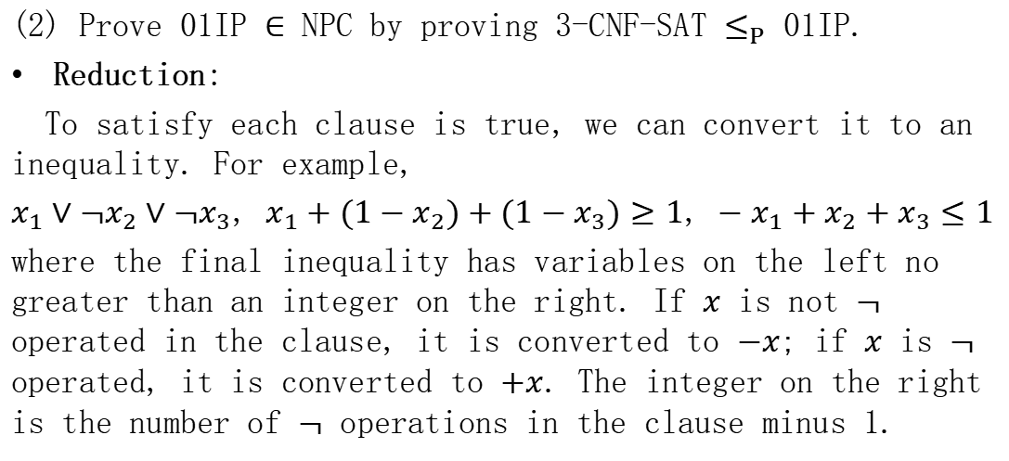
Homework
(2) Prove 01IP $∈$ NPC by proving 3-CNF-SAT $≤_{P}$ 01IP.
Reduction:
To satisfy each clause is true, we can convert it to an inequality. For example,
$x_{1}∨¬x_{2}∨¬x_{3}$, $x_{1}+(1−x_{2})+(1−x_{3})≥1$, $−x_{1}+x_{2}+x_{3}≤1$
where the final inequality has variables on the left no greater than an integer on the right. If $x$ is not $¬$ operated in the clause, it is converted to $−x$; if $x$ is $¬$ operated, it is converted to $+x$. The integer on the right is the number of $¬$ operations in the clause minus 1.

Slide 5
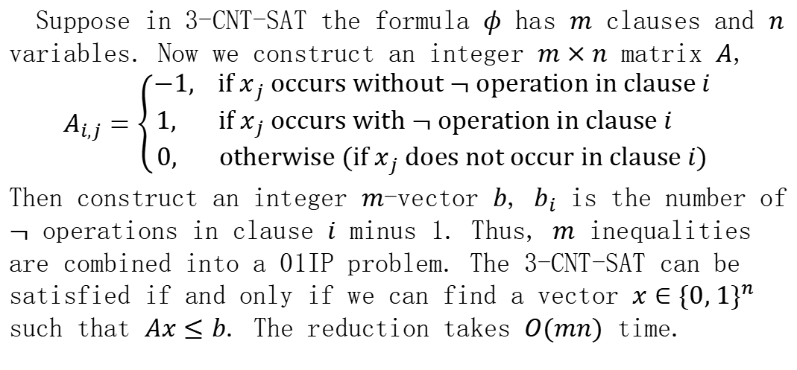
Homework
Suppose in 3-CNT-SAT the formula $φ$ has $m$ clauses and $n$ variables. Now we construct an integer $m×n$ matrix $A$,
$$A_{i,j}=\left\{\begin{aligned}−1, if x_{j} occurs without ¬ operation in clause i \\ 1, if x_{j} occurs with ¬ operation in clause i \\ 0, otherwise (if x_{j} does not occur in clause i)\end{aligned}\right.$$
Then construct an integer $m$-vector $b$, $b_{i}$ is the number of $¬$ operations in clause $i$ minus 1. Thus, $m$ inequalities are combined into a 01IP problem. The 3-CNT-SAT can be satisfied if and only if we can find a vector $x∈{\{0, 1\}}^{n}$ such that $Ax≤b$. The reduction takes $O(mn)$ time.

