Slide 1
Homework-1
What happens if the assumption for Δ does not hold? Which property is violated? Give an example.
Strong accuracy is violated.
If a process p is detected by any process, then p has crashed.

Slide 2

Example
2Δ
p1
p2
p3
heartbeat_
request
heartbeat_
reply
alive = {p1,p2,p3}
detected = {}
p1,p3:
alive = {p2}
detected = {p1,p3}
p2:

Slide 3
Homework-2
If we would prefer p2 to be the leader (though it may crash), give an eventual leader detection algorithm that additionally ensures
If p2 does not crash, then eventually p2 is elected as the leader by every correct process.

Slide 4
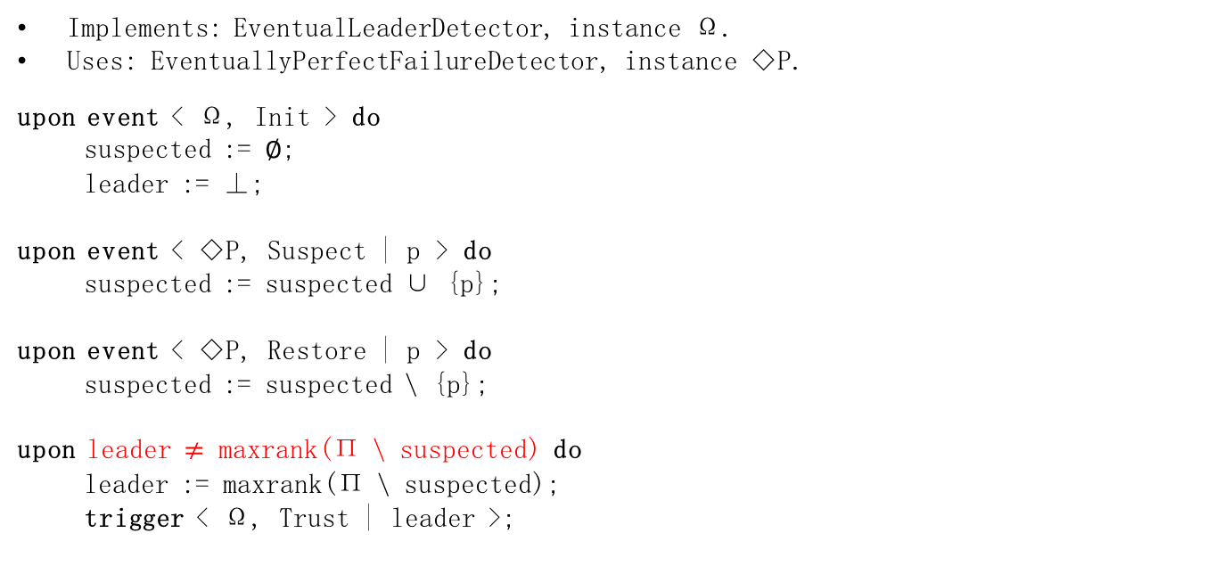
Algorithm: Monarchical Eventual Leader Detection
Implements: EventualLeaderDetector, instance Ω.
Uses: EventuallyPerfectFailureDetector, instance ◇P.
upon event < Ω, Init > do
suspected := ∅;
leader := ⊥;
upon event < ◇P, Suspect | p > do
suspected := suspected ∪ {p};
upon event < ◇P, Restore | p > do
suspected := suspected \ {p};
upon leader $≠$ maxrank(Π \ suspected) do
leader := maxrank(Π \ suspected);
trigger < Ω, Trust | leader >;

Slide 5
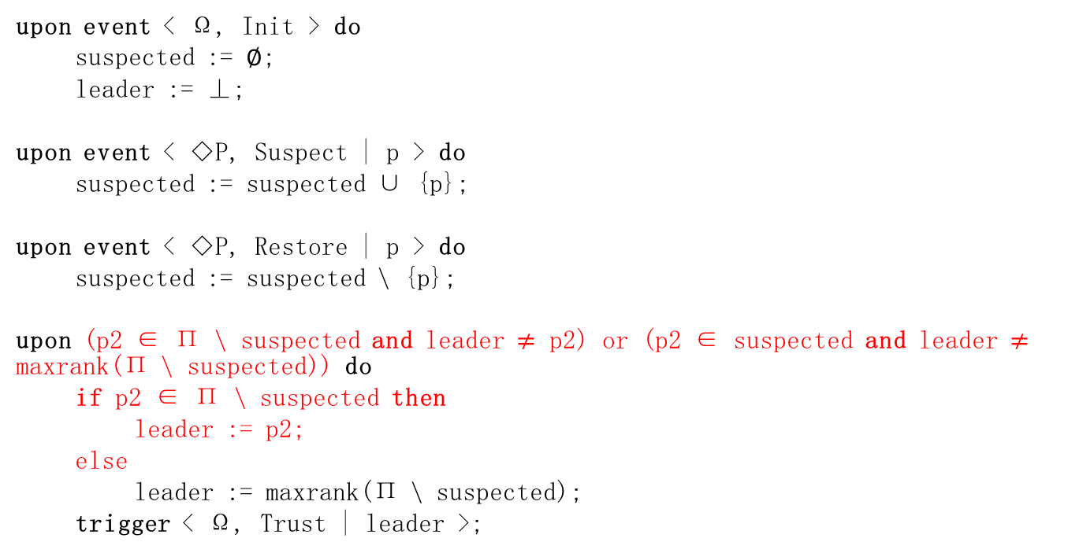
Algorithm-1
upon event < Ω, Init > do
suspected := ∅;
leader := ⊥;
upon event < ◇P, Suspect | p > do
suspected := suspected ∪ {p};
upon event < ◇P, Restore | p > do
suspected := suspected \ {p};
upon (p2 ∈ Π \ suspected and leader $≠$ p2) or (p2 ∈ suspected and leader $≠$ maxrank(Π \ suspected)) do
if p2 ∈ Π \ suspected then
leader := p2;
else
leader := maxrank(Π \ suspected);
trigger < Ω, Trust | leader >;

Slide 6
Algorithm-2
maxrank'(S) = p2, if p2 ∈ S;
maxrank(S), otherwise.

