Slide 1
Algorithms and Complexities Divide and Conquer
刘盛云

Slide 2
Divide-and-conquer
Divide the problem into one or more subproblems that are smaller instances of the same problem
Conquer the subproblems by solving them recursively
Combine the subproblem solutions to form a solution to the original problem

Slide 3
Merge sort: general idea
Divide the subarray A[p,r] to be sorted into two adjacent subarrays, each of half the size
Compute the midpoint q of A[p,r]
Divide A[p,r] into subarrays A[p,q] and A[q+1,r]
Conquer by sorting each of the two subarrays A[p,q] and A[q+1,r] recursively using merge sort
Combine by merging the two sorted subarrays A[p,q] and A[q+1,r] back into A[p,q], producing the sorted answer

Slide 4
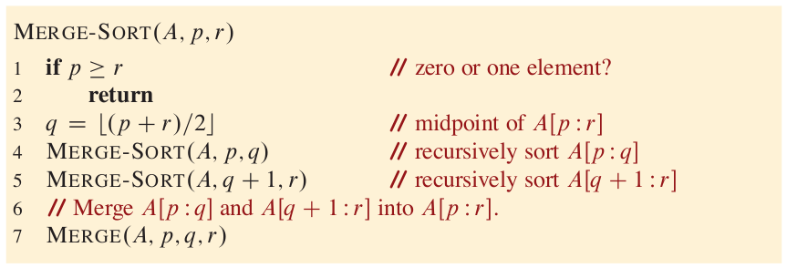
Merge sort - 1

Slide 5
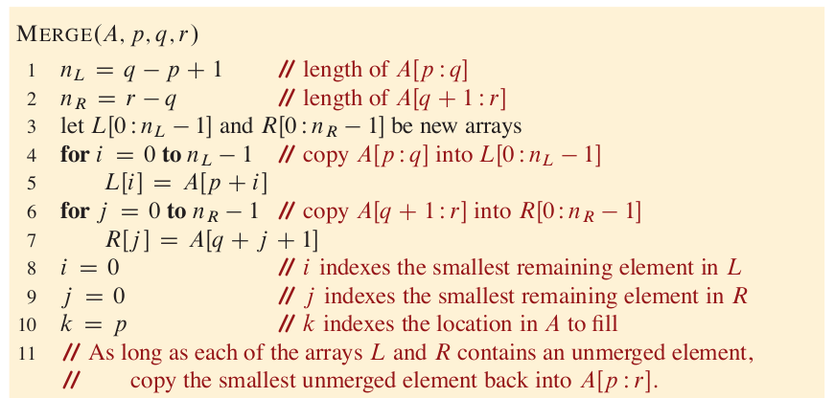
Merge sort - 2

Slide 6
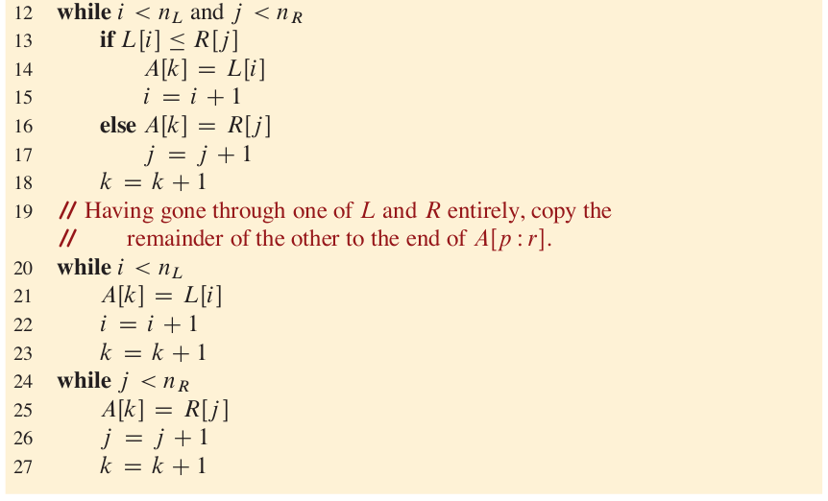
Merge sort - 3

Slide 7
Merge sort: example
Take [3, 5, 2, 6, 4, 1, 8, 7] for example
Divide
[3, 5, 2, 6, 4, 1, 8, 7]
[3, 5, 2, 6], [4, 1, 8, 7]
[3, 5], [2, 6], [4, 1], [8, 7]
[3] [5] [2] [6] [4] [1] [8] [7]

Slide 8
Merge sort: example
Take [3, 5, 2, 6, 4, 1, 8, 7] for example
Combine
[1, 2, 3, 4, 5, 6, 7, 8]
[2, 3, 5, 6], [1, 4, 7, 8]
[3, 5], [2, 6], [1, 4], [7, 8]
[3] [5] [2] [6] [4] [1] [8] [7]
bottom up

Slide 9

Merge sort: efficiency
Recurrence equation
For simplicity, we assume $n=2^{m}$ for some $m≥0$
$T\left(n\right)=\left\{\begin{aligned}c_{1}, if n=1 \\ 2T\left(\frac{n}{2}\right)+c_{2}n,if n>1\end{aligned}\right.$

Slide 10








Recurrence tree: $T\left(n\right)=2T\left(\frac{n}{2}\right)+c_{2}n$
$$c_{2}n$$
$c_{2}n/2$, $c_{2}n/2$
$c_{2}n/4$, $c_{2}n/4$, $c_{2}n/4$, $c_{2}n/4$
…
$c_{1}$, $c_{1}$, $c_{1}$, $c_{1}$, $c_{1}$, $c_{1}$, $c_{1}$, $c_{1}$
$$c_{2}n$$
$$c_{2}n$$
$$\log{n}$$
$$c_{2}n$$
…
…
…
…
…
…
…
…
$$c_{1}n$$
$$c_{2}nlogn+c_{1}n=Θ\left(nlogn\right)$$

Slide 11
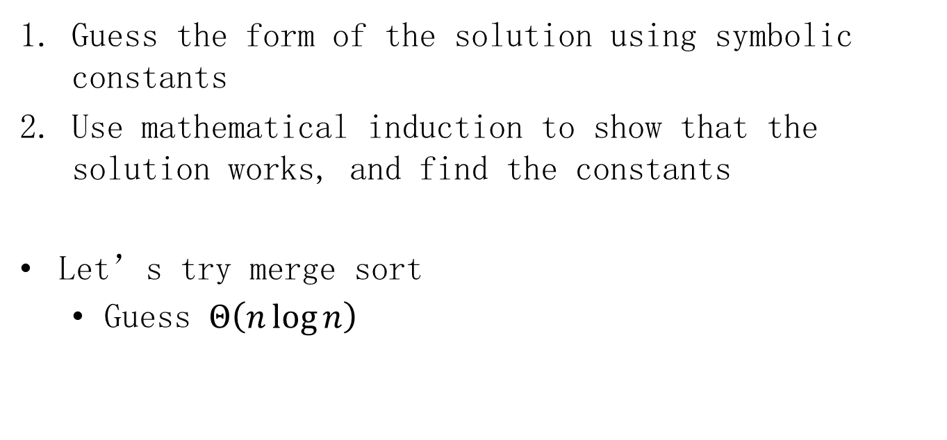
The substitution method
Guess the form of the solution using symbolic constants
Use mathematical induction to show that the solution works, and find the constants
Let’s try merge sort
Guess $Θ\left(n\log{n}\right)$

Slide 12
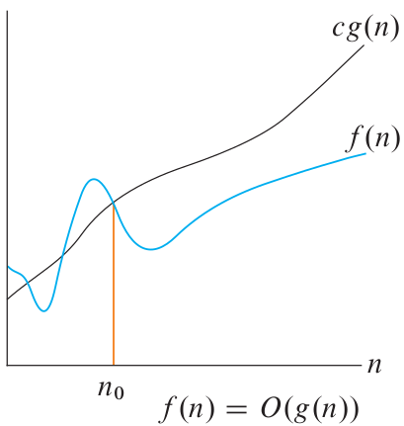

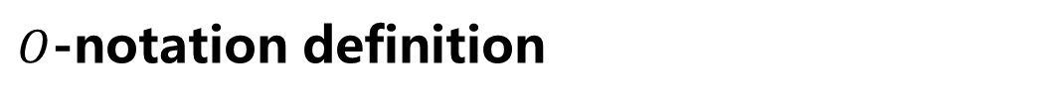
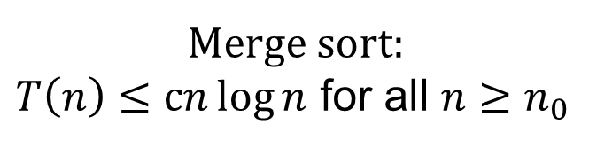
$O$-notation definition
there exist positive constants $c$ and $n_{0}$ such that
$0≤f(n)≤cg(n)$ for all $n≥n_{0}$
Merge sort:
$T\left(n\right)≤cn\log{n}$ for all $n≥n_{0}$

Slide 13

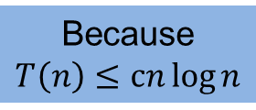

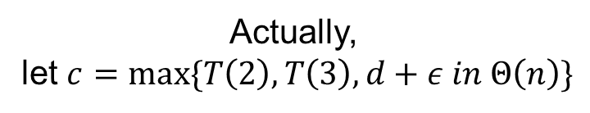
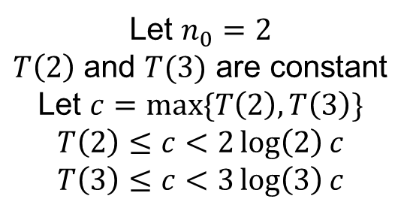
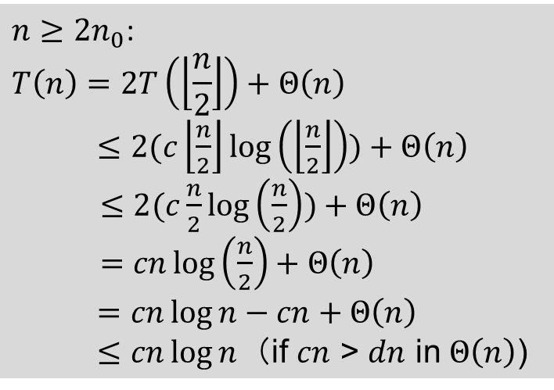
The substitution method: Merge sort
base cases
inductive case
$$n_{0}$$
$${2n}_{0}$$
Because
$$T\left(n\right)≤cn\log{n}$$
${n≥2n}_{0}$:
$$T\left(n\right)=2T\left(\left\lfloor \frac{n}{2}\right\rfloor \right)+Θ\left(n\right)$$
$≤2(c\left\lfloor \frac{n}{2}\right\rfloor \log\left(\left\lfloor \frac{n}{2}\right\rfloor \right))+Θ\left(n\right)$
$≤2(c\frac{n}{2}\log\left(\frac{n}{2}\right))+Θ\left(n\right)$
$=cn\log\left(\frac{n}{2}\right)+Θ\left(n\right)$
$=cn\log{n}−cn+Θ\left(n\right)$
$≤$ $cn\log{n}$ （if $cn$ > $dn$ in $Θ\left(n\right)$)
Let $n_{0}=2$
$T\left(2\right)$ and $T(3)$ are constant
Let $c=max\{T\left(2\right),T\left(3\right)\}$
$$T\left(2\right)≤c<2\log\left(2\right)c$$
$$T\left(3\right)≤c<3\log\left(3\right)c$$
Actually,
let $c=max\{T\left(2\right),T\left(3\right),d+ε in Θ\left(n\right)\}$

Slide 14
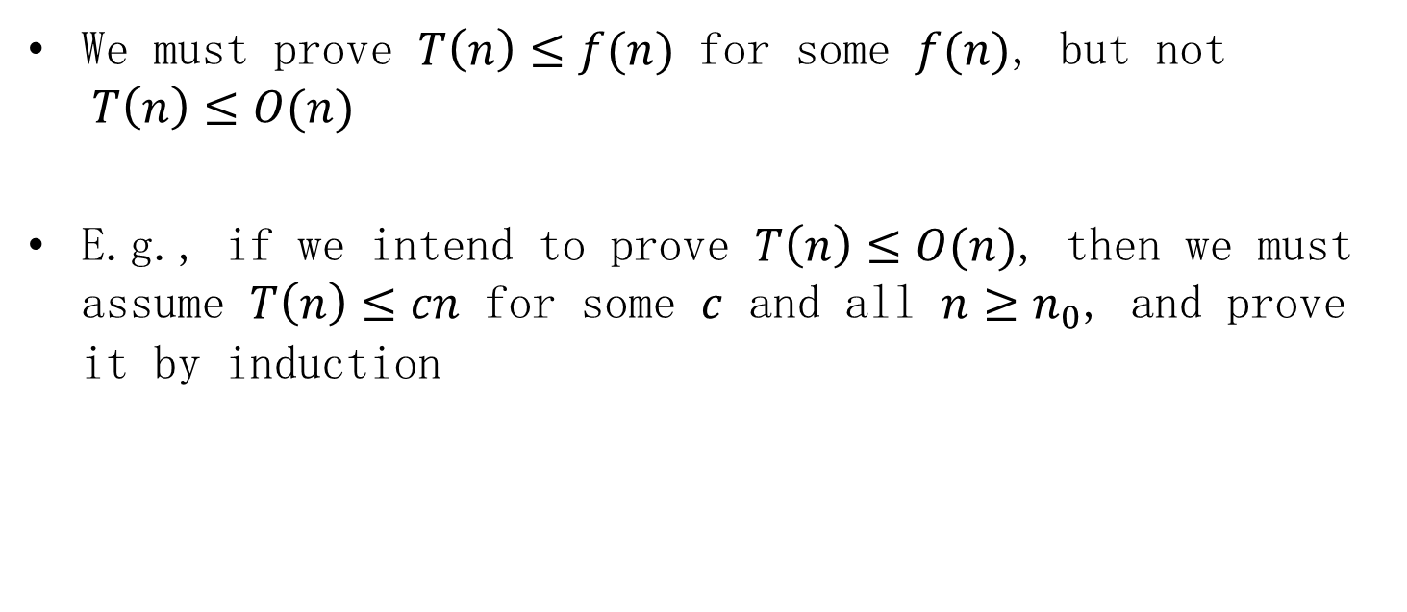
Avoiding pitfalls
We must prove $T\left(n\right)≤f(n)$ for some $f(n)$, but not $T\left(n\right)≤O(n)$
E.g., if we intend to prove $T\left(n\right)≤O(n)$, then we must assume $T\left(n\right)≤cn$ for some $c$ and all $n≥n_{0}$, and prove it by induction

Slide 15

The recursion-tree method
Example 1
$T\left(n\right)=3T\left(\frac{n}{4}\right)+Θ\left(n^{2}\right)$
$=3T\left(\frac{n}{4}\right)+c_{2}n^{2}$

Slide 16








Recurrence tree $T\left(n\right)=3T\left(\frac{n}{4}\right)+c_{2}n^{2}$
$$c_{2}n^{2}$$
$c_{2}{(\frac{n}{4})}^{2}$,$c_{2}{(\frac{n}{4})}^{2}$,$c_{2}{(\frac{n}{4})}^{2}$
$c_{2}{(\frac{n}{16})}^{2}$,$c_{2}{(\frac{n}{16})}^{2}$,$c_{2}{(\frac{n}{16})}^{2}$,…$c_{2}{(\frac{n}{16})}^{2}$
…
$c_{1}$, $c_{1}$, $c_{1}$, $c_{1}$, $c_{1}$, $c_{1}$, $c_{1}$, $c_{1}$
$$c_{2}n^{2}$$
$$\frac{3}{16}{c_{2}n}^{2}$$
$$\log_{4}{n}$$
$${{(\frac{3}{16})}^{2}c_{2}n}^{2}$$
…
…
…
…
…
…
…
…
$$c_{1}3^{\log_{4}{n}}=Θ(n^{\log_{4}{3}})$$
$$3^{\log_{4}{n}}=n^{\log_{4}{3}}$$

Slide 17
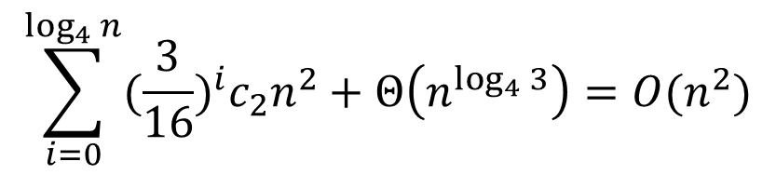
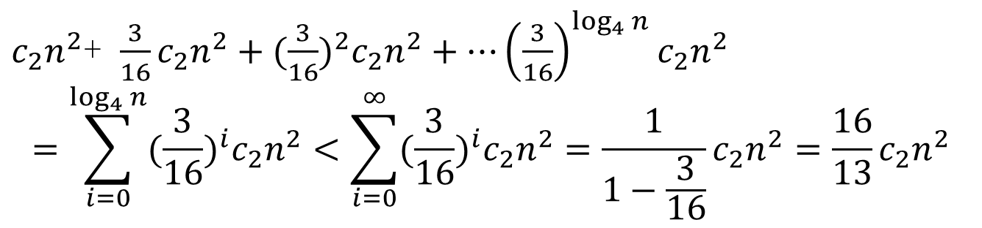
Recurrence tree
$c_{2}n^{2}$+ $\frac{3}{16}{c_{2}n}^{2}+{{(\frac{3}{16})}^{2}c_{2}n}^{2}+…{{\left(\frac{3}{16}\right)}^{\log_{4}{n}}c_{2}n}^{2}$
$$=\sum_{i=0}^{\log_{4}{n}}{{(\frac{3}{16})}^{i}c_{2}n^{2}}<\sum_{i=0}^{∞}{{(\frac{3}{16})}^{i}c_{2}n^{2}=\frac{1}{1−\frac{3}{16}}}c_{2}n^{2}=\frac{16}{13}c_{2}n^{2}$$
$$\sum_{i=0}^{\log_{4}{n}}{{(\frac{3}{16})}^{i}c_{2}n^{2}}+Θ\left(n^{\log_{4}{3}}\right)=O(n^{2})$$

Slide 18

Recurrence tree $T\left(n\right)=3T\left(\frac{n}{4}\right)+c_{2}n^{2}$
$$c_{2}n^{2}$$
$c_{2}{(\frac{n}{4})}^{2}$,$c_{2}{(\frac{n}{4})}^{2}$,$c_{2}{(\frac{n}{4})}^{2}$
$c_{2}{(\frac{n}{16})}^{2}$,$c_{2}{(\frac{n}{16})}^{2}$,$c_{2}{(\frac{n}{16})}^{2}$,…$c_{2}{(\frac{n}{16})}^{2}$
…
$c_{1}$, $c_{1}$, $c_{1}$, $c_{1}$, $c_{1}$, $c_{1}$, $c_{1}$, $c_{1}$
$$c_{2}n^{2}$$
$$\frac{3}{16}{c_{2}n}^{2}$$
$$\log_{4}{n}$$
$${{(\frac{3}{16})}^{2}c_{2}n}^{2}$$
…
…
…
…
…
…
…
…
$$c_{1}3^{\log_{4}{n}}=Θ(n^{\log_{4}{3}})$$
$$3^{\log_{4}{n}}=n^{\log_{4}{3}}$$

Slide 19

Example 2
$T\left(n\right)=8T\left(\frac{n}{2}\right)+Θ\left(n\right)$
$=8T\left(\frac{n}{2}\right)+c_{2}n$

Slide 20
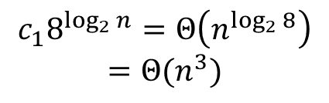






Example 2: recurrence tree $T\left(n\right)=8T\left(\frac{n}{2}\right)+c_{2}n$
$$c_{2}n$$
$c_{2}\frac{n}{2}$,$c_{2}\frac{n}{2}$,$c_{2}\frac{n}{2}$,$c_{2}\frac{n}{2},c_{2}\frac{n}{2}\text{,}c_{2}\frac{n}{2}\text{,}c_{2}\frac{n}{2}\text{,}c_{2}\frac{n}{2}$
$c_{2}\frac{n}{4}$,$c_{2}\frac{n}{4}$,$c_{2}\frac{n}{4}$,$c_{2}\frac{n}{4},c_{2}\frac{n}{4}\text{,}c_{2}\frac{n}{4}\text{,}c_{2}\frac{n}{4}\text{,}…c_{2}\frac{n}{4}$
…
$c_{1}$, $c_{1}$, $c_{1}$, $c_{1}$, $c_{1}$, $c_{1}$, $c_{1}$, $c_{1}$
$$c_{2}n$$
$$\frac{8}{2}c_{2}n$$
$$\log_{2}{n}$$
$${(\frac{8}{2})}^{2}c_{2}n$$
…
…
…
…
…
…
…
…
$$c_{1}8^{\log_{2}{n}}=Θ\left(n^{\log_{2}{8}}\right)$$
$$=Θ(n^{3})$$
$$8^{\log_{2}{n}}=n^{\log_{2}{8}}$$

Slide 21
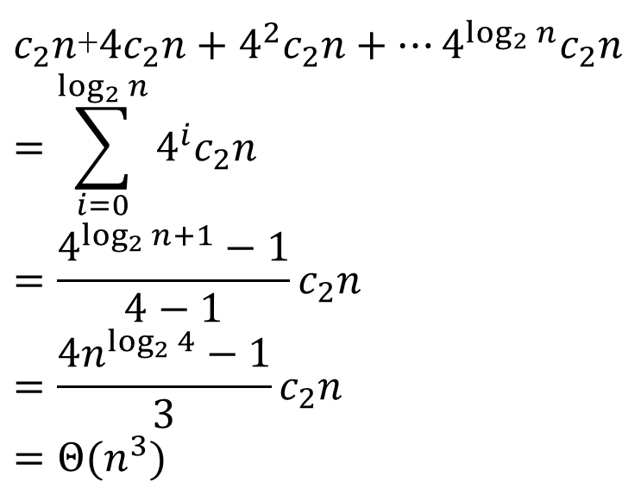
Example 2: recurrence tree
$c_{2}n$+$4c_{2}n+4^{2}c_{2}n+…4^{\log_{2}{n}}c_{2}n$
$$=\sum_{i=0}^{\log_{2}{n}}{4^{i}c_{2}n}$$
$$=\frac{4^{\log_{2}{n}+1}−1}{4−1}c_{2}n$$
$$=\frac{{4n}^{\log_{2}{4}}−1}{3}c_{2}n$$
$$=Θ(n^{3})$$

Slide 22
Example 2: recurrence tree $T\left(n\right)=8T\left(\frac{n}{2}\right)+c_{2}n$
$$c_{2}n$$
$c_{2}\frac{n}{2}$,$c_{2}\frac{n}{2}$,$c_{2}\frac{n}{2}$,$c_{2}\frac{n}{2},c_{2}\frac{n}{2}\text{,}c_{2}\frac{n}{2}\text{,}c_{2}\frac{n}{2}\text{,}c_{2}\frac{n}{2}$
$c_{2}\frac{n}{4}$,$c_{2}\frac{n}{4}$,$c_{2}\frac{n}{4}$,$c_{2}\frac{n}{4},c_{2}\frac{n}{4}\text{,}c_{2}\frac{n}{4}\text{,}c_{2}\frac{n}{4}\text{,}…c_{2}\frac{n}{4}$
…
$c_{1}$, $c_{1}$, $c_{1}$, $c_{1}$, $c_{1}$, $c_{1}$, $c_{1}$, $c_{1}$
$$c_{2}n$$
$$\frac{8}{2}c_{2}n$$
$$\log_{2}{n}$$
$${(\frac{8}{2})}^{2}c_{2}n$$
…
…
…
…
…
…
…
…
$$c_{1}8^{\log_{2}{n}}=Θ\left(n^{\log_{2}{8}}\right)$$
$$=Θ(n^{3})$$
$$8^{\log_{2}{n}}=n^{\log_{2}{8}}$$

Slide 23
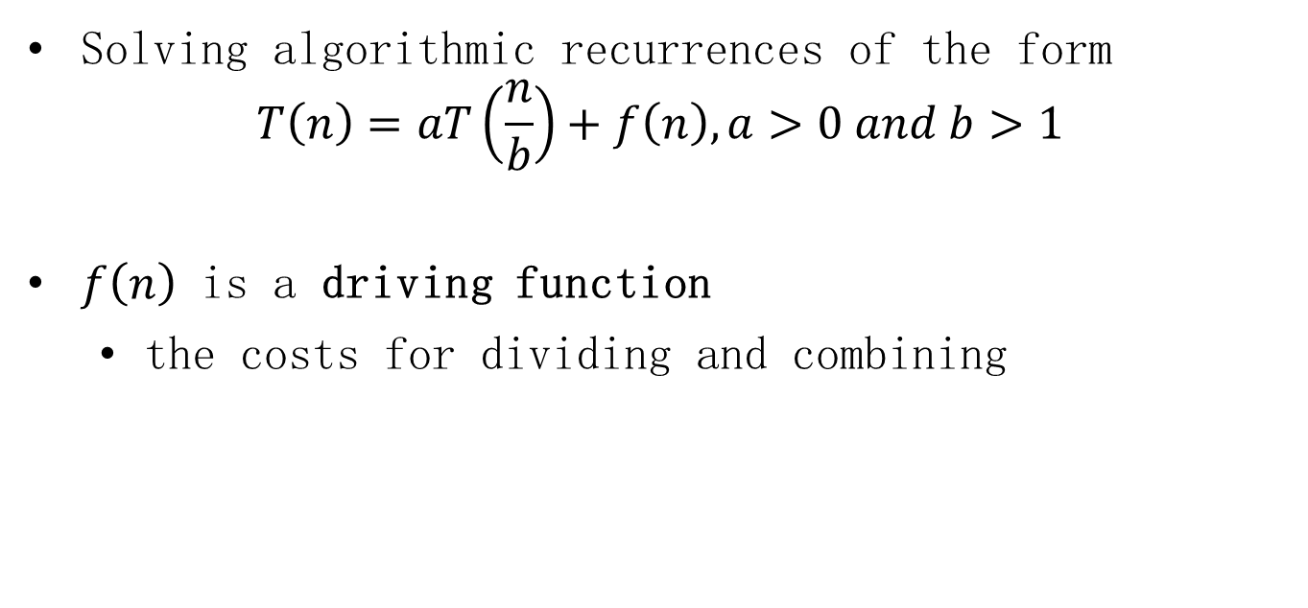
The master method
Solving algorithmic recurrences of the form
$$T\left(n\right)=aT\left(\frac{n}{b}\right)+f\left(n\right), a>0 and b>1$$
$f\left(n\right)$ is a driving function
the costs for dividing and combining

Slide 24
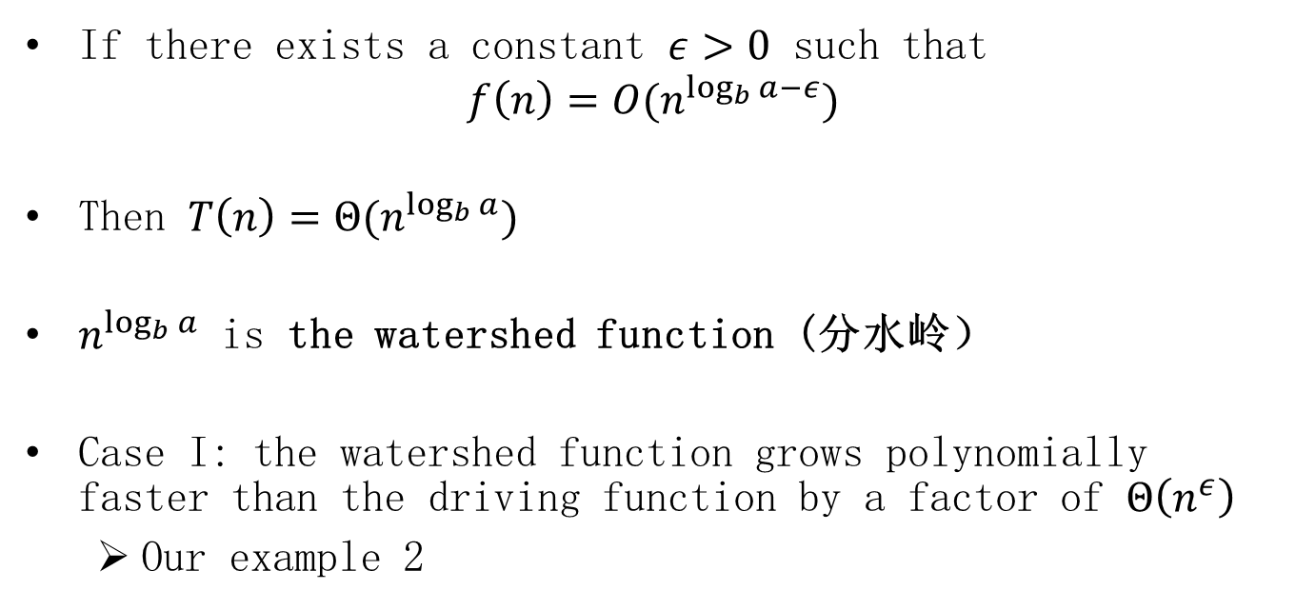
The master method: Case I
If there exists a constant $ε>0$ such that
$$f\left(n\right)=O(n^{\log_{b}{a}−ε})$$
Then $T\left(n\right)=Θ(n^{\log_{b}{a}})$
$n^{\log_{b}{a}}$ is the watershed function (分水岭）
Case I: the watershed function grows polynomially faster than the driving function by a factor of $Θ\left(n^{ε}\right)$
Our example 2

Slide 25
Example 2: recurrence tree $T\left(n\right)=8T\left(\frac{n}{2}\right)+c_{2}n$
$$c_{2}n$$
$c_{2}\frac{n}{2}$,$c_{2}\frac{n}{2}$,$c_{2}\frac{n}{2}$,$c_{2}\frac{n}{2},c_{2}\frac{n}{2}\text{,}c_{2}\frac{n}{2}\text{,}c_{2}\frac{n}{2}\text{,}c_{2}\frac{n}{2}$
$c_{2}\frac{n}{4}$,$c_{2}\frac{n}{4}$,$c_{2}\frac{n}{4}$,$c_{2}\frac{n}{4},c_{2}\frac{n}{4}\text{,}c_{2}\frac{n}{4}\text{,}c_{2}\frac{n}{4}\text{,}…c_{2}\frac{n}{4}$
…
$c_{1}$, $c_{1}$, $c_{1}$, $c_{1}$, $c_{1}$, $c_{1}$, $c_{1}$, $c_{1}$
$$c_{2}n$$
$$\frac{8}{2}c_{2}n$$
$$\log_{2}{n}$$
$${(\frac{8}{2})}^{2}c_{2}n$$
…
…
…
…
…
…
…
…
$$c_{1}8^{\log_{2}{n}}=Θ\left(n^{\log_{2}{8}}\right)$$
$$=Θ(n^{3})$$
$$8^{\log_{2}{n}}=n^{\log_{2}{8}}$$

Slide 26
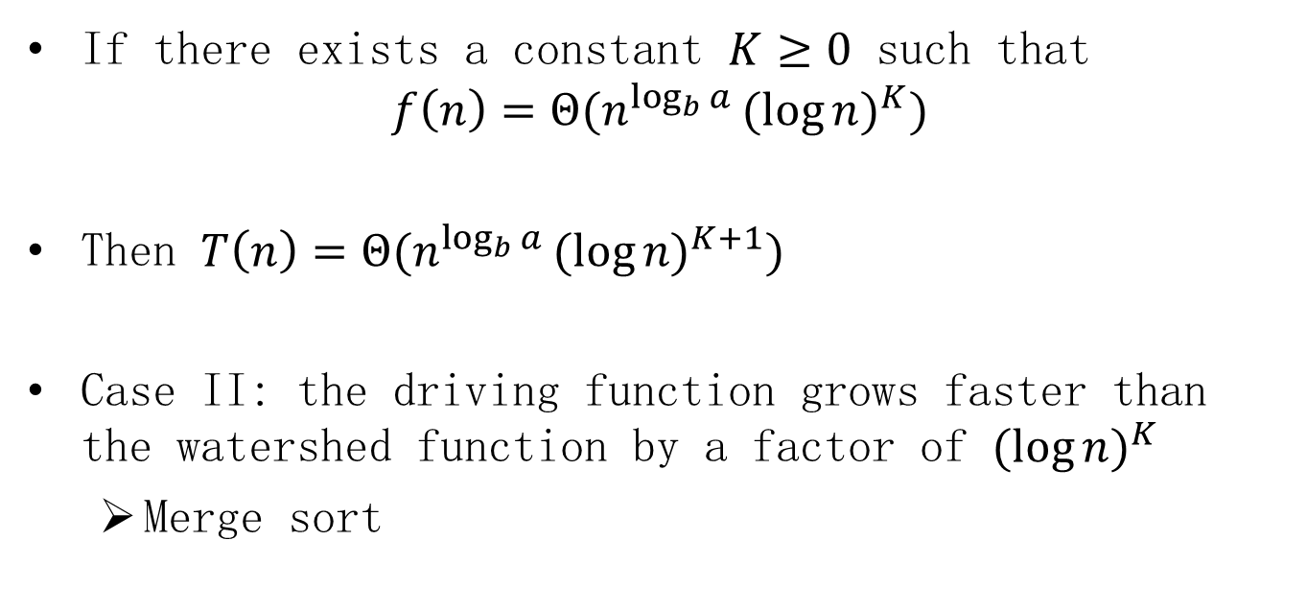
The master method: Case II
If there exists a constant $K≥0$ such that
$$f\left(n\right)=Θ(n^{\log_{b}{a}}{(log{n)}}^{K})$$
Then $T\left(n\right)=Θ(n^{\log_{b}{a}}{(log{n)}}^{K+1})$
Case II: the driving function grows faster than the watershed function by a factor of ${(log{n)}}^{K}$
Merge sort

Slide 27

Recurrence tree: $T\left(n\right)=2T\left(\frac{n}{2}\right)+c_{2}n$
$$c_{2}n$$
$c_{2}n/2$, $c_{2}n/2$
$c_{2}n/4$, $c_{2}n/4$, $c_{2}n/4$, $c_{2}n/4$
…
$c_{1}$, $c_{1}$, $c_{1}$, $c_{1}$, $c_{1}$, $c_{1}$, $c_{1}$, $c_{1}$
$$c_{2}n$$
$$c_{2}n$$
$$\log{n}$$
$$c_{2}n$$
…
…
…
…
…
…
…
…
$$c_{1}n$$
$$c_{2}nlogn+c_{1}n=Θ\left(nlogn\right)$$

Slide 28
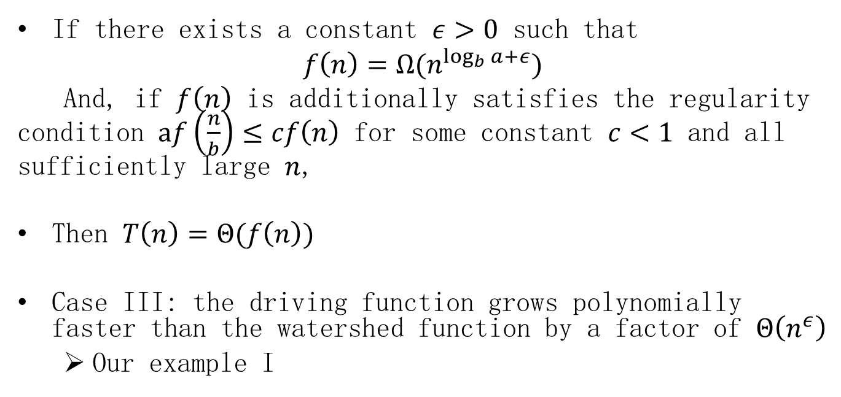
The master method: Case III
If there exists a constant $ε>0$ such that
$$f\left(n\right)=Ω(n^{\log_{b}{a}+ε})$$
And, if $f\left(n\right)$ is additionally satisfies the regularity condition $af\left(\frac{n}{b}\right)≤cf\left(n\right)$ for some constant $c<1$ and all sufficiently large $n$,
Then $T\left(n\right)=Θ(f\left(n\right))$
Case III: the driving function grows polynomially faster than the watershed function by a factor of $Θ\left(n^{ε}\right)$
Our example I

Slide 29

Recurrence tree $T\left(n\right)=3T\left(\frac{n}{4}\right)+c_{2}n^{2}$
$$c_{2}n^{2}$$
$c_{2}{(\frac{n}{4})}^{2}$,$c_{2}{(\frac{n}{4})}^{2}$,$c_{2}{(\frac{n}{4})}^{2}$
$c_{2}{(\frac{n}{16})}^{2}$,$c_{2}{(\frac{n}{16})}^{2}$,$c_{2}{(\frac{n}{16})}^{2}$,…$c_{2}{(\frac{n}{16})}^{2}$
…
$c_{1}$, $c_{1}$, $c_{1}$, $c_{1}$, $c_{1}$, $c_{1}$, $c_{1}$, $c_{1}$
$$c_{2}n^{2}$$
$$\frac{3}{16}{c_{2}n}^{2}$$
$$\log_{4}{n}$$
$${{(\frac{3}{16})}^{2}c_{2}n}^{2}$$
…
…
…
…
…
…
…
…
$$c_{1}3^{\log_{4}{n}}=Θ(n^{\log_{4}{3}})$$
$$3^{\log_{4}{n}}=n^{\log_{4}{3}}$$

Slide 30

Example
$T\left(n\right)=6T\left(\frac{n}{2}\right)+Θ\left(n^{2}\right)=Θ\left(n^{2.58}\right)$
Case I: $\log{6>2.58>2}$

Slide 31
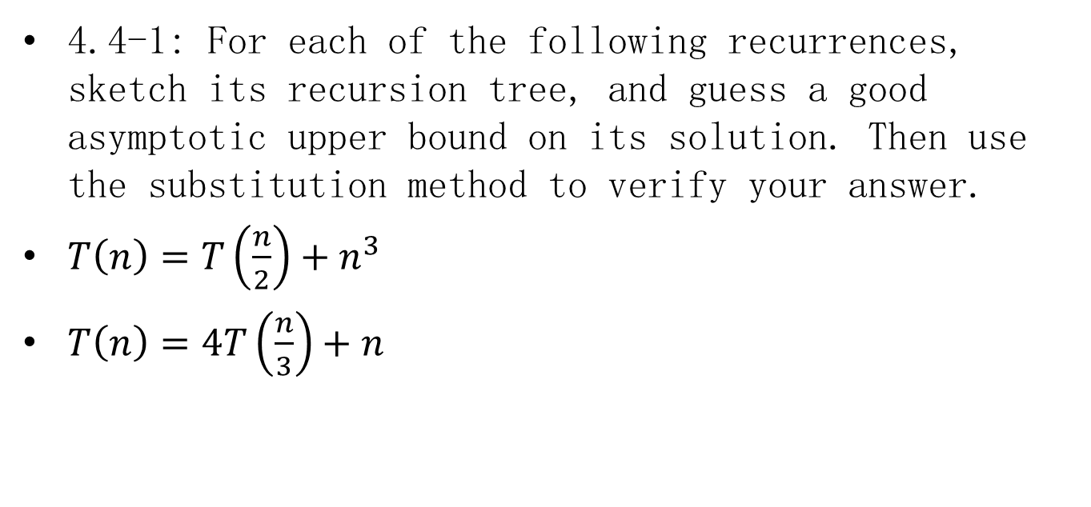
Homework-1
4.4-1: For each of the following recurrences, sketch its recursion tree, and guess a good asymptotic upper bound on its solution. Then use the substitution method to verify your answer.
$T\left(n\right)=T\left(\frac{n}{2}\right)+n^{3}$
$T\left(n\right)=4T\left(\frac{n}{3}\right)+n$

Slide 32
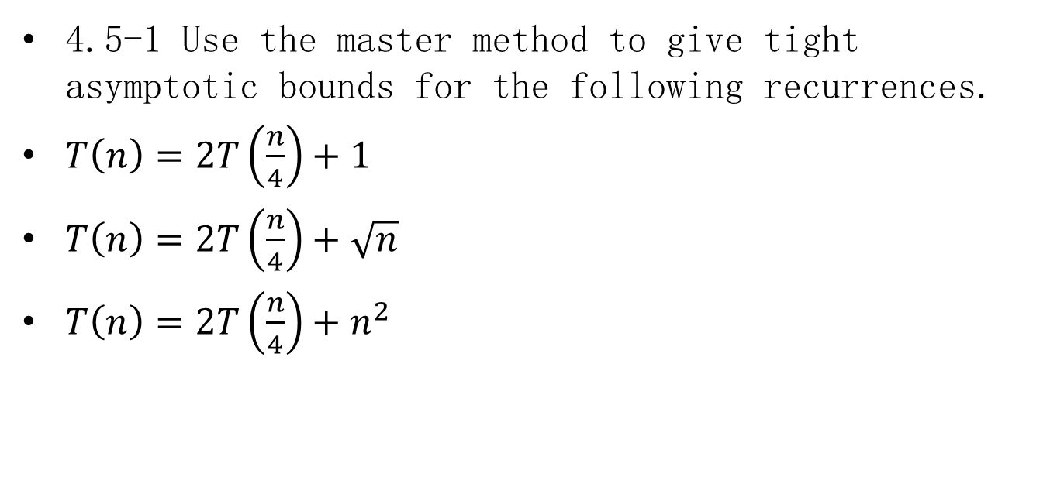
Homework-2
4.5-1 Use the master method to give tight asymptotic bounds for the following recurrences.
$T\left(n\right)=2T\left(\frac{n}{4}\right)+1$
$T\left(n\right)=2T\left(\frac{n}{4}\right)+\sqrt{n}$
$T\left(n\right)=2T\left(\frac{n}{4}\right)+n^{2}$

