Slide 1
Algorithms and Complexities Dynamic Programming
刘盛云

Slide 2
Dynamic programming (DP)
DP typically applies to optimization problems
Find a solution with the optimal value
Like the divide-and-conquer method
Solves problems by combining the solutions to subproblems
Unlike the divide-and-conquer method
The subproblems overlap
Subproblems share subproblems

Slide 3
Main steps
Characterize the structure of an optimal solution
Recursively define the value of an optimal solution
Compute the value of an optimal solution, typically in a bottom-up fashion
(Optional) Construct an optimal solution from computed information

Slide 4
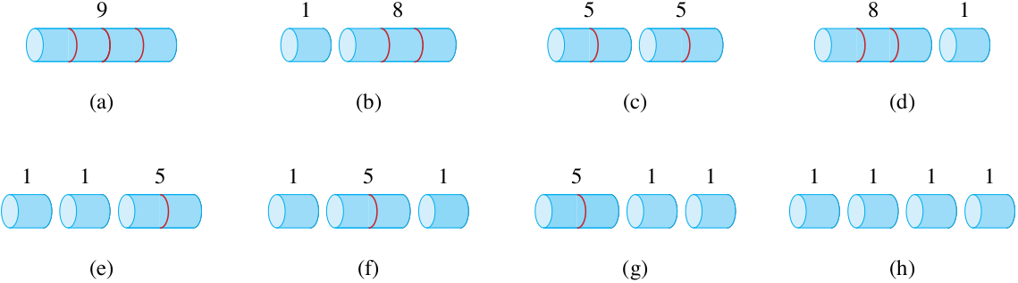
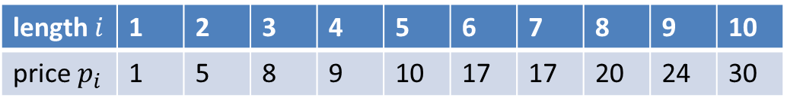
Rod cutting: example
length $i$ | 1 | 2 | 3 | 4 | 5 | 6 | 7 | 8 | 9 | 10
price $p_{i}$ | 1 | 5 | 8 | 9 | 10 | 17 | 17 | 20 | 24 | 30

Slide 5
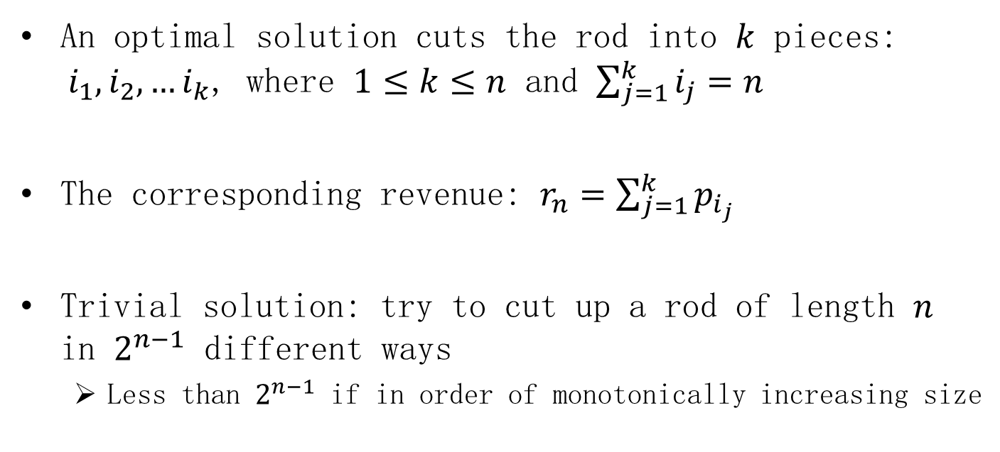
Rod cutting
An optimal solution cuts the rod into $k$ pieces: $i_{1},i_{2},…i_{k}$, where $1≤k≤n$ and $\sum_{j=1}^{k}{i_{j}=n}$
The corresponding revenue: $r_{n}=\sum_{j=1}^{k}{p_{i_{j}}}$
Trivial solution: try to cut up a rod of length $n$ in $2^{n−1}$ different ways
Less than $2^{n−1}$ if in order of monotonically increasing size

Slide 6
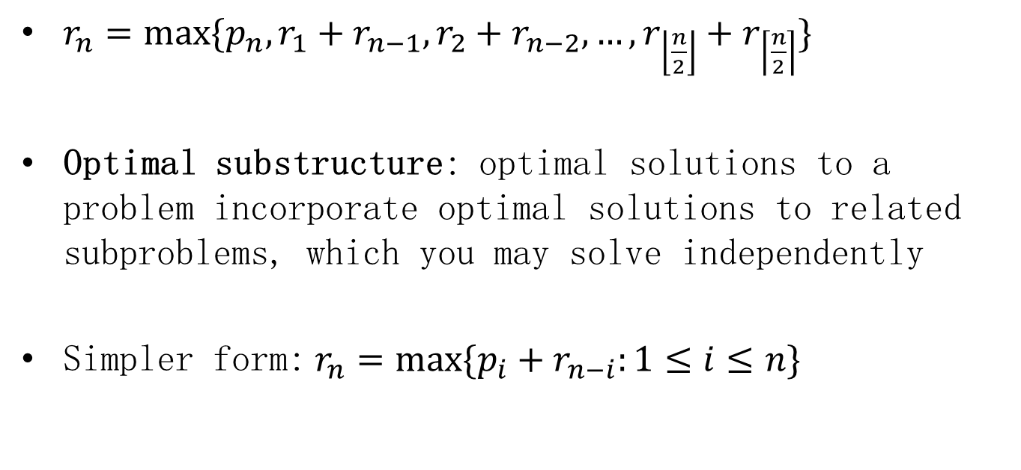
Rod cutting: optimal substructure
$r_{n}=max⁡\{p_{n},r_{1}+r_{n−1},r_{2}+r_{n−2},…,r_{\left\lfloor \frac{n}{2}\right\rfloor }+r_{\left\lceil \frac{n}{2}\right\rceil }\}$
Optimal substructure: optimal solutions to a problem incorporate optimal solutions to related subproblems, which you may solve independently
Simpler form:$r_{n}=max⁡\{p_{i}+r_{n−i}:1≤i≤n\}$

Slide 7
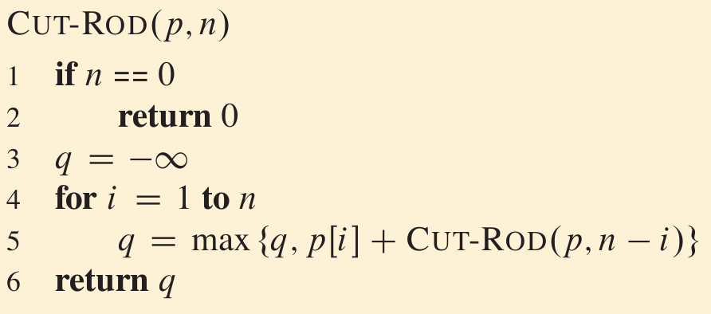
Rod cutting: trivial solution
$$T\left(n\right)=2^{n}$$

Slide 8
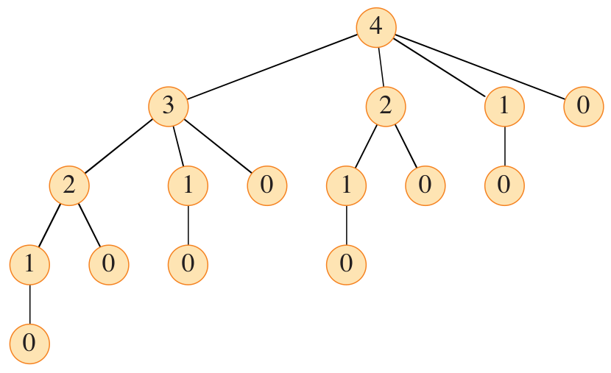
Trivial solution: problem

Slide 9
Dynamic programming (DP)
DP arranges for each subproblem to be solved only once
The first time you solve a subproblem, save its solution
Saving subproblem solutions comes with a cost
the additional memory needed to store solutions
a time-memory trade-off
Two approaches: top-down with memoization and bottom-up

Slide 10
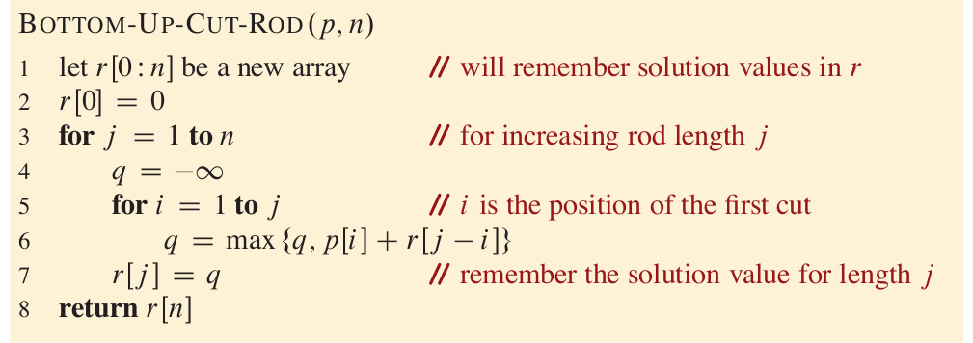
Rod cutting using DP
$T\left(n\right)=Θ(n^{2})$ time complexity due to doubly nested loop structure

Slide 11
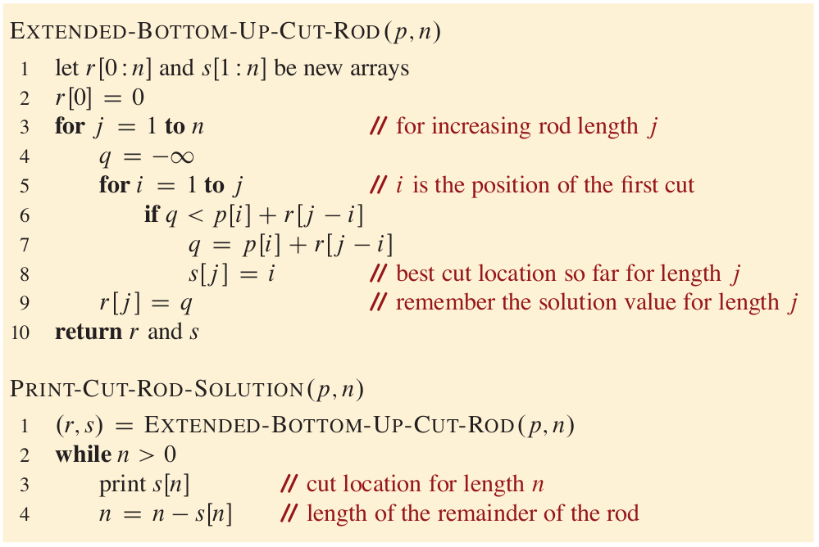
Reconstructing a solution

Slide 12
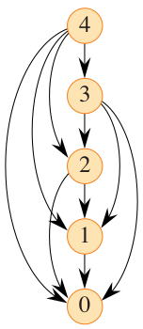
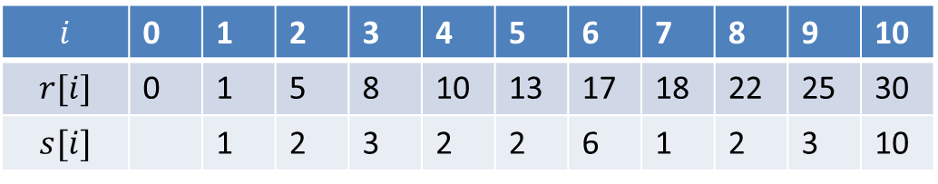
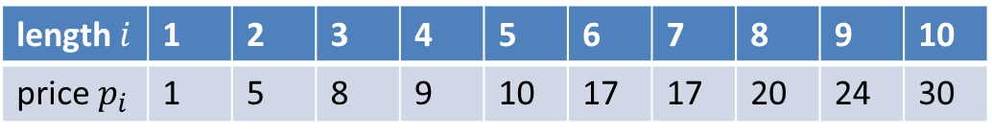
Example
length $i$ | 1 | 2 | 3 | 4 | 5 | 6 | 7 | 8 | 9 | 10
price $p_{i}$ | 1 | 5 | 8 | 9 | 10 | 17 | 17 | 20 | 24 | 30
$$i$$ | 0 | 1 | 2 | 3 | 4 | 5 | 6 | 7 | 8 | 9 | 10
$$r[i]$$ | 0 | 1 | 5 | 8 | 10 | 13 | 17 | 18 | 22 | 25 | 30
$$s[i]$$ |  | 1 | 2 | 3 | 2 | 2 | 6 | 1 | 2 | 3 | 10

Slide 13
Elements of dynamic programming
Optimal substructure
Overlapping subproblems
In contrast to divide-and-conquer

Slide 14
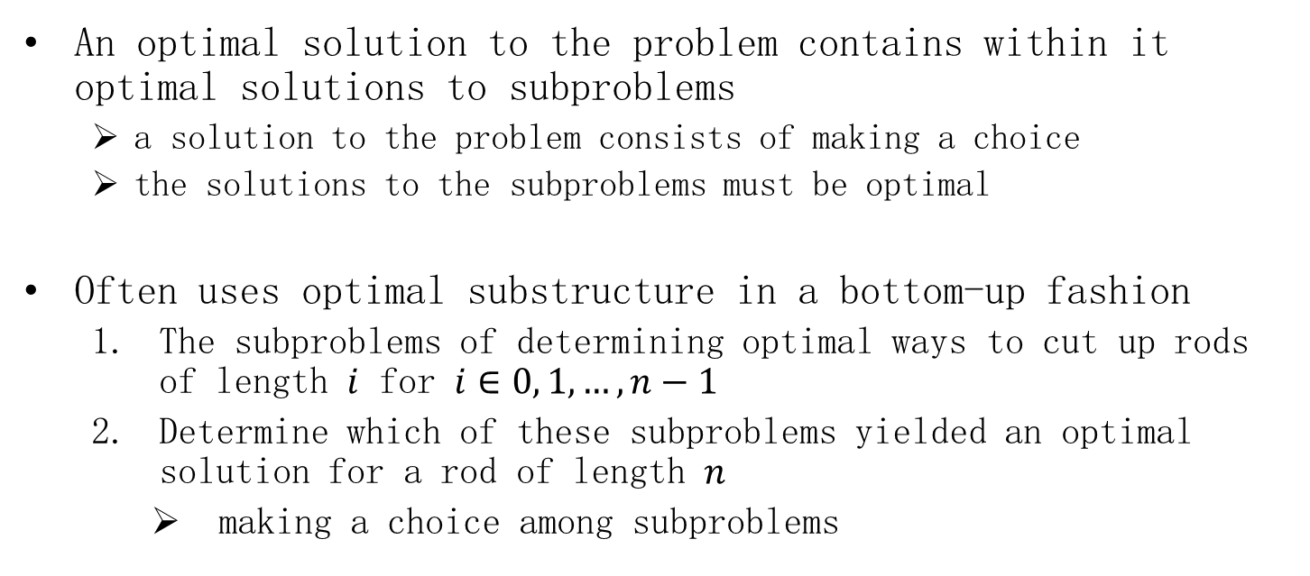
Optimal substructure
An optimal solution to the problem contains within it optimal solutions to subproblems
a solution to the problem consists of making a choice
the solutions to the subproblems must be optimal
Often uses optimal substructure in a bottom-up fashion
The subproblems of determining optimal ways to cut up rods of length $i$ for $i∈0, 1, …,n−1$
Determine which of these subproblems yielded an optimal solution for a rod of length $n$
making a choice among subproblems

Slide 15
Overlapping subproblems
the space of subproblems must be small
the total number of distinct subproblems is a polynomial
solve each subproblem only once

Slide 16
Longest common subsequence (LCS)
$S_{1}$:ACCGGTCGAGTGCGCGGAAGCCGGCCGAA
$S_{2}$:GTCGTTCGGAATGCCGTTGCTCTGTAAA
LCS
GTCGTCGGAAGCCGGCCGAA

Slide 17
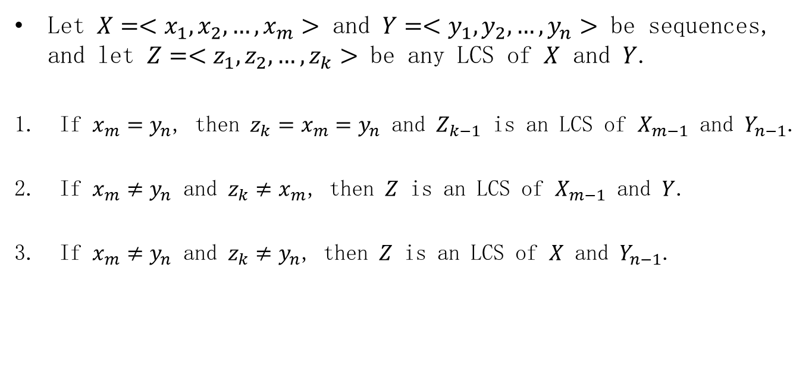
Optimal substructure of an LCS
Let $X=<x_{1},x_{2},…,x_{m}>$ and $Y=<y_{1},y_{2},…,y_{n}>$ be sequences, and let $Z=<z_{1},z_{2},…,z_{k}>$ be any LCS of $X$ and $Y$.
If $x_{m}=y_{n}$, then $z_{k}=x_{m}=y_{n}$ and $Z_{k−1}$ is an LCS of $X_{m−1}$ and $Y_{n−1}$.
If $x_{m}≠y_{n}$ and $z_{k}≠x_{m}$, then $Z$ is an LCS of $X_{m−1}$ and $Y$.
If $x_{m}≠y_{n}$ and $z_{k}≠y_{n}$, then $Z$ is an LCS of $X$ and $Y_{n−1}$.

Slide 18

The corresponding recursive formula
$$c\left[i,j\right]=\left\{\begin{matrix}0 & if i=0 or j=0 \\ c\left[i−1,j−1\right]+1 & if i,j>0 and x_{i}=y_{j}, \\ max⁡\{c\left[i,j−1\right],c\left[i−1,j\right]\} & if i,j>0 and x_{i}≠y_{j}.\end{matrix}\right.$$

Slide 19
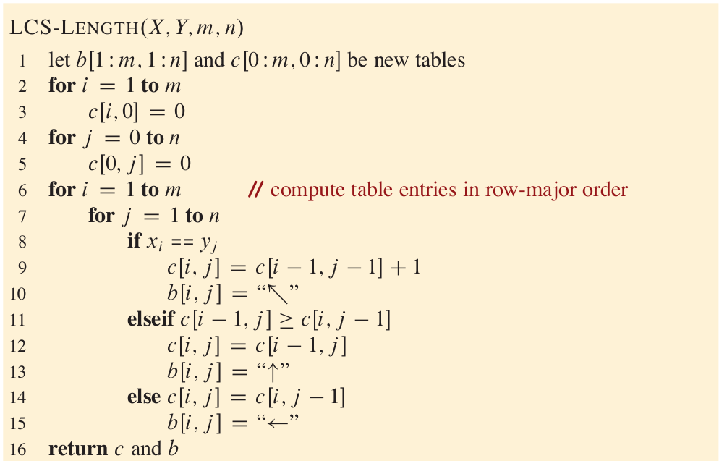

LCS using DP
$$T\left(n\right)=Θ(mn)$$

Slide 20
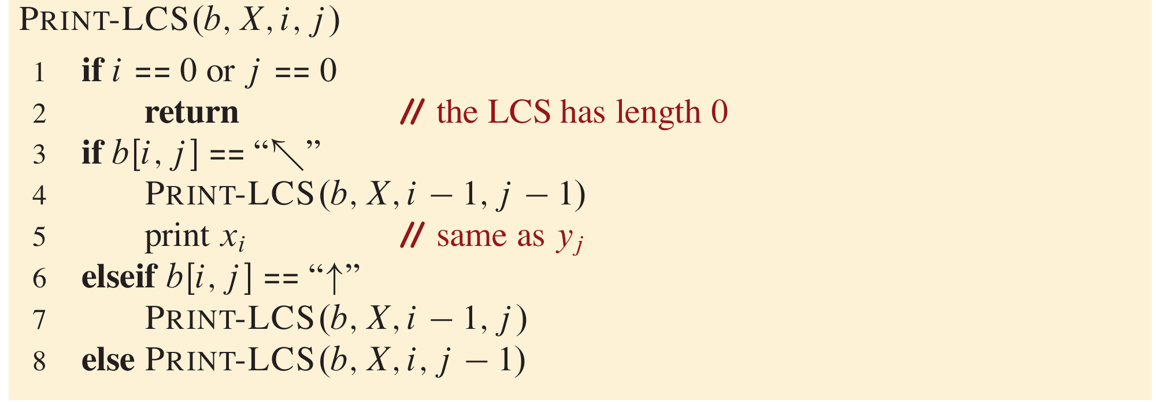
Constructing an LCS
The procedure takes $O(m+n)$ time

Slide 21
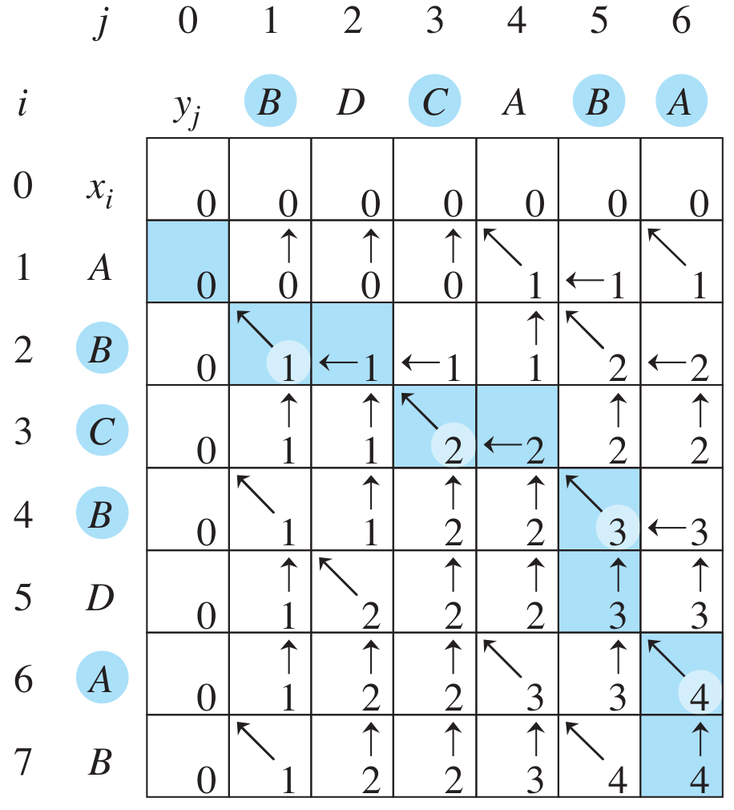
Example

Slide 22
Optimal binary search trees
Translate text from one language to another
Perform lookup operations by building a binary search tree
Goal: the total time spent searching to be as low as possible
Words have different frequencies

Slide 23

























Example
$$\sum_{i=1}^{n}{p_{i}+\sum_{i=0}^{n}{q_{i}}}=1$$
$$d_{0}$$
$$k_{1}$$
$$d_{1}$$
$$k_{2}$$
$$d_{2}$$
$$k_{3}$$
$$d_{3}$$
$$k_{4}$$
$$d_{4}$$
$$k_{5}$$
$$d_{5}$$
0.05
0.15
0.10
0.10
0.05
0.05
0.05
0.10
0.05
0.20
0.10
$$k_{2}$$
the
0.10
cat
dog
$$k_{1}$$
$$k_{4}$$
$$p_{1}=0.15$$
0.10
$$d_{0}$$
$$d_{1}$$
$$k_{3}$$
$$k_{5}$$
0.10
0.05
0.20
$$q_{0}=0.05$$
$$d_{2}$$
$$d_{3}$$
$$d_{4}$$
$$d_{5}$$
0.05
0.05
0.05
0.10

Slide 24








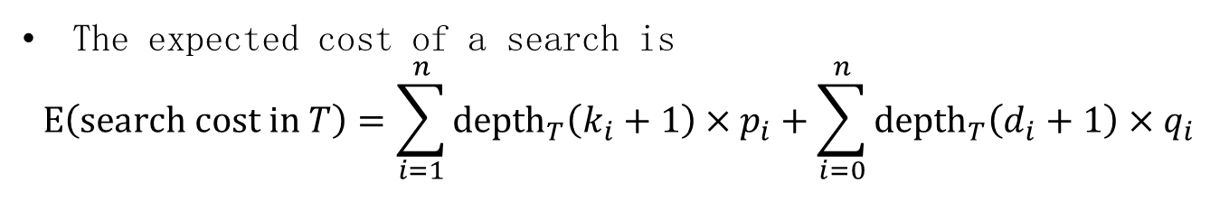










Example
The expected cost of a search is
$$E\left(search cost in T\right)=\sum_{i=1}^{n}{{depth}_{T}\left(k_{i}+1\right)×p_{i}+\sum_{i=0}^{n}{{depth}_{T}\left(d_{i}+1\right)×q_{i}}}$$
$${depth}_{T}$$
$$0$$
$$k_{2}$$
0.1
0.10
$$1$$
$$k_{1}$$
$$k_{4}$$
0.3+0.2
$$p_{1}=0.15$$
0.10
2.8
$$2$$
$$d_{0}$$
$$d_{1}$$
$$k_{3}$$
$$k_{5}$$
0.15+0.3+0.15+0.6
0.10
0.05
0.20
$$q_{0}=0.05$$
$$3$$
$$d_{2}$$
$$d_{3}$$
$$d_{4}$$
$$d_{5}$$
0.2+0.2+0.2+0.4
0.05
0.05
0.05
0.10

Slide 25



















Optimal solution
$${depth}_{T}$$
$$0$$
$$k_{2}$$
0.1
0.10
$$1$$
$$k_{1}$$
$$k_{5}$$
0.3+0.4
$$p_{1}=0.15$$
0.20
$$2$$
$$d_{0}$$
$$d_{1}$$
$$k_{4}$$
$$d_{5}$$
2.75
0.15+0.3+0.3+0.3
$$q_{0}=0.05$$
0.10
0.10
0.10
$$3$$
$$k_{3}$$
$$d_{4}$$
0.20+0.20
0.05
0.05
$$4$$
$$d_{2}$$
$$d_{3}$$
0.25+0.25
0.05
0.05

Slide 26


























Cut-and-paste
0.85
$$k_{2}$$
$$k_{2}$$
0.10
0.10
$$k_{1}$$
$$k_{4}$$
$$k_{1}$$
$$k_{5}$$
$$p_{1}=0.15$$
0.10
$$p_{1}=0.15$$
0.20
$$d_{0}$$
$$d_{1}$$
$$k_{3}$$
$$k_{5}$$
$$d_{0}$$
$$d_{1}$$
$$k_{4}$$
$$d_{5}$$
0.10
0.05
0.20
$$q_{0}=0.05$$
0.10
0.10
0.10
$$q_{0}=0.05$$
$$d_{2}$$
$$d_{3}$$
$$d_{4}$$
$$d_{5}$$
$$k_{3}$$
$$d_{4}$$
0.05
0.05
0.05
0.10
0.05
0.05
1.95
$$d_{2}$$
$$d_{3}$$
1.90
0.05
0.05

Slide 27
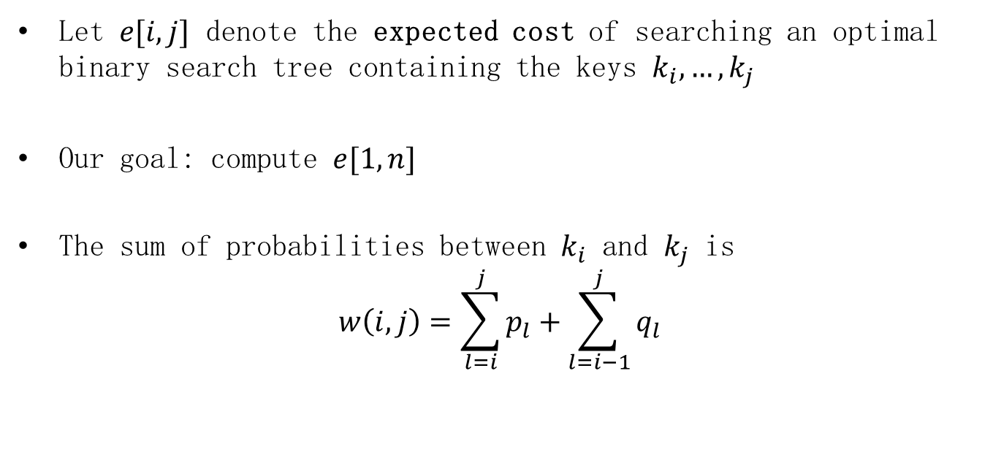
Optimal substructure
Let $e[i,j]$ denote the expected cost of searching an optimal binary search tree containing the keys $k_{i},…,k_{j}$
Our goal: compute $e[1,n]$
The sum of probabilities between $k_{i}$ and $k_{j}$ is
$$w\left(i,j\right)=\sum_{l=i}^{j}{p_{l}+\sum_{l=i−1}^{j}{q_{l}}}$$

Slide 28
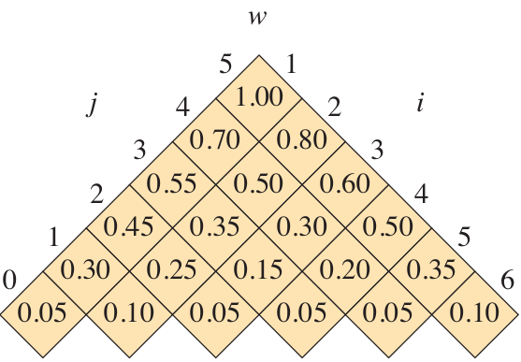











Example
$$d_{0}$$
$$k_{1}$$
$$d_{1}$$
$$k_{2}$$
$$d_{2}$$
$$k_{3}$$
$$d_{3}$$
$$k_{4}$$
$$d_{4}$$
$$k_{5}$$
$$d_{5}$$
0.05
0.15
0.10
0.10
0.05
0.05
0.05
0.10
0.05
0.20
0.10

Slide 29

Optimal substructure
If we use node $k_{r}$ as the root, we have
$$e\left(i,j\right)=e\left(i,r−1\right)+e\left(r+1,j\right)+w(i,j)$$
We thus have the following recursive formulation：
$$e\left[i,j\right]=\left\{\begin{matrix}q_{i−1} & if j=i−1 \\ \min{\{e[i,r−1]+e[r+1,j]+w\left(i,j\right):i≤r≤j\}} & if i≤j\end{matrix}\right.$$

Slide 30
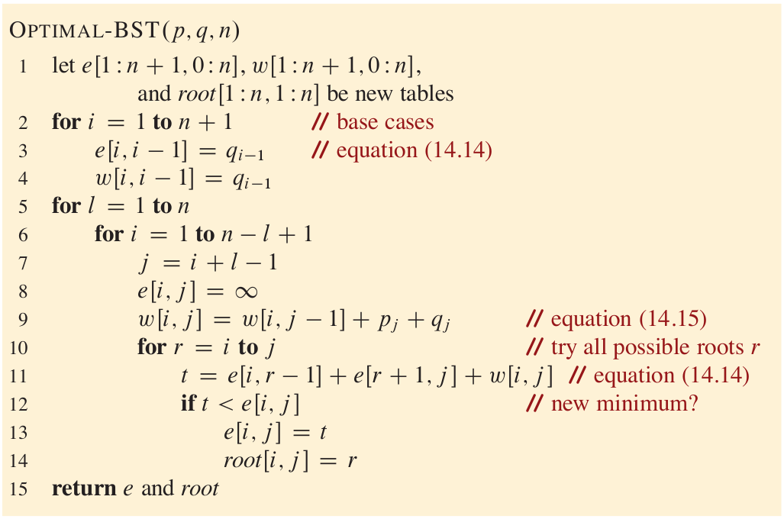

Optimal-BST
$$T\left(n\right)=Θ\left(n^{3}\right)$$

Slide 31
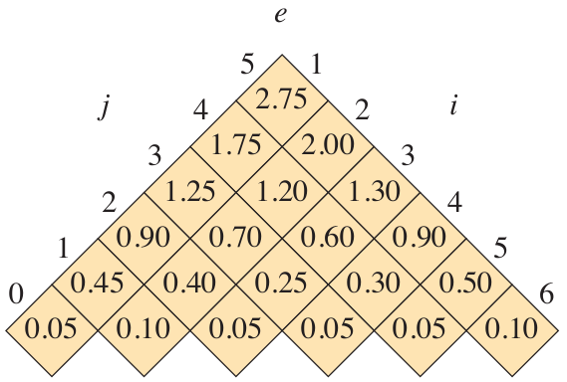













Example
$$k_{2}$$
0.10
$$k_{1}$$
$$k_{5}$$
$$0.15$$
0.20
$$d_{0}$$
$$d_{1}$$
$$k_{4}$$
$$d_{5}$$
$$0.05$$
0.10
0.10
0.10
$$k_{3}$$
$$d_{4}$$
0.05
0.05
$$d_{2}$$
$$d_{3}$$
0.05
0.05

Slide 32
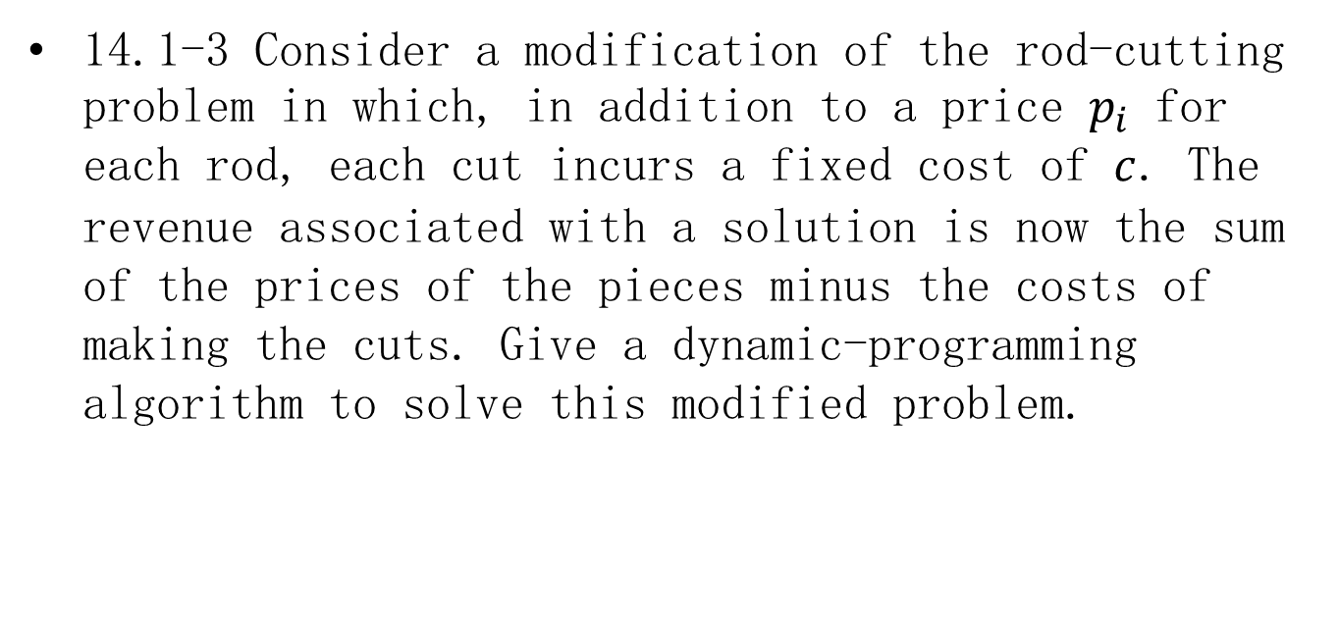
Homework
14.1-3 Consider a modification of the rod-cutting problem in which, in addition to a price $p_{i}$ for each rod, each cut incurs a fixed cost of $c$. The revenue associated with a solution is now the sum of the prices of the pieces minus the costs of making the cuts. Give a dynamic-programming algorithm to solve this modified problem.

Slide 33

Homework
14.4-2 Give pseudocode to reconstruct an LCS from the completed $c$ table and the original sequences $X=<x_{1},x_{2},…,x_{m}>$ and $Y=<y_{1},y_{2},…,y_{n}>$ in $O(m+n)$ time, without using the $b$ table.

Slide 34
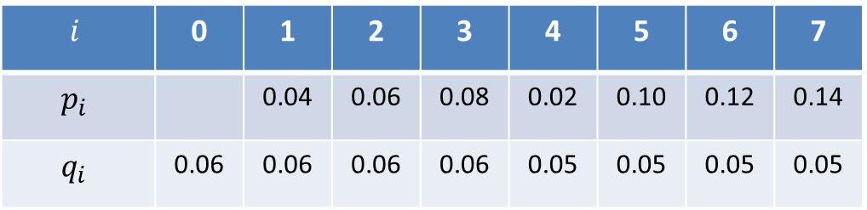

Homework
14.5-2 Determine the cost and structure of an optimal binary search tree for a set of $n=7$ keys with the following probabilities:
$$i$$ | 0 | 1 | 2 | 3 | 4 | 5 | 6 | 7
$$p_{i}$$ |  | 0.04 | 0.06 | 0.08 | 0.02 | 0.10 | 0.12 | 0.14
$$q_{i}$$ | 0.06 | 0.06 | 0.06 | 0.06 | 0.05 | 0.05 | 0.05 | 0.05

