Slide 1
Algorithms and Complexities Greedy Algorithms
刘盛云

Slide 2
General idea
A greedy algorithm always makes the choice that looks best at the moment
A locally optimal choice → a globally optimal solution
In contrast to dynamic programming

Slide 3
Applications
minimum-spanning-tree algorithms
Dijkstra's algorithm for shortest paths

Slide 4
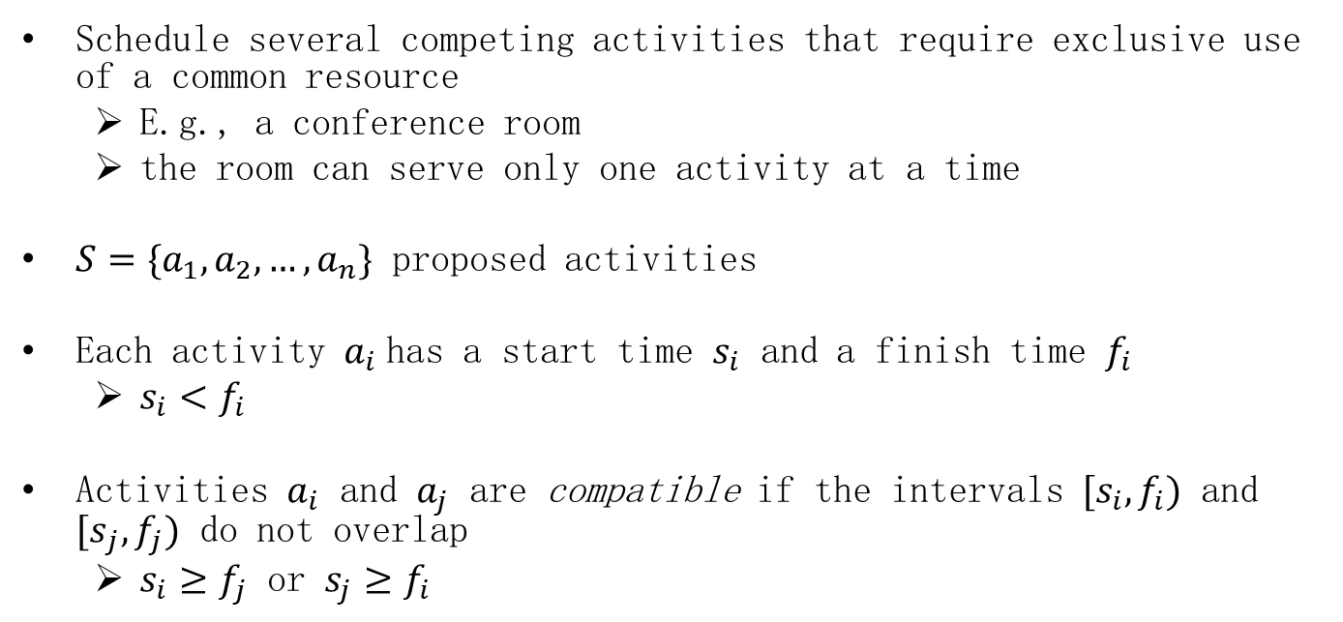
Activity-selection problem
Schedule several competing activities that require exclusive use of a common resource
E.g., a conference room
the room can serve only one activity at a time
$S=\{a_{1},a_{2},…,a_{n}\}$ proposed activities
Each activity $a_{i}$has a start time $s_{i}$ and a finish time $f_{i}$
$s_{i}<f_{i}$
Activities $a_{i}$ and $a_{j}$ are compatible if the intervals ${[s}_{i},f_{i})$ and ${[s}_{j},f_{j})$ do not overlap
$s_{i}≥f_{j}$ or $s_{j}≥f_{i}$

Slide 5
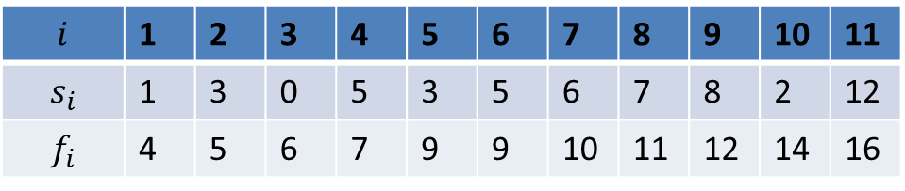

Activity-selection problem
Our goal: to select a maximum-size subset of mutually compatible activities
Let’s further assume $f_{1}≤f_{2}≤…≤f_{n}$
Such a requirement can be satisfied by sorting them a priori
$\left\{a_{1},a_{4},a_{8},a_{11}\right\}$ is an optimal solution
$$i$$ | 1 | 2 | 3 | 4 | 5 | 6 | 7 | 8 | 9 | 10 | 11
$$s_{i}$$ | 1 | 3 | 0 | 5 | 3 | 5 | 6 | 7 | 8 | 2 | 12
$$f_{i}$$ | 4 | 5 | 6 | 7 | 9 | 9 | 10 | 11 | 12 | 14 | 16

Slide 6
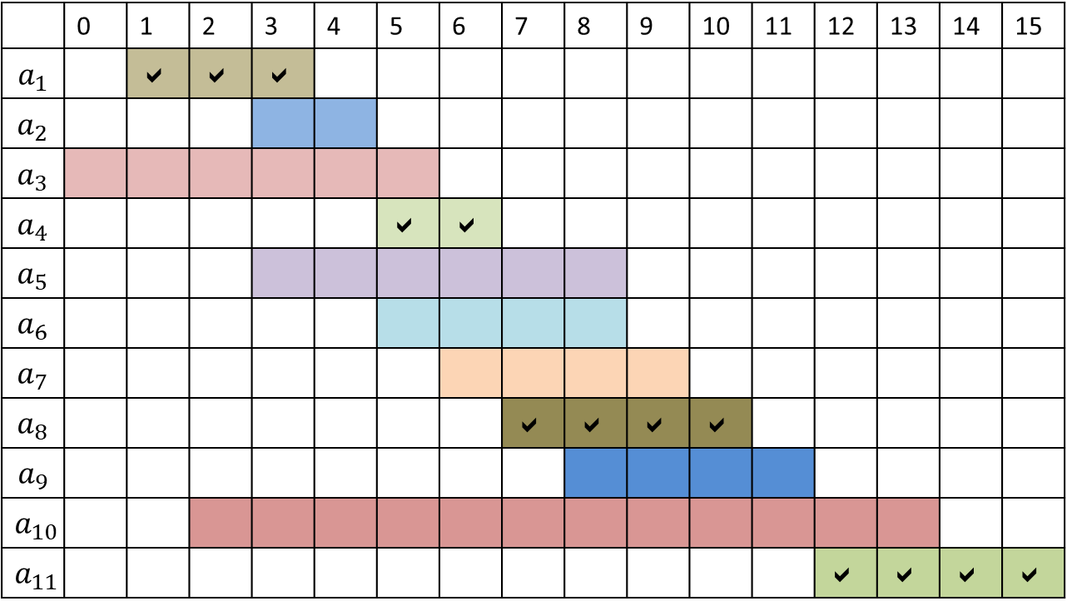
Solution 1
 | 0 | 1 | 2 | 3 | 4 | 5 | 6 | 7 | 8 | 9 | 10 | 11 | 12 | 13 | 14 | 15
$$a_{1}$$ |  |  |  | 
$$a_{2}$$
$$a_{3}$$
$$a_{4}$$ |  |  |  |  |  |  | 
$$a_{5}$$
$$a_{6}$$
$$a_{7}$$
$$a_{8}$$ |  |  |  |  |  |  |  |  |  |  | 
$$a_{9}$$
$$a_{10}$$
$$a_{11}$$ |  |  |  |  |  |  |  |  |  |  |  |  |  |  |  | 

Slide 7

Solution 2
 | 0 | 1 | 2 | 3 | 4 | 5 | 6 | 7 | 8 | 9 | 10 | 11 | 12 | 13 | 14 | 15
$$a_{1}$$
$$a_{2}$$ |  |  |  |  | 
$$a_{3}$$
$$a_{4}$$ |  |  |  |  |  |  | 
$$a_{5}$$
$$a_{6}$$
$$a_{7}$$
$$a_{8}$$
$$a_{9}$$ |  |  |  |  |  |  |  |  |  |  |  | 
$$a_{10}$$
$$a_{11}$$ |  |  |  |  |  |  |  |  |  |  |  |  |  |  |  | 

Slide 8
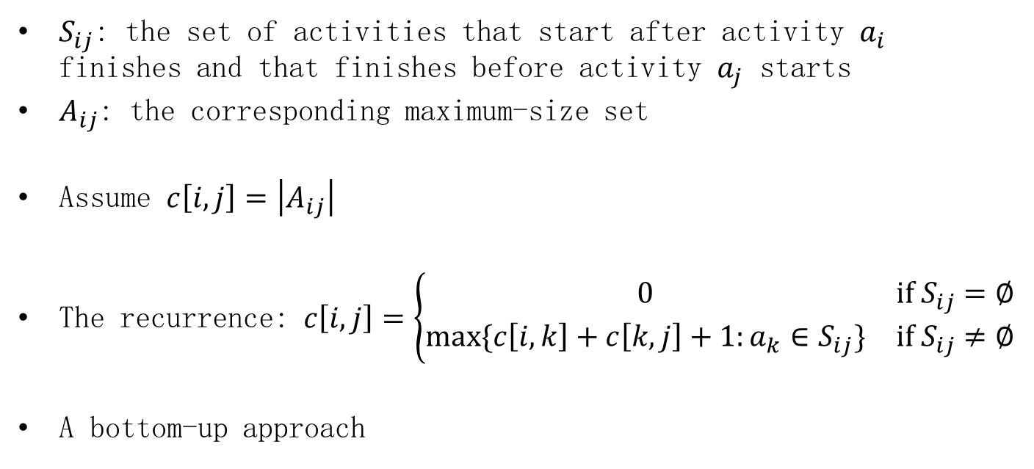
DP: the optimal substructure
$S_{ij}$: the set of activities that start after activity $a_{i}$ finishes and that finishes before activity $a_{j}$ starts
$A_{ij}$: the corresponding maximum-size set
Assume $c\left[i,j\right]=\left|A_{ij}\right|$
The recurrence: $c\left[i,j\right]=\left\{\begin{matrix}0 & if S_{ij}=∅ \\ max⁡\{c\left[i,k\right]+c\left[k,j\right]+1:a_{k}∈S_{ij}\} & if S_{ij}≠∅\end{matrix}\right.$
A bottom-up approach

Slide 9
The greedy choice
Intuition: we only maximize the number of compatible activities
choose an activity that leaves the resource available for as many other activities as possible
How about sorting and selecting activities according to their lengths?
No!
Choose the activity with the earliest finish time
Once you make the greedy choice, you have only one remaining subproblem to solve

Slide 10
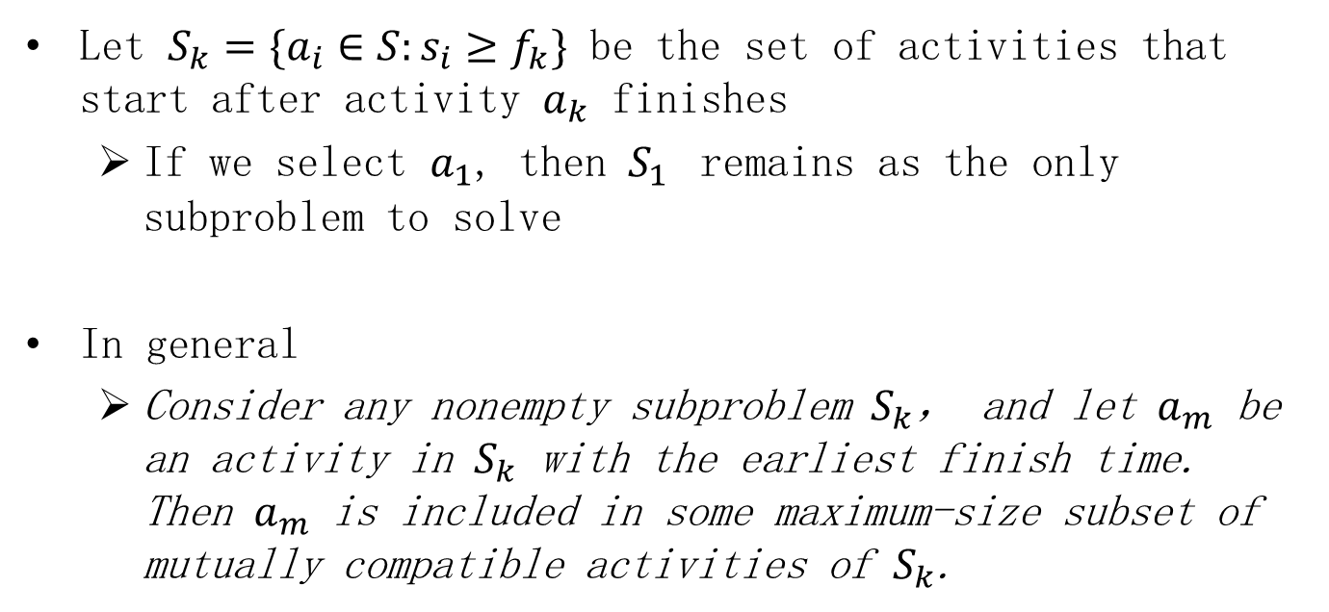
Important theorem
Let $S_{k}=\{a_{i}∈S:s_{i}≥f_{k}\}$ be the set of activities that start after activity $a_{k}$ finishes
If we select $a_{1}$, then $S_{1}$ remains as the only subproblem to solve
In general
Consider any nonempty subproblem $S_{k}$， and let $a_{m}$ be an activity in $S_{k}$ with the earliest finish time. Then $a_{m}$ is included in some maximum-size subset of mutually compatible activities of $S_{k}$.

Slide 11
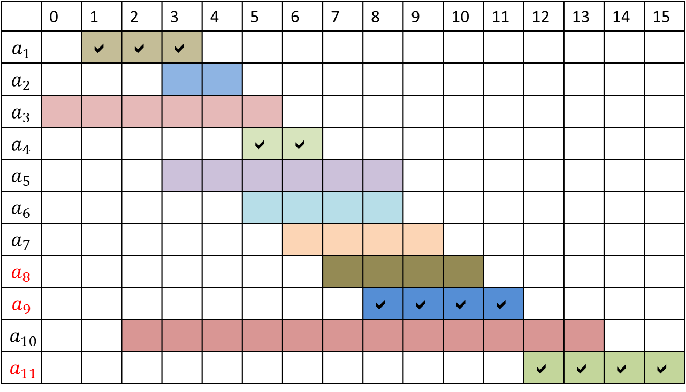
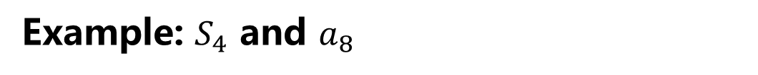
Example: $S_{4}$ and $a_{8}$
 | 0 | 1 | 2 | 3 | 4 | 5 | 6 | 7 | 8 | 9 | 10 | 11 | 12 | 13 | 14 | 15
$$a_{1}$$ |  |  |  | 
$$a_{2}$$
$$a_{3}$$
$$a_{4}$$ |  |  |  |  |  |  | 
$$a_{5}$$
$$a_{6}$$
$$a_{7}$$
$$a_{8}$$
$$a_{9}$$ |  |  |  |  |  |  |  |  |  |  |  | 
$$a_{10}$$
$$a_{11}$$ |  |  |  |  |  |  |  |  |  |  |  |  |  |  |  | 

Slide 12
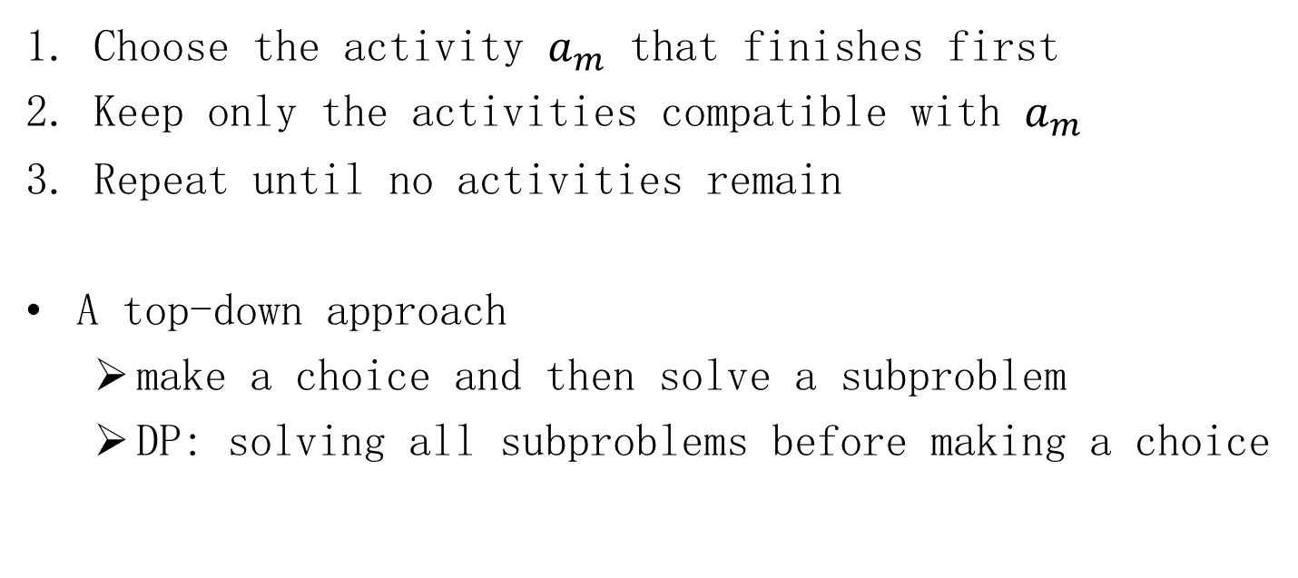
General idea
Choose the activity $a_{m}$ that finishes first
Keep only the activities compatible with $a_{m}$
Repeat until no activities remain
A top-down approach
make a choice and then solve a subproblem
DP: solving all subproblems before making a choice

Slide 13
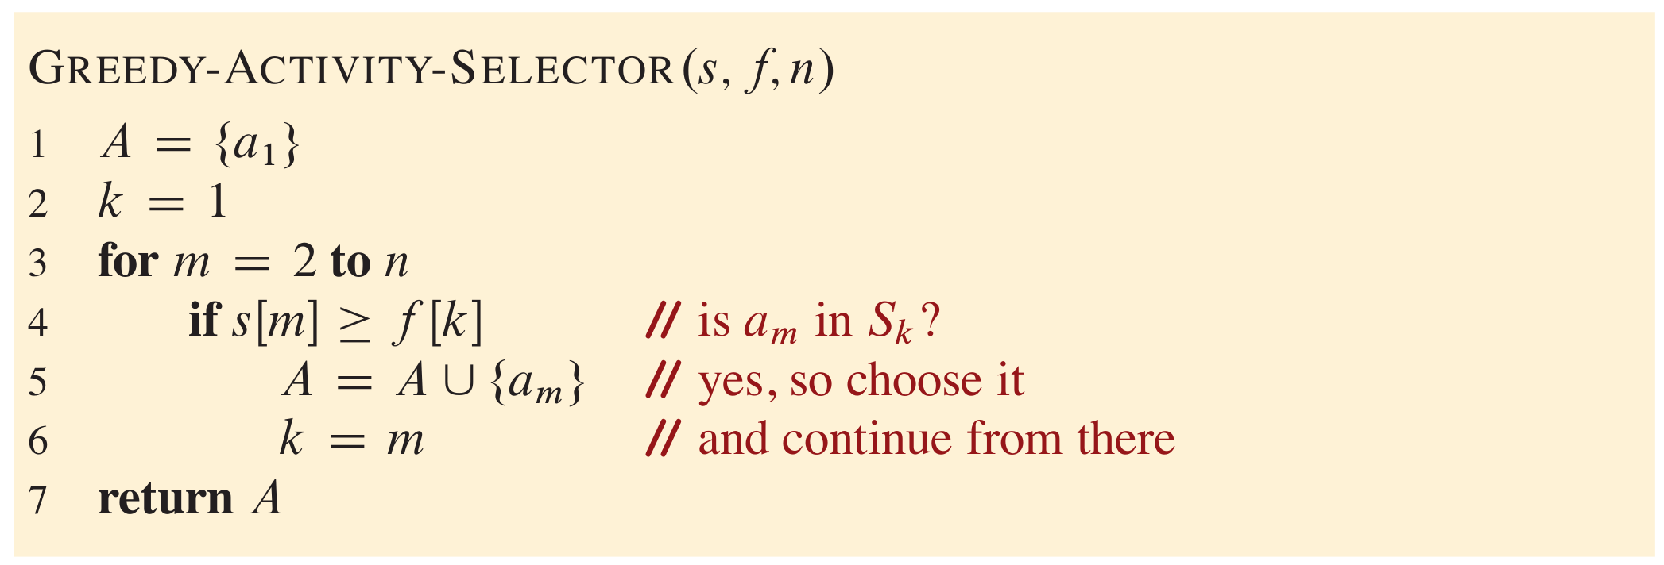
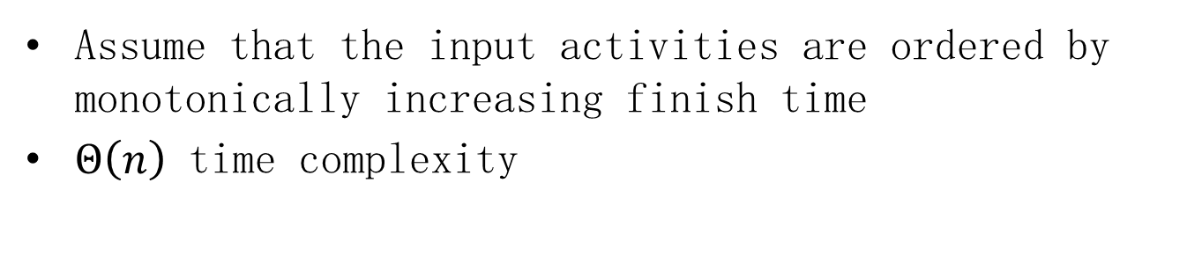
An iterative greedy algorithm
Assume that the input activities are ordered by monotonically increasing finish time
$Θ\left(n\right)$ time complexity

Slide 14

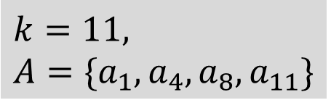


Example
 | 0 | 1 | 2 | 3 | 4 | 5 | 6 | 7 | 8 | 9 | 10 | 11 | 12 | 13 | 14 | 15
$$a_{1}$$ |  |  |  | 
$$a_{2}$$
$$a_{3}$$
$$a_{4}$$ |  |  |  |  |  |  | 
$$a_{5}$$
$$a_{6}$$
$$a_{7}$$
$$a_{8}$$ |  |  |  |  |  |  |  |  |  |  | 
$$a_{9}$$
$$a_{10}$$
$$a_{11}$$ |  |  |  |  |  |  |  |  |  |  |  |  |  |  |  | 
$$k=1, A=\{a_{1}\}$$
$$k=4, A=\{a_{1},a_{4}\}$$
$$k=8, A=\{a_{1},a_{4},a_{8}\}$$
$$k=11, \\ A=\{a_{1},a_{4},a_{8},a_{11}\}$$

Slide 15
Elements of the greedy strategy
Make a sequence of choices
At each decision point, the algorithm makes the choice that seems best at the moment
Two ingredients
greedy-choice property
optimal substructure

Slide 16
Main steps
Cast the optimization problem as one in which you make a choice and are left there is always an optimal solution to the original problem that makes the greedy choice, so that the greedy choice is always safe
Demonstrate optimal substructure by showing that, having made the greedy choice, what remains is a subproblem with the property that if you combine an optimal solution to the subproblem with the with one subproblem to solve
Prove that greedy choice you have made, you arrive at an optimal solution to the original problem

Slide 17
Greedy-choice property
Assemble a globally optimal solution by making locally optimal (greedy) choices
without considering results from subproblems
in contrast to DP
bottom-up → top-down
make the first choice before solving any subproblems

Slide 18
Optimal substructure
An optimal solution to the problem contains within it optimal solutions to subproblems
Essential for both DP and greedy algorithms
For greedy algorithms,
an optimal solution to the subproblem, combined with the greedy choice already made, yields an optimal solution to the original problem

Slide 19
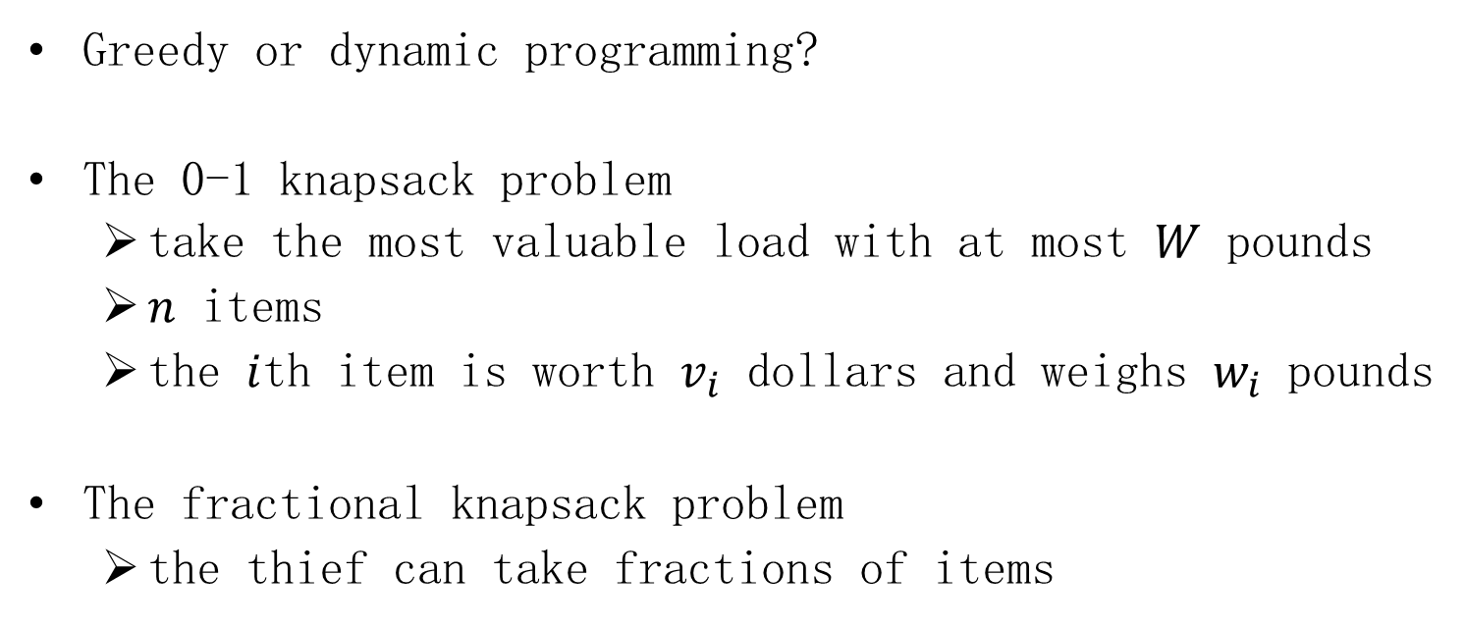
Greedy versus dynamic programming
Greedy or dynamic programming?
The 0-1 knapsack problem
take the most valuable load with at most $W$ pounds
$n$ items
the $i$th item is worth $v_{i}$ dollars and weighs $w_{i}$ pounds
The fractional knapsack problem
the thief can take fractions of items

Slide 20
Greedy versus dynamic programming
Both knapsack problems exhibit the optimal-substructure property
The fractional knapsack problem
The 0-1 knapsack problem
Greedy!
DP!

Slide 21
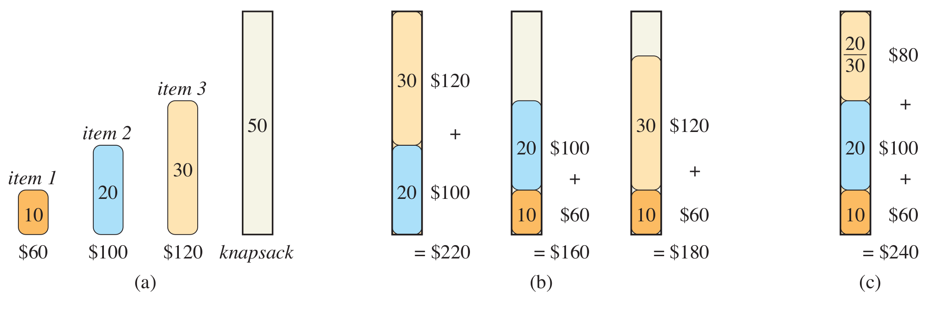
Examples

Slide 22
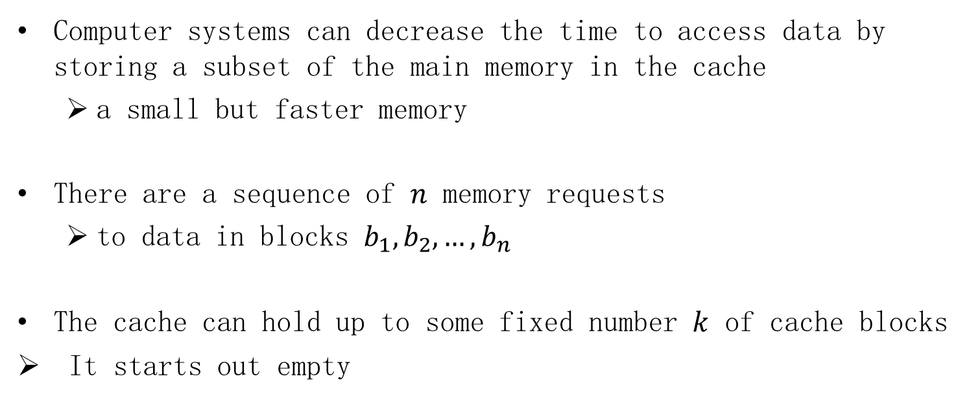
Offline caching
Computer systems can decrease the time to access data by storing a subset of the main memory in the cache
a small but faster memory
There are a sequence of $n$ memory requests
to data in blocks $b_{1},b_{2},…,b_{n}$
The cache can hold up to some fixed number $k$ of cache blocks
It starts out empty

Slide 23
“Numbers Everyone Should Know” from Jeff Dean
L1 cache reference | 0.5 ns
Branch mispredict | 5 ns
L2 cache reference | 7 ns
Mutex lock/unlock | 100 ns
Main memory reference | 100 ns
Compress 1K bytes with Zippy | 10,000 ns | 0.01 ms
Send 2K bytes over 1 Gbps network | 20,000 ns | 0.02 ms
Read 1 MB sequentially from memory | 250,000 ns | 0.25 ms
Round trip within same datacenter | 500,000 ns | 0.5 ms
Disk seek | 10,000,000 ns | 10 ms
Read 1 MB sequentially from network | 10,000,000 ns | 10 ms
Read 1 MB sequentially from disk | 30,000,000 ns | 30 ms
Send packet CA->Netherlands->CA | 150,000,000 ns | 150 ms

Slide 24
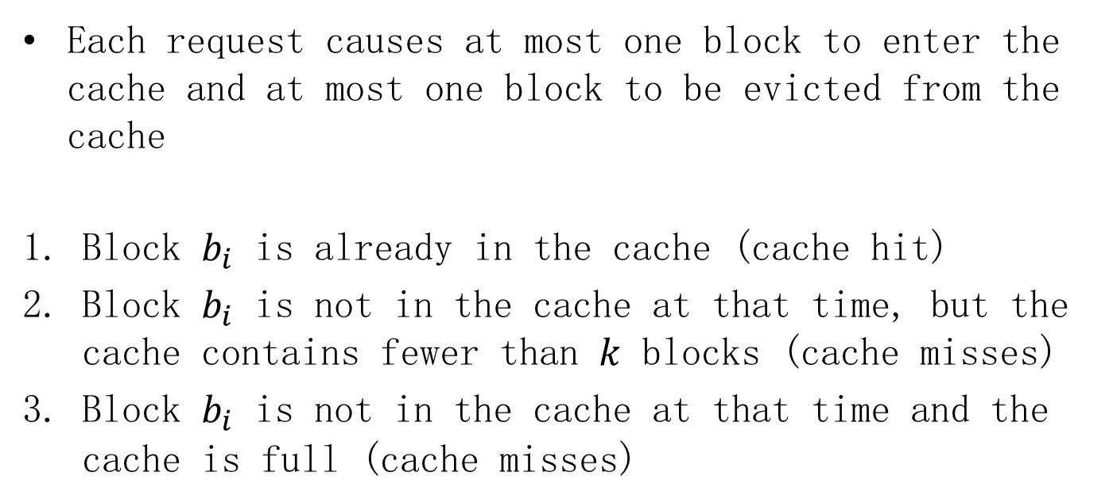
Offline caching
Each request causes at most one block to enter the cache and at most one block to be evicted from the cache
Block $b_{i}$ is already in the cache (cache hit)
Block $b_{i}$ is not in the cache at that time, but the cache contains fewer than $k$ blocks (cache misses)
Block $b_{i}$ is not in the cache at that time and the cache is full (cache misses)

Slide 25
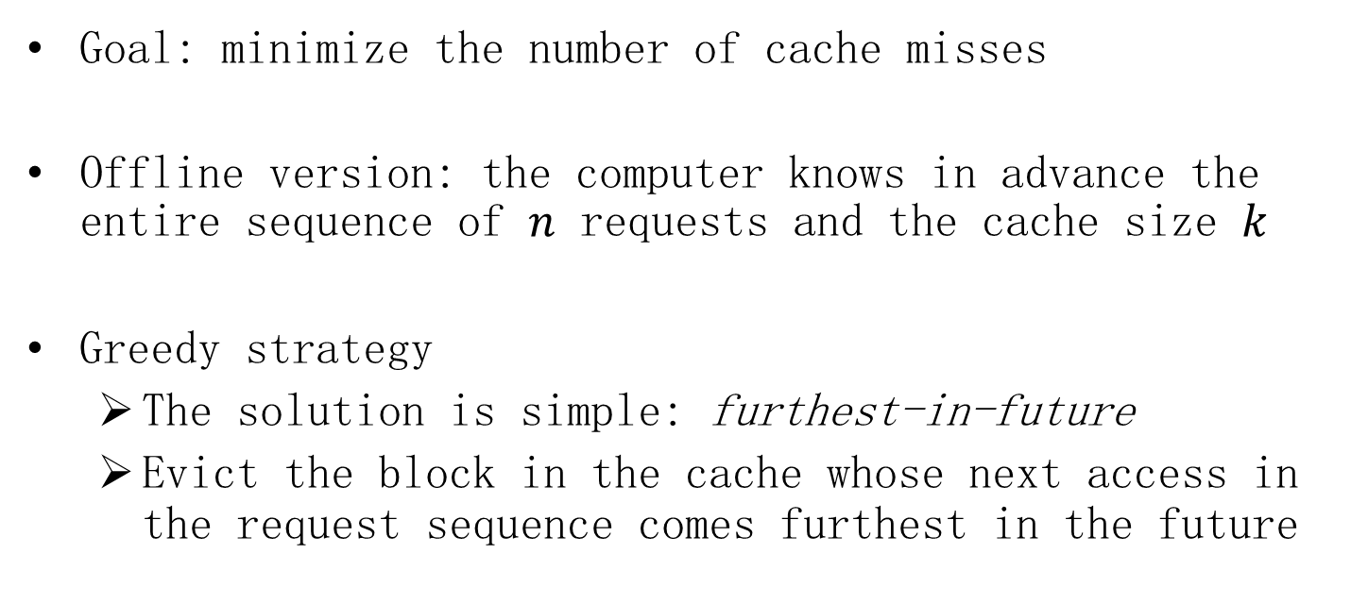
Offline caching
Goal: minimize the number of cache misses
Offline version: the computer knows in advance the entire sequence of $n$ requests and the cache size $k$
Greedy strategy
The solution is simple: furthest-in-future
Evict the block in the cache whose next access in the request sequence comes furthest in the future

Slide 26

Example
Assume $k=3$ and there are four distinct blocks
s, q, s, p, r, s, s, q, p, r, q
s
s
q
s
q
s
q
p
s
q
r
s
q
r
s
q
r
s
q
r
p
q
r
p
q
r
p
q
r
miss
miss

Slide 27
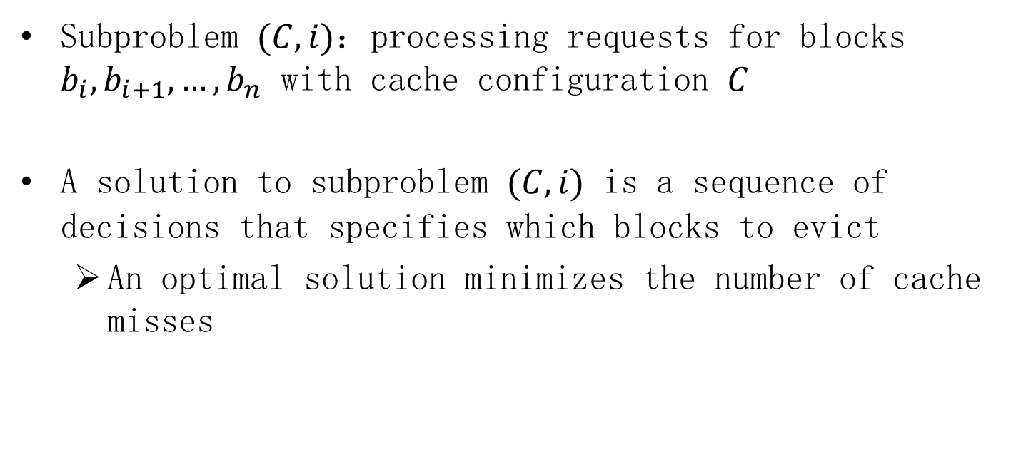
Optimal substructure
Subproblem $(C,i)$：processing requests for blocks $b_{i},b_{i+1},…,b_{n}$ with cache configuration $C$
A solution to subproblem $(C,i)$ is a sequence of decisions that specifies which blocks to evict
An optimal solution minimizes the number of cache misses

Slide 28
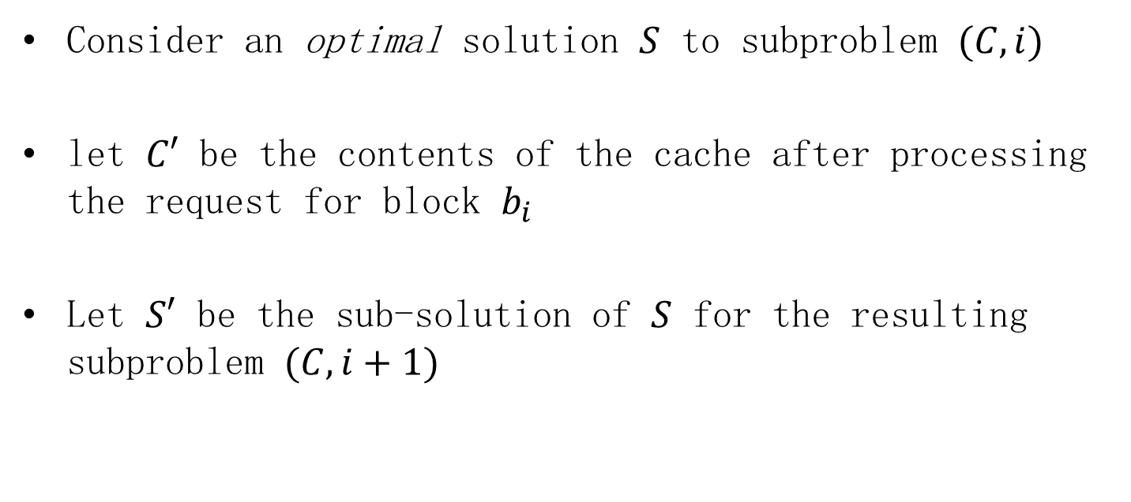
Optimal substructure
Consider an optimal solution $S$ to subproblem $(C,i)$
let $C′$ be the contents of the cache after processing the request for block $b_{i}$
Let $S′$ be the sub-solution of $S$ for the resulting subproblem $(C,i+1)$

Slide 29
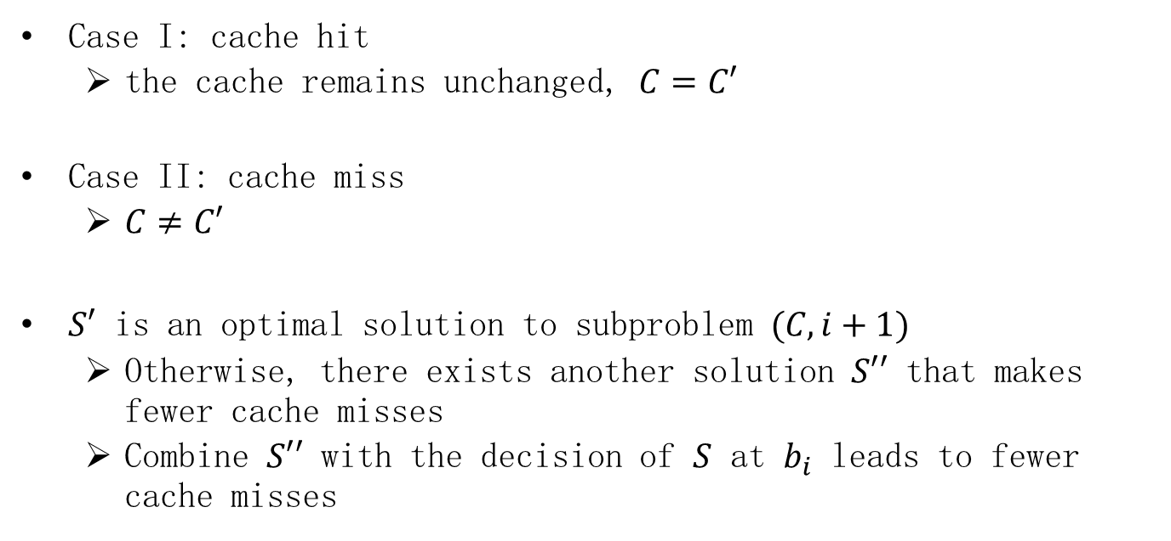
Optimal substructure
Case I: cache hit
the cache remains unchanged, $C=C′$
Case II: cache miss
$C≠C′$
$S′$ is an optimal solution to subproblem $(C,i+1)$
Otherwise, there exists another solution $S′′$ that makes fewer cache misses
Combine $S′′$ with the decision of $S$ at $b_{i}$ leads to fewer cache misses

Slide 30
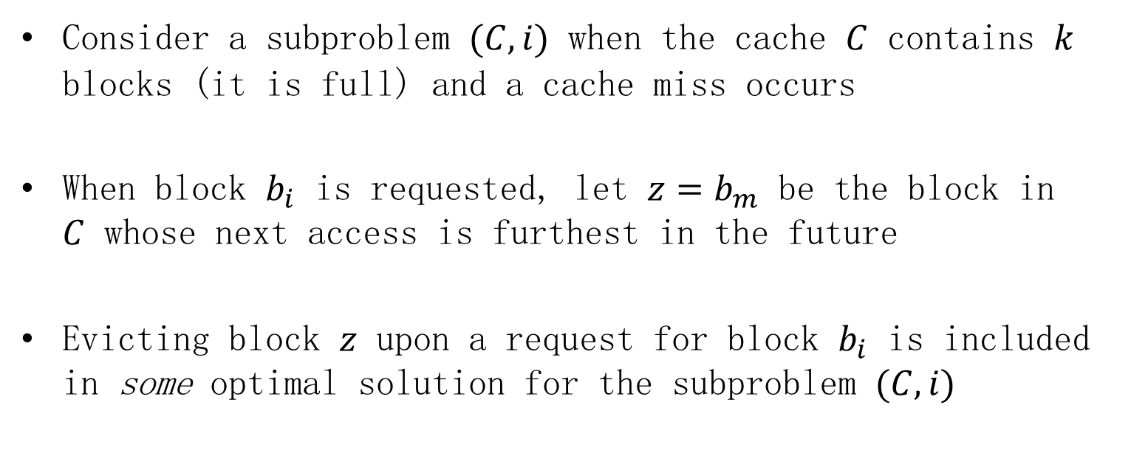
Greedy-choice property
Consider a subproblem $(C,i)$ when the cache $C$ contains $k$ blocks (it is full) and a cache miss occurs
When block $b_{i}$ is requested, let $z=b_{m}$ be the block in $C$ whose next access is furthest in the future
Evicting block $z$ upon a request for block $b_{i}$ is included in some optimal solution for the subproblem $(C,i)$

Slide 31



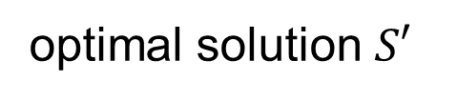


Greedy-choice property
optimal solution $S′$
$(C,i)$
$$z=b_{m}$$
$$b_{n}$$
$b_{i}$
furthest in the future
$$z→b_{i}$$

Slide 32




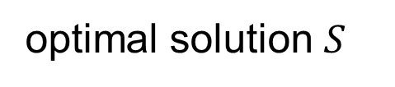





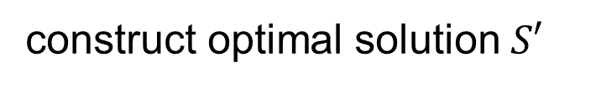
Greedy-choice property
Let $S$ be an optimal solution to subproblem $(C,i)$
optimal solution $S$
$$C_{S, i}$$
$$C_{S, i+1}$$
$$C_{S, j}$$
$$…$$
$$…$$
$$z=b_{m}$$
$$b_{n}$$
$b_{i}$
$b_{i+1}$
$b_{j}$
$$x→b_{i}$$
$$x≠z$$
construct optimal solution $S′$

Slide 33
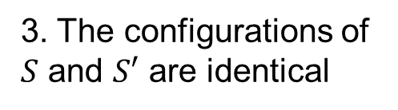

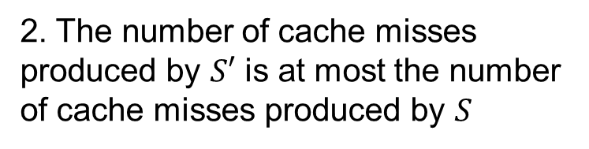
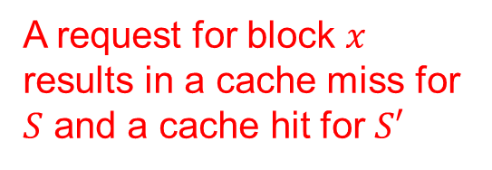
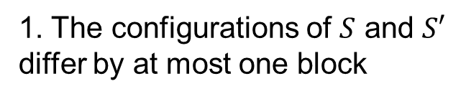
Greedy-choice property: main idea
1. The configurations of $S$ and $S′$ differ by at most one block
3. The configurations of $S$ and $S′$ are identical
$$C_{S, i}$$
$$C_{S, i+1}$$
$$C_{S, j}$$
$$…$$
$$…$$
$b_{i}$
$b_{i+1}$
$b_{j}$
$$z=b_{m}$$
$$b_{n}$$
A request for block $x$ results in a cache miss for $S$ and a cache hit for $S′$
2. The number of cache misses produced by $S′$ is at most the number of cache misses produced by $S$

Slide 34

Homework-1
15.2-5 Describe an efficient algorithm that, given a set $\left\{x_{1},x_{2},…,x_{n}\right\}$ of points on the real line, determines the smallest set of unit-length closed intervals that contains all of the given points. Argue that your algorithm is correct.

Slide 35
Homework-2
15.4-2 Real cache managers do not know the future requests, and so they often use the past to decide which block to evict. The least-recently-used, or LRU, strategy evicts the block that, of all blocks currently in the cache, was the least recently requested. Give an example of a request sequence in which the LRU strategy is not optimal, by showing that it induces more cache misses than the furthest-in-future strategy does on the same request sequence.

