Slide 1
Algorithms and Complexities Minimum Spanning Trees
刘盛云

Slide 2
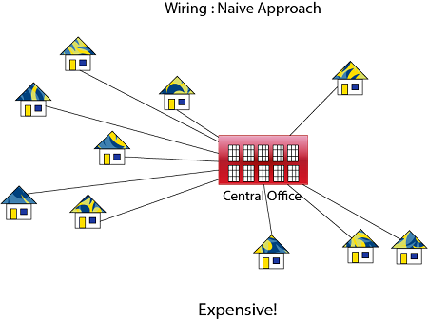
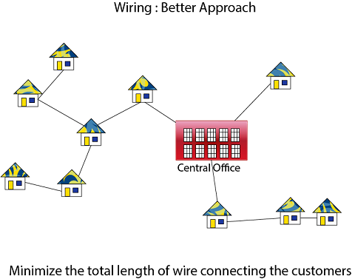

Applications
Telecommunications networks
Computer networks
Electronic circuit designs
Others

Slide 3
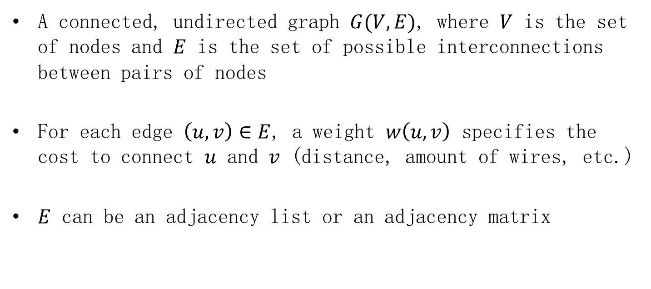
Model
A connected, undirected graph $G(V,E)$, where $V$ is the set of nodes and $E$ is the set of possible interconnections between pairs of nodes
For each edge $\left(u,v\right)∈E$, a weight $w\left(u,v\right)$ specifies the cost to connect $u$ and $v$ (distance, amount of wires, etc.)
$E$ can be an adjacency list or an adjacency matrix

Slide 4
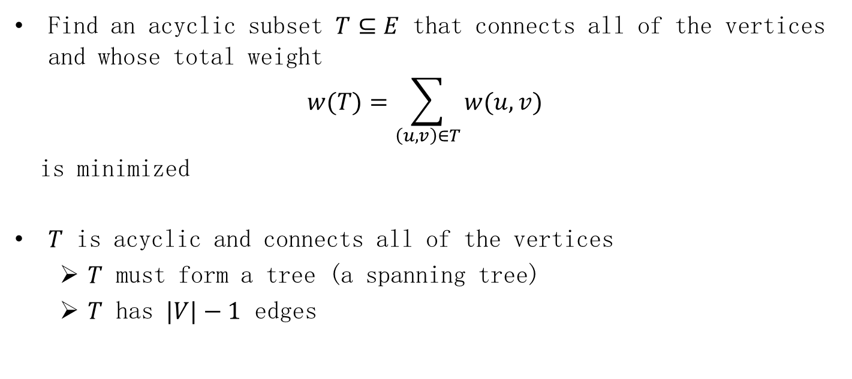
Our goal
Find an acyclic subset $T⊆E$ that connects all of the vertices and whose total weight
$$w(T)=\sum_{\left(u,v\right)∈T}{w(u,v)}$$
is minimized
$T$ is acyclic and connects all of the vertices
$T$ must form a tree (a spanning tree)
$T$ has $|V|−1$ edges

Slide 5
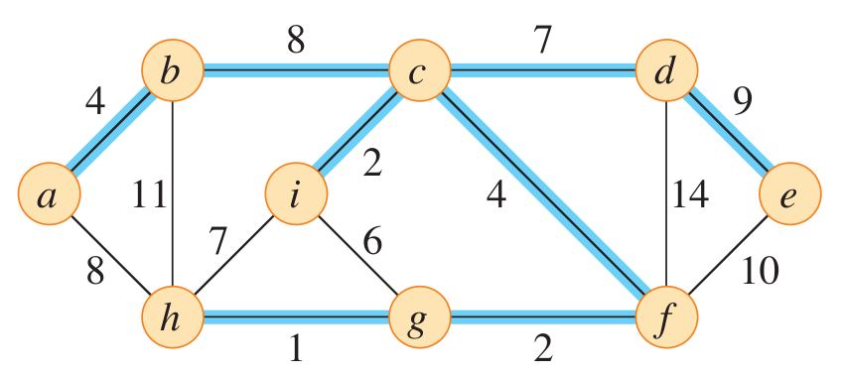
Example

Slide 6
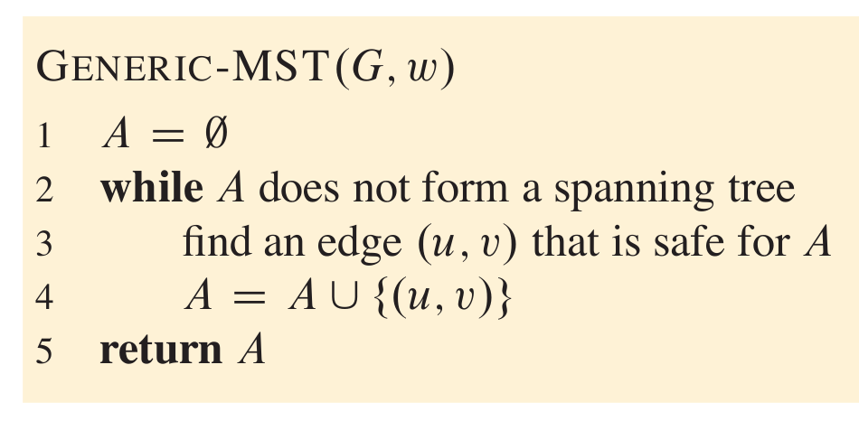
Greedy strategy
Generic method
grows the minimum spanning tree one edge at a time
How do you find a safe edge?
Prior to each iteration, $A$ is a subset of some minimum spanning tree
$A∪\{\left(u,v\right)\}$ is still a subset of a minimum spanning tree

Slide 7
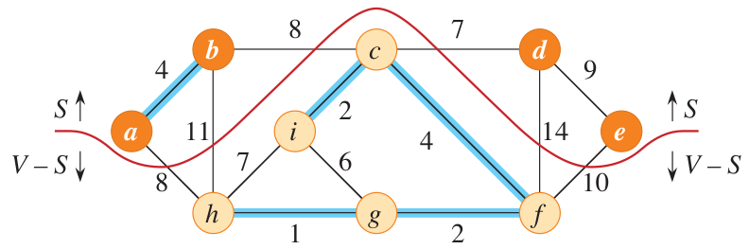

Graph-cut
A cut $(S,V−S)$ of an undirected graph $G(V,E)$ is a partition of $V$
An edge $\left(u,v\right)∈E$ crosses the cut $(S,V−S)$ if one of its endpoints belongs to $S$ and the other belongs to $V−S$

Slide 8
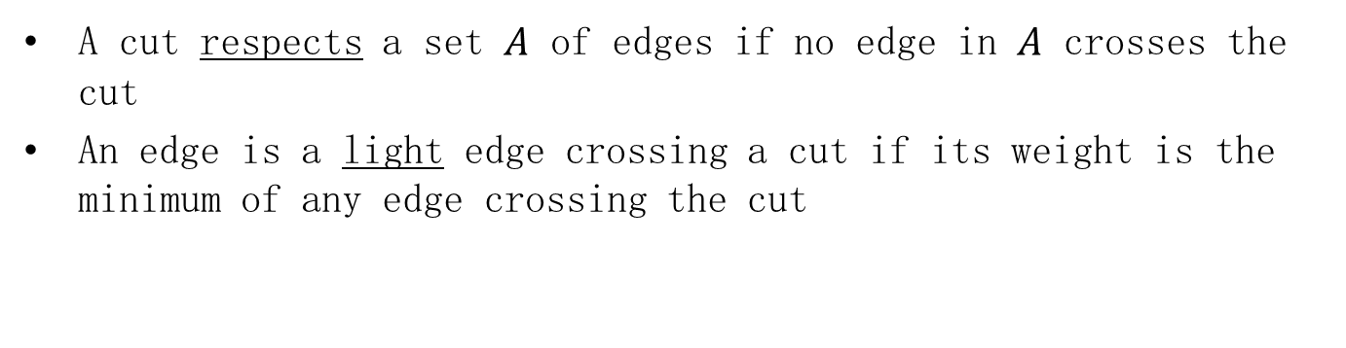
Graph-cut
A cut respects a set $A$ of edges if no edge in $A$ crosses the cut
An edge is a light edge crossing a cut if its weight is the minimum of any edge crossing the cut

Slide 9
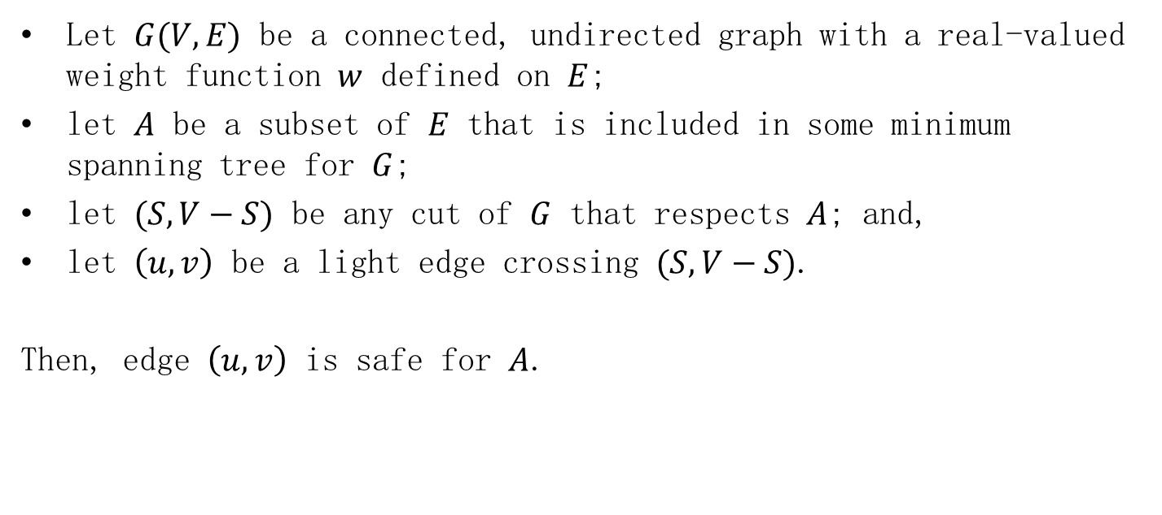
Important theorem
Let $G(V,E)$ be a connected, undirected graph with a real-valued weight function $w$ defined on $E$;
let $A$ be a subset of $E$ that is included in some minimum spanning tree for $G$;
let $(S,V−S)$ be any cut of $G$ that respects $A$; and,
let $\left(u,v\right)$ be a light edge crossing $(S,V−S)$.
Then, edge $\left(u,v\right)$ is safe for $A$.

Slide 10
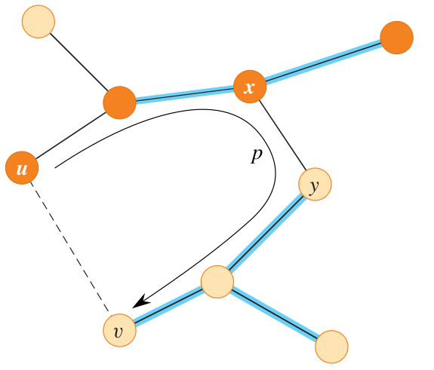
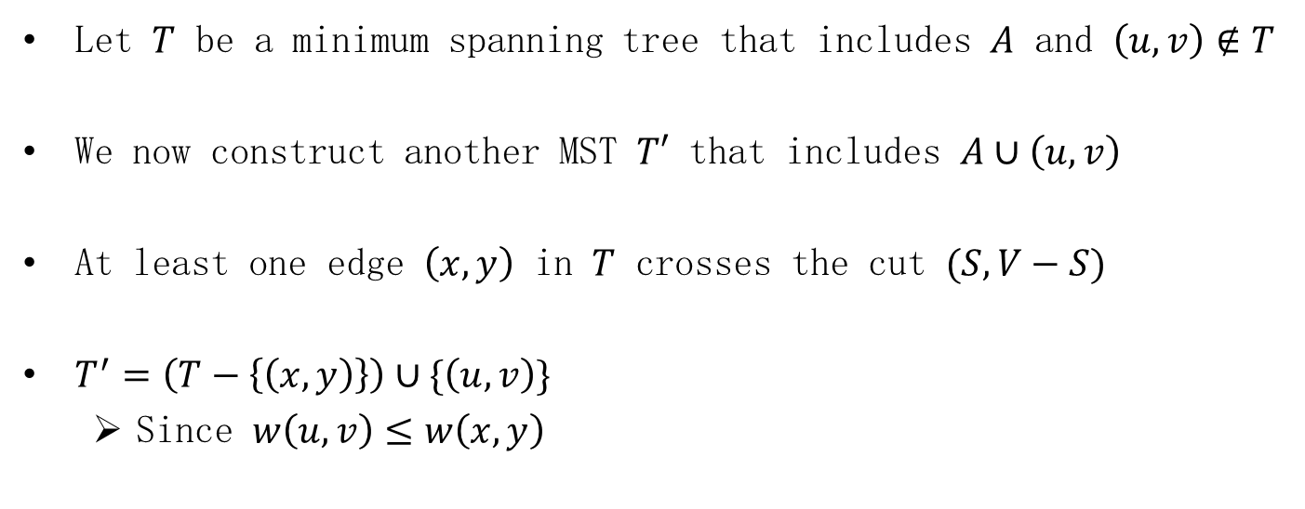
Proof
Let $T$ be a minimum spanning tree that includes $A$ and $\left(u,v\right)∉T$
We now construct another MST $T′$ that includes $A∪\left(u,v\right)$
At least one edge $\left(x,y\right)$ in $T$ crosses the cut $(S,V−S)$
$T^{′}=\left(T−\left\{\left(x,y\right)\right\}\right)∪\{\left(u,v\right)\}$
Since $w\left(u,v\right)≤w\left(x,y\right)$

Slide 11
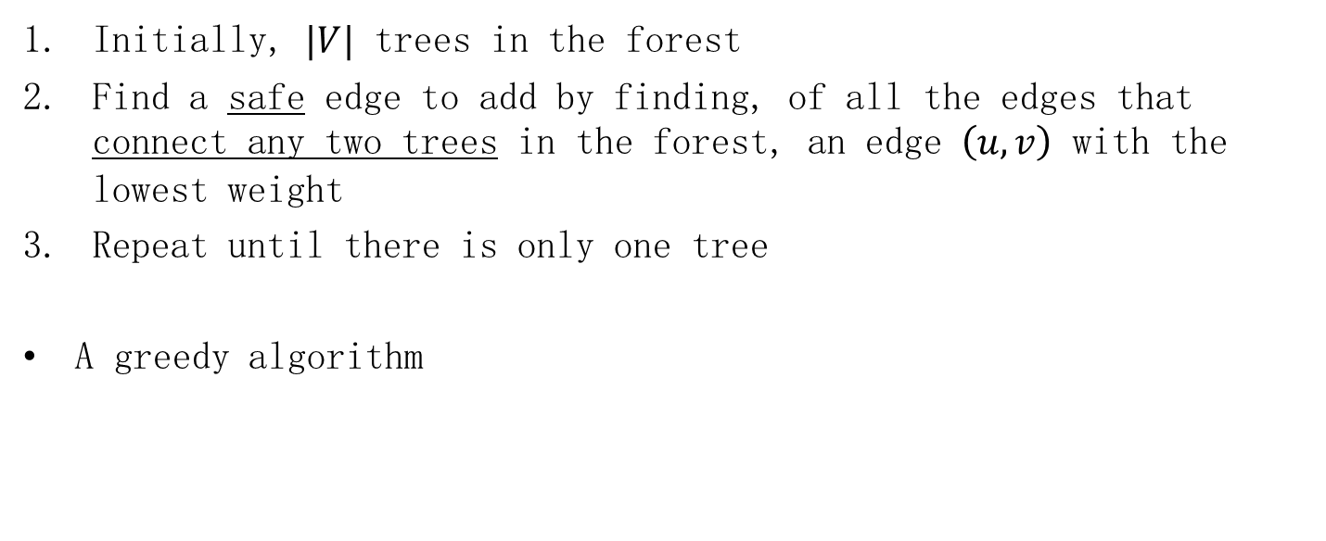
Kruskal's algorithm
Initially, $|V|$ trees in the forest
Find a safe edge to add by finding, of all the edges that connect any two trees in the forest, an edge $\left(u,v\right)$ with the lowest weight
Repeat until there is only one tree
A greedy algorithm

Slide 12
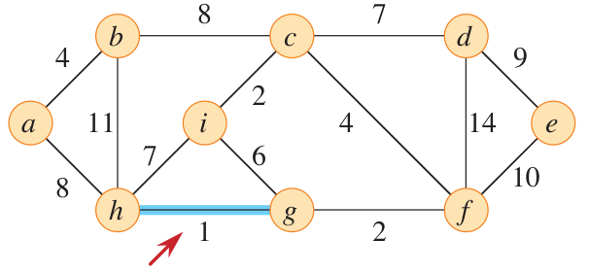
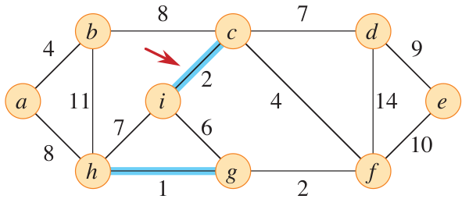
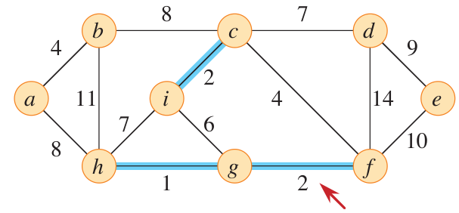
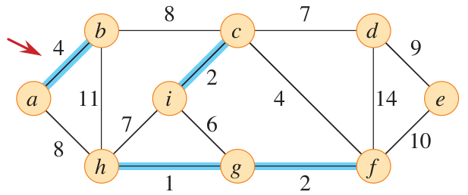
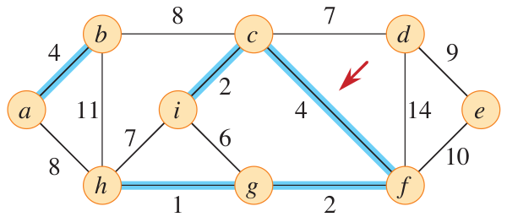
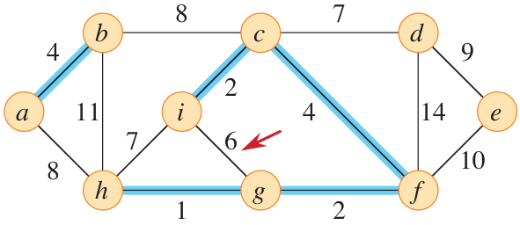
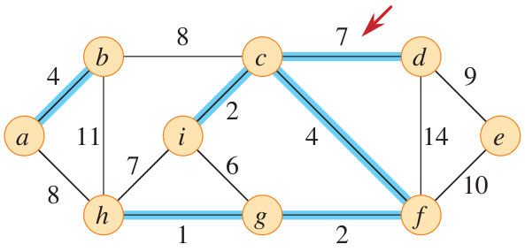
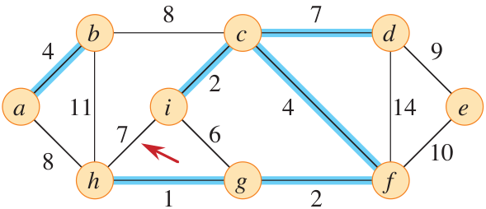
Example

Slide 13
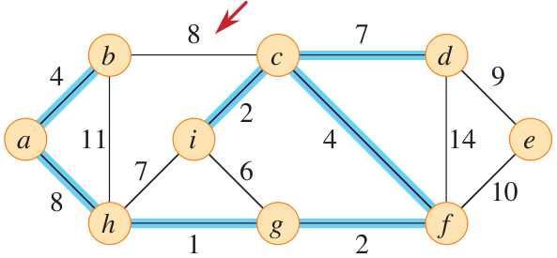
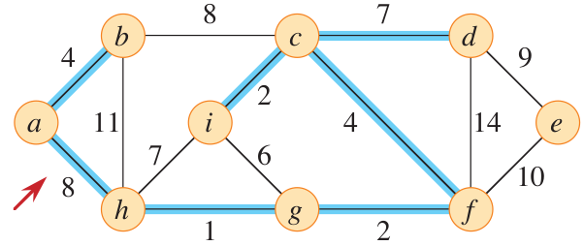
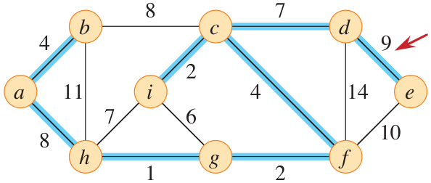
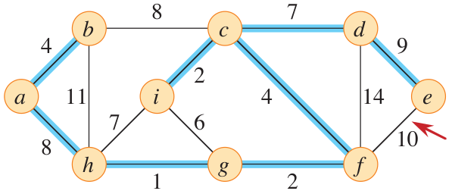
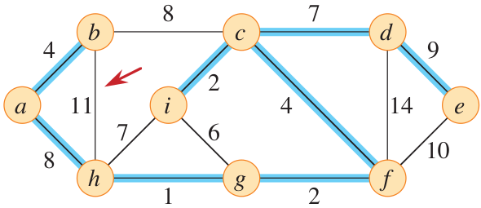
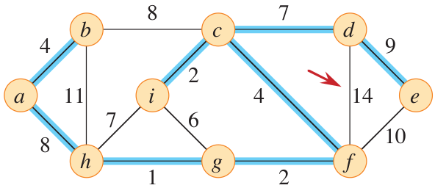
Example

Slide 14
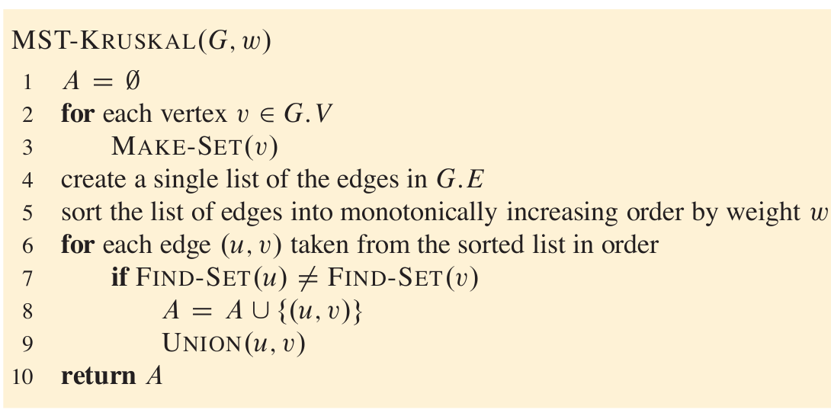
Pseudocode

Slide 15
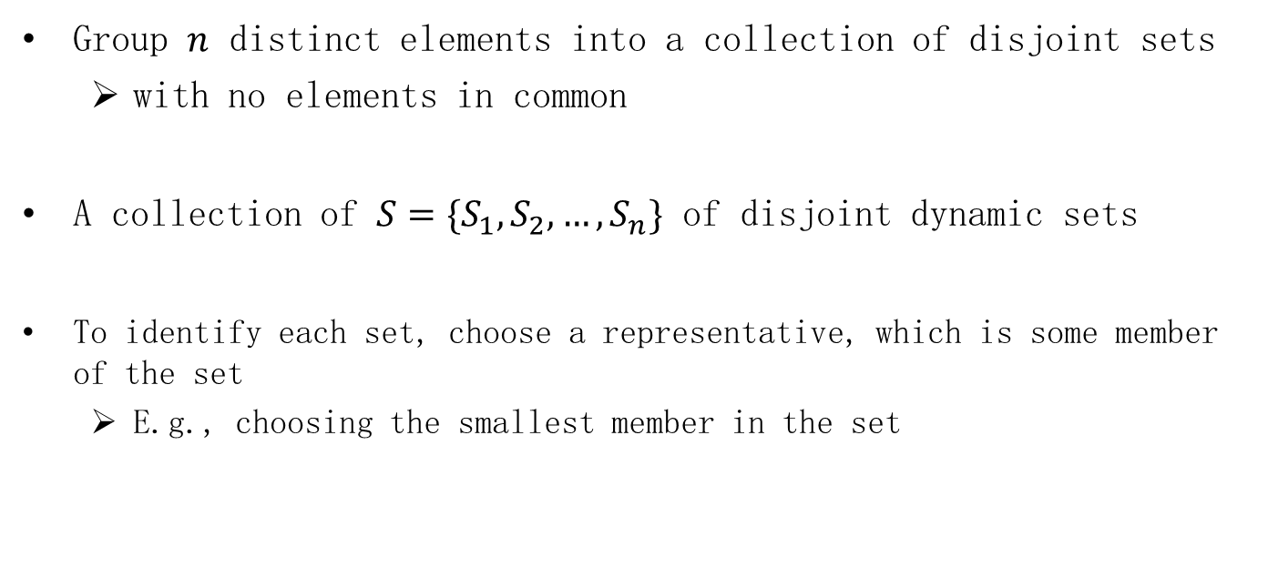
Disjoint-set data structure
Group $n$ distinct elements into a collection of disjoint sets
with no elements in common
A collection of $S=\{S_{1},S_{2},…,S_{n}\}$ of disjoint dynamic sets
To identify each set, choose a representative, which is some member of the set
E.g., choosing the smallest member in the set

Slide 16
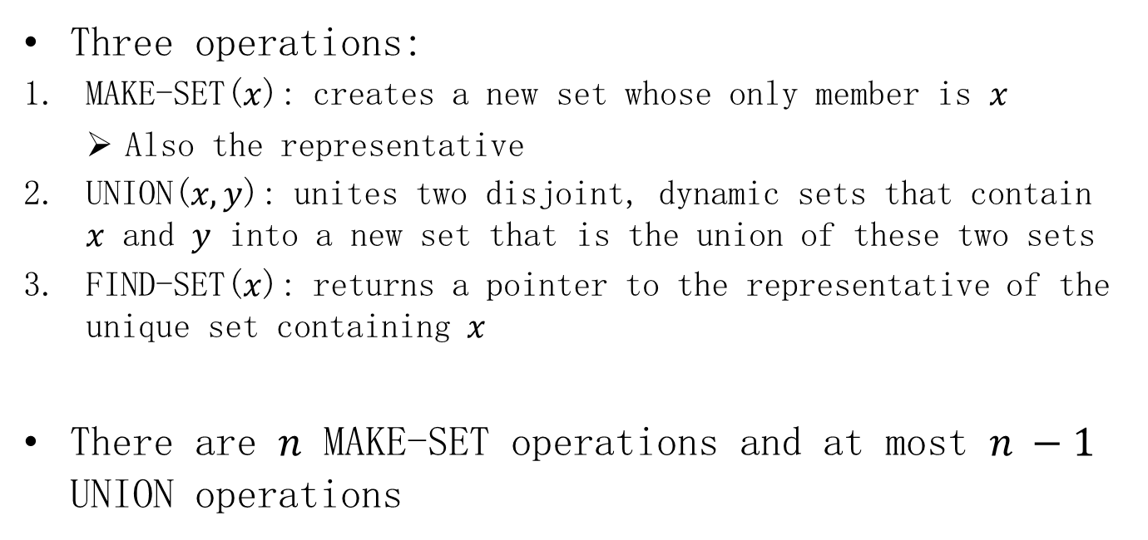
Disjoint-set data structure
Three operations:
MAKE-SET($x$): creates a new set whose only member is $x$
Also the representative
UNION($x,y$): unites two disjoint, dynamic sets that contain $x$ and $y$ into a new set that is the union of these two sets
FIND-SET($x$): returns a pointer to the representative of the unique set containing $x$
There are $n$ MAKE-SET operations and at most $n −1$ UNION operations

Slide 17
Disjoint-set forests
A fast implementation of disjoint sets represents sets by trees
Each tree represents one set
Each member points only to its parent
The root contains the representative
Heuristic #1: union by rank
The root with smaller rank points to the root with larger rank
Heuristic #2: path compression
The FIND-SET procedure updates each node to point directly to the root

Slide 18
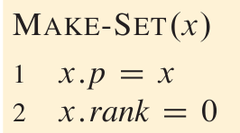
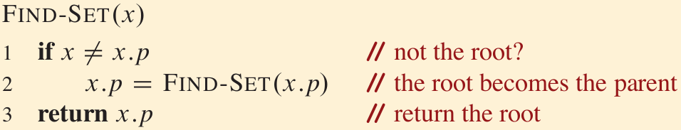
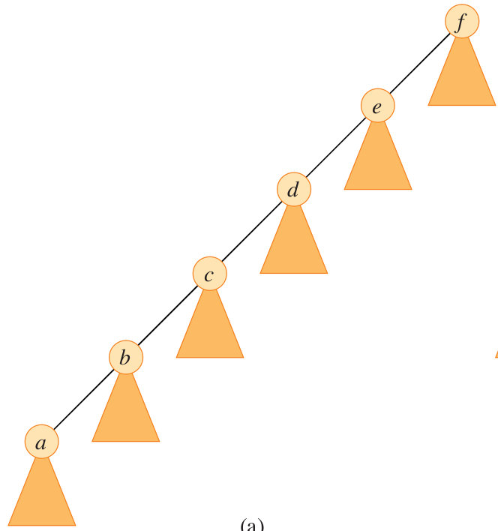
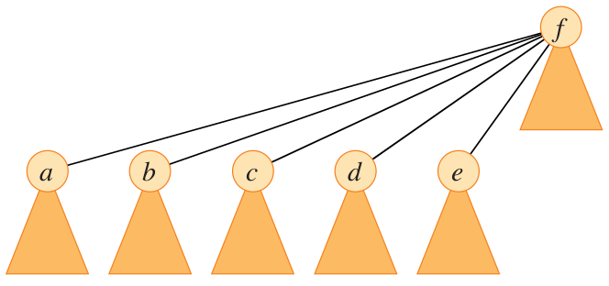
Pseudocode: path compression
before
after

Slide 19
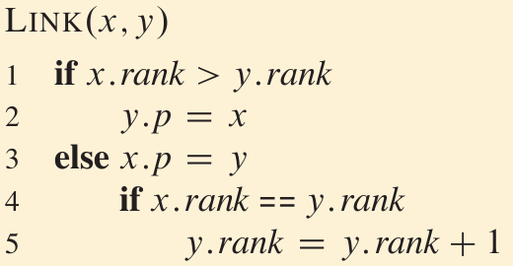
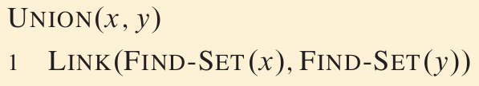
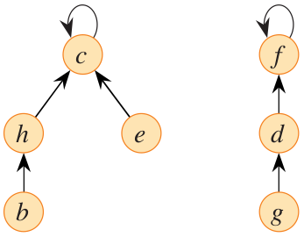
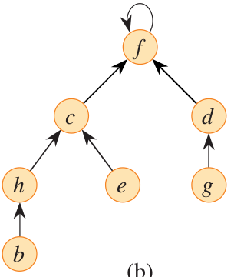
Pseudocode: union by rank

Slide 20
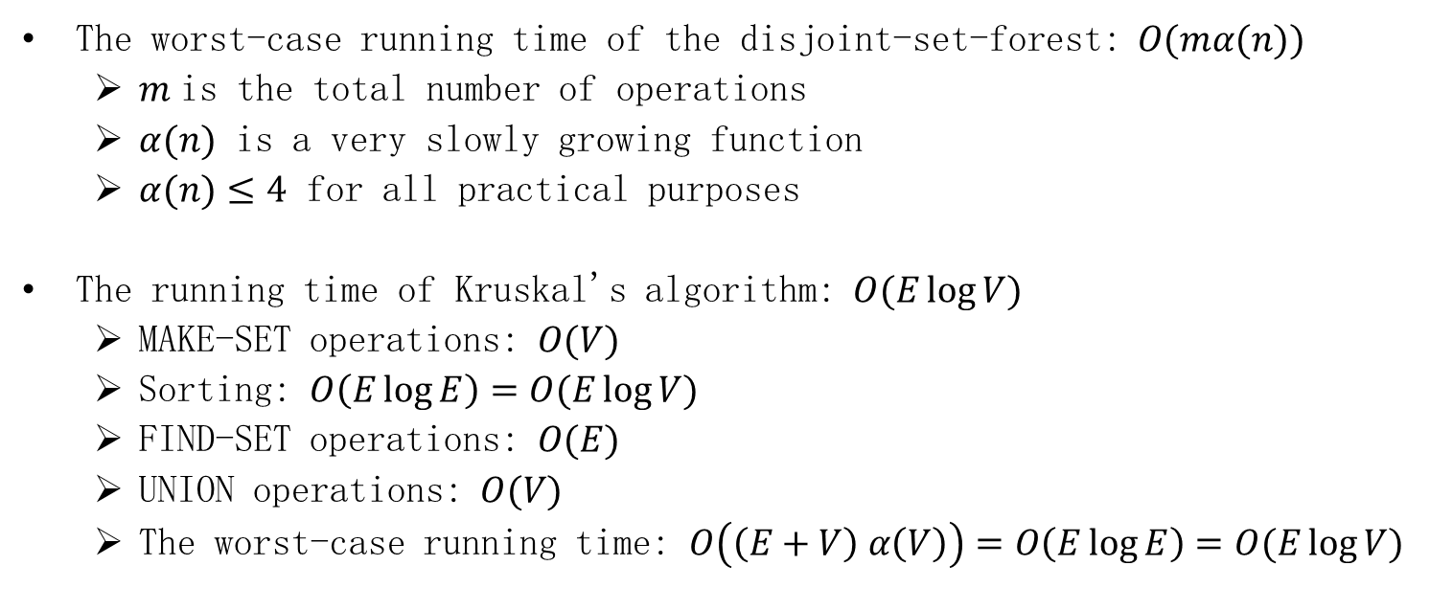
Time Complexity
The worst-case running time of the disjoint-set-forest: $O(mα(n))$
$m$ is the total number of operations
$α(n)$ is a very slowly growing function
$α(n)≤4$ for all practical purposes
The running time of Kruskal's algorithm: $O(E\log{V})$
MAKE-SET operations: $O(V)$
Sorting: $O\left(E\log{E}\right)=O(E\log{V})$
FIND-SET operations: $O(E)$
UNION operations: $O(V)$
The worst-case running time: $O\left(\left(E+V\right) α\left(V\right)\right)=O\left(E\log{E}\right)=O(E\log{V})$

Slide 21
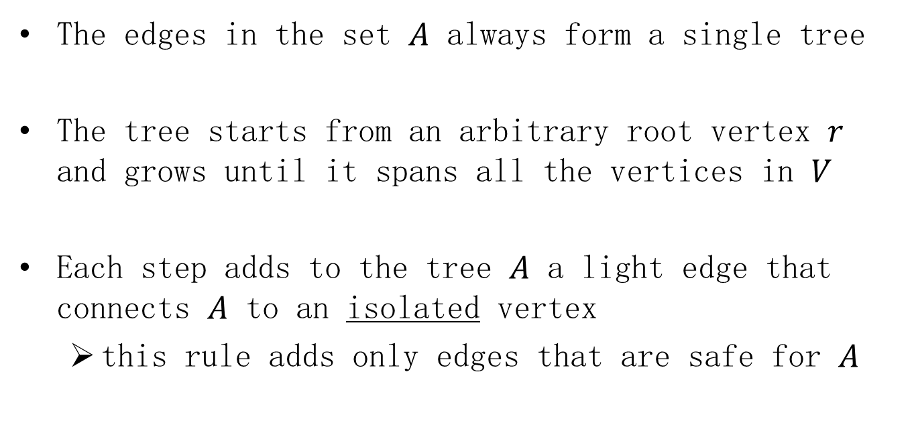
Prim's algorithm
The edges in the set $A$ always form a single tree
The tree starts from an arbitrary root vertex $r$ and grows until it spans all the vertices in $V$
Each step adds to the tree $A$ a light edge that connects $A$ to an isolated vertex
this rule adds only edges that are safe for $A$

Slide 22

Prim's algorithm
Maintain a min-priority queue $Q$ of all vertices that are not in the tree
The minimum weight of any edge connecting $v$ to a vertex in the tree

Slide 23
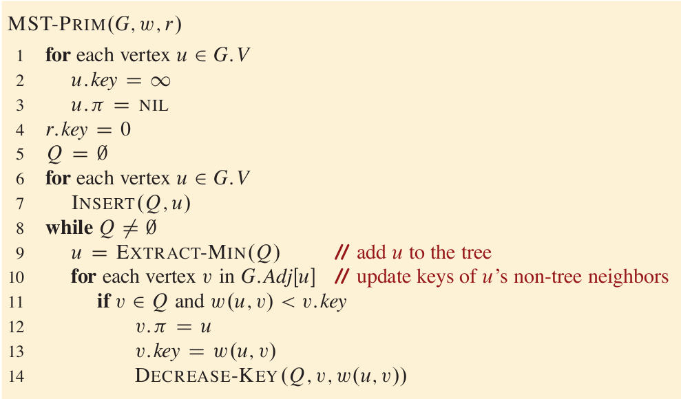
Pseudocode

Slide 24
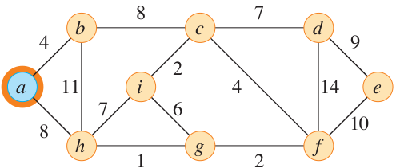
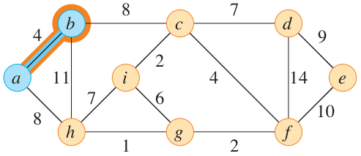
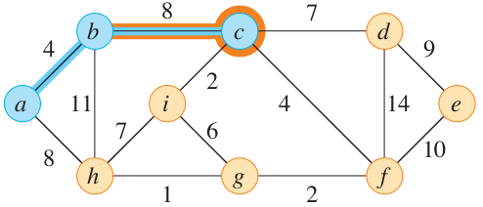
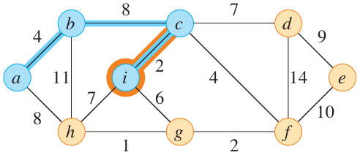
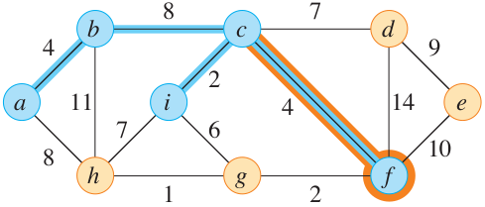
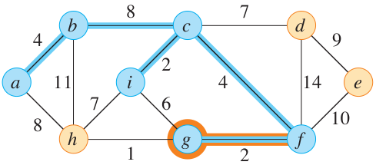
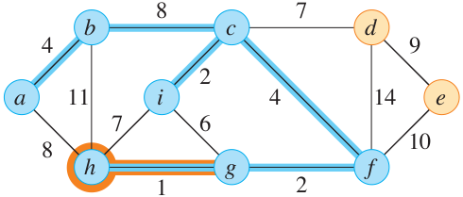
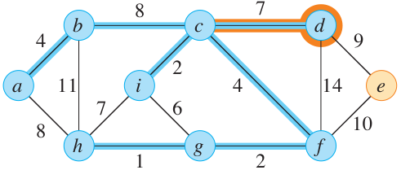

Example

Slide 25

Min-priority queue
(Binary) heap: a nearly complete binary tree
The value of a node is at most (at least) the value of its parent

Slide 26







EXTRACT-MIN (actually, MAX)
$$O(\log{n)}$$

Slide 27





DECREASE-KEY (actually, INCREASE)
$$O(\log{n)}$$

Slide 28

Time complexity
The total time for Prim's algorithm is $O(E\log{V})$
$O(V)$ for initialization
EXTRACT-MIN operations: $|V|$ times, $O(V\log{V})$
Update keys: $O\left(E\right)$ times, $O(E\log{V})$

Slide 29

Homework
21.1-4 Give a simple example of a connected graph such that the set of edges $\{\left(u,v\right):$ there exists a cut $(S,V−S)$ such that $\left(u,v\right)$ is a light edge crossing $(S,V−S)\}$ does not form a minimum spanning tree.

Slide 30

Homework
21.2-2 Give a simple implementation of Prim’s algorithm that runs in $O(V^{2})$ time when the graph $G(V,E)$ is represented as an adjacency matrix.

