Slide 1
Algorithms and Complexities Shortest Paths
刘盛云

Slide 2
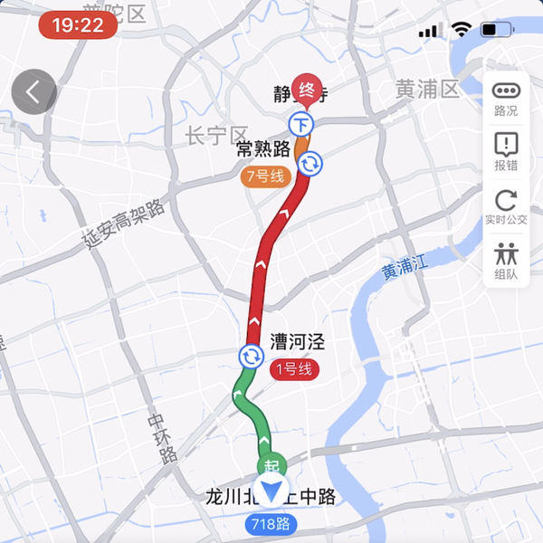
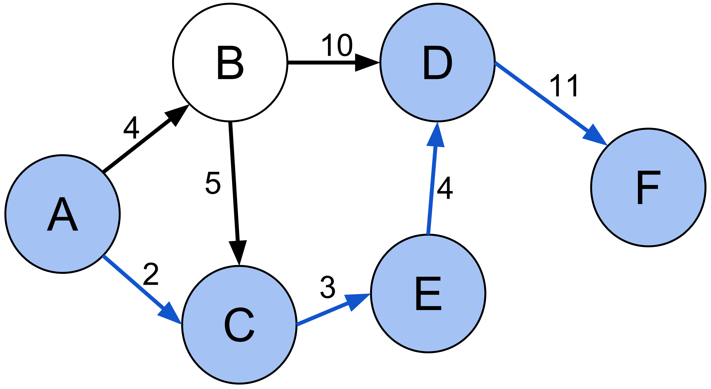
Applications
Road networks
Logistics
Communications
Others

Slide 3
Variants
Single-source shortest-paths problem
Single-destination shortest-paths problem
↑ reversing the direction of each edge in the graph
Single-pair shortest-path problem
All-pairs shortest-paths problem

Slide 4
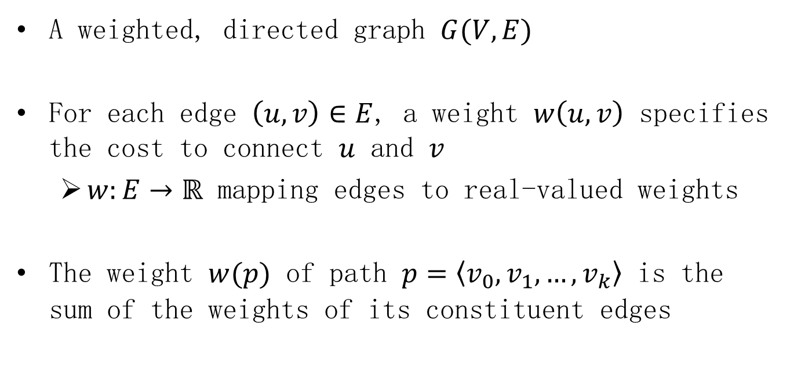
Model
A weighted, directed graph $G(V,E)$
For each edge $\left(u,v\right)∈E$, a weight $w\left(u,v\right)$ specifies the cost to connect $u$ and $v$
$w:E→ℝ$ mapping edges to real-valued weights
The weight $w(p)$ of path $p=\left\langle v_{0},v_{1},…,v_{k}\right\rangle$ is the sum of the weights of its constituent edges

Slide 5
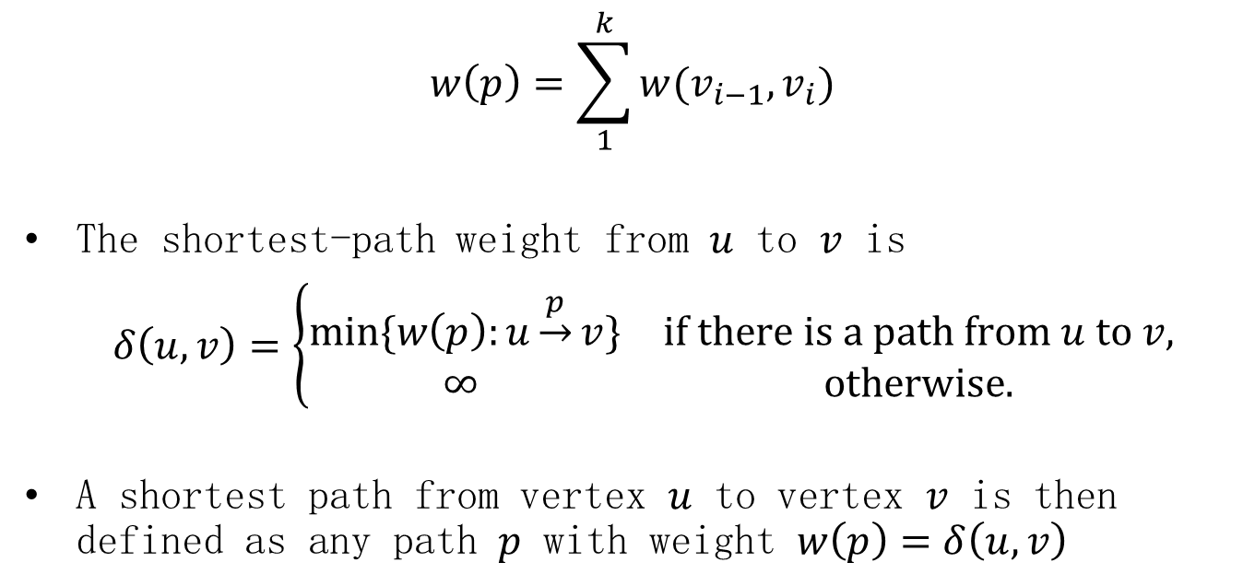
Model
$$w\left(p\right)=\sum_{1}^{k}{w(v_{i−1},v_{i})}$$
The shortest-path weight from $u$ to $v$ is
$δ\left(u,v\right)=\left\{\begin{matrix}min⁡\{w\left(p\right):u\underset{→}{p}v\} & if there is a path from u to v, \\ ∞ & otherwise.\end{matrix}\right.$
A shortest path from vertex $u$ to vertex $v$ is then defined as any path $p$ with weight $w\left(p\right)=δ\left(u,v\right)$

Slide 6
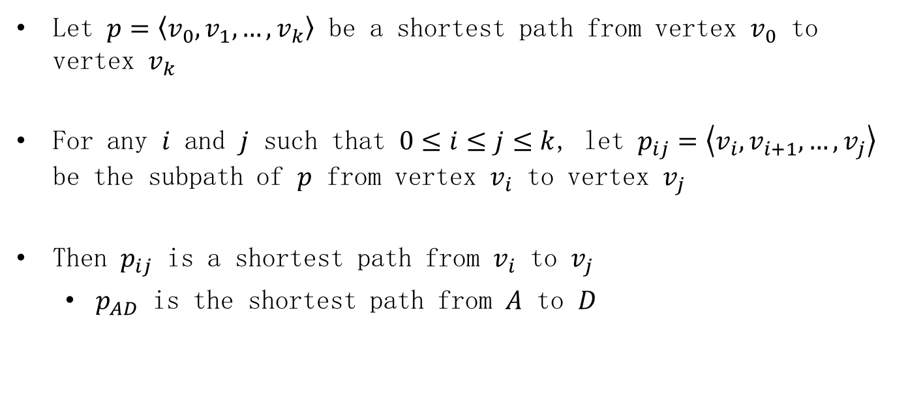
Optimal substructure
Let $p=\left\langle v_{0},v_{1},…,v_{k}\right\rangle$ be a shortest path from vertex $v_{0}$ to vertex $v_{k}$
For any $i$ and $j$ such that $0≤i≤j≤k$, let $p_{ij}=\left\langle v_{i},v_{i+1},…,v_{j}\right\rangle$ be the subpath of $p$ from vertex $v_{i}$ to vertex $v_{j}$
Then $p_{ij}$ is a shortest path from $v_{i}$ to $v_{j}$
$p_{AD}$ is the shortest path from $A$ to $D$

Slide 7
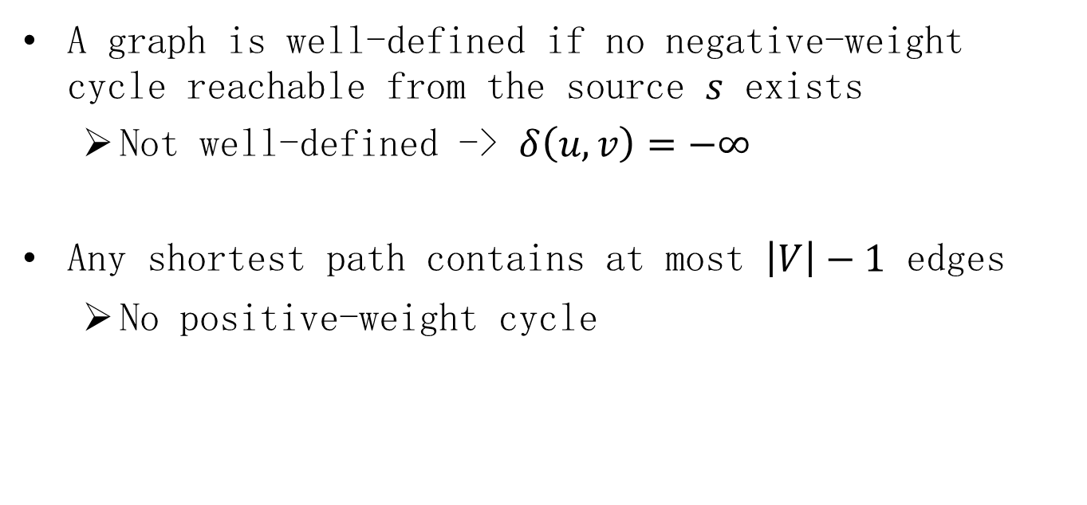
Negative-weight edges and cycles
A graph is well-defined if no negative-weight cycle reachable from the source $s$ exists
Not well-defined -> $δ\left(u,v\right)=−∞$
Any shortest path contains at most $\left|V\right|−1$ edges
No positive-weight cycle

Slide 8
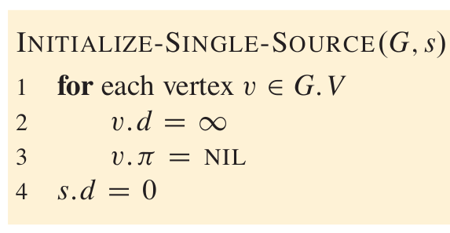

Relaxation
Attribute $v.d$: a shortest-path estimate
An upper bound on the weight of a shortest path to $v$
Attribute $v.π$: a predecessor
The chain of predecessors runs backward along a shortest path

Slide 9
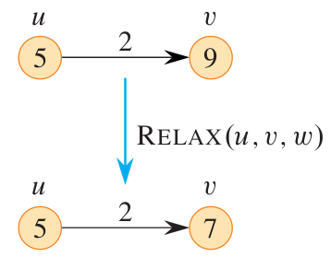
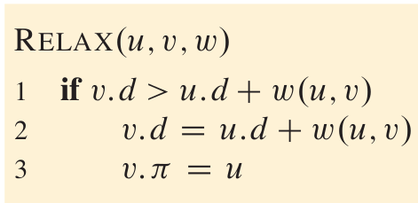

Relaxation
The process of relaxing an edge $\left(u,v\right)$ consists of testing whether going through vertex $u$ improves the shortest path to vertex $v$

Slide 10
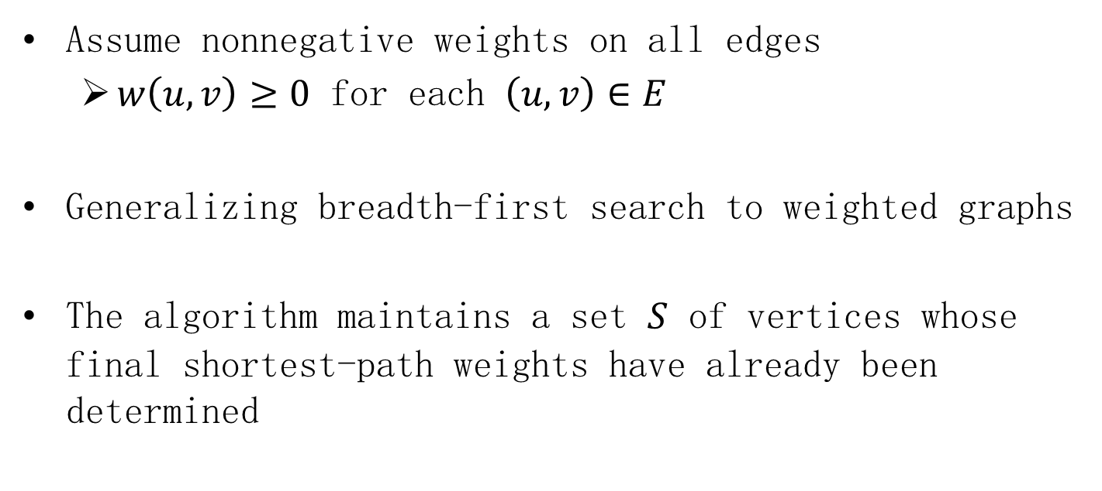
Dijkstra's algorithm: main idea
Assume nonnegative weights on all edges
$w\left(u,v\right)≥0$ for each $\left(u,v\right)∈E$
Generalizing breadth-first search to weighted graphs
The algorithm maintains a set $S$ of vertices whose final shortest-path weights have already been determined

Slide 11
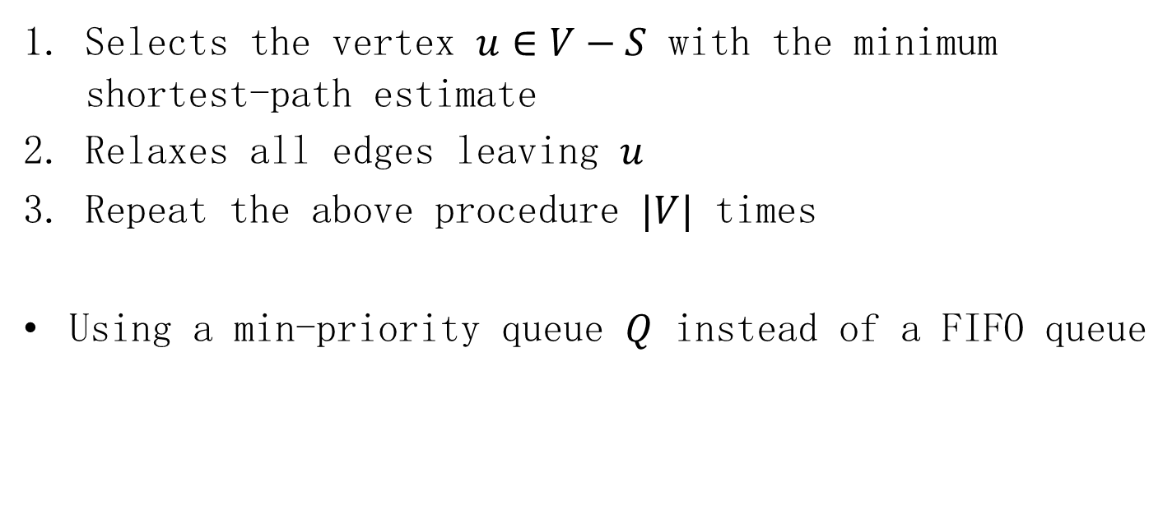
Dijkstra's algorithm: procedure
Selects the vertex $u∈V−S$ with the minimum shortest-path estimate
Relaxes all edges leaving $u$
Repeat the above procedure $|V|$ times
Using a min-priority queue $Q$ instead of a FIFO queue

Slide 12
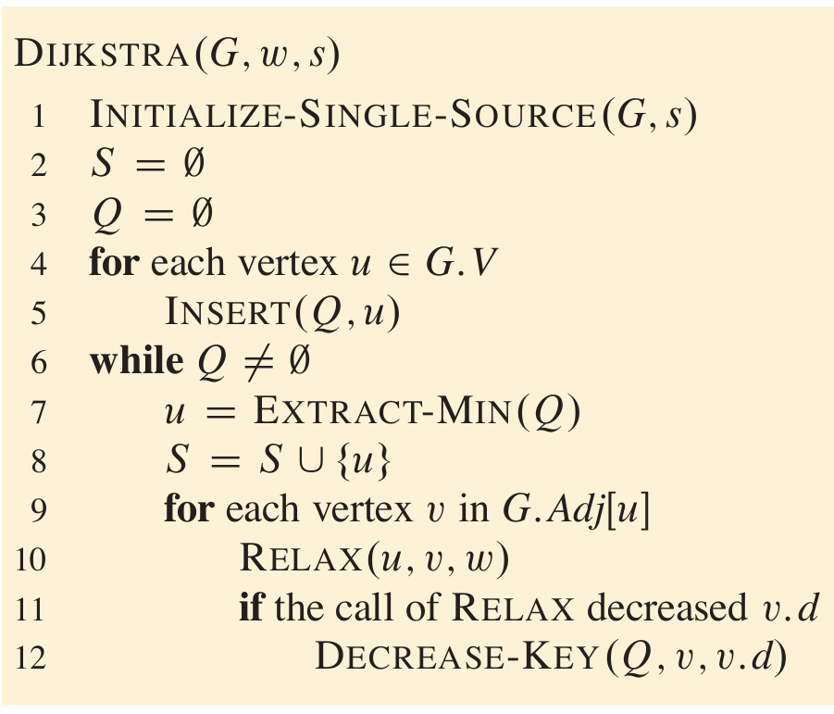
Pseudocode

Slide 13
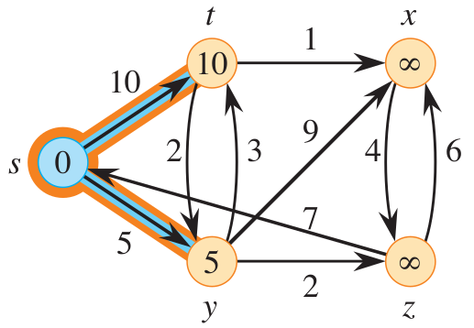
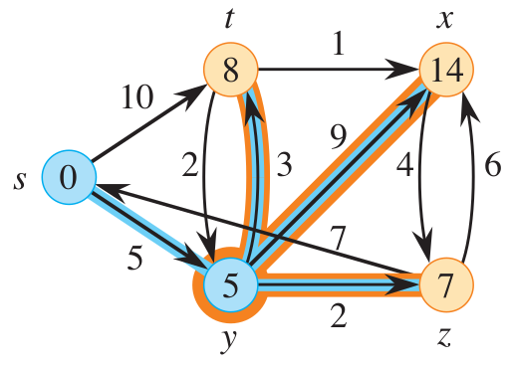
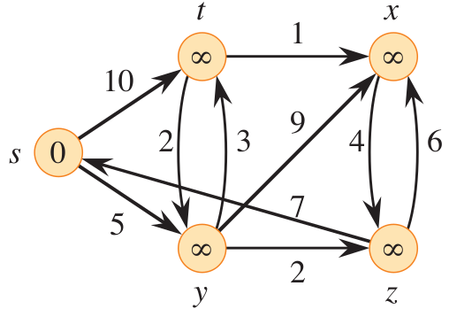
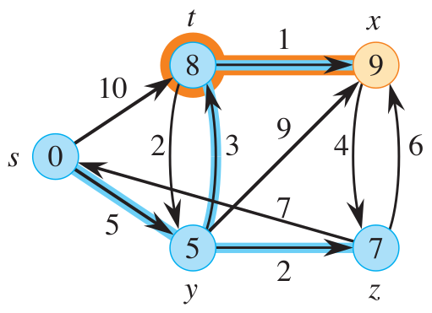
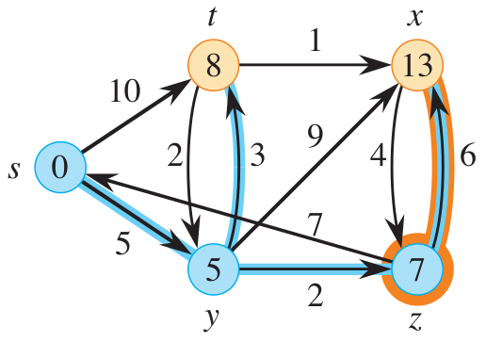
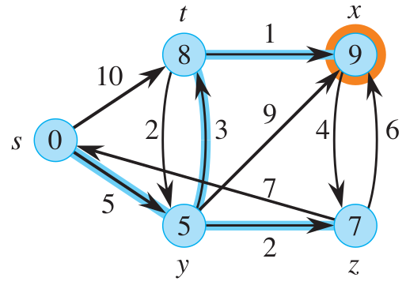
Example

Slide 14
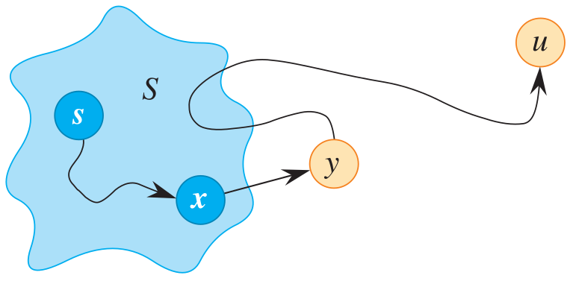
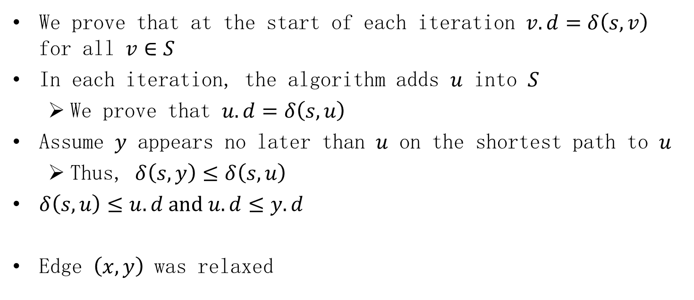
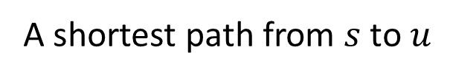
Correctness
We prove that at the start of each iteration $v.d=δ\left(s,v\right)$ for all $v∈S$
In each iteration, the algorithm adds $u$ into $S$
We prove that $u.d=δ\left(s,u\right)$
Assume $y$ appears no later than $u$ on the shortest path to $u$
Thus, $δ\left(s,y\right)≤δ\left(s,u\right)$
$δ\left(s,u\right)≤u.d and u.d≤y.d$
Edge $\left(x,y\right)$ was relaxed
A shortest path from $s$ to $u$

Slide 15
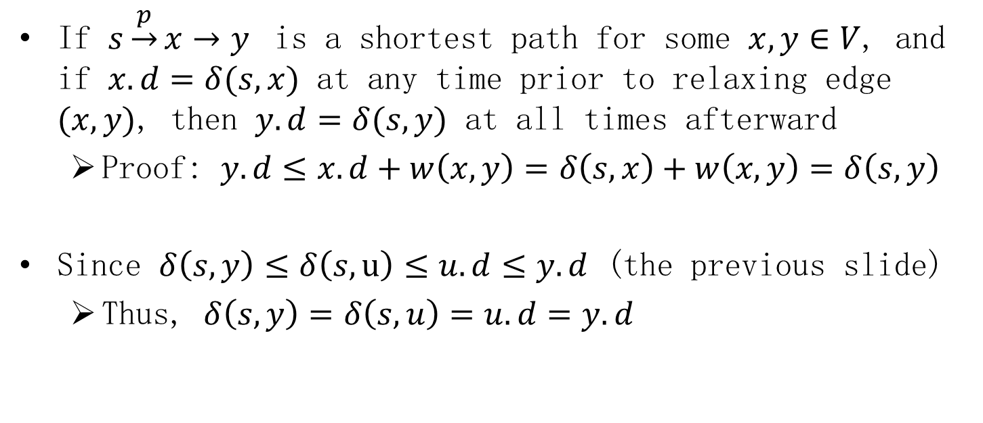
Correctness: Convergence property
If $s\underset{→}{p}x→y$ is a shortest path for some $x,y∈V$, and if $x.d=δ(s,x)$ at any time prior to relaxing edge $(x,y)$, then $y.d=δ(s,y)$ at all times afterward
Proof: $y.d≤x.d+w\left(x,y\right)=δ\left(s,x\right)+w\left(x,y\right)=δ\left(s,y\right)$
Since $δ\left(s,y\right)≤δ\left(s,u\right)≤u.d≤y.d$ (the previous slide)
Thus, $δ\left(s,y\right)=δ\left(s,u\right)=u.d=y.d$

Slide 16
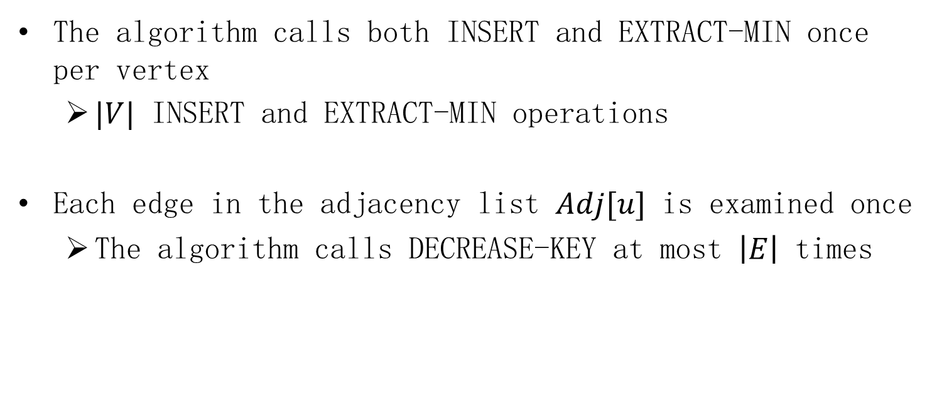
Time complexity
The algorithm calls both INSERT and EXTRACT-MIN once per vertex
$|V|$ INSERT and EXTRACT-MIN operations
Each edge in the adjacency list $Adj[u]$ is examined once
The algorithm calls DECREASE-KEY at most $\left|E\right|$ times

Slide 17
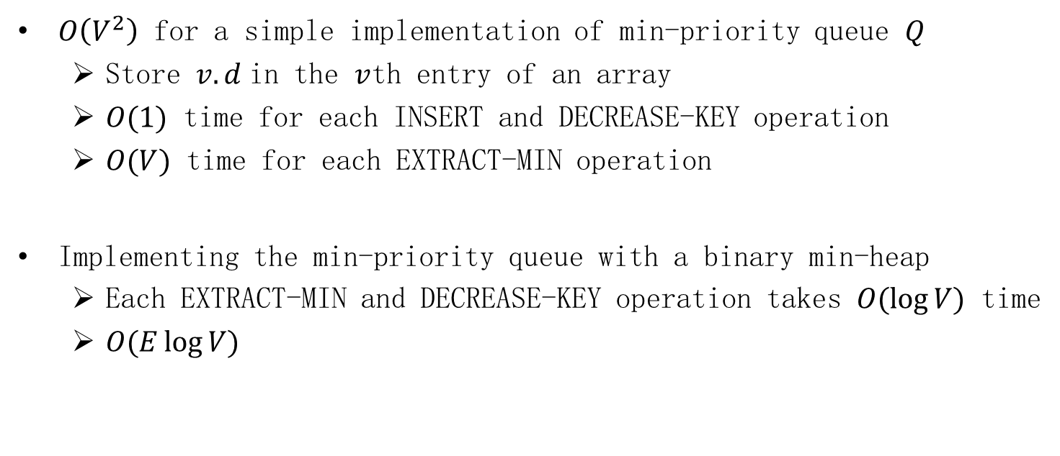
Time complexity
$O\left(V^{2}\right)$ for a simple implementation of min-priority queue $Q$
Store $v.d$in the $v$th entry of an array
$O(1)$ time for each INSERT and DECREASE-KEY operation
$O(V)$ time for each EXTRACT-MIN operation
Implementing the min-priority queue with a binary min-heap
Each EXTRACT-MIN and DECREASE-KEY operation takes $O(\log{V})$ time
$O(E\log{V})$

Slide 18
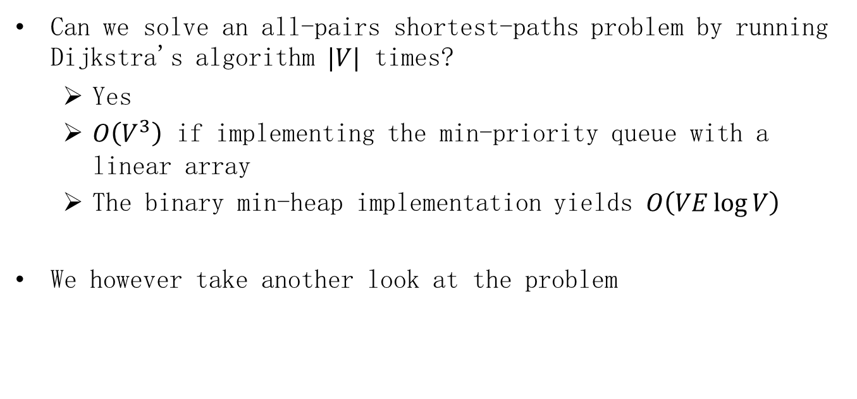
All-Pairs Shortest Paths
Can we solve an all-pairs shortest-paths problem by running Dijkstra's algorithm $|V|$ times?
Yes
$O\left(V^{3}\right)$ if implementing the min-priority queue with a linear array
The binary min-heap implementation yields $O\left(VE\log{V}\right)$
We however take another look at the problem

Slide 19
Floyd–Warshall algorithm
Negative-weight edges may be present
But no negative-weight cycle exists

Slide 20
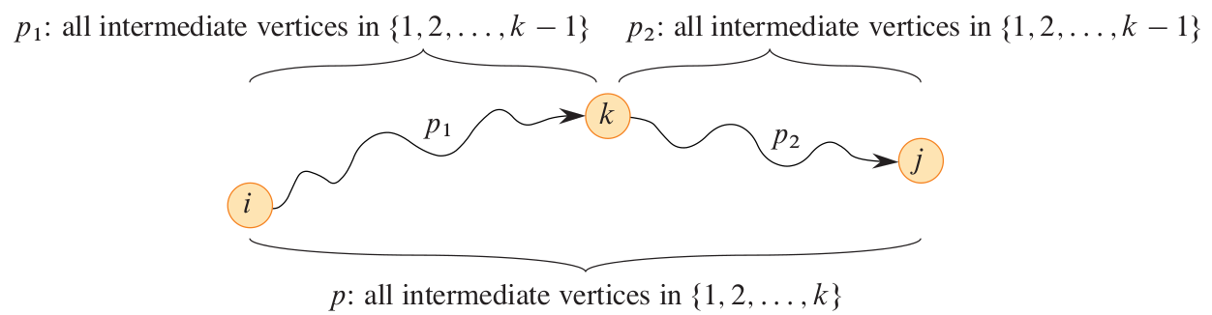
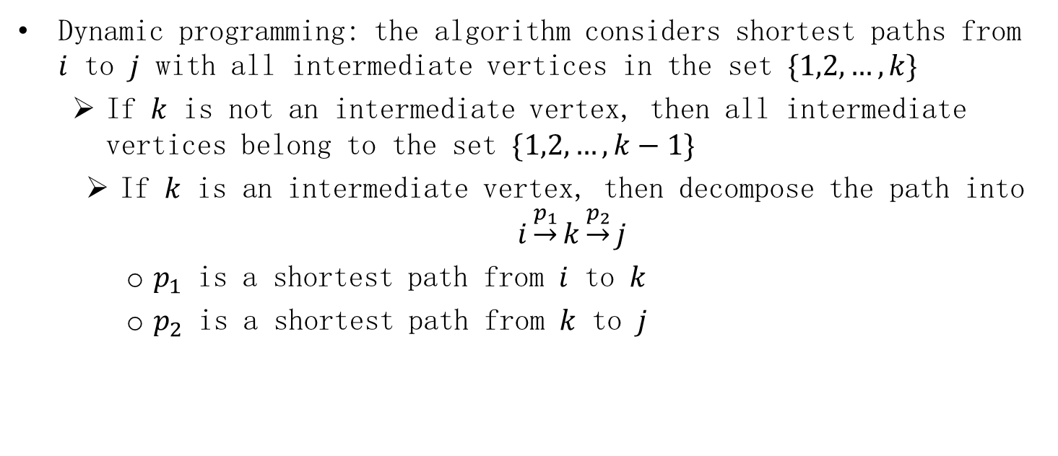
Floyd–Warshall algorithm
Dynamic programming: the algorithm considers shortest paths from $i$ to $j$ with all intermediate vertices in the set $\{1,2,…,k\}$
If $k$ is not an intermediate vertex, then all intermediate vertices belong to the set $\{1,2,…,k−1\}$
If $k$ is an intermediate vertex, then decompose the path into $i\underset{→}{p_{1}}k\underset{→}{p_{2}}j$
$p_{1}$ is a shortest path from $i$ to $k$
$p_{2}$ is a shortest path from $k$ to $j$

Slide 21
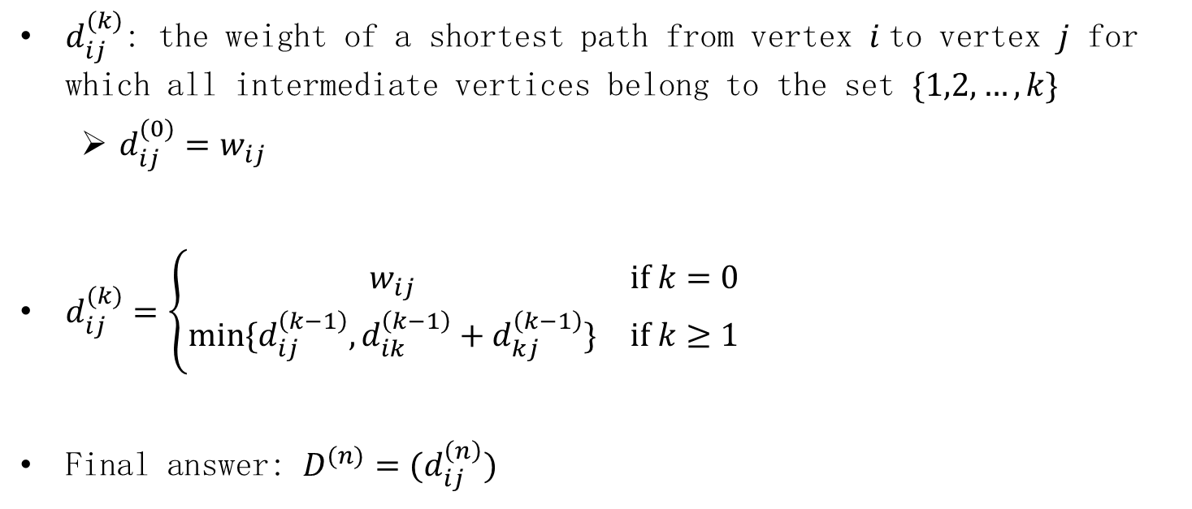
Optimal substructure
$d_{ij}^{(k)}$: the weight of a shortest path from vertex $i$to vertex $j$ for which all intermediate vertices belong to the set $\{1,2,…,k\}$
$d_{ij}^{(0)}=w_{ij}$
$d_{ij}^{(k)}=\left\{\begin{matrix}w_{ij} & if k=0 \\ min⁡\{d_{ij}^{\left(k−1\right)},d_{ik}^{\left(k−1\right)}+d_{kj}^{\left(k−1\right)}\} & if k≥1\end{matrix}\right.$
Final answer: $D^{(n)}=(d_{ij}^{\left(n\right)})$

Slide 22
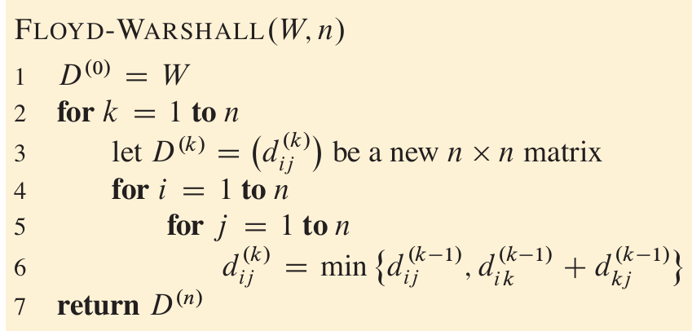

Pseudocode
The bottom-up procedure
$Θ(n^{3})$ time complexity

Slide 23
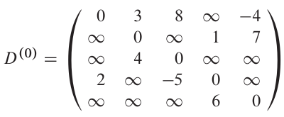
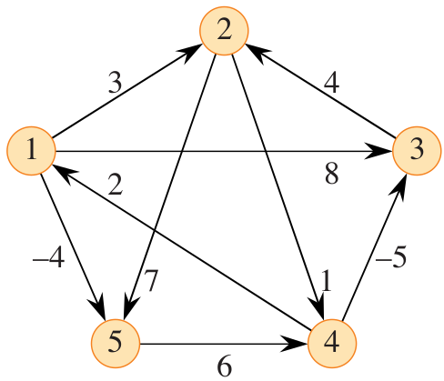
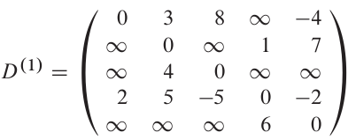
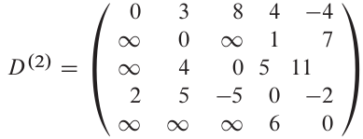
Example

Slide 24
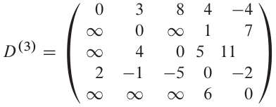
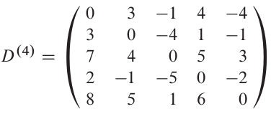
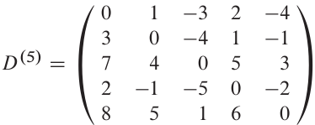
Example

Slide 25
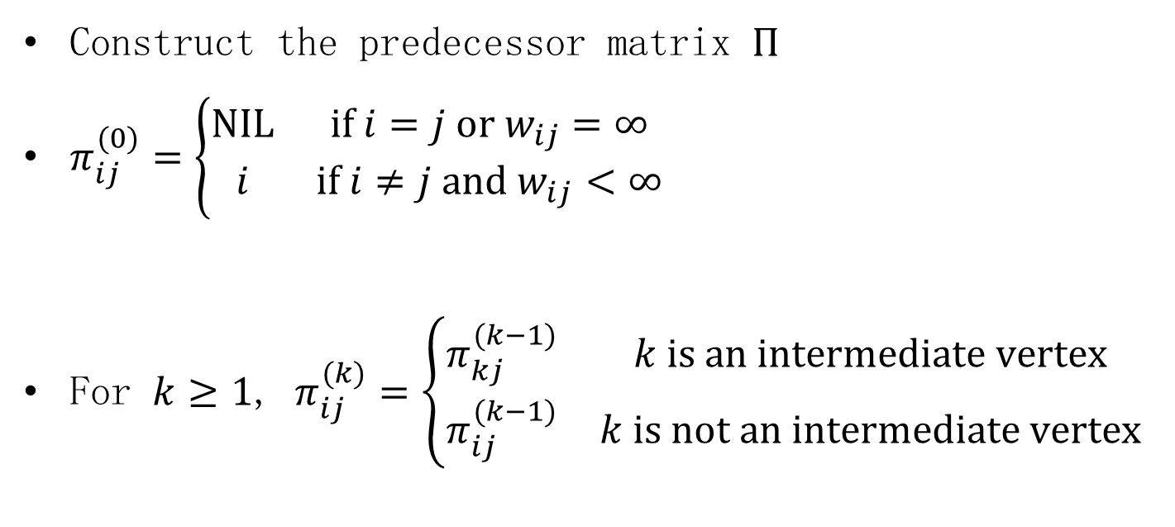
Constructing a shortest path
Construct the predecessor matrix $Π$
$π_{ij}^{(0)}=\left\{\begin{matrix}NIL & if i=j or w_{ij}=∞ \\ i & if i≠j and w_{ij}<∞\end{matrix}\right.$
For $k≥1$, $π_{ij}^{(k)}=\left\{\begin{matrix}π_{kj}^{(k−1)} & k is an intermediate vertex \\ π_{ij}^{(k−1)} & k is not an intermediate vertex\end{matrix}\right.$

Slide 26
Homework
22.3-2 Give a simple example of a directed graph with negative-weight edges for which Dijkstra's algorithm produces an incorrect answer.

Slide 27
Homework
23.2-6 Show how to use the output of the Floyd-Warshall algorithm to detect the presence of a negative-weight cycle.

